Slide 1
Incarnation: God with us
Week 2: Incarnation, Salvation and Trinity

Slide 2
Incarnation, Salvation and Trinity
Overview:
In NT proclamation about Jesus, the question 'who is Jesus?' is connected with the question 'what has God done for and with Jesus?'
Earliest faith in Jesus as the Christ associated the Son/the Word with creation;
Christological controversies concern the nature of salvation, not just the nature of Christ.
Becomes fully human in Christ; all of created humanity is transformed through Christ
Jesus Christ is God the Word, uncreated, of one substance with the Father; to be saved through Christ is to share in incorruptibility.

Slide 3
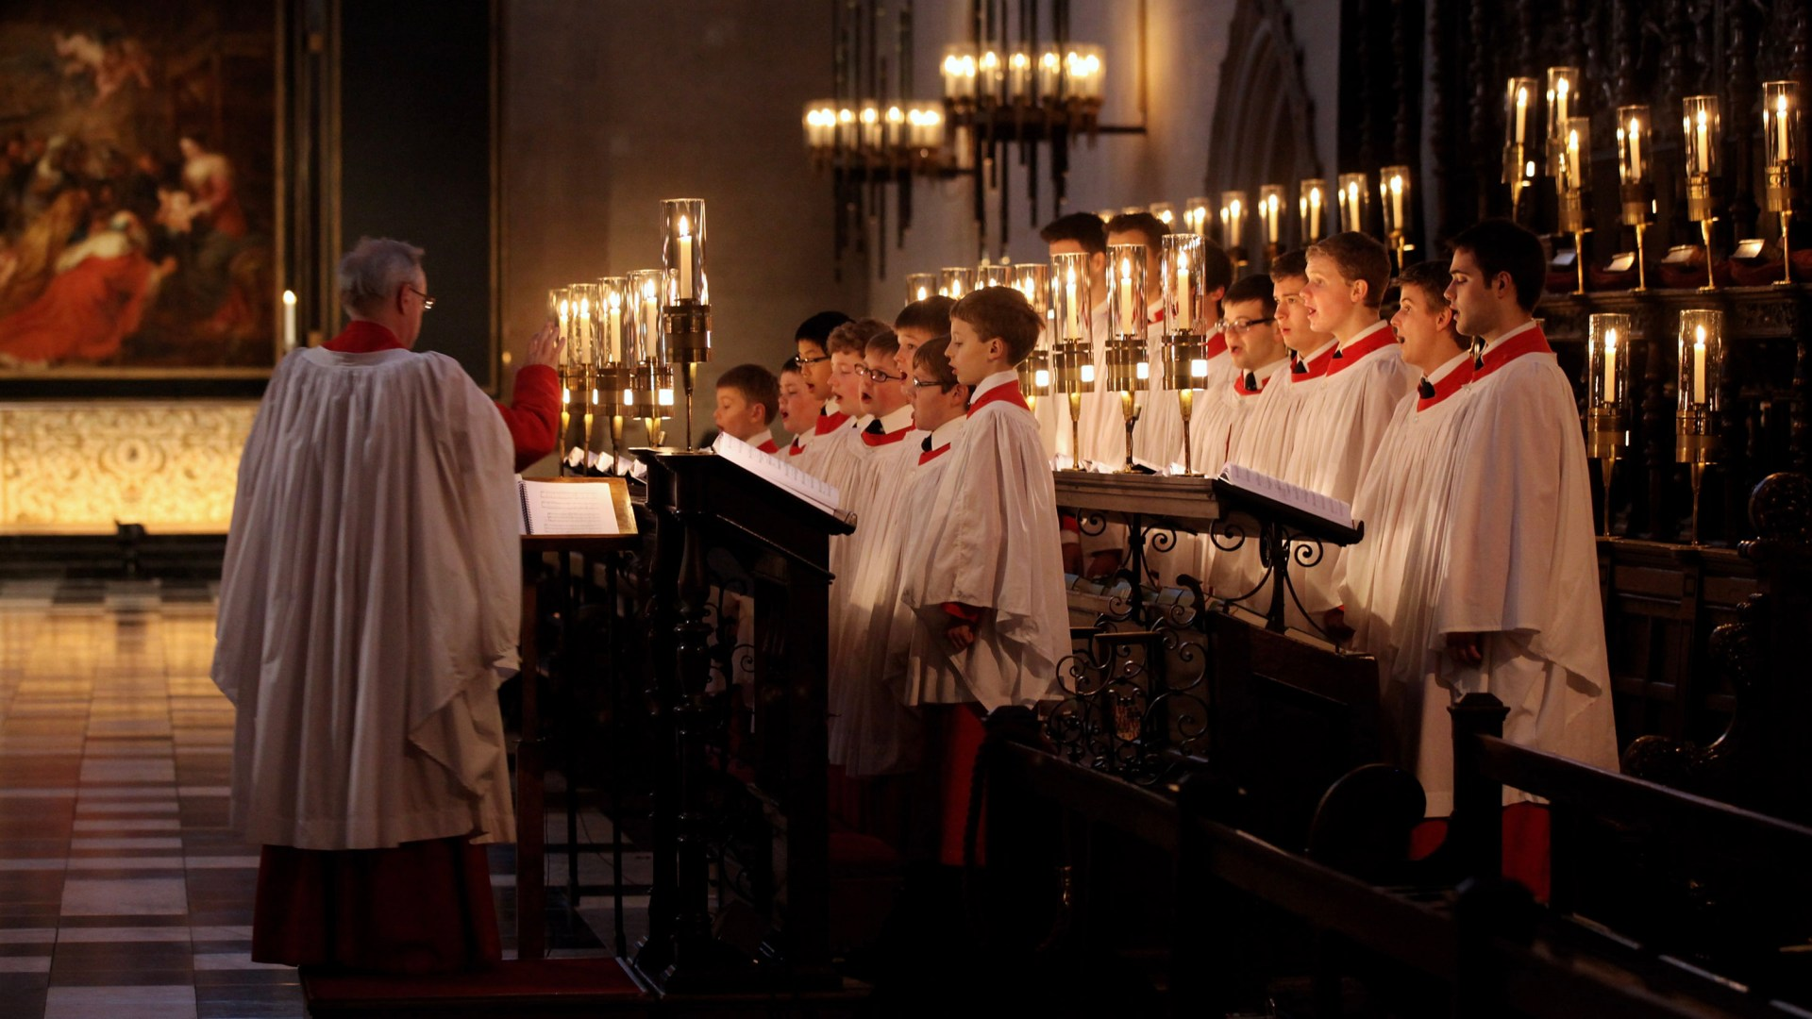
Incarnation in the NT
John 1:
‘And the Word became flesh and lived among us, and we have seen his glory, the glory as of a father’s only son, full of grace and truth. (John testified to him and cried out, ‘This was he of whom I said, “He who comes after me ranks ahead of me because he was before me.”’) From his fullness we have all received, grace upon grace. The law indeed was given through Moses; grace and truth came through Jesus Christ. No one has ever seen God. It is God the only Son, who is close to the Father’s heart, who has made him known.’

Slide 4
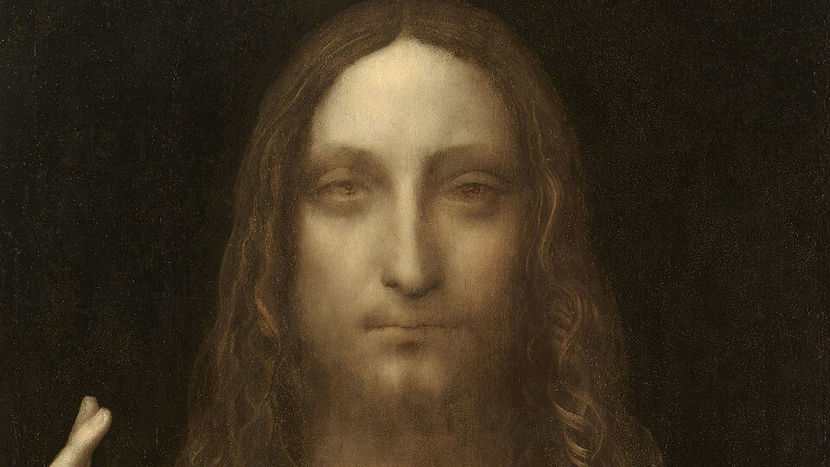
Incarnation in the NT
Hebrews 1
'Long ago God spoke to our ancestors in many and various ways by the prophets, but in these last days he has spoken to us by a Son, whom he appointed heir of all things, through whom he also created the worlds. He is the reflection of God’s glory and the exact imprint of God’s very being, and he sustains all things by his powerful word. When he had made purification for sins, he sat down at the right hand of the Majesty on high, having become as much superior to angels as the name he has inherited is more excellent than theirs.’

Slide 5
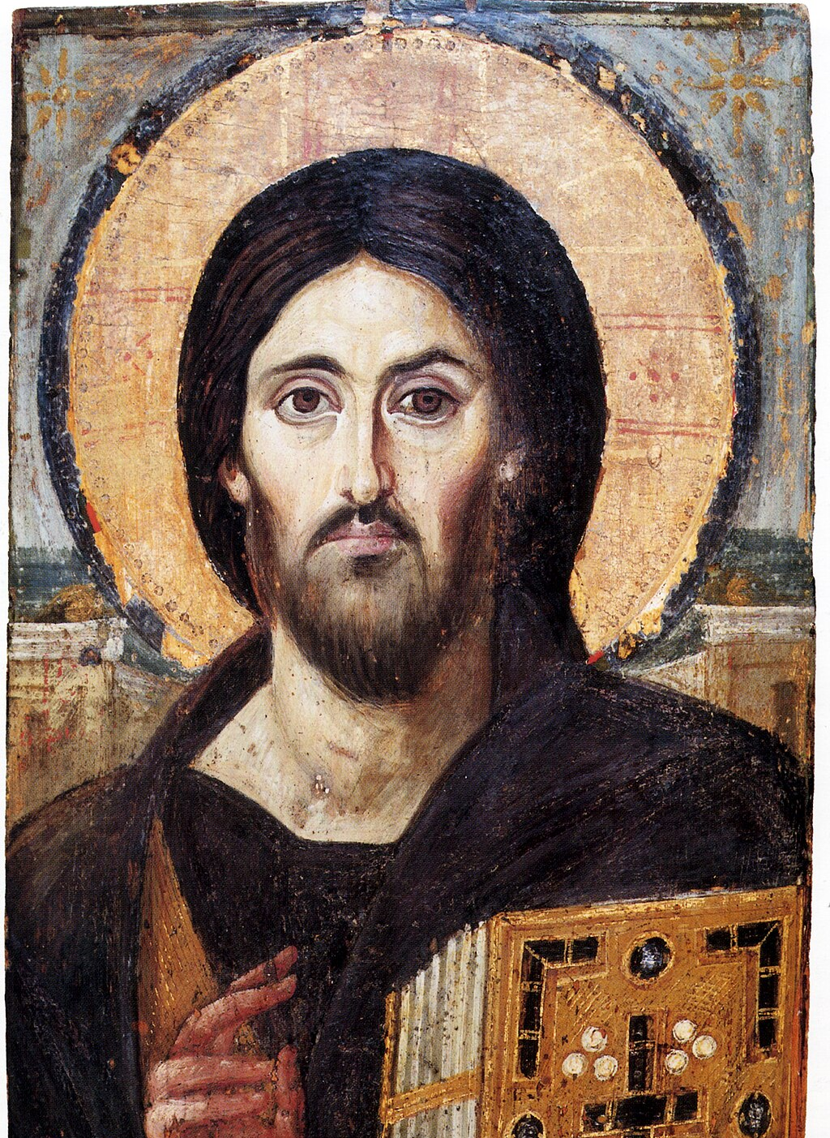
Incarnation in the NT
Colossians 1
‘He is the image of the invisible God, the firstborn of all creation; for in him all things in heaven and on earth were created, things visible and invisible, whether thrones or dominions or rulers or powers—all things have been created through him and for him. He himself is before all things, and in him all things hold together. He is the head of the body, the church; he is the beginning, the firstborn from the dead, so that he might come to have first place in everything. For in him all the fullness of God was pleased to dwell, and through him God was pleased to reconcile to himself all things, whether on earth or in heaven, by making peace through the blood of his cross.’

Slide 6
Incarnation in the NT
1 Timothy 3: 16
‘Without any doubt, the mystery of our religion is great:
He was revealed in flesh, vindicated in spirit, seen by angels, proclaimed among Gentiles, believed in throughout the world, taken up in glory.’

Slide 7
Incarnation in the NT
Philippians 2
Let the same mind be in you that was in Christ Jesus,
who, though he was in the form of God, did not regard equality with God as something to be exploited, but emptied himself, taking the form of a slave, being born in human likeness. And being found in human form, he humbled himself and became obedient to the point of death— even death on a cross.
Therefore God also highly exalted him and gave him the name that is above every name, so that at the name of Jesus every knee should bend, in heaven and on earth and under the earth, and every tongue should confess that Jesus Christ is Lord, to the glory of God the Father.

Slide 8
Incarnation and salvation
In the early centuries, the doctrine of incarnation was very heavily contested and debated, and so carefully elaborated and developed. Why? Primarily because of the connection between incarnation and salvation:
‘It can be shown that there are soteriological motives behind all the Christological pronouncements of the early church. Both the defence of the true divinity and that of the true humanity are intended to ensure the reality of Redemption.’ (Kasper, 2011: 10).
The seven ecumenical councils ‘presumed and prescribed a conception of salvation as the deification of human beings through their graced inclusion into trinitarian life’ (Anatolios 2020: 168).

Slide 9
First four ecumenical councils
Nicea (325) - Arianism condemned (there was never a time 'when he was not'; the Son is ‘of one substance’ with the Father)
Constantinople (381) - Nicea confirmed; Apollinarianism condemned (Jesus has a rational human soul, not just a human body)
Ephesus (431) - Nestorianism condemned
Chalcedon (451) - ‘Two natures, one person’

Slide 10
Creation, salvation and Christ
To understand why it was so important for Church Fathers (like Irenaeus) to insist on the full humanity and divinity of Jesus, we have to think about the connections between different Christian affirmations.
This should help us to see the logic that drives Christological reflection:
God’s created all things, visible and invisible, out of nothing;
Salvation is of the whole human person…;
…in and through the fully-human Christ

Slide 11
Salvation and Christology
Salvation is given securely, decisively;
It must be God who gives;
But it is not simply done ‘to’ us, it involves humanity;
Salvation involves whole created person;
Salvation is God-involving.
Not extrinsically given; salvation comes through being united with God, in Christ.

Slide 12
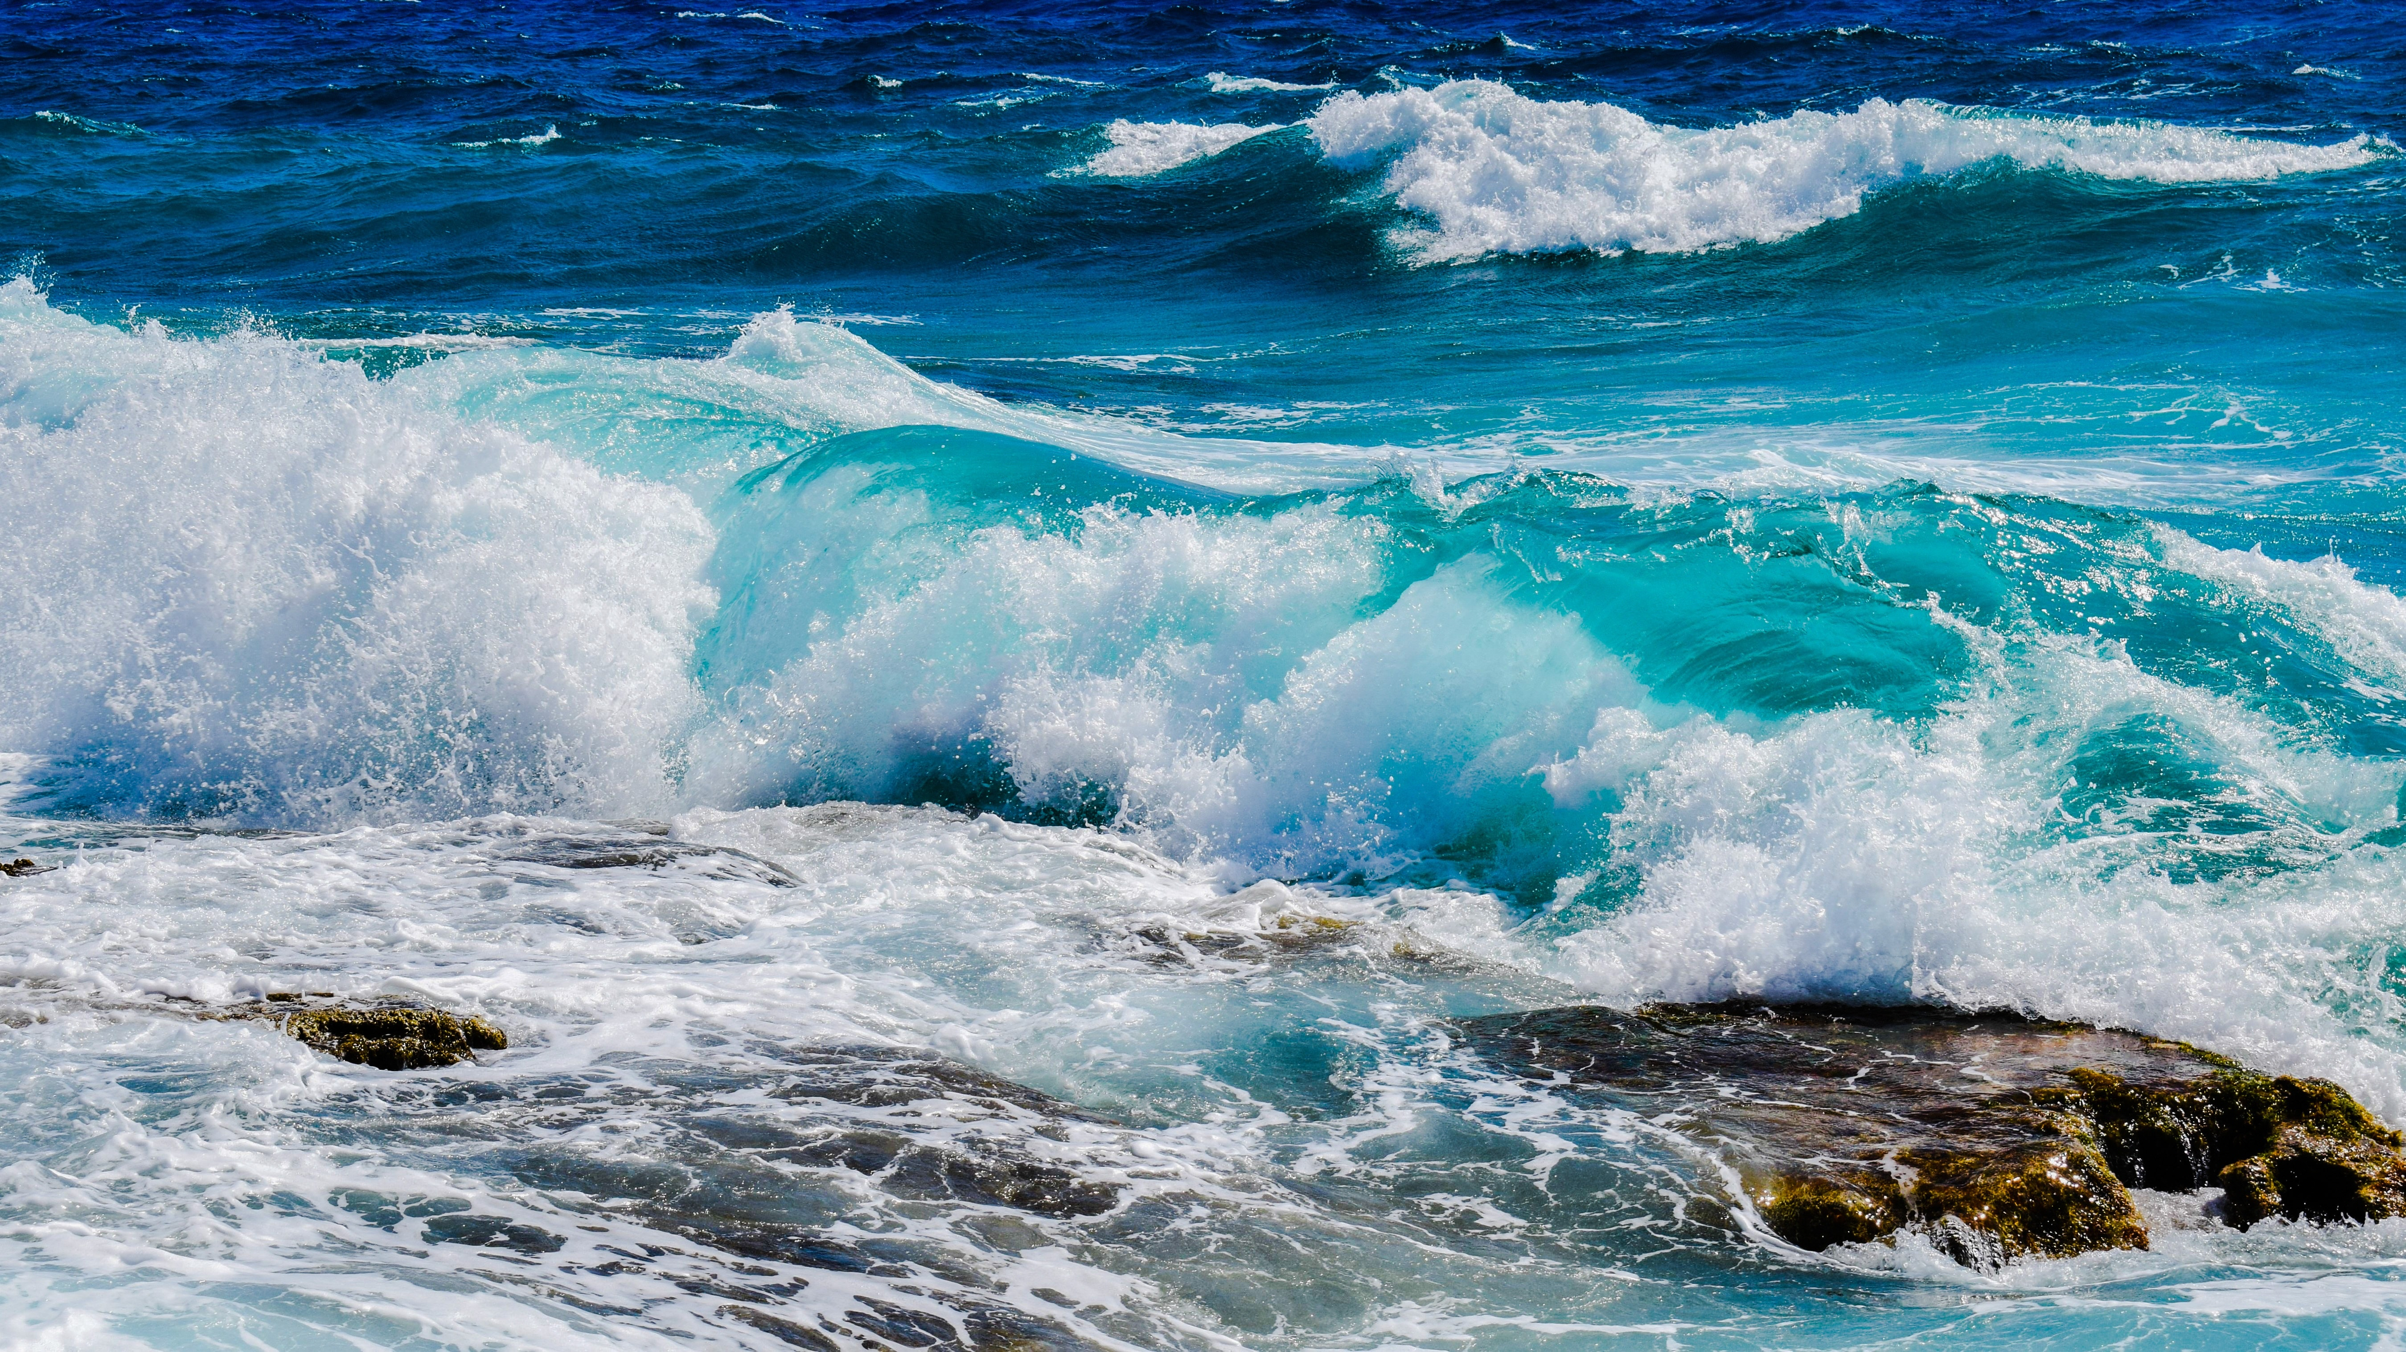
Creation ‘ex nihilo’
For the most part, creation ‘ex nihilo’ is not taught in the Hebrew Bible...
Often, creation is described in terms of bringing order to (watery) chaos:
He set the earth on its foundations;
it can never be moved.
You covered it with the watery depths as with a garment;
the waters stood above the mountains.
But at your rebuke the waters fled,
at the sound of your thunder they took to flight;
they flowed over the mountains,
they went down into the valleys,
to the place you assigned for them.
You set a boundary they cannot cross;
never again will they cover the earth. (Psalm 104)

Slide 13
Creation ‘ex nihilo’
But only very late on, just before the New Testament period do we get the first hint of creation as being an absolute origin:
‘Since the young man would not listen to him at all, the king called the mother to him and urged her to advise the youth to save himself. After much urging on his part, she undertook to persuade her son. But, leaning close to him, she spoke in their native language as follows, deriding the cruel tyrant: ‘My son, have pity on me. I carried you for nine months in my womb, and nursed you for three years, and have reared you and brought you up to this point in your life, and have taken care of you. I beg you, my child, to look at the heaven and the earth and see everything that is in them, and recognize that God did not make them out of things that existed. And in the same way the human race came into being. Do not fear this butcher, but prove worthy of your brothers. Accept death, so that in God’s mercy I may get you back again along with your brothers.’

Slide 14
Creation ‘ex nihilo’
The first explicit affirmation of ‘creation from nothing’ is by Theophilus of Antioch:
'And what great thing is it if God made the world out of existent materials? For even a human artist, when he gets material from some one, makes of it what he pleases. But the power of God is manifested in this, that out of things that are not He makes whatever He pleases; just as the bestowal of life and motion is the prerogative of no other than God alone. For even man makes indeed an image, but reason and breath, or feeling, he cannot give to what he has made. But God has this property in excess of what man can do, in that He makes a work, endowed with reason, life, sensation. As, therefore, in all these respects God is more powerful than man, so also in this; that out of things that are not He creates and has created things that are, and whatever He pleases, as He pleases.' (Apology to Autolycus)

Slide 15
Philosophical question of origins
Two influential philosophical currents in first few centuries regarding the origin of the world:
Plato’s ‘demiurge’ – an intelligence that works on pre-existent formless matter (which is eternal);
Helps to explain limitation/death and disorder/suffering and imperfection;
The world is not perfect, but as good as it can be given limitations of matter;
Idea of emanation – the physical world emanates from the divine being;
In some sense the world is necessary, and perhaps even divine itself.

Slide 16
Gnosticism
Another major influence on early Christian thought was Gnosticism. This term relates to a wide range of groups and ideas, both inside and outside of early Christianity especially in the second century, but perhaps earlier.
Some of the common features were:
a distinction between the Creator (the Demiurge) and the ultimate Father/Origin;
an account of the origin of things which included a pre-cosmic fall, so that the existence of the material world is an accident or result of sin;
an understanding of the goal of human life as re-union with the divine which involved a release from material imprisonment (for a spiritual elite, not everyone);
salvation comes via secret ‘gnosis’ (knowledge) that is normally accessible only to a few.

Slide 17
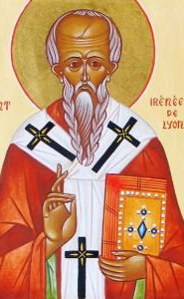
Irenaeus of Lyons (130-202 AD)
Irenaeus is one of the most influential theologians in the development of early Christianity. He lived and wrote just after the group of people known as the 'Apostolic Fathers'; those who had known the apostles (Clement of Rome, Polycarp, Ignatius, Barnabus, Papius).
He is usually thought of as the thinker who first began to reflect more systematically on the Christian faith, in contrast to the pastoral and apologetic emphasis of the Apostolic Fathers.
Famous for his opposition to gnostic thinking in his book Against Heresies.
This Photo by Unknown Author is licensed under CC BY

Slide 18
Irenaeus of Lyons (130-202 AD)
Against the backdrop of these philosophical trends, and against these ‘gnostic’ tendencies, Irenaeus attempts a more systematic presentation of the gospel, which emphasises the unity of God, and the redemption of the whole of creation in Christ. Irenaeus affirms:
Goodness of created order (created freely by God’s will; creation is a good thing, not a mistake);
Goodness of human nature in its entirety (not something to be delivered from);
Salvation as perfection, or ‘summing up’ in Christ (so God’s saving action is in harmony with God’s creative action). This does mean union with God – but union of the whole human person, not just the ‘soul’.
This Photo by Unknown Author is licensed under CC BY

Slide 19
Irenaeus of Lyons (130-202 AD)
For Irenaeus, the final state of humans is seen as a continuation and perfection of earthly life, rather than a release from it:
‘For neither is the substance nor the essence of the creation annihilated (for faithful and true is He who has established it), but “the fashion of the world passeth away;” that is, those things among which transgression has occurred, since man has grown old in them.’ (Against Heresies V. 36)
This Photo by Unknown Author is licensed under CC BY

Slide 20
Irenaeus of Lyons (130-202 AD)
Nevertheless, salvation is understood as a way of becoming one with God (to 'pass into the glory of the Father' - AH. IV. 20. 4). Salvation is not simply cleansing from sin, or forgiveness, but perfection. In fact, to become fully human means to be one with God:
‘Therefore, as I have already said, He caused man to cleave to and to become, one with God. [. . .] For it was incumbent upon the Mediator between God and men, by His relationship to both, to bring both to friendship and concord, and present man to God, while He revealed God to man. For, in what way could we be partaken of the adoption of sons, unless we had received from Him through the Son that fellowship which refers to Himself, unless His Word, having been made flesh, had entered into communion with us?’ (AH. III. 18. 7)
This Photo by Unknown Author is licensed under CC BY

Slide 21
Irenaeus of Lyons (130-202 AD)
Salvation is not just a restoration of God’s good creation, but a perfection and completion of it (that is, creation is a story – it is headed towards a fulfilment):
[. . .] it was possible for God Himself to have made man perfect from the first, but man could not receive this [perfection], being as yet an infant. And for this cause our Lord in these last times, when He had summed up all things into Himself, came to us, not as He might have come, but as we were capable of beholding Him. He might easily have come to us in His immortal glory, but in that case we could never have endured the greatness of the glory; and therefore it was that He, who was the perfect bread of the Father, offered Himself to us as milk, [because we were] as infants.' (IV. 38. 1)
This Photo by Unknown Author is licensed under CC BY

Slide 22
Irenaeus of Lyons (130-202 AD)
This fulfilment is conceived in terms of ‘theosis’ (becoming like God), not just deliverance from sin – but this becoming like God is based on God’s becoming like us:
'For it was for this end that the Word of God was made man, and He who was the Son of God became the Son of man, that man, having been taken into the Word, and receiving the adoption, might become the son of God. For by no other means could we have attained to incorruptibility and immortality, unless we had been united to incorruptibility and immortality. But how could we be joined to incorruptibility and immortality, unless, first, incorruptibility and immortality had become that which we also are, so that the corruptible might be swallowed up by incorruptibility, and the mortal by immortality, that we might receive the adoption of sons?' (AH. III. 19. 1)
This Photo by Unknown Author is licensed under CC BY

Slide 23
Irenaeus of Lyons (130-202 AD)
We also find the idea of salvation as a kind of victory over ‘the enemy’ – and again, if this is the case, it is vital that Jesus is affirmed as fully human in order for the victory become fully ours:
‘For indeed the enemy would not have been fairly vanquished, unless it had been a man [born] of a woman who conquered him. For it was by means of a woman that he got the advantage over man at first, setting himself up as man’s opponent. And therefore does the Lord profess Himself to be the Son of man, comprising in Himself that original man out of whom the woman was fashioned [. . .], in order that, as our species went down to death through a vanquished man, so we may ascend to life again through a victorious one; and as through a man death received the palm [of victory] against us, so again by a man we may receive the palm against death.' (AH V. 21. 1)
This Photo by Unknown Author is licensed under CC BY

Slide 24
Salvation and incarnation
When salvation is seen in the light of incarnation, sinful humanity is saved by becoming one with God, and this one-ness with God is first achieved in the person of Jesus Christ, in whom God joins himself with human nature.
This is developed further by in the 4th century. For example:
Gregory Nazienzen (329-390): the Word ‘bears all me and mine in himself, that in himself he may exhaust the bad, as fire does wax, or as the sun does the mists of the earth; and that I may partake of his nature by the blending.’

Slide 25
Salvation and incarnation
Gregory of Nyssa (330-395): ‘although Christ took our filth upon himself, nevertheless he is not himself defiled by our pollution, but in his own self he cleanses our filth, for it says, the light shone in the darkness, but the darkness did not overpower it' and 'whatever is weak in our nature and subject to death was united with his deity and became what the deity is.’
Cyril of Alexandria (376-444): ‘There was no other way for the flesh to become life-giving, even though by its own nature it is subject to the necessity of corruption, except that it become the very flesh of the Word who gives life to all things ... There is nothing astonishing here, for if it is true that fire has converse with materials that in their nature are not hot, and yet renders them hot since it so abundantly introduces to them the inherent energy of its own power, then surely to an even greater degree the Word who is God can introduce the life-giving power and energy of his own nature into his very own flesh.’

Slide 26
Salvation and incarnation
So the salvific significance of incarnation is understood at the level of human nature:
In Christ, something happens to human nature – it is ‘assumed’ or taken up/on by the divine Word;
Cf. Romans 5 – Christ as the new Adam: ‘For just as by the one man’s disobedience the many were made sinners, so by the one man’s obedience the many will be made righteous.’
But the question is then: how are we to understand the relationship between the divine and the human in Jesus?

Slide 27
Creation
Theophilus of Antioch:
'Some of the philosophers of the Porch say that there is no God at all [. . .] And others say that all things are produced without external agency, and that the world is uncreated, and that nature is eternal; and have dared to give out that there is no providence of God at all, but maintain that God is only each man's conscience. And others again maintain that the spirit which pervades all things is God. But Plato and those of his school acknowledge indeed that God is uncreated, and the Father and Maker of all things; but then they maintain that matter as well as God is uncreated, and aver that it is coeval with God. But if God is uncreated and matter uncreated, God is no longer, according to the Platonists, the Creator of all things, nor, so far as their opinions hold, is the monarchy of God established. And further, as God, because He is uncreated, is also unalterable; so if matter, too, were uncreated, it also would be unalterable, and equal to God; for that which is created is mutable and alterable, but that which is uncreated is immutable and unalterable.'

Slide 28
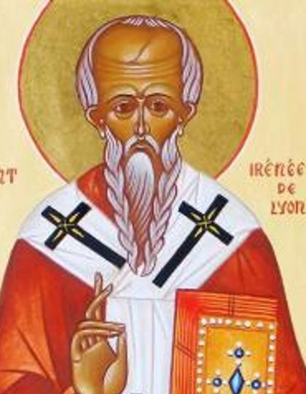
Incarnation and salvation
E.g. Irenaeus of Lyon:
'For it was for this end that the Word of God was made man, and He who was the Son of God became the Son of man, that man, having been taken into the Word, and receiving the adoption, might become the son of God. For by no other means could we have attained to incorruptibility and immortality, unless we had been united to incorruptibility and immortality. But how could we be joined to incorruptibility and immortality, unless, first, incorruptibility and immortality had become that which we also are, so that the corruptible might be swallowed up by incorruptibility, and the mortal by immortality, that we might receive the adoption of sons?' (AH. III. 19. 1)

