Slide 1
Session Three The Passion of Christ

Slide 2
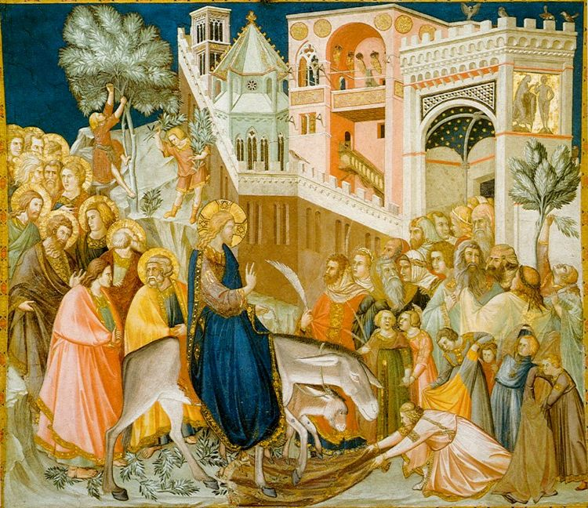
Notes:
Entry of Christ into Jerusalem, Pietro Lorenzetti, Basilica of San Francesco d'Assisic. 1320
The picture shows one of the scenes from the life of Christ painted by Pietro Lorenzetti on the vault of the south arm of the western transept of the Lower Church.

Slide 3
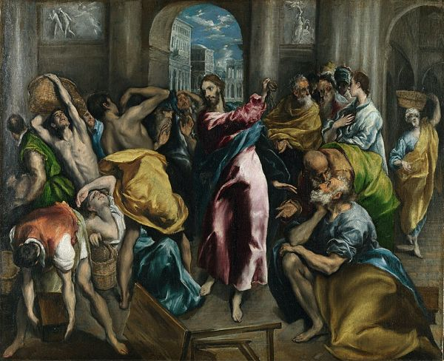
Notes:
El Greco, Christ driving the Traders from the Temple c.1600 (National Gallery, London)

Slide 4
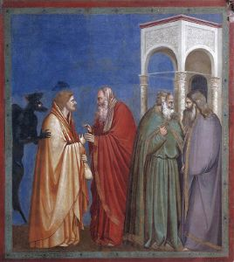
Notes:
El Greco, Christ driving the Traders from the Temple c.1600 (National Gallery, London)

Slide 5
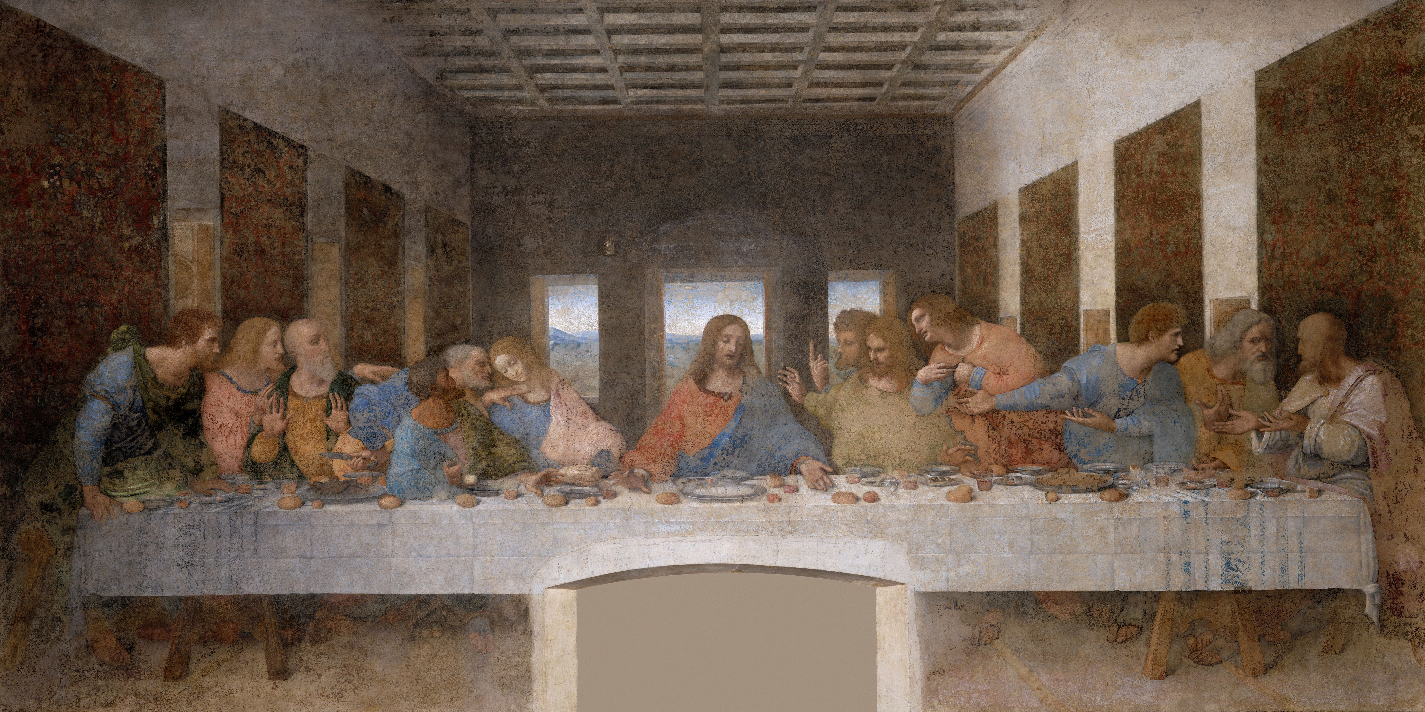
Notes:
Leonardo da Vinci The Last Supper c. 1495–1498 ( Santa Maria delle Grazie, Milan, Italy)

Slide 6
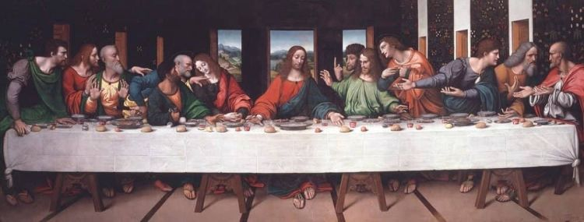
Notes:
The Last Supper Copy - by Giampietrino

Slide 7
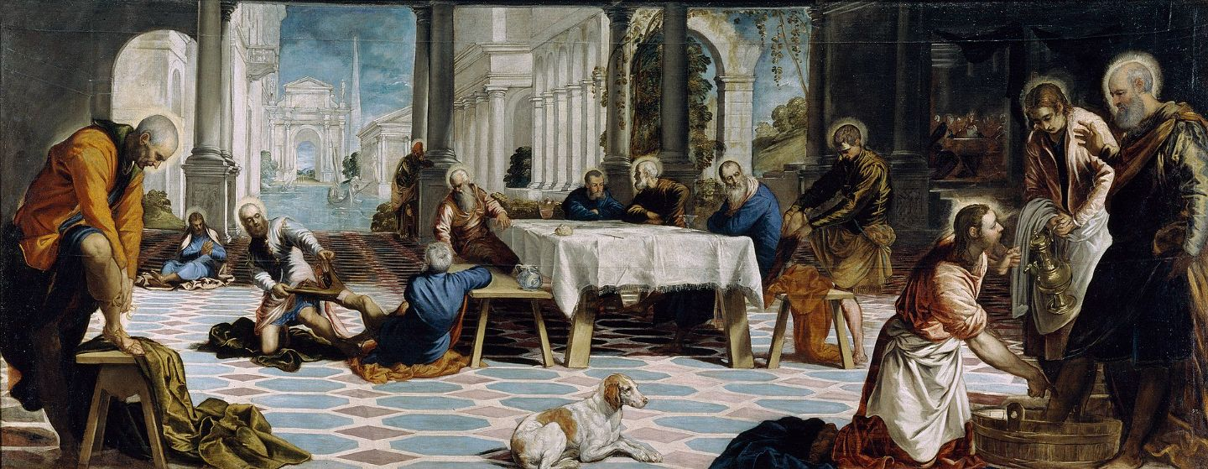
Notes:
Jacopo TintorettoChrist washing the Disciples' feet c. 1548 (Museo del Prado, Madrid)

Slide 8
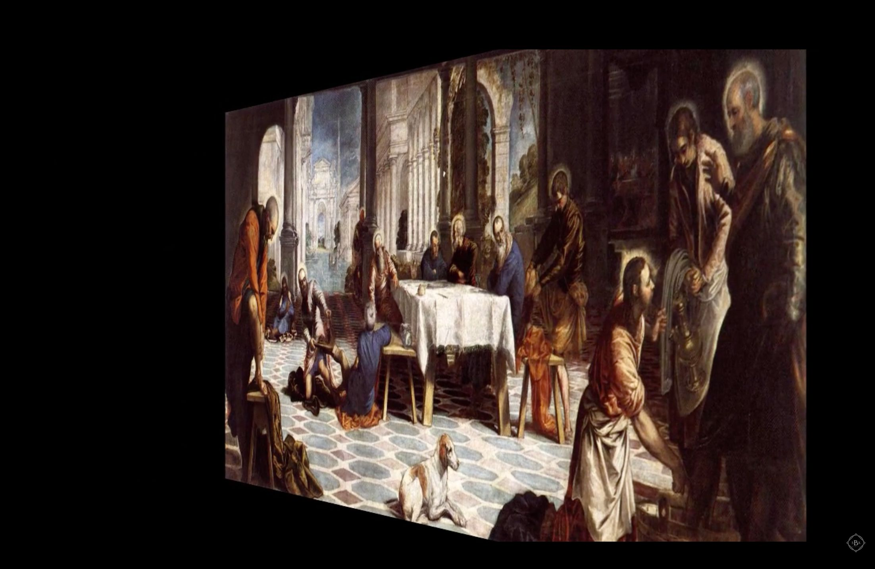
Notes:
Jacopo TintorettoChrist washing the Disciples' feet c. 1548 (Museo del Prado, Madrid)

Slide 9
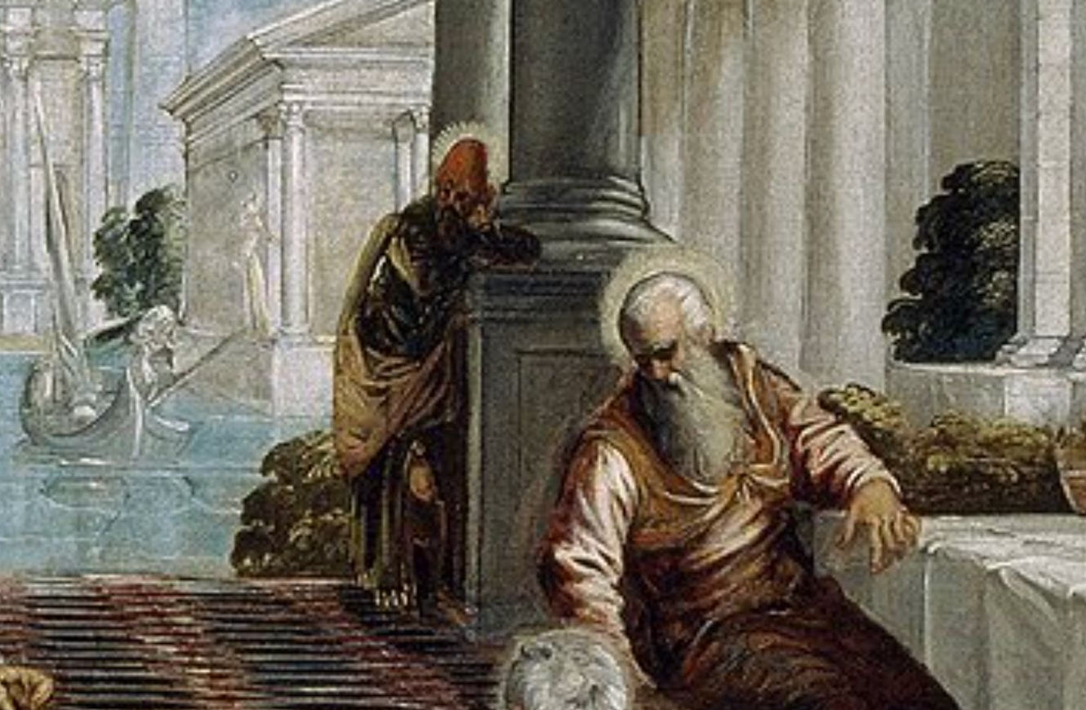
Notes:
Jacopo TintorettoChrist washing the Disciples' feet c. 1548 (Museo del Prado, Madrid)

Slide 10
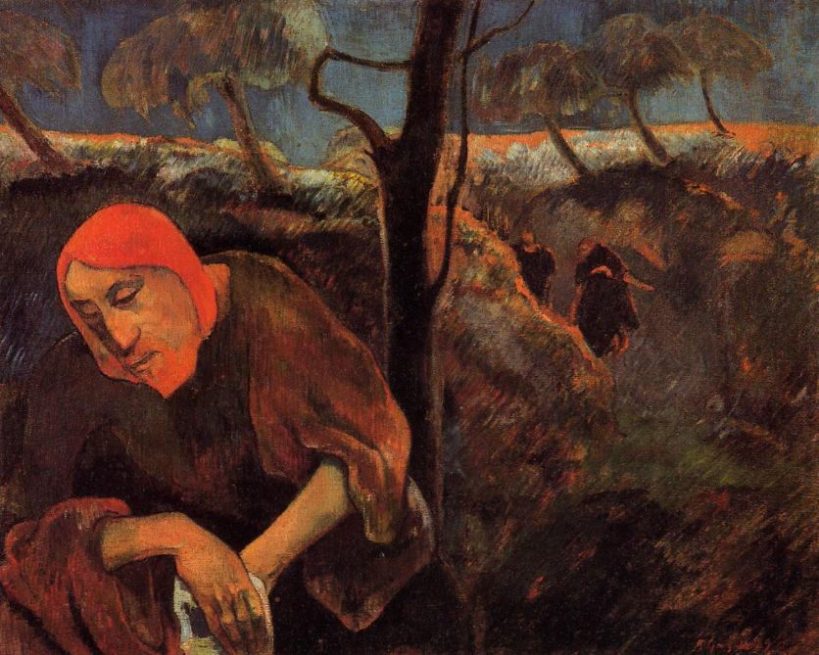
Notes:
Paul Gauguin - The Agony in the Garden c.1889 (Norton Gallery, Palm Beach, Florida, USA)
Cloisonnism is a style of post-Impressionist painting with bold and flat forms separated by dark contours.

Slide 11
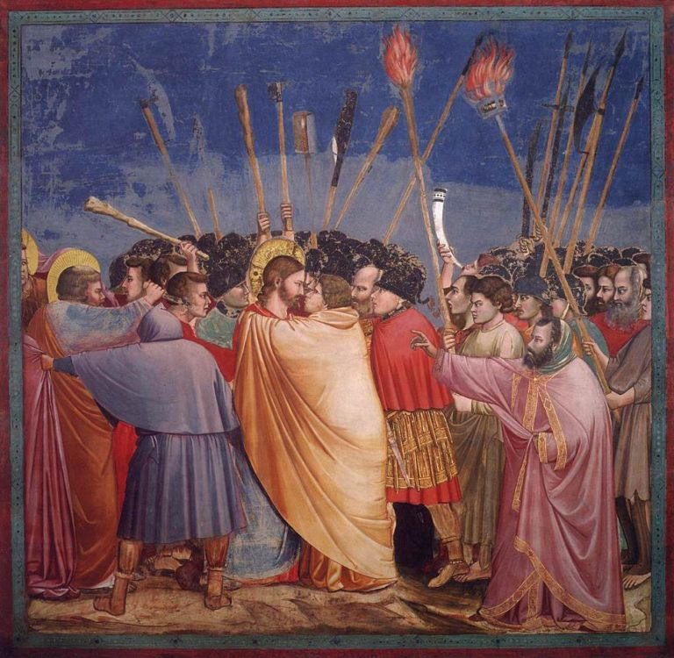
Notes:
Giotto, The Arrest of Christ, c. 1305, Scrovegni Chapel, Padua.

Slide 12
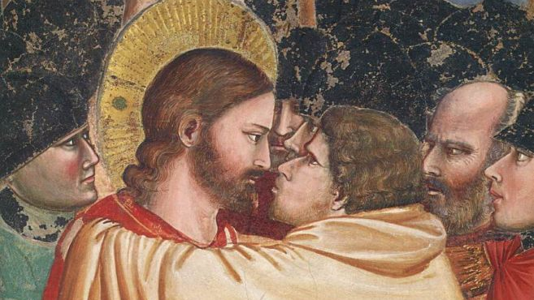
Notes:
Detail: Judas puckers his lips to kiss Jesus

Slide 13
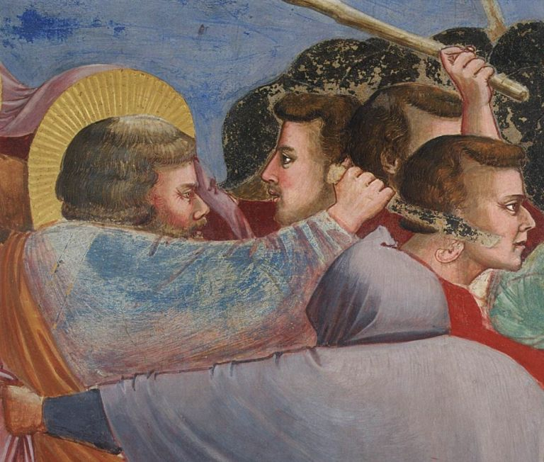

Slide 14
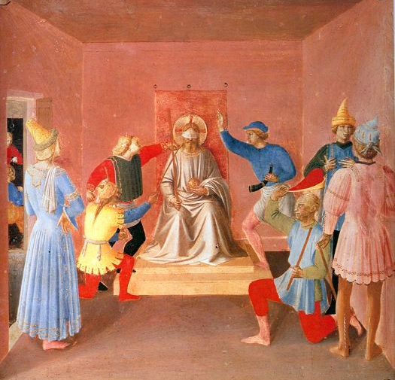
Notes:
Fra Angelico, The Mocking of Christ (Silver Cabinet), about 1450, Florence, Museum of San Marco
Fra Angelico, The Mocking of Christ (detail), with the Virgin and Saint Dominic, 1439-1443, fresco, Cell 7, Convent of San Marco, Florence (1439-43)

Slide 15
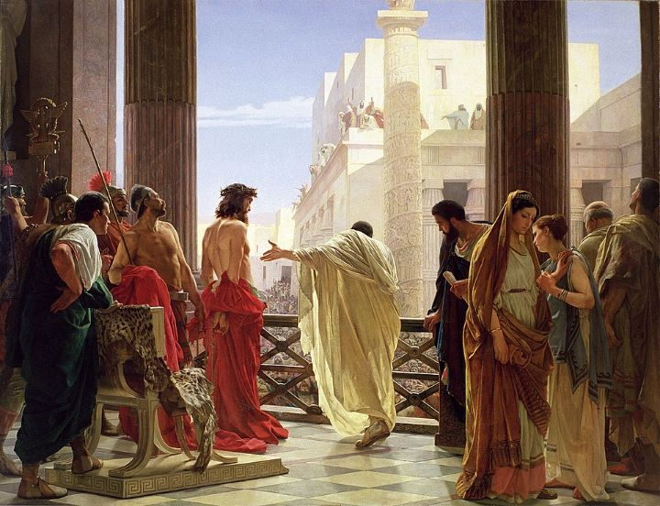
Notes:
Ecce Homo, Antonio Ciseri, c. 1860-80, Galleria dell'Arte Moderna (Gallery of Modern Art) within Palazzo Pitti in Florence, Italy
Behold the man

Slide 16
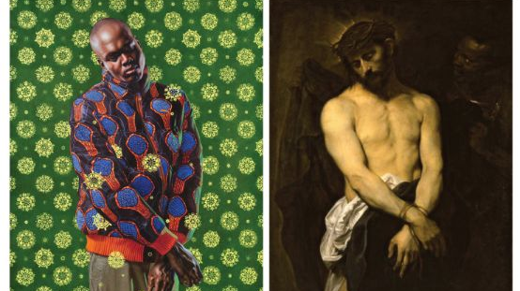
Notes:
Kehinde Wiley, Ecce Homo, c.2012, Baber Institute of Fine Art
Anthony Van Dyck, Ecce Homo, c.1626,

Slide 17
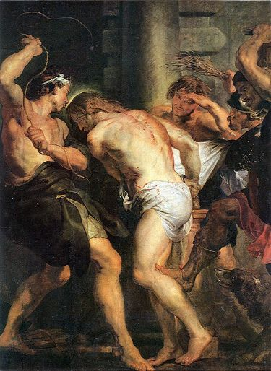
Notes:
Hans Maler, “Christ Carrying the Cross,” ca. 1510, Art Institute Chicago (photo: Public Domain)

Slide 18
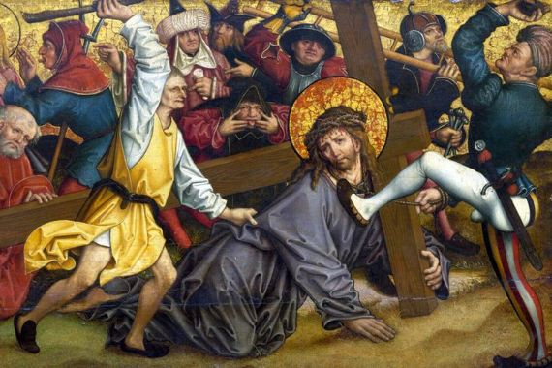
Notes:
Hans Maler, “Christ Carrying the Cross,” ca. 1510, Art Institute Chicago (photo: Public Domain)

Slide 19
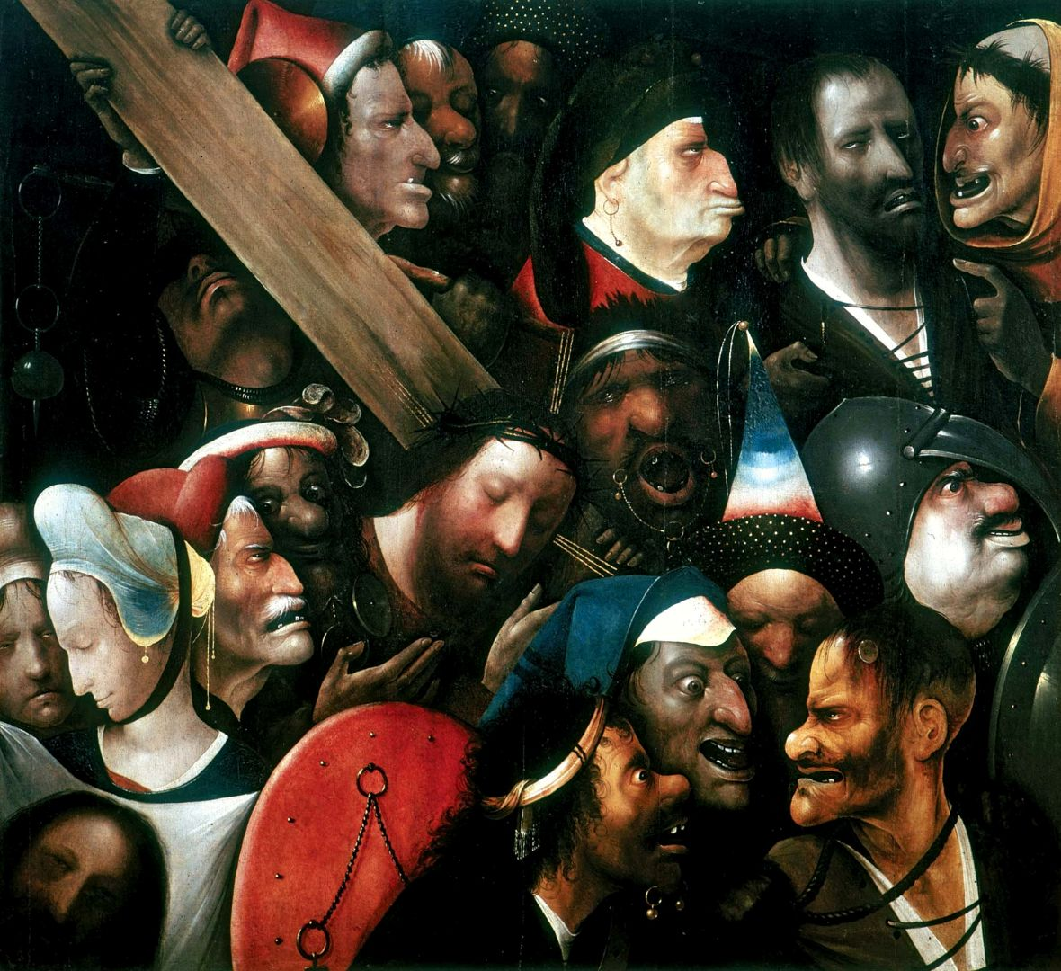

Slide 20
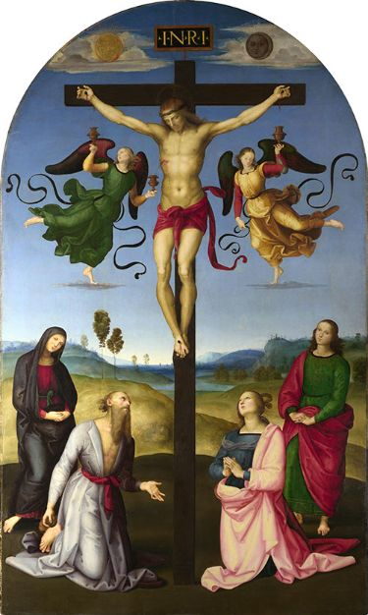
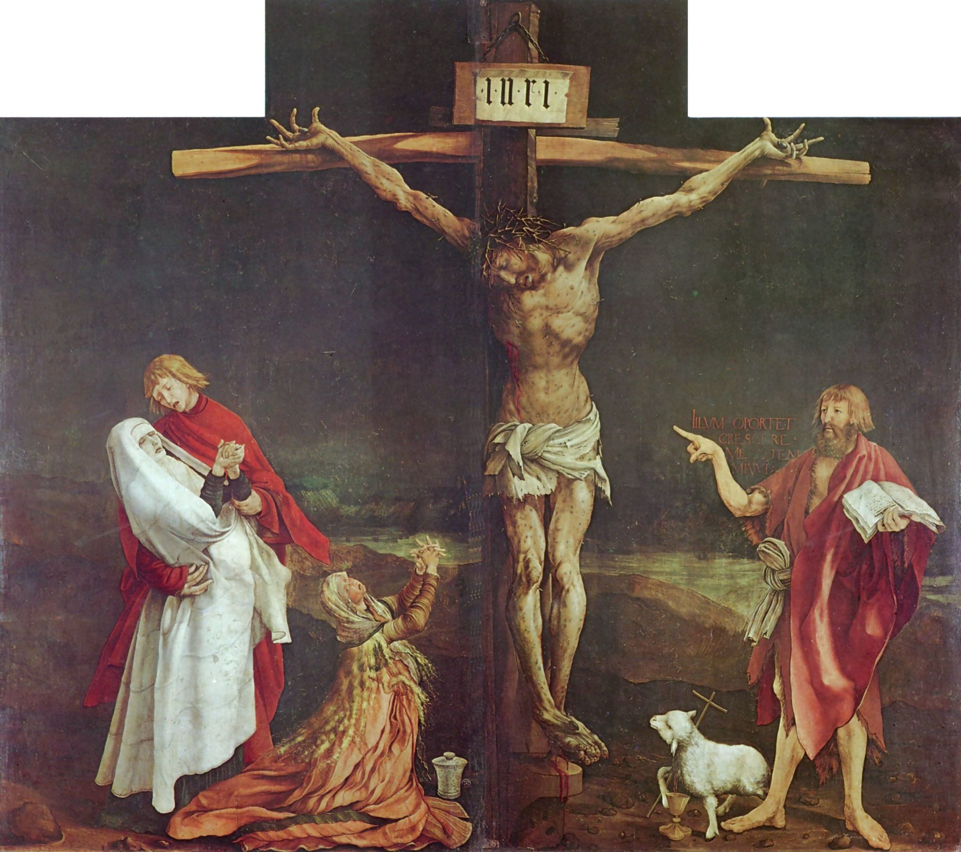
Notes:
Raphael, The Crucified Christ with the Virgin Mary, Saints and Angels (‘The Mond Crucifixion’), c. 1502-1503
Mathias Grunwald, The Crucifixion, c.1512 -1515, Museed'Unterlinden, Colmar (part of the larger Isenheim Altarpiece)
Saints past and future why?

Slide 21
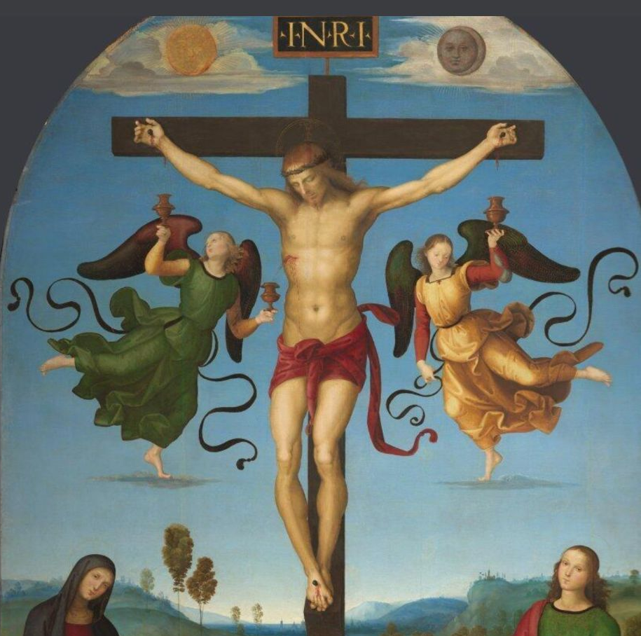
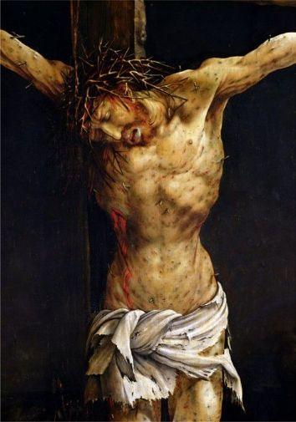

Slide 22
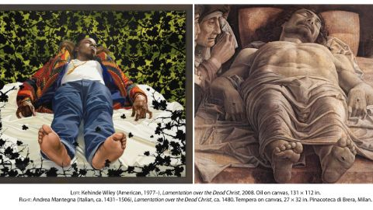
Notes:
Kehinde Wiley, Lamentation over the Dead Christ, c.2008
Andrea Mantegna, Lamentation over the Dead Christ, c.1480, Pinacoteca di Brera, Milan

Slide 23
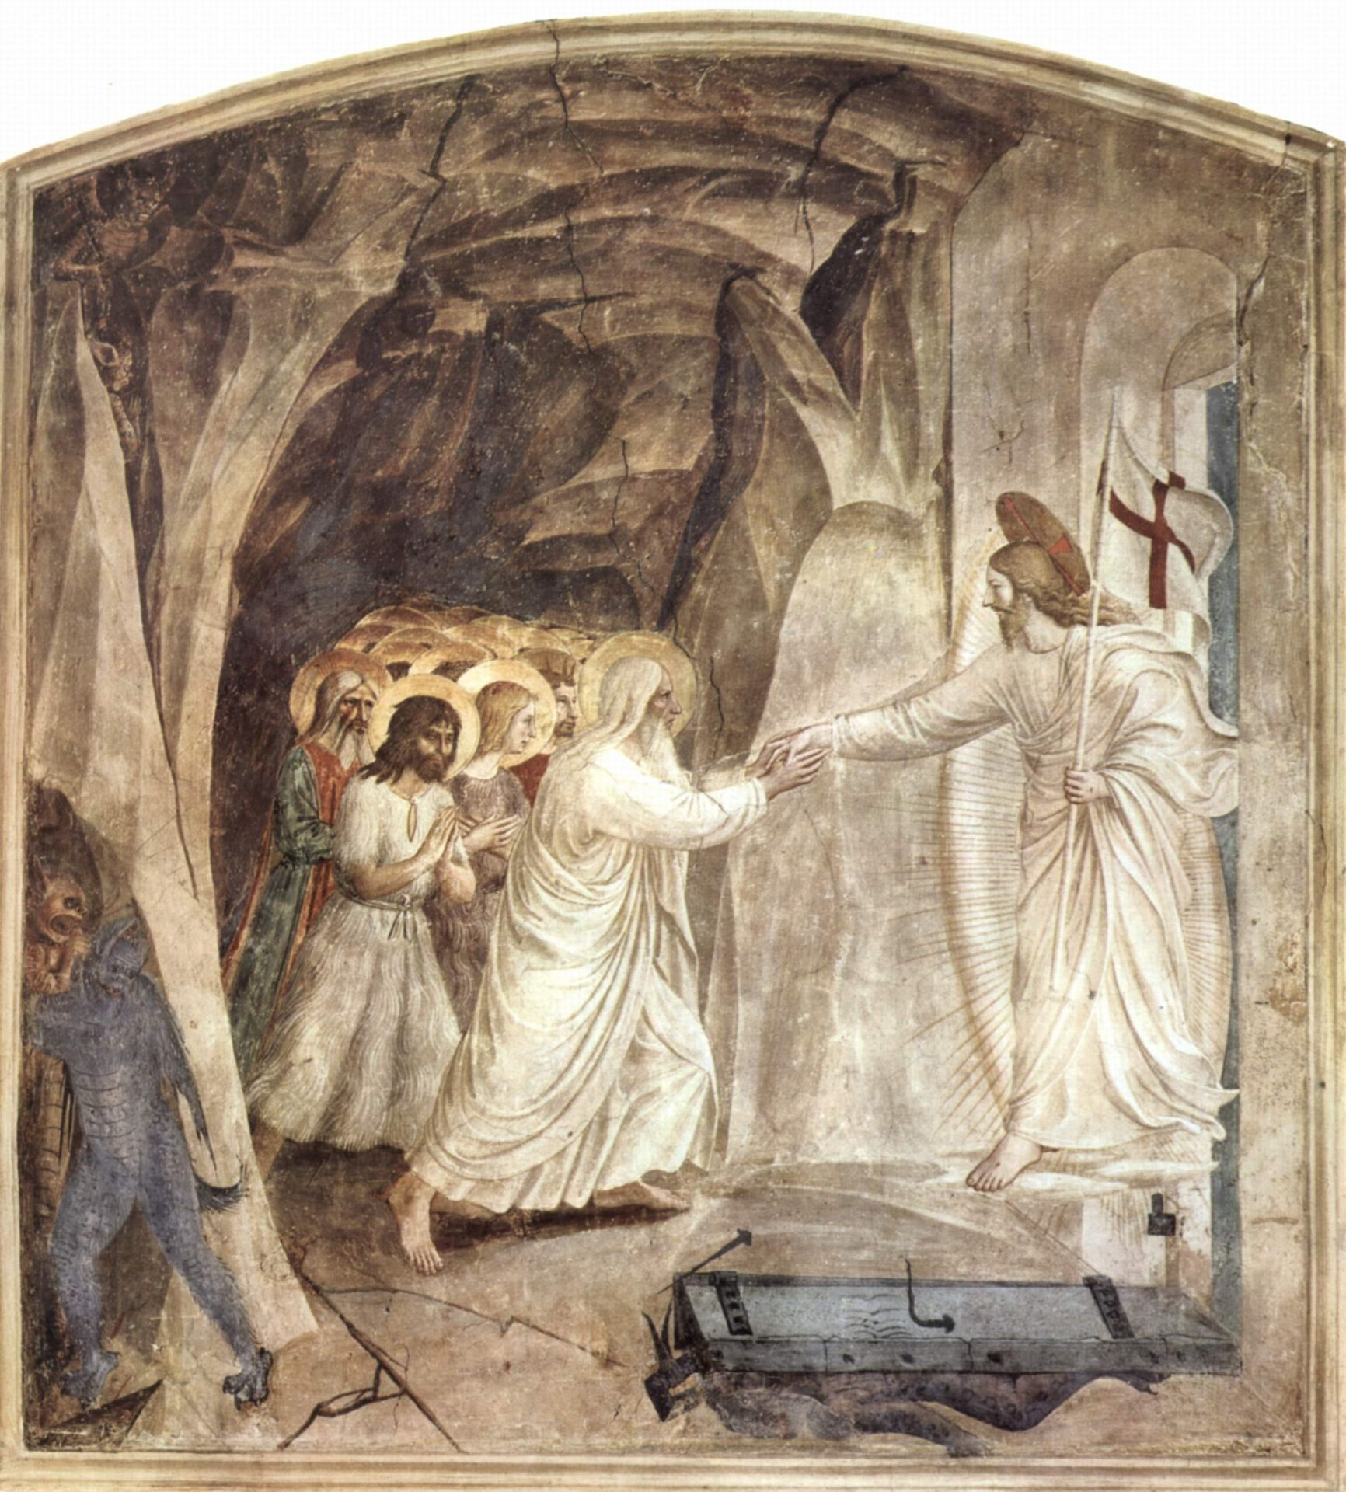
Notes:
Fra Angelico The Harrowing of Hell

