Slide 1
Incarnation: God with us
Week 4: Death and kenosis

Slide 2
First four ecumenical councils
Nicea (325) - Arianism condemned (there was never a time 'when he was not'; the Son is ‘of one substance’ ['homoousios'] with the Father)
Constantinople (381) - Nicea confirmed; Apollinarianism condemned (Jesus has a rational human soul, not just a human body)
Ephesus (431) - Nestorianism condemned
Chalcedon (451) - ‘Two natures, one person’

Slide 3
Salvation and incarnation
When salvation is seen in the light of incarnation, sinful humanity is saved by becoming one with God, and this one-ness with God is first achieved in the person of Jesus Christ, in whom God joins himself with human nature.
This is developed further by in the 4th century. For example:
Gregory Nazienzen (329-390):
'what is not assumed is not healed'
'the Word ‘bears all me and mine in himself, that in himself he may exhaust the bad, as fire does wax, or as the sun does the mists of the earth; and that I may partake of his nature by the blending.'

Slide 4
Salvation and incarnation
Gregory of Nyssa (330-395): ‘although Christ took our filth upon himself, nevertheless he is not himself defiled by our pollution, but in his own self he cleanses our filth, for it says, the light shone in the darkness, but the darkness did not overpower it' and 'whatever is weak in our nature and subject to death was united with his deity and became what the deity is.’
Cyril of Alexandria (376-444): ‘There was no other way for the flesh to become life-giving, even though by its own nature it is subject to the necessity of corruption, except that it become the very flesh of the Word who gives life to all things ... There is nothing astonishing here, for if it is true that fire has converse with materials that in their nature are not hot, and yet renders them hot since it so abundantly introduces to them the inherent energy of its own power, then surely to an even greater degree the Word who is God can introduce the life-giving power and energy of his own nature into his very own flesh.’

Slide 5
Divinity, humanity, union
So the salvific significance of incarnation is understood at the level of human nature:
In Christ, something happens to human nature – it is ‘assumed’ or taken up/on by the divine Word;
Cf. Romans 5 – Christ as the new Adam: ‘For just as by the one man’s disobedience the many were made sinners, so by the one man’s obedience the many will be made righteous.’
But the question is then: how are we to understand the relationship between the divine and the human in Jesus Christ?
Or: what is the nature of the union?

Slide 6
Divinity, humanity, union
Very roughly, there could be two problems, viewed from different perspectives:
Too much distinction – dualistic presentation of Christ (the Son of Man AND the Son of God);
Too much ‘blending’ or ‘confusion’ – implies that Christ had a unique nature (as a ‘God-man’), or a hybrid nature.
Is Mary ‘Mother of Christ’ or ‘Mother of God’? Why
In Christ, did God ‘become human’, or ‘a human’?

Slide 7
The ‘definition’ of Chalcedon, A.D. 451
‘THEREFORE, following the holy fathers, we all with one accord teach men to acknowledge one and the same Son, our Lord Jesus Christ, at once complete in Godhead and complete in manhood, truly God and truly man, consisting also of a reasonable soul and body; of one substance with the Father as regards his Godhead, and at the same time of one substance with us as regards his manhood; like us in all respects, apart from sin; as regards his Godhead, begotten of the Father before the ages, but yet as regards his manhood begotten, for us men and for our salvation, of Mary the Virgin, the Godbearer; one and the same Christ, Son, Lord, Only-begotten, recognized in two natures, without confusion, without change, without division, without separation; the distinction of natures being in no way annulled by the union, but rather the characteristics of each nature being preserved and coming together to form one person and subsistence, not as parted or separated into two persons, but one and the same Son and Only-begotten God the Word, Lord Jesus Christ; even as the prophets from earliest times spoke of him, and our Lord Jesus Christ himself taught us, and the creed of the fathers has handed down to us.’
(Translation from Bettenson, Henry. Documents of the Christian Church. Oxford Univ. Press, 1947, p. 73)

Slide 8
The ‘definition’ of Chalcedon, A.D. 451
‘THEREFORE, following the holy fathers, we all with one accord teach men to acknowledge one and the same Son, our Lord Jesus Christ, at once complete in Godhead and complete in manhood, truly God and truly man, consisting also of a reasonable soul and body; of one substance with the Father as regards his Godhead, and at the same time of one substance with us as regards his manhood; like us in all respects, apart from sin; as regards his Godhead, begotten of the Father before the ages, but yet as regards his manhood begotten, for us men and for our salvation, of Mary the Virgin, the Godbearer; one and the same Christ, Son, Lord, Only-begotten, recognized in two natures, without confusion, without change, without division, without separation; the distinction of natures being in no way annulled by the union, but rather the characteristics of each nature being preserved and coming together to form one person and subsistence, not as parted or separated into two persons, but one and the same Son and Only-begotten God the Word, Lord Jesus Christ; even as the prophets from earliest times spoke of him, and our Lord Jesus Christ himself taught us, and the creed of the fathers has handed down to us.’
(Translation from Bettenson, Henry. Documents of the Christian Church. Oxford Univ. Press, 1947, p. 73)

Slide 9
Some philosophical terms
“ousia” (Greek):
being/substance (a): an individual thing of an identifiable kind which we can say something about;
- we might say: a being; the ‘subject’ of a sentence
being/essence: the properties of a thing that make it that thing (rather than something else)
- we might say, the ‘nature’ or ‘form’ or ‘kind’
being/substance (b): the primary material (atoms and molecules/flesh and bone) out of which an individual consists.
- we might say: stuff, substance, matter.

Slide 10
Some philosophical terms
“homoousios” (Greek); “consubstantialis” (Latin)
Of one being = the same individual existent thing (e.g. Venus is of one being with ‘the morning star’ = Venus is the morning star)
Of one essence: i.e. sharing the same defining properties (e.g. two different swans are ‘of one being’)

Slide 11
Some philosophical terms
“hypostasis” (Greek)
being/substance (a): an individual, actual member of a kind with its unique characteristics;
being/substance (b): the underlying material in any individual thing, like the bronze in a statue.

Slide 12
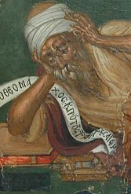
The suffering of Christ
The question of how to relate the suffering of the life of Jesus of Nazareth to God was an important part of many of the theological controversies experienced by the early church. Three interpretations of the person of Christ in particular are relevant here:
that Christ was a divine being and therefore could not suffer (Docetism);
that in the incarnation God the Father was temporally changed into the suffering Son (Patripassianism, or Sabellianism);
because Christ was involved in change, birth, suffering and death, he could not have been fully divine, or equal to God (Arianism)
This Photo by Unknown Author is licensed under CC BY-SA

Slide 13
The suffering of Christ
In other words, what came to be orthodox Christianity negotiated a path that avoided certain obvious ways of resolving the contradiction between the following claims:
God does not suffer (because God does not change);
Jesus was God incarnate;
Jesus suffered.
According to Paul Gavrillyuk, the orthodox position that emerged was a delicate and paradoxical affirmation:
'Having ruled out the three extreme options, the church asserted that the Son of God suffered in reality and not in mere appearance; that it was the Son who became incarnate and suffered, not the Father; that the Son's involvement in suffering did not diminish his divine status, because the incarnation was a supreme act of divine compassion and as such it was most appropriate and God-befitting.'

Slide 14
The suffering of Christ
The question of suffering was particularly important in the debate between Cyril of Alexandria (c. 376 - 444) and Nestorius (c. 386 - 451), and here the distinction between what came to be classed as 'orthodoxy' as opposed to 'heresy' is very subtle.
By this point, the church had ruled out certain ways of talking about the incarnation, and the relationship between Jesus Christ and God. It had become generally accepted that:
the Son was of the same essence (consubstantial) with the Father;
the Son (or Word – Logos), not the Father, became incarnate and suffered;
the birth, suffering and death of the Son did not diminish his divine status (as in Arianism)

Slide 15
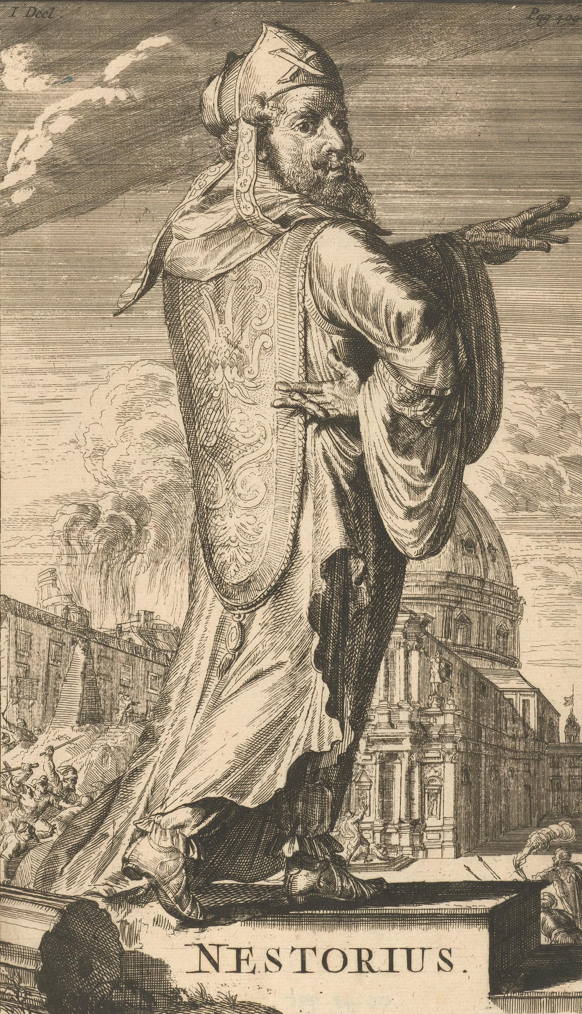
The suffering of Christ in early controversies
However, another form of division is also possible: the divine and the human natures within Christ. In the debates between Cyril and Nestorius, the question of how to conceive the relationship between the two natures became crucial.
Nestorius followed Theodore of Mopsuestia, who was concerned to emphasise the absolute difference between creator and created. Nestorius and those who followed him also stressed the importance of keeping the distinction between the divine and the human within Christ, so that one should speak of two subjects in Christ.

Slide 16
The suffering of Christ in early controversies
This divides up different aspects of the life of Christ between the two natures (the humanity of Jesus suffers, learns, is born and dies; the eternal Word in Jesus remains impassible), so that the integrity of each is preserved:
'For the (divine) substance cannot fall under the necessity of change and suffering, because if the godhead underwent change, there would no longer be a revelation, but a corruption of godhead, and if again the manhood departed from its nature, there would no longer be salvation, but an extinction of manhood.’ (Gavrillyuk, 2004: 143)

Slide 17
The suffering of Christ in early controversies
In contrast to this, Cyril claimed, paradoxically, that ‘the Word suffered impassibly’.
For Nestorius, this was either straightforwardly heresy (similar to Arianism, which concluded that the Son was not equal to the Father) or simply a useless contradiction. For Cyril, however, this clarification was a way of holding on to the truth of incarnation: that it was actually the divine Word who was incarnate, and that it was a real incarnation, an assumption of real – not modified - human nature.

Slide 18
The suffering of Christ in early controversies
We cannot say that God suffers, because in his own nature, the Word does not suffer, but as incarnate, the Word experiences human suffering:
'I [Cyril] certainly do not say that any confusion, or blending, or mixture took place, as some people maintain, because I know that the Word of God is by nature changeless and unalterable, and in his proper nature is altogether incapable of any suffering. That which is divine is impassible and does not admit even the 'shadow of a change' (James 1: 17) of suffering. On the contrary it is established with unshakeable stability in the realities of its own goodness. I maintain, however, that it was the Only Begotten Son of God, the One Christ and Lord, who suffered in the flesh for our sake, in accordance with the scriptures. . .
God's word is, of course, undoubtedly impassible in his own nature and nobody is so mad as to imagine the all-transcending nature capable of suffering; but by very reason of the fact that he has become man, making flesh from the Holy Virgin his own, we adhere to the principles of the divine plan and maintain that he who as God transcends suffering, suffered humanly in his flesh.'

Slide 19
The suffering of Christ in early controversies
For Cyril, however, his position allowed him to affirm the unity of Christ’s person, and also implied that the idea incarnation necessitates a change in how we think of God:
‘For Cyril, divine impassibility meant that the Word remained unconquered by suffering and death and that he was unable to experience suffering in his ‘naked divinity’, but only in and through the flesh. The presence of the Word transformed Christ’s human sufferings, while preserving their tragic reality. The Word was in a qualified sense passible to the degree to which he made the sufferings of humanity his very own. In appropriating the experiences of humanity the Word directed them towards the salvific end and rendered them life-giving.’ (Gavrilyuk, 2004:171.)

Slide 20
The suffering of Christ in early controversies
So all in all:
“God suffers” – NO
“God suffers in Christ” – YES
So, on the cross:
The suffering is undergone by a person who is ONE person;
That one person is formed of TWO natures…
…that are not diluted or mixed.
So Jesus’ suffering is fully human suffering (not ‘divine suffering’), but it is fully human suffering undergone by the incarnate Word of God.

Slide 21
The ‘definition’ of Chalcedon, A.D. 451
‘THEREFORE, following the holy fathers, we all with one accord teach men to acknowledge one and the same Son, our Lord Jesus Christ, at once complete in Godhead and complete in manhood, truly God and truly man, consisting also of a reasonable soul and body; of one substance with the Father as regards his Godhead, and at the same time of one substance with us as regards his manhood; like us in all respects, apart from sin; as regards his Godhead, begotten of the Father before the ages, but yet as regards his manhood begotten, for us men and for our salvation, of Mary the Virgin, the Godbearer; one and the same Christ, Son, Lord, Only-begotten, recognized in two natures, without confusion, without change, without division, without separation; the distinction of natures being in no way annulled by the union, but rather the characteristics of each nature being preserved and coming together to form one person and subsistence, not as parted or separated into two persons, but one and the same Son and Only-begotten God the Word, Lord Jesus Christ; even as the prophets from earliest times spoke of him, and our Lord Jesus Christ himself taught us, and the creed of the fathers has handed down to us.’
(Translation from Bettenson, Henry. Documents of the Christian Church. Oxford Univ. Press, 1947, p. 73)

Slide 22
After Chalcedon
Question:
Could Jesus have given into temptation in the wilderness (e.g. throw yourself down... etc.). If not, why not? If so – what would the consequences have been?
Could Jesus have saved himself, once he was nailed to the cross, as the thief suggested? If not, why not? If so – what would the consequences have been?

Slide 23
After Chalcedon
The Christological controversies did not abate in the wake of Chalcedon, because questions about the 'hypostatic union' remained, e.g.:
Does Christ have a human, or a divine will?
If 'both', in what sense is there a unified person acting in the life of Jesus?
Question of 'monothelitism' - condemned at the 3rd Council of Constantinople (681)
Instead: 'Two wills, one activity'
Etc!

Slide 24
After Chalcedon
Some theologians have argued that the basic framework of Chalcedonian Christology became so abstract that it ended up disconnecting the confession of Jesus as 'God with us' from the drama of his life, death and resurrection...
e.g. Wolfhart Pannenberg:
'With the doctrine of Christ's two wills, the pattern of the two natures was uncompromisingly carried through, but the perception of the concrete vital unity of Jesus was basically lost [. . .] the basis for affirming Jesus' divinity lies precisely in his unity of will with the Father in the execution of his mission.' (Pannenberg 1968: 284)

Slide 25
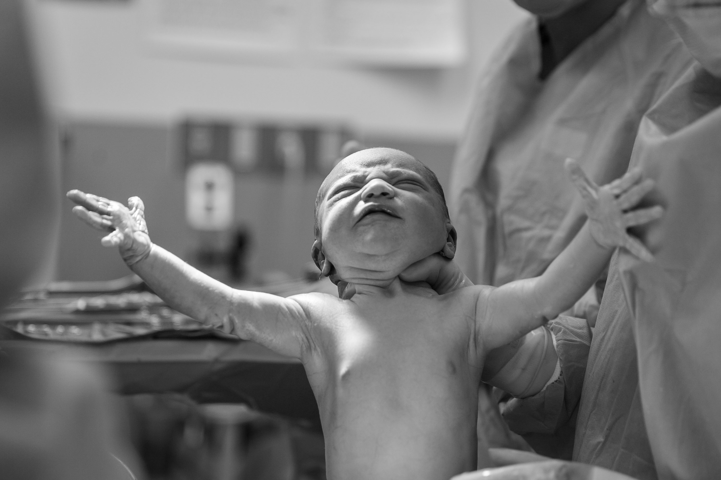
Tanner on assumption
For Tanner, incarnation concerns the whole course of Jesus' life. Sometimes the doctrine is spoken of as if it simply concerned the birth of Jesus, but we should instead think in terms of the whole of Jesus' life:
'The assumption of humanity by the Word is of course responsible for the fact that the man Jesus exists at all; it is therefore a way of talking about Jesus' birth. But it also underlies and makes sense of what happens over the whole course of Jesus' existence, from his birth to his death and beyond: his whole human life and death are that of the Word incarnate.' (Tanner 2010: 259)

Slide 26
Tanner on assumption
It is suffering, sinful human nature that is 'assumed' by the Word. In other words, human nature as it actually is, is assumed by and joined with the divine nature:
'The humanity of the Word is humanity suffering from fear and distress, persecution by others, anxiety before death, betrayal and isolation, separation from God - all the qualities of death-infused, sin-corrupted life that require remedy. The cross then exemplifies in paradigmatic fashion the very character of human life that the Word becomes incarnate to reverse by making its own.' (Tanner 2010: 260)

Slide 27
Tanner on assumption
Healing or salvation is a temporal process. Although it is the reality of incarnation that gives the possibility of salvation, this is not an immediate achievement:
'One must say, instead, that humanity suffering under the weight of sin is reworked in a process of salvation over time, from Jesus' birth up to and through his death. . . . Salvation, what the incarnation brings about, takes time, in short; salvation is a form of temporal, historical process, involving struggle with the forces of sin and death, and the sort of changes that typify any human life, sinful or not.' (Tanner 2010: 261)

Slide 28

Tanner on assumption
The crucifixion of Jesus is one example of the plight that humanity is in, and through incarnation, God wills to be intimately involved in the struggle against this evil. The cross expresses God's solidarity with humanity:
'a God of gift-giving abundance struggling against the forces of sin and death in the greatest possible solidarity with us - that of incarnation.' (Tanner 2010: 261)

Slide 29
Tanner on assumption
The 'mechanism' of atonement is the same as the 'mechanism' of of incarnation: union with God.
So the relationship between Jesus' life/teaching and his death remains essential - he did not come to die but to live. The 'mechanism' of salvation is at work throughout the whole of Jesus' life:
'And the effects of this salvific mechanism - its point - are, indeed much clearer away from the cross than on it - for example, in Jesus' healing ministry to the sick and the outcast, the advent of the new community of God, and Jesus' resurrected life.' (Tanner 2010: 262)

