Slide 1
Emotions and Moral Life
Philosophy Through the Year
London Jesuit Centre

Slide 2
What counts as an emotion?
Fear
Anger
Grief
Surprise
Gratitude
Remorse
Determination
Uncertainty
Pity
Humility
Anxiety
Depression
Guilt
Desire
Love
Trust

Slide 3
Emotions and...?
One part of the task might involve situating emotions in relation to other, related, states.
beliefs/believing
perception/experiencing
attitudes
volition/motivation
desires
E.g.: perhaps emotions are a distinctive kind of experience, typically prompted by beliefs, and often connected with volition, or giving rise to desires.

Slide 4
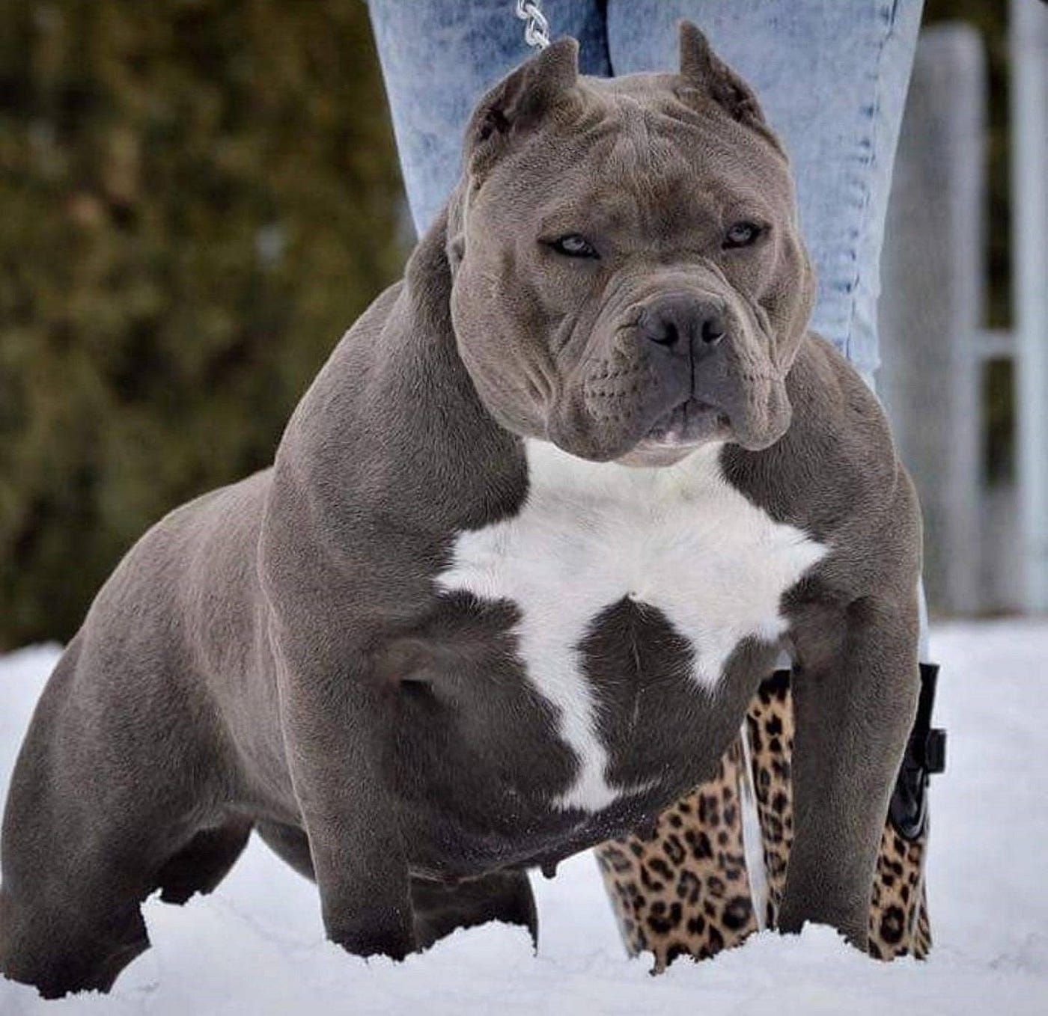
Emotions and...?
I perceive that a dangerous dog is chasing me;
I feel afraid
I want to escape/get ready to fight.

Slide 5
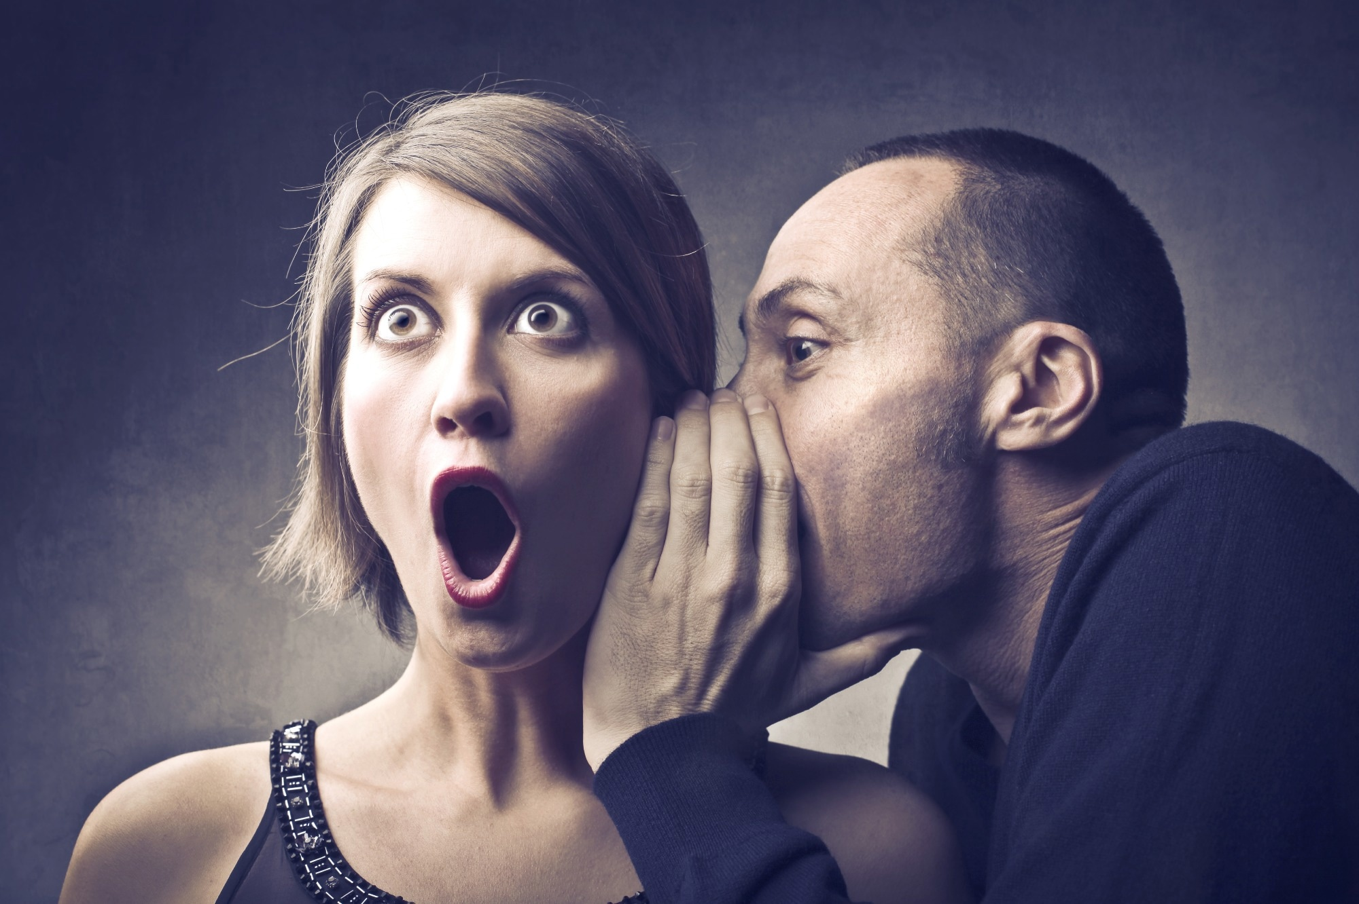
Emotions and...?
I believe that my colleague has been spreading false rumours about me;
I feel angry;
I desire revenge/seek vindication
OR
I feel ashamed;
I try to avoid people;

Slide 6
Defining emotion
Three main approaches:
Emotions as experiences
Emotions as evaluations
Emotions as motivations
‘The Feeling Tradition takes the way emotions feel to be their most essential characteristic, and defines emotions as distinctive conscious experiences. The Evaluative Tradition regards the way emotions construe the world as primary, and defines emotions as being (or involving) distinctive evaluations of the eliciting circumstances. The Motivational Tradition defines emotions as distinctive motivational states.’

Slide 7
Defining emotion
According to Scarantino, the explanatory challenges can be summarised like this:
Differentiation: How are emotions different from one another, and from things that are not emotions?
Motivation: Do emotions motivate behavior, and if so how?
Intentionality: Do emotions have object-directedness, and if so can they be appropriate or inappropriate to their objects?
Phenomenology: Do emotions always involve subjective experiences, and if so of what kind?
So it seems that there are a number of dimensions that must be taken into account in developing an understanding of what emotions are….

Slide 8

Dimensions of emotions
The affective/experiential dimension:
emotions are felt; emotions are feelings.
BUT distinguishing emotions seems to involve more than identifying differences in feeling.
And are all emotions felt (and in the same way?); are all emotions conscious? (can anger, or guilt, or fear, be unconscious?)

Slide 9
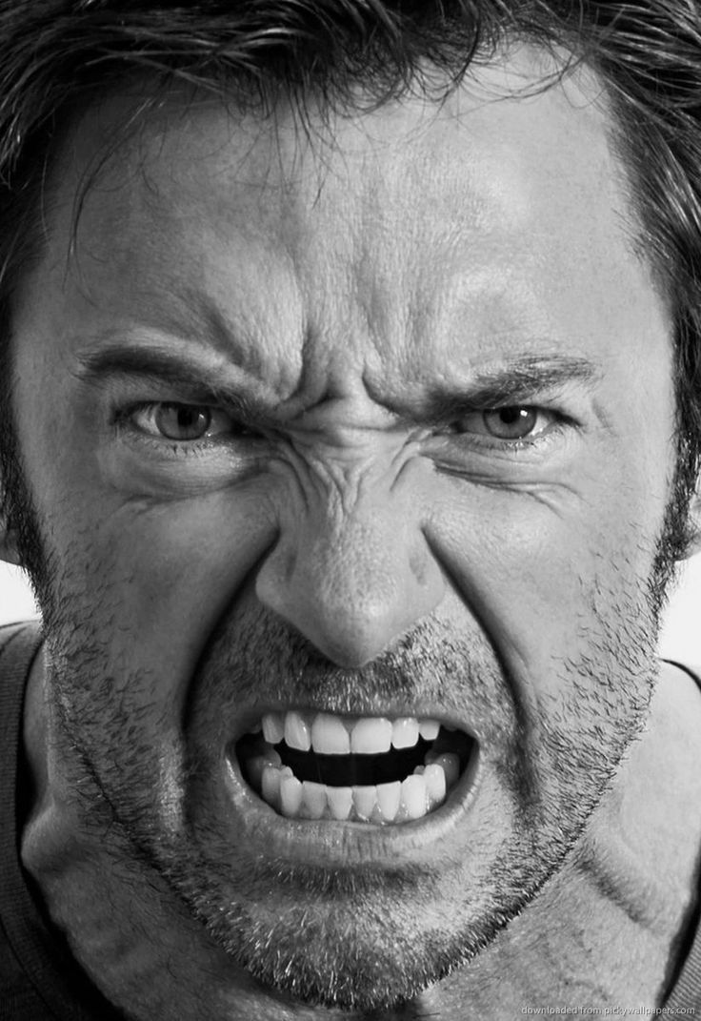
Dimensions of emotions
The intentional/evaluative dimension
Emotions are typically directed; they are about something;
And the tend to involve evaluation of the intentional object.
The object of an emotion often seems needed to explain emotion.... (the most natural question to ask: what are you angry about? what are you sad about?
This is linked to our tendency to evaluate emotions (e.g. excessive or inappropriate anger; unwarranted shame, etc.).
But: emotions seem to arise in non-human animals, and very young children… without cognitive capacity for evaluative judgement.
And: which comes first (do we become angry because something is unfair; do we judge things as 'unfair' because of our anger?)

Slide 10
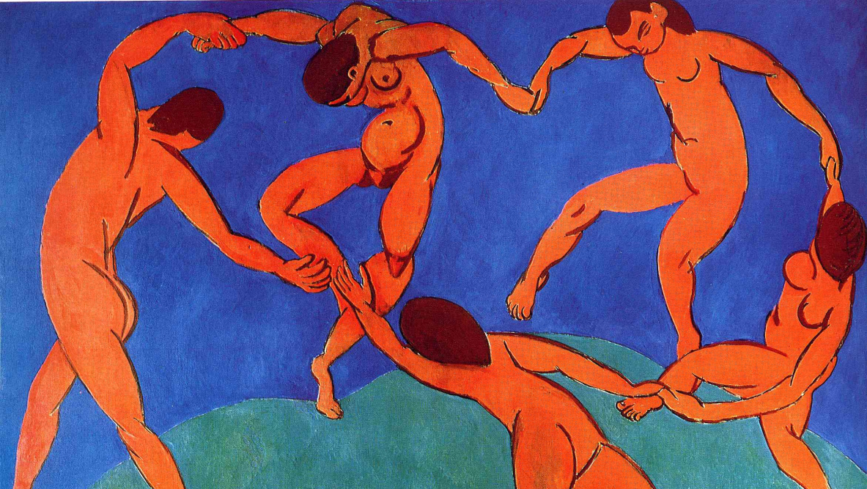
Dimensions of emotions
The motivational dimension
We often explain actions, or inaction, with reference to emotions...
"I danced for joy"
"I’m sorry I said that, I wasn’t thinking, I was too angry";
"I wanted to help, but I was too scared"
Hence emotions have been seen as the enemy of moral life (cowardice; envy; pride; wrath; etc. all seem to impede right action on occasion...
...but equally, for the same reason, some have seen emotions as crucial to moral life, as a result of their motivational force.
Bishop Joseph Butler on resentment/indignation as a 'weapon' based in 'fellow-feeling'
Hume on the motivating role of the passions.

Slide 11
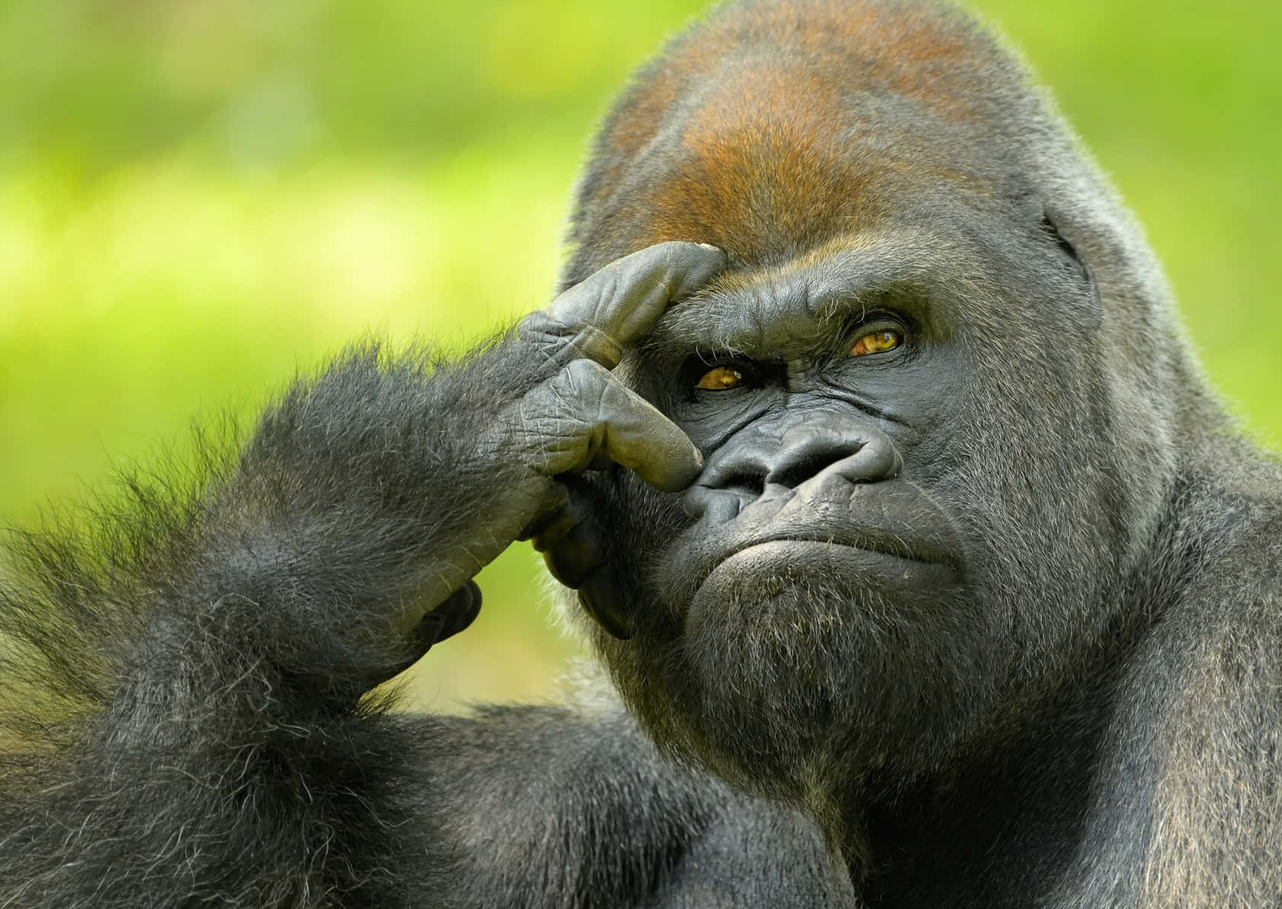
Dimensions of emotions
The physiological dimension
Emotions are often connected with typical physiological changes (increased heart rate; tears; sweat; facial expressions/displays; postural change, etc.)
often these are involuntary;
some are shared with other species (raised eyebrows = surprise; raised hair = fear)
emotions are evolved capacities, so perhaps basic emotions correspond to adaptive behaviours that are crucial to survival.
BUT the same physiological states can accompany contrasting emotions;
And some expressions of emotion can be highly culturally specific…

Slide 12
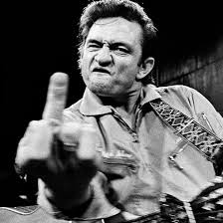
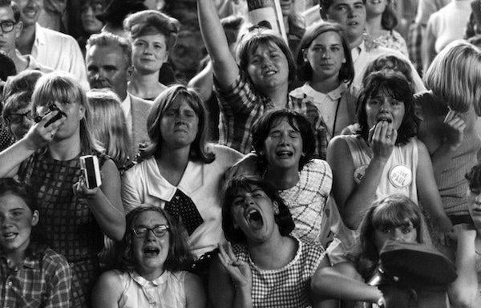
Dimensions of emotions
The cultural/educative dimension
It seems that emotions are shaped by culture, and can be ‘educated’
different cultures have different ‘catalogues’ of emotions;
The same emotions can be expressed in very different ways in different cultures.
Open questions about the degree of universality in basic emotions, and their typical expressions.

Slide 13
References
Scarantino, Andrea and Ronald de Sousa, "Emotion", The Stanford Encyclopedia of Philosophy (Summer 2021 Edition), Edward N. Zalta (ed.), URL = <https://plato.stanford.edu/archives/sum2021/entries/emotion/>.
Solomon, R. C. (2008). ‘The philosophy of emotions’. In M. Lewis, J. M. Haviland-Jones, & L. F. Barrett (Eds.), Handbook of emotions (3rd ed., pp. 3–16). The Guilford Press.

