Slide 1
Emotions and Moral Life: Emotion, value and reason
Philosophy Through the Year

Slide 2

Dimensions of emotions
The affective/experiential dimension:
emotions are felt; emotions are feelings.
BUT distinguishing emotions seems to involve more than identifying differences in feeling.
And are all emotions felt (and in the same way?); are all emotions conscious? (can anger, or guilt, or fear, be unconscious?)

Slide 3

Dimensions of emotions
The intentional/evaluative dimension
Emotions are typically directed; they are about something;
And the tend to involve evaluation of the intentional object.
The object of an emotion often seems needed to explain emotion.... (the most natural question to ask: what are you angry about? what are you sad about?
This is linked to our tendency to evaluate emotions (e.g. excessive or inappropriate anger; unwarranted shame, etc.).
But: emotions seem to arise in non-human animals, and very young children… without cognitive capacity for evaluative judgement.
And: which comes first (do we become angry because something is unfair; do we judge things as 'unfair' because of our anger?)

Slide 4

Dimensions of emotions
The motivational dimension
We often explain actions, or inaction, with reference to emotions...
"I danced for joy"
"I’m sorry I said that, I wasn’t thinking, I was too angry";
"I wanted to help, but I was too scared"
Hence emotions have been seen as the enemy of moral life (cowardice; envy; pride; wrath; etc. all seem to impede right action on occasion...
...but equally, for the same reason, some have seen emotions as crucial to moral life, as a result of their motivational force.
Bishop Joseph Butler on resentment/indignation as a 'weapon' based in 'fellow-feeling'
Hume on the motivating role of the passions.

Slide 5
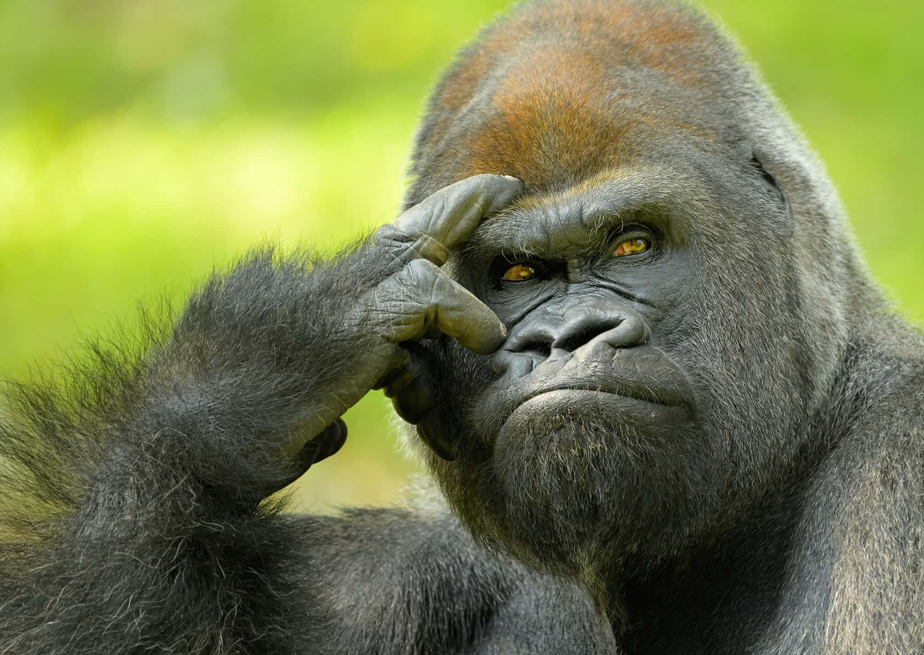
Dimensions of emotions
The physiological dimension
Emotions are often connected with typical physiological changes (increased heart rate; tears; sweat; facial expressions/displays; postural change, etc.)
often these are involuntary;
some are shared with other species (raised eyebrows = surprise; raised hair = fear)
emotions are evolved capacities, so perhaps basic emotions correspond to adaptive behaviours that are crucial to survival.
BUT the same physiological states can accompany contrasting emotions;
And some expressions of emotion can be highly culturally specific…

Slide 6

Emotions as judgements
Emotions are not the brutish, unlearned, uncultured, illogical and stupid drives that they are so often argued to be. To the contrary, they are extremely subtle, cunning, sophisticated, cultured, learned, logical and intelligent. To the contrary, they are extremely subtle, cunning, sophisticated, cultured, learned, logical and intelligent. There is more intelligence in resentment than in the routine calculations of syllogizing; and there is far more strategy in envious Jago than in thoughtful Hamlet’. (Solomon 1977)

Slide 7

Emotions as judgements
‘What distinguishes emotions among judgments (for not all judgments are emotional)? Emotional judgments are marked by their importance to us, by the fact that our self-esteem is at stake in them. It is important that the propositional content of the judgment need not be self-involved, but only that self-esteem be tied up with that judgment. [. . .] Anger, as I want to analyze it, is a set of judgments of accusation, an indictment for a personal offense, for example, an insult. I might make a similar set of judgments to the effect that what someone has said is insulting and offensive, but without being angry. What constitutes the anger is my judging that I have been insulted and offended. It is my "taking it personally" that makes this set of judgments anger.’ (Solomon 1977: 47)

Slide 8
Emotions as judgements of value and importance
According to Nussbaum, emotions have a number of features which means that they should be thought of as ‘intelligent’:
They are about something;
  E.g. my grief is about a deceased relative; my fear is about the risk of assault
Their ‘aboutness’ is a way of seeing; perception is active, and involves interpretation, from a point of view
  E.g. in grief we perceive something as lost to us; in fear I perceive something as a threat to me
They involve beliefs;
  E.g. in order to fear I must believe that non-trivial bad events, out of my control are approaching
They are concerned with value;
  The relationship with the lost relative was central to my sense of self; fear arises because my physical well-being is valuable
This value is connected with my own ultimate flourishing
(Nussbaum 2001 : 27-33]

Slide 9
Emotions as judgements of value and importance
Emotions are judgements about fragility, or exposure:
‘The judgements that the neo-Stoic identifies with emotions all have a common subject matter: all are concerned with vulnerable externalities: those that can be affect by events beyond one’s control, those that are unexpected, those that can be destroyed or removed even when one does not wish it. This implies that the acceptance of such propositions [evaluative and eudaemonistic] reveals something about the person: that she allows herself and her good to depend upon things beyond her control, that she acknowledges a certain passivity before the world.’
In summary:
‘emotions are forms of evaluative judgement that ascribe to certain things and persons outside a person’s own control great importance for the person’s own flourishing’ (Nussbaum 2001: 22]

Slide 10
Emotions as judgements of value and importance
All this means that we should understand thought, or judgement in such a way as to include movement:
‘we are conceiving of judging as dynamic, not static. Reason here moves, embraces, refuses: it moves rapidly or slowly, surely or hesitantly. [. . .] The movement toward my mother was a movement of my thought about what is most important in the world; that is all that needs to be said about it. If anything, the movement of my arms and legs, as I ran to University Hospital, was a vain mimesis of the movement of my thought toward her. It was my thought that was receiving, and being shaken by, the knowledge of her death. [. . .] The recognising and the upheaval belong to one and the same part of me, the part with which I make sense of the world.’ (194)
‘Knowing can be violent, given the truths that are there to be known.’ (195)

Slide 11
Problems with the judgement account?

Slide 12
References
Nussbaum, Martha C. ‘Emotions as judgements of value and importance’ in Solomon, ed. Thinking about Feelings: Contemporary Philosophers on Emotions (2010: Oxford, Oxford University Press).
Scarantino, Andrea and Ronald de Sousa, "Emotion", The Stanford Encyclopedia of Philosophy (Summer 2021 Edition), Edward N. Zalta (ed.), URL = <https://plato.stanford.edu/archives/sum2021/entries/emotion/>.
Solomon, R. C. (1977) ‘The logic of emotion’ in Nous vol. 11: 1
Solomon, R. C. (2008). ‘The philosophy of emotions’. In M. Lewis, J. M. Haviland-Jones, & L. F. Barrett (Eds.), Handbook of emotions (3rd ed., pp. 3–16). The Guilford Press.

