Slide 1
Emotions and Moral Life: Emotion, action and reasons
Philosophy Through the Year

Slide 2
Emotion, actions and reason
Two connected issues:
What is the place of action and motivation in understanding what emotions are? Does it make sense to say that emotions are defined in terms of motivation?
  For example: that to be afraid to want to avoid some danger; to be angry is to desire payback in some way?
Secondly, how should we situate the motivational dimension of emotions in relation to moral life?
If emotions are strongly connected with action, and responses that are not always consciously/deliberately intended, then this might change our understanding of the ethical significance of our actions, but also how we understand the emotional aspect of ourselves.

Slide 3
Emotion, actions and reason
Some have argued that emotions should be understood as ways of activating particular behaviours:
'the modularity of our emotional responses can be seen as a mechanism for saving us from our own intelligence by rapidly and involuntarily initiating essential behaviors. If central cognitive processes conform more or less closely to rational decision theory and implement plans designed to maximize expected outcomes, there may be evolutionary advantages in retaining more cautious and conservative mechanisms to handle certain vital responses. (1997, p. 95)
It makes evolutionary sense that we should have responses are 'quick and dirty' in that way...
… and this explains why emotional responses can easily be disproportionate, or misplaced.

Slide 4
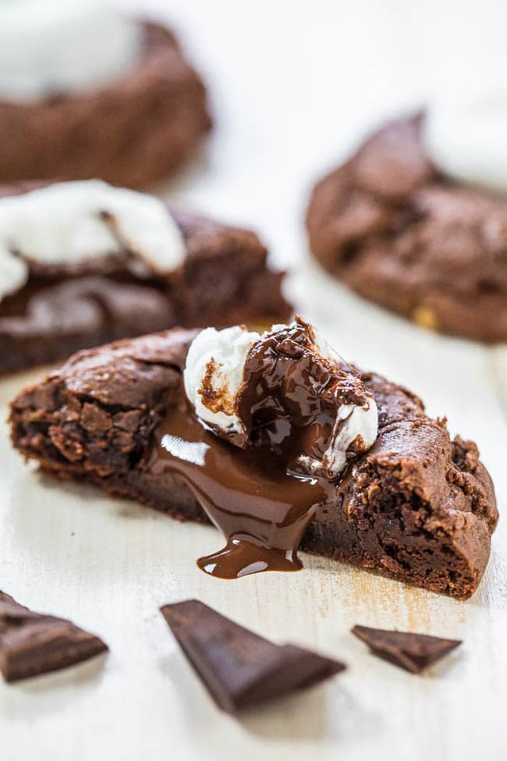
Emotion, motivation and 'direction of fit'
On Hume’s account, reason has no power to influence our action except insofar as it is connected to some ‘passion’, or desire:
‘It has been observed that reason, in a strict and philosophical sense, can have an influence on our conduct only after two ways: either when it excites a passion by informing us of the existence of something which is a proper object of it; or when it discovers the connection of causes and effects, so as to afford us means of exerting any passion.’ (Hume in Wolff 2018: 18)
ThePhoto by PhotoAuthor is licensed under CCYYSA.

Slide 5
Emotion, motivation and 'direction of fit'
(represents)
How the world is
Belief
“there are no biscuits in the cupboard”
can be true/false
Emotions?
Desire
(represents)
“I really want a biscuit”
How the world is to be
neither true nor false
See Smith 1993

Slide 6
Belief, desire and reasons for action
So on this picture, beliefs on their own do not give reasons for action; they only do so given the presence of a desire:
‘Crudely, our beliefs tell us how the world is, and thus how it has to be changed , so as to make it the way our desire tell us it is to be. An action is thus the product of these two forces: a desire representing the way the world is to be and a belief telling us how the world has to be changed so as to make it that way’ (Smith 1993: 401)
So: we expect to be able to resolve disagreements about beliefs by finding out about the world, but we don’t expect beliefs about the world to motivate us in the absence of a relevant desire. And we don’t expect to evaluate desires rationally…

Slide 7
Belief, desire and reasons for action
= false, if belief conflicts with reality
Belief
“there are biscuits in the cupboard”
Action
*goes to cupboard, gets biscuit*
Desire
“I really want a biscuit”
See Smith 1993

Slide 8
Belief, desire and reasons for action (‘the standard picture’)
Belief
“there are no biscuits in the cupboard”
Action
*goes to cupboard, gets biscuit*
Desire
Irrational, because action conflicts with belief
“I really want a biscuit”
See Smith 1993

Slide 9
Belief, desire and reasons for action (‘the standard picture’)
Belief
“there are biscuits in the cupboard”
Action
*goes to cupboard, gets biscuit*
Desire
“I really want a biscuit, because biscuits make you more intelligent”
irrational because of false belief
See Smith 1993

Slide 10
Belief, desire and reasons for action (‘the standard picture’)
Reason for action
= desire + belief
Belief
“there are biscuits in the cupboard”
Action
*goes to cupboard, gets biscuit*
Desire
“I really want a biscuit”
See Smith 1993

Slide 11
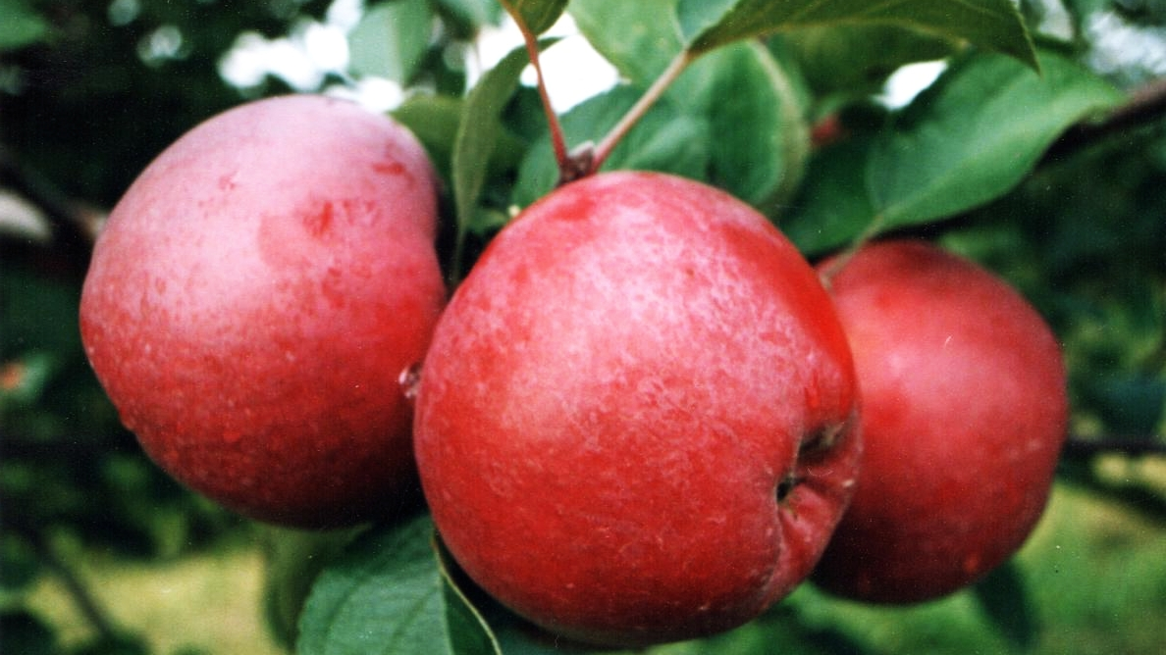
Hume: ‘no ought from an is’
On Hume’s account, moral reasoning is often flawed insofar as we expect to move from a description to a prescription. Description of ‘matters of fact’ never produces an ‘ought’ or an ‘ought not’:
‘Wilful murder, for instance. Examine it in all its lights, and see if you can find that matter of fact, or real existence, which you call vice. In whichever way you take it, you find only certain passions, motives, volitions, and thoughts. There is no other matter of fact in the case. The vice entirely escapes you, as long as you consider the object. You never can find it, till you turn your reflection into your own breast, and find a sentiment of disapprobation, which arises in you, towards this action. Here is a matter of fact; but it is the object of feeling, not of reason. It lies in yourself, not in the object.’ (Hume in Wolff 2018: 21)
This Photo by Unknown Author is licensed under CC BY-SA

Slide 12
Hume: ‘no ought from an is’
So Hume suggests that moral properties can be compared to ‘secondary qualities’, like sound, or colour, or taste:
The ‘redness’ of an apple is not something that can be found in the apple itself; rather, the redness is a secondary quality that describes the way that the apple affects us;
So moral properties – like ‘badness’ or ‘wrongness’ are not something that are to be found in the objective, external world, but in our responses to the world:
‘So that when you pronounce any action of character to be vicious , you mean nothing, but that from the constitution of your nature you have a feeling or sentiment of blame from the contemplation of it.’ (Hume in Wolff 2018: 21)
This Photo by Unknown Author is licensed under CC BY-SA

Slide 13
References
Nussbaum, Martha C. ‘Emotions as judgements of value and importance’ in Solomon, ed. Thinking about Feelings: Contemporary Philosophers on Emotions (2010: Oxford, Oxford University Press).
Scarantino, Andrea and Ronald de Sousa, "Emotion", The Stanford Encyclopedia of Philosophy (Summer 2021 Edition), Edward N. Zalta (ed.), URL = <https://plato.stanford.edu/archives/sum2021/entries/emotion/>.
Solomon, R. C. (1977) ‘The logic of emotion’ in Nous vol. 11: 1
Solomon, R. C. (2008). ‘The philosophy of emotions’. In M. Lewis, J. M. Haviland-Jones, & L. F. Barrett (Eds.), Handbook of emotions (3rd ed., pp. 3–16). The Guilford Press.

