Slide 1

Anger, resentment and blame
Philosophy Through the Year: Emotions
Dr Stuart Jesson
London Jesuit Centre

Slide 2
The legacy of Hume and Kant
Hume: moral judgements founded on ‘passions’;
Approval of benevolence;
Disapproval of cruelty;
Moral passions based on capacity for ‘sympathy’;
sympathy based on instinctive response to resemblance;
similarly instinctive responses underlie many rational principles
So we don’t have rational insight into the basis of our moral lives; ultimately based on the brute fact of our passions.
Kant: insists that moral judgements must involve necessity;
E.g. it somehow has to be the case that lying is wrong);
Moral reasoning is based on rational insight, not passions;
Feelings inspire us unreliably towards some of the same actions that our moral reason prescribes;
So moral action is ‘out of duty’ not just ‘in accordance with duty’
The basis of morality is ultimately our own ‘rational nature’; rational nature is that before which we stand in awe.

Slide 3
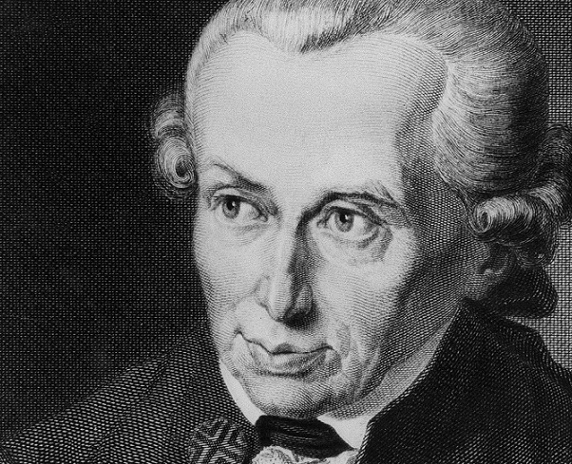
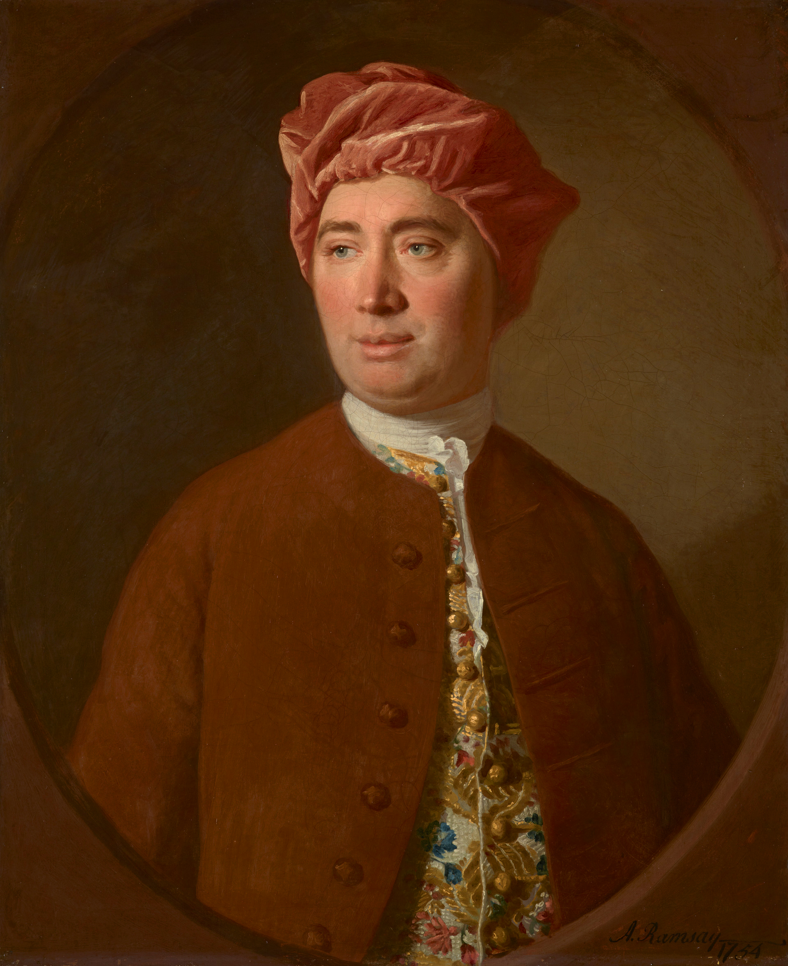
The legacy of Hume and Kant
So a crude reading of the development of moral philosophy in the modern world seems to leave us with an unenviable choice:
Either moral life is understood in terms of reason, duty and the moral law; founded, ultimately, on our nature as rational beings, or;
Moral life is understood in terms of sentiments, and ‘fellow-feeling’, but lacks any deep rational integrity, and is founded ultimately and how we just happen to be.
One key development in moral philosophy that responds to this apparent disjunction is by those who want to understand the importance of emotions in our intellectual lives.
This Photo by Unknown Author is licensed under CC BY-SA-NC
This Photo by Unknown Author is licensed under CC BY-SA

Slide 4
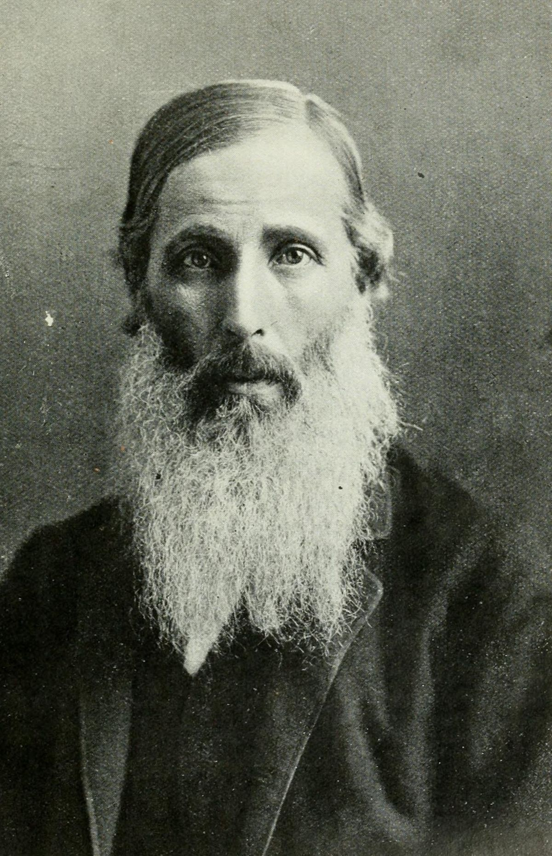
Happiness, benevolence and reason
An interesting problem emerges in Utilitarian thinking: what kind of reason do we have to act so as to increase the happiness of others?
The increased happiness of the greatest number only gives me a reason to act IF I already desire the happiness of the greatest number, or feel that to be significant…
So the problem is that an egoist could be completely rational in seeking only their own pleasure.
Henry Sedgewick (1838-1900), one of the most important Utilitarian thinkers after Mill, ends up pointing out what seems to be an impasse: ‘the dualism of practical reason’…
This Photo by Unknown Author is licensed under CC BY-SA

Slide 5
Happiness, benevolence and reason
If the intrinsic value of pleasure seems intuitively obvious, so does the intrinsic difference between my own experiences and that of others:
‘It would be contrary to Common Sense to deny that the distinction between any one individual and any other is real and fundamental, and that consequently ‘I’ am concerned with the quality of my existence as an individual in a sense, fundamentally important, in which I am not concerned with the quality of the existence of other individuals: and this being so, I do not see how it is to be proved that this distinction is not to be taken as fundamental in determining the ultimate end of rational action for an individual.’ (Sidgwick in Schneewind 1986: 365)
This Photo by Unknown Author is licensed under CC BY-SA

Slide 6
Happiness, benevolence and reason
So if it is not always in my own interests to promote the greatest happiness, what reasons do I have to act according to the principle of utility?
Hence the dualism of practical reason:
It appears that the principle of utility (acting so as to maximise the general happiness) and rational egoism (acting prudently to maximise my own happiness) are equally rational…
But they could easily be opposed in many circumstances
Which suite of emotions are more rational? Those responsive to my own well-being? Or those responsive to the well-being of others?
This Photo by Unknown Author is licensed under CC BY-SA

Slide 7

Anger
What, if anything, is valuable about anger?
Are there occasions on which it is right to be angry?
If so, what makes the anger a ‘fitting’ response?
On Nussbaum’s account, we can ask questions about the value of our emotional states – even though it is also obvious that our emotional states are not something that we can straightforwardly make decisions about.
E.g. I cannot just decide to stop being afraid of something; but my sense that my fear is irrational and unhelpful might provide a ground for me to work on my fear, over time.

Slide 8

To recall, according to Nussbaum have a number of features which means that they should be thought of as ‘intelligent’. This is designed to counter the thought that emotions are just irrational forces that take us over. She says:
They are about something;
  E.g. my grief is about a deceased relative; my fear is about the risk of assault
Their ‘aboutness’ is a way of seeing; perception is active, and involves interpretation, from a point of view
  E.g. in grief we perceive something as lost to us; in fear I perceive something as a threat to me
So they involve beliefs;
  E.g. in order to fear I must believe that non-trivial bad events, out of my control are approaching
They are concerned with value;
  The relationship with the lost relative was central to my sense of self; fear arises because my physical well-being is valuable. (Nussbaum 2001 : 27-33]
This Photo by Unknown Author is licensed under CC BY-SA

Slide 9
But intriguingly, Nussbaum’s book Anger and Forgiveness is designed to challenge the contemporary valourisation of anger (often on feminist principles).
She identifies three intuitions about the value of anger:
Anger is necessary for the protection of dignity and self-respect;
Anger is necessary if one is to take wrongdoers seriously, as responsible beings;
Anger pushes us to combat injustice
In challenge to these views, Nussbaum argues that anger is ‘normatively irrational’, and that the good person has a responsibility to ‘transition’ from anger into a determined, resolute hope…
This Photo by Unknown Author is licensed under CC BY-SA

Slide 10

Anger and ‘payback’
Anger is a forward-facing emotion, with its own distinct motivational force;
It involves desire for payback of some kind; as an answer to a perceived wrongdoing (anger takes payback to be ‘fitting’).
Two ways to desire payback:
Retributive idea of search for moral balance;
Personal satisfaction – idea of ‘lowering’ someone in response to status injury

Slide 11
Anger and ‘payback’
Two problems with this:
The search for equilibrium; ‘bad because imaginary’!
  moral balance is not restored by punishment, or revenge, etc.
Status injury shows investment in prestige-based system of valuing… but this is bad in itself!
So payback is either irrational, or immoral!
In the first case, people who genuinely want justice would be better off investing their energies elsewhere;
In the second case, desire for payback is actually a symptom of the same problem.

Slide 12
Butler on resentment
Might it be that resentment has a particular kind of value? In the 18th century, Bishop Butler thought so:
‘The indignation raised by cruelty and injustice, and the desire of having it punished, which persons unconcerned would feel, is by no means malice. No; it is resentment against vice and wickedness: it is one of the common bonds, by which society is held together; a fellow feeling which each individual has on behalf of the whole species, as well as of himself.’
‘It is to be considered as a weapon put into our hands by nature, against injury, injustice and cruelty.’
Bishop Butler, Fifteen Sermons Preached at the Rolls Chapel (1726), 'Sermon VIII – Upon resentment and forgiveness of injuries'.

Slide 13
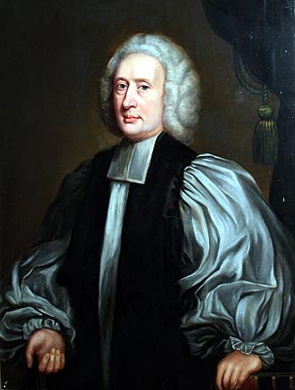
Butler on resentment
Although the administration of justice is based on reason, rather than passion, the passion of resentment is necessary to motivate the actual implementation of justice:
‘Since therefore it is necessary for the very subsistence of the world, that injury, injustice, and cruelty, should be punished; and since compassion, which is so natural to mankind, would render that execution of justice exceedingly difficult and uneasy; indignation against vice and wickedness is, and may be allowed to be, a balance to that weakness of pity, and also to anything else which would prevent the necessary methods of severity.’
This Photo by Unknown Author is licensed under CC BY-SA

Slide 14

Darwall on resentment
‘Resentment [. . .] is felt in response to apparent injustice, as if from the victim’s point of view. We resent what we take to be violations against ourselves or those with whom we identify. If you resent someone’s treading on your foot or, even more, his rejecting your request or demand that he stop doing so, you feel as if he has violated a valid claim or demand and as if some claim-exacting or responsibility-seeking response by you, or on your behalf, is justified. What you feel is not just (or even) that this response would be justified as an effective or desirable means to desirable relief. And although you might think that some such response would make for a more morally fitting whole, that thought is not itself part of resentment. Resentment seems rather to be warranted simply by the other’s conduct and by what you and he can validly, that is, authoritatively, claim and demand of one another. “You can’t do that to me,” you might think, referring, not to your respective power, but to your authority.’ (Stephen Darwall)

Slide 15
Darwall on resentment
So resentment is a ‘second-personal reactive attitude’.
Morality is fundamentally second-personal: moral concepts of obligation, right and wrong, responsibility, etc. arise from the second-personal perspective.
Morality as ‘equal accountability’.
Resentment is the attitude through which we address each other second-personally, with moral demands. A ‘participant’ attitude. Resentment issues an ‘RSVP’; it looks for answerability.
To be feel oneself to be blameworthy = to feel that one would be the appropriate target of another’s resentment.

