Slide 1
The Woman of Samaria
(from ‘The Witnesses’)
He came to me with his eyes and asked for water,
Stretched out his hands and spoke.
His mind burned into mine like the noon sun,
My pitcher of thoughts broke.
I had not noticed him at rest by the well-head
Shadowed by the rare tree;
But as I carried my shame into its coolness
His eyes awaited me.
I tried to avoid them as I drew the well-rope
Taut through a mindless hand.
I saw his robe cross the speckled sunlight,
His feet stir the hot sand.
I saw his face. It was white with road-dust,
Whiter than any stone.
But his eyes were ageless and deep as well-shafts
As they met my own.
They unroofed my brain with their profound gazing,
Made the heart a molten thing:
Every purdahed thought unveiled itself
Under their questioning.
He spoke of water to cleanse the spirit:
I tried not to understand
He followed me along the road of my evasions
And when it ceased in sand
He brought me home from my self-forced journey –
He showed me my own soul
Cracked and dry as a discarded wine-skin,
And made it whole……
He came to me with his eyes and asked for water,
Stretched out his hands and spoke.
As I carried my peace back to the streets of Sychar,
A new world woke. C. Samson

Slide 2
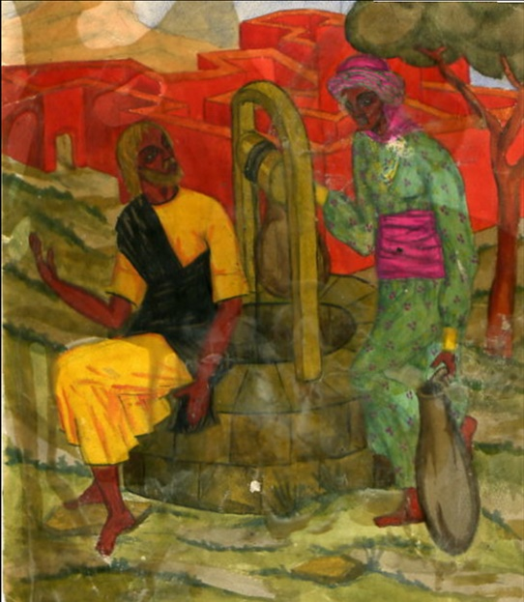
by Mother Mary Skobtsova
1891-1945)

