Slide 1
5. At-one-ment Disputed in Tradition
Sacrifice: a Gift fit for God
Recap: models rejected, the “sacrificial ritual” model
Note: the Fall and Original Sin in the 1st Century/New Testament
Translation issue: “Justification” and “Righteousnessing”
Prepared questions: pairs
Prepared questions: share
Atonement theories: what do we want?
Comparative Evaluation

Slide 2
Recap: traditional models of the atonement
Models
Problems
Ransom Theory a, e
Christus Victor b, e?
Recapitulation c, e
Mixing c or e
Exemplarism d, e
Vicarious Satisfaction e
Penal Substitution a
“Sacrificial Ritual” f
Jesus dies to satisfy norms of justice; redemption violates them anyway
Depends on another model to explain how it works
Doesn’t explain why all humans are affected
Doesn’t explain what makes Jesus unique
Implies “easy universalism”
Requires sin to be manipulable by blood. (Requires robust Real Presence)

Slide 3
The Fall and Original Sin
In explaining the effects of Jesus’ death and resurrection, Paul proposes that human nature, and relationship with God, is ruined by Adam’s sin. This guarantees that all humans need Christ, not just Jews.
In many places where the effects of Jesus’ work are discussed/explained, the Fall is not mentioned: that we are separated from God is taken for granted.
It was obvious to many 1st Century Israelites that the Temple Cult was not making them righteous/bringing them into union with God; that Israel is disobedient to the Law.
Gentiles were obviously in a state of separation from God, but…
In other places Paul diagnoses the causes of separation from God differently. (E.g. at the beginning of Romans it is idolatry which causes gentile separation.)
Rival interpretations of Genesis persist into the early centuries. The Pelagian controversy embeds the historicity of the Fall.

Slide 4
“Justification”
E P Sanders’ Very Short Introduction to Paul (Sanders is a skeptic/critical NT scholar)
The Greek term for just is dike, and from it we get the word translated as “justification”. This word was used to describe acquittal in courts in the Greek-speaking world.
BUT this word is also the word for right, as in “righteous”! In Greek “justice”=“righteousness”
This means that the verb translated as “justification” can also mean being made righteous.
Translators who believe that justification is imputed at the moment of initial repentance and faith prefer “justification”
Translators who believe faith makes people righteous will use both (since it is clearly being used in the legal sense in some places).
My model supposes that Paul’s legal usages are a metaphor for expiation, since there are no legal events involved in Israelite sacrificial practices. It describes the effects of expiation in putting us into a place where we are fit to become holy/righteous through proper cult.

Slide 5
Prepared Questions
Did the lecture (or footnotes in the script, if you were curious) raise any initial questions for you?
Perhaps you have long appealed to a traditional theory of the atonement to understand or explain how Christ saves you.
Do you think it was mischaracterised?
Are there replies to Hugh’s objections that should be aired?
Does it have advantages over the sacrificial model?
Do you have in mind any Biblical material you think other theories of the atonement are needed to explain/account for?
What impact, if any, do you think a particular understanding of the atonement might have on someone’s spiritual life? Apart from the question of losing one’s faith because one can’t believe what one doesn’t understand at all, how important is it to understand how Jesus saves?
Hugh emphasises that a theory of the atonement needs to explain the need for repentance and faith, and the role of the sacraments. Does a theory of the atonement need to explain the possibility of salvation through “extraordinary grace” (i.e. not having explicit faith in Christ; not participating in the sacraments)? How do different models fare there?
Do you have any questions left over?

Slide 6
Atonement Theories: what do we want?
Essential
Desirable
Must explain why Jesus had to die
Avoids circularity (type>antitype)
Must explain how all humans are affected (at least in potential)
Must explain why humans must respond in some way, to be saved
Must enable eternal glory
Must enable humans to become righteous and/or holy
Must enable humans to be reconciled to God.
Must make some use of Biblical language.
(If it treats this language as metaphorical/symbolic, it must say what objective process is being described. That process must meet conditions 1-8)
Explains why Jesus was crucified Explains the Passion
Jesus connects these events to the Last Supper – why?
Makes the Resurrection effective rather than merely evidential
Explains why the Christ must do this
Explains what the Sacraments (and prayer) have to do with salvation/righteousnessing/reconciliation
Must explicitly undo the effects of the Fall

Slide 7
Comparative Evaluation
Mechanics
Task
I can’t share documents “live”; I have to give a link to Federica for her to upload them. I’m sorry about the frustration this has caused!
So, I couldn’t just give you the resource for the following “group investigation task” beforehand, so you could keep it on your screens in breakout rooms.
On the next slide are screencap commands, in case I can’t just paste into the Messages!
The “resource” is a long list of things we want from a theory of atonement.
Your task is to decide which theory does best – you could even rank them.
You can dispute any of them, and add to the list!
You can also add details to the theories in addition to whatever you’ve heard or read sketched – but these could ‘cost’ the theory coherence or fidelity to Scripture.

Slide 8
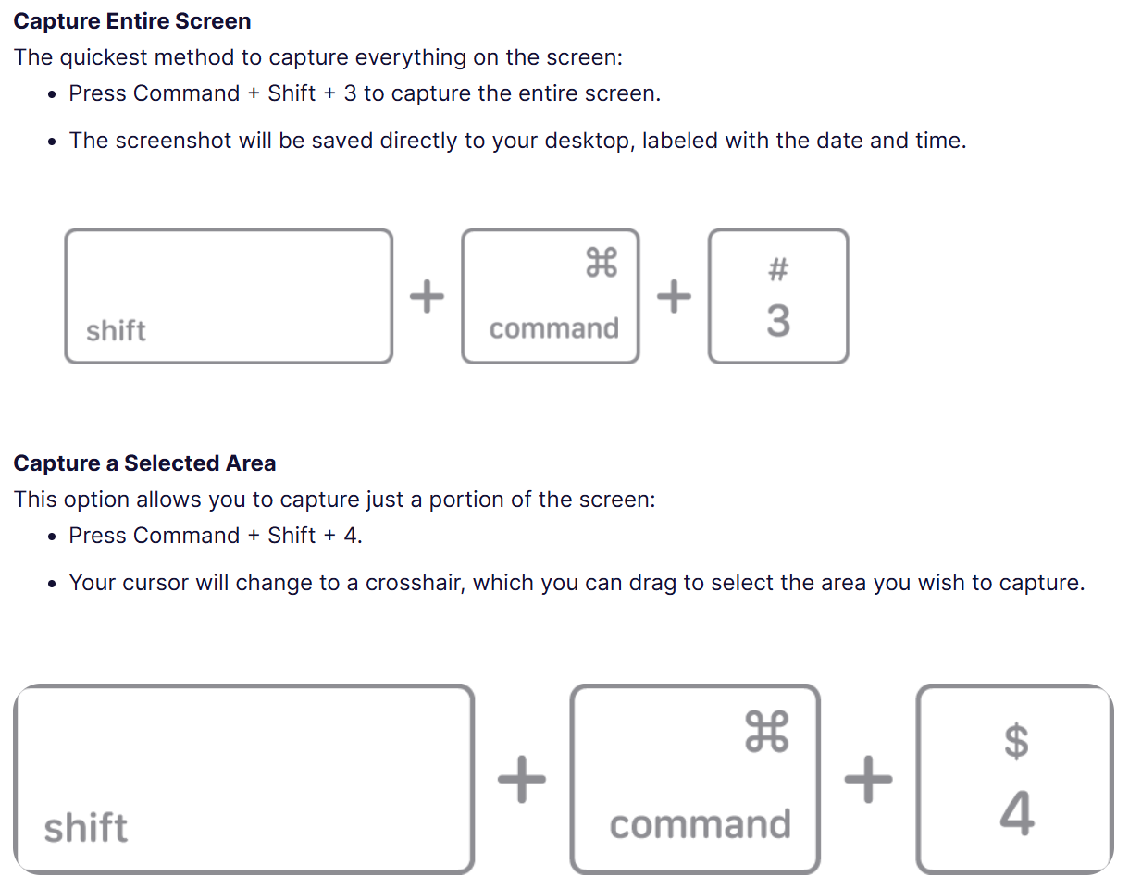

Slide 9


Slide 10
Atonement Theories: what do we want?
Essential
Desirable
Must explain why Jesus had to die
Avoids explanatory circles (e.g. type::antitype)
Must explain how all humans are affected (at least in potential)
Must explain why humans must respond in some way, to be saved
Must enable eternal glory
Must enable humans to become righteous and/or holy
Must enable humans to be reconciled to God.
Must make some use of Biblical language.
(If it treats this language as metaphorical/symbolic, it must say what objective process is being described. That process must meet conditions 1-7)
Explains why Jesus was crucified
Explains the Passion
Jesus connects these events to the Last Supper – why?
Makes the Resurrection effective rather than merely evidential
Explains why the Christ must do this
Explains what the Sacraments (and prayer) have to do with salvation/righteousnessing/reconciliation
Must explicitly undo the effects of the Fall
Any theory can satisfy all of these if you just add more and more assertions about what is needed/happens. A theory does better if those explanations follow from the “model” at work.

Slide 11
How the “Blood Sacrifice Model” meets the desiderata
Necessary
Desirable
Must explain why Jesus had to die...by Crucifixion, after the Passion Offerings must be destroyed. Jesus must beat sin into death.
Avoids circularity (type>antitype) Old explains New, New fulfils Old.
Must explain how all humans are affected (at least in potential) Heaven expiated; New Covenant is globally feasible
Must explain why humans must respond in some way, to be saved You have to eat the flesh and drink the blood. Covenants and expiations require loyalty and contrition.
Must enable eternal glory Divine life is in the flesh and blood. Heaven is accessible for (eternal) worship
Must enable humans to become righteous and/or holy Divine life is in the flesh and blood. Sincere ritual actions form habits and change attitudes
Must enable humans to be reconciled to God. Offerings effect penance and express contrition
Must make some use of Biblical language. Less ‘symbolic’ than competing theories
Explains why Jesus was crucified The Crucifixion teaches it’s a Passover.
Explains the Passion Allows Jesus to give up His life totally in spite of not being burnt whole.
Jesus connects these events to the Last Supper – why? New Passover ritual lasts from foot-washing to moment of death.
Makes the Resurrection effective rather than merely evidential Resurrection is needed to be an eternal High Priest
Explains why the Christ must do this Davidic lineage is needed to be in the Order of Melchizedek and re/design His own rituals legally.
Explains what the Sacraments (and prayer) have to do with salvation/righteousnessing/reconciliation You have to eat the flesh and drink the blood. You have to be purified before you engage in a zebah of any kind (baptism). Reciprocity is established, which brings about unity, and conversation is a natural part of this.
Must explicitly undo the effects of the Fall A weak point of the theory! The Heavenly Temple doesn’t need Adam’s sin to be in the state it is in by 1st Century.

