Slide 1

What is Spiritual Conversation?
God
Speaker
Listener

Slide 2



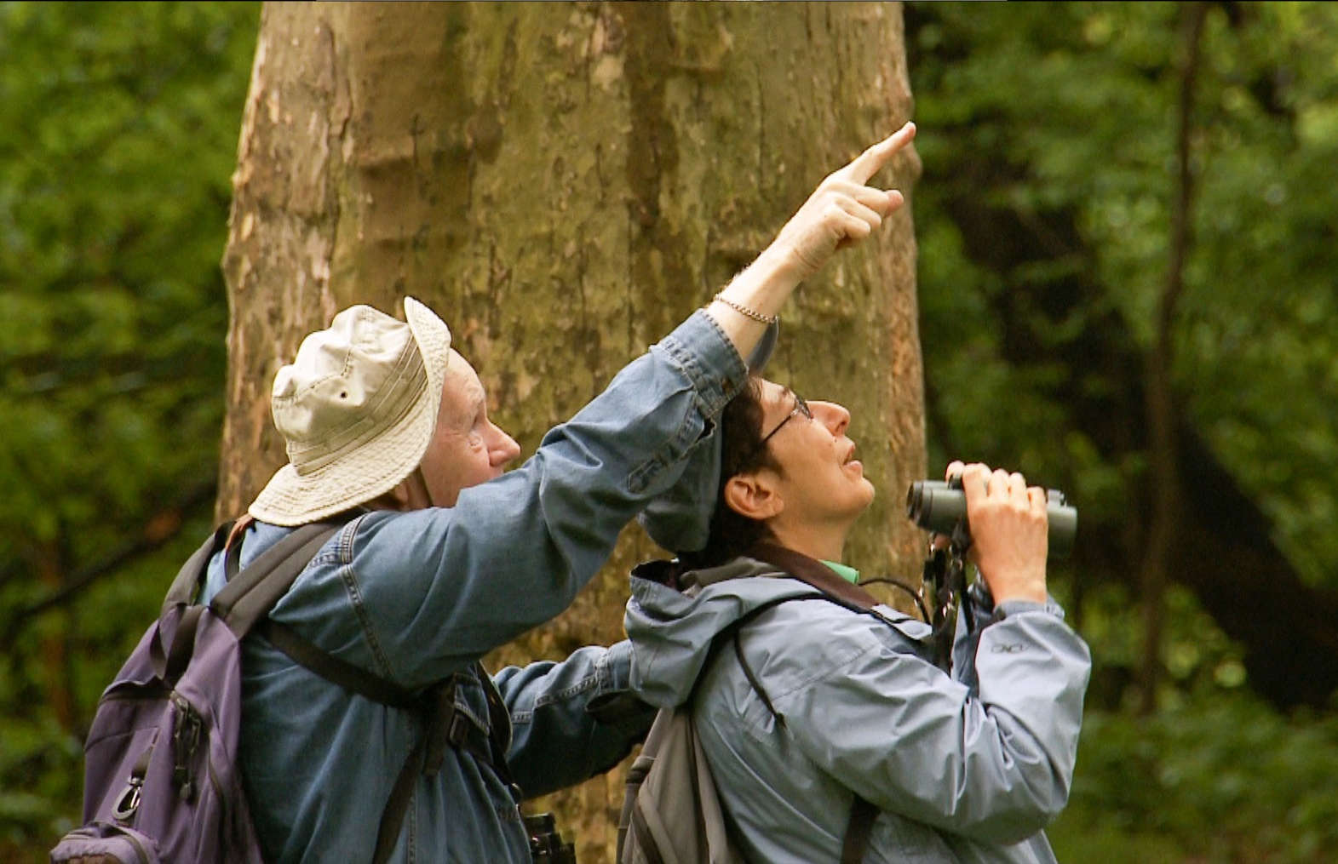
WHAT MIGHT YOUR IMAGE BE?
Notes:
Is there an image that might help you to consider what’s going in such conversations? What might your image be?
the bottom right…this is Gaping Gill in the Yorkshire Dales…if you walk past the entrance on the way up Ingleborough, you would have no idea what lies below your feet…similarly you might suddenly find your self in a conversation that has dropped a level, and then become deeper and more expansive.
Or maybe the conversation is like untangling threads of wool, or finding direction with a compass, or sharing something fascinating or beautiful in the trees….
Ponder for moment…you might share your image later ….
So if the goal of SC is to bring people closer to God, and to do that we need to be in real conversational relationships with those people, then what does Ignatius suggest we might need to do to help these converesations to come about and develop?

Slide 3
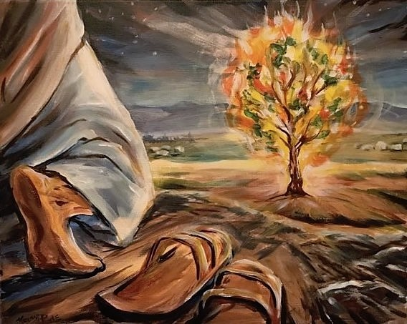
Notes:
It begins with relationship and our own individual relationship with God.
Through the Bible, we see God seeking relationship with men and women. As Moses turned aside to behold a burning bush, God spoke to him about the mission he was giving Moses. It was a remarkable conversation, full of the presence and signs of God’s power, but it was a very honest one as well.

Slide 4
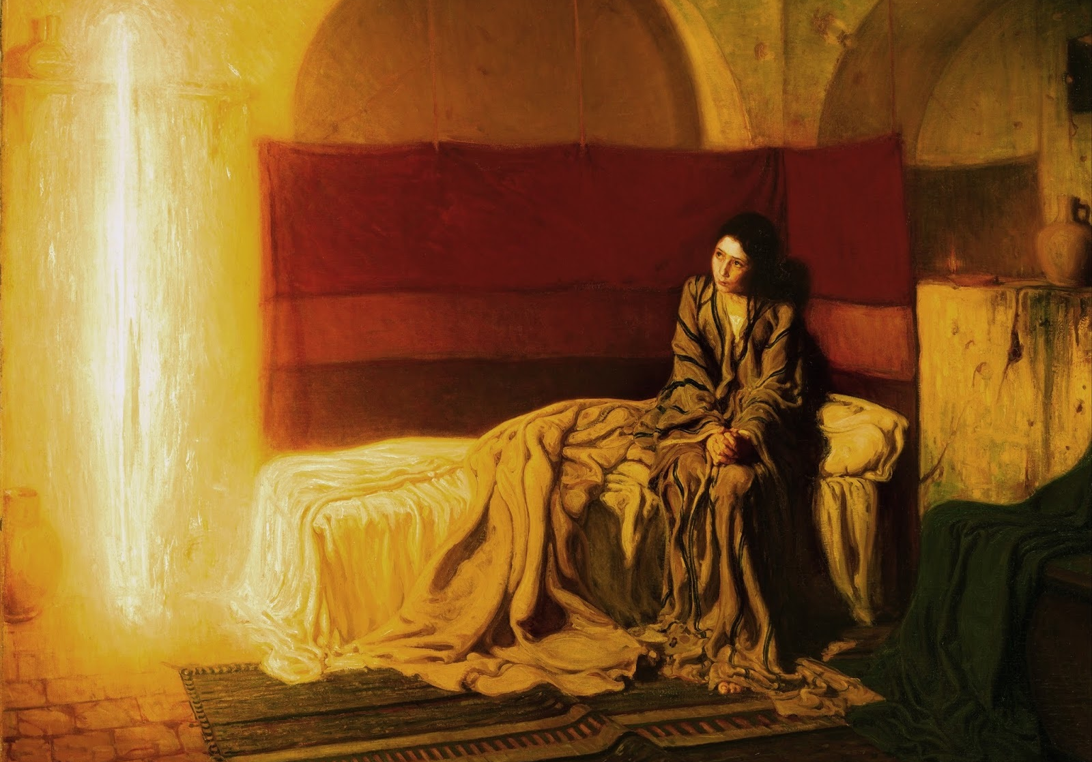
Notes:
This is an image of the annunciation when the angel announces to Mary the extraordinary call she had been given to give birth to Jesus and it’s also a very honest conversation. How is this going to happen?

Slide 5
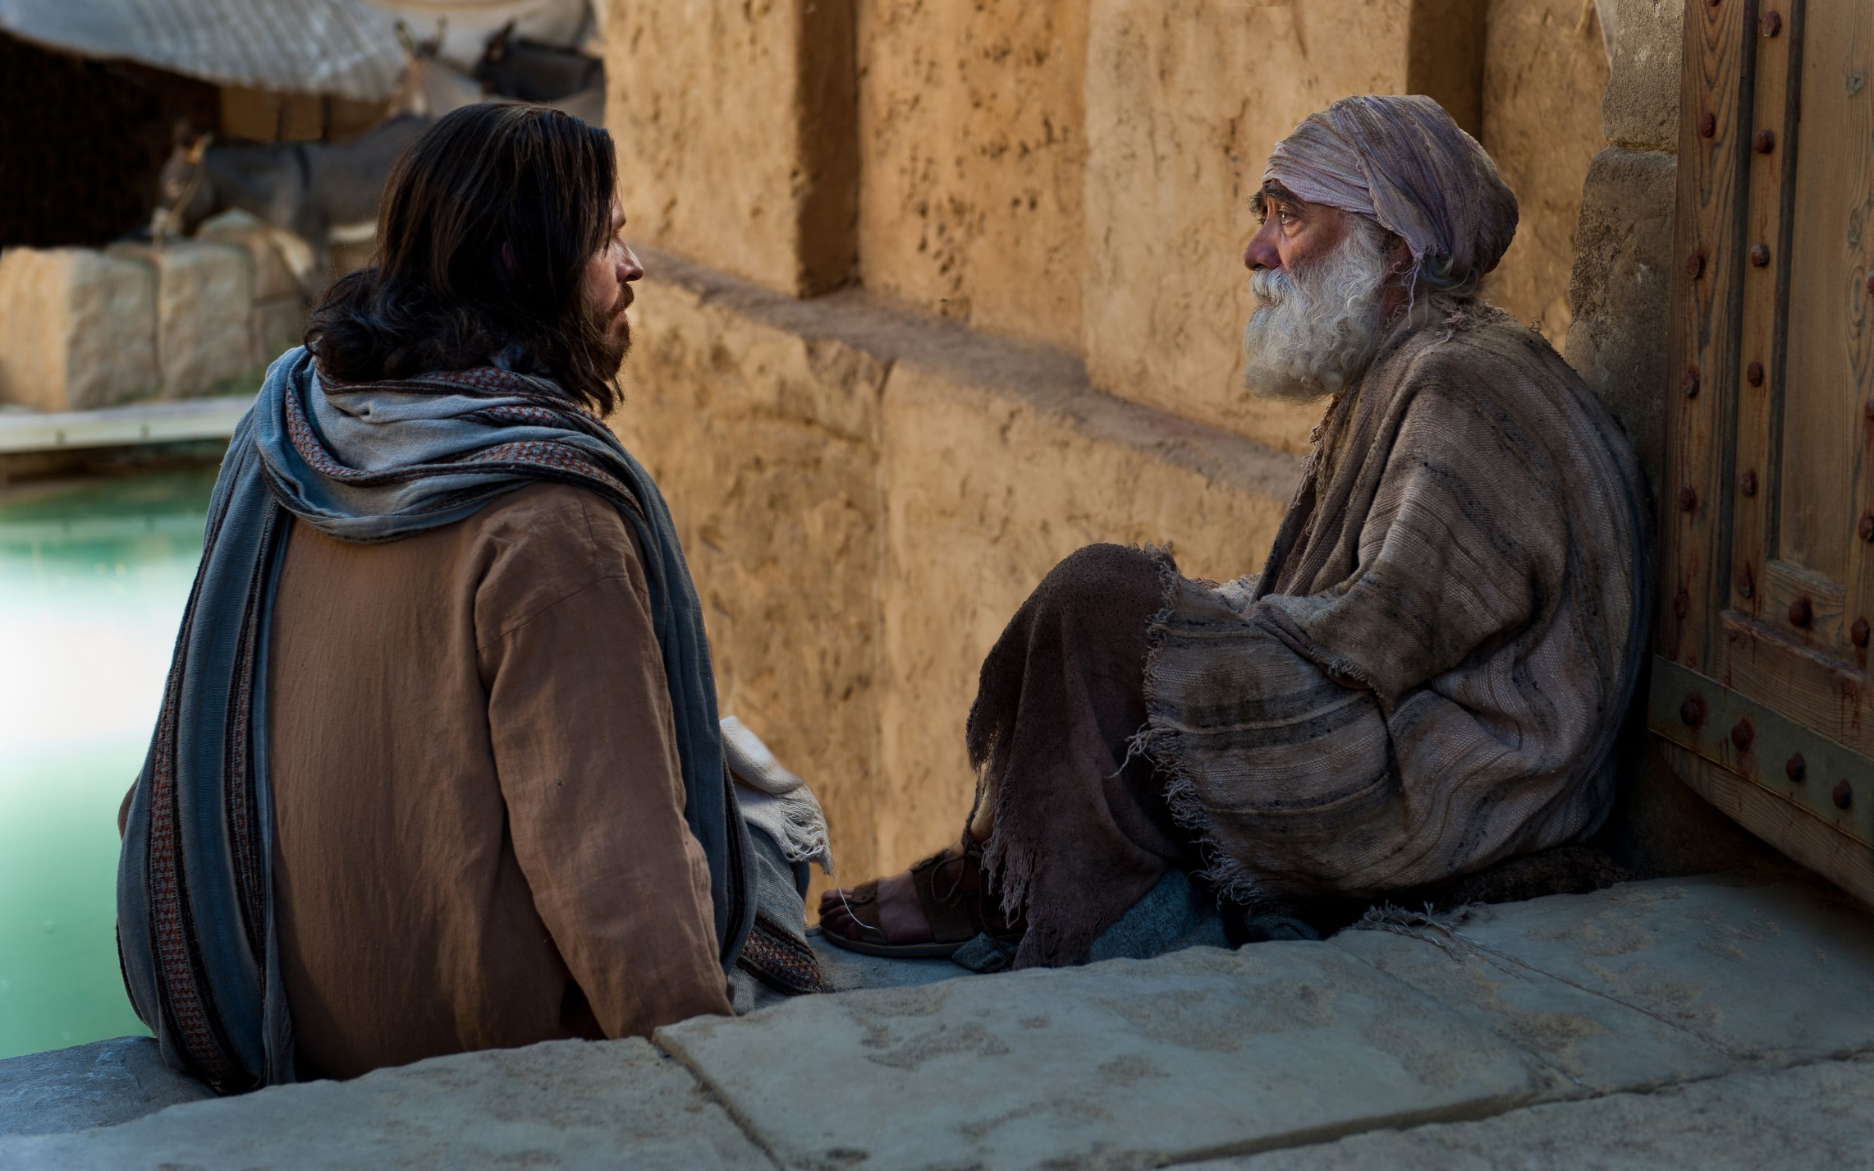
Notes:
And God became human, came in the flesh in Jesus to enter into conversation with us face to face…
Throughout the gospels we see Jesus in conversation with his disciples and those he encountered every day – men and women, lepers, beggars, the woman at the well, Nicodemus a Pharisee, Pilate and Herod in the final hours of his life. These were all spiritual conversations and often it was a question from Jesus that opened the conversation up…
What are you looking for? What do you want me to do for you? Why are you weeping? The conversations often went in surprising ways and deeply impacted those who encountered Jesus.

Slide 6
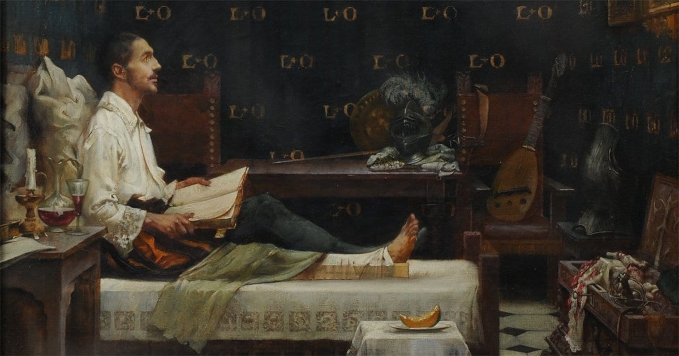
Notes:
And then we come to Ignatius….
Ignatian spirituality is founded by St Ignatius of Loyola. Ignatius was a 16th Century Spanish nobleman, who was leading a life that was very far from God, but whose life was brought to a pause by a cannonball in his leg when defending Pamplona against the French and he was taken back to his family home in Loyola to convalesce…
So, a cannonball moment, leading to an enforced pause, and a retreat from his usual daily life. And in that pause, he starts to listen, and to notice.
(I wonder what enforced pauses you may have had in your own life, and what insights they may have led to?)
Lying on his sick bed, Ignatius asks for reading material and he is given a life of Christ and lives of the saints; and courtly romances of brave knights and beautiful ladies.
He begins to observe what happens in his inner being as he reads these two types of material.
He enjoys them both and they elicit desires in him to be a noble knight achieving great things, or to emulate Christ and the saints in a life of holiness and service to others.
And he notices that the pleasure he feels in response to the courtly romances is fleeting, , whereas the attraction he feels to the life of Christ and the saints feels more substantial and enduring, more real.
And so the beginnings of the Ignatian understanding of discernment come into focus. And this was the beginning of his conversion and his eventual founding of a religious order, the Jesuits.

Slide 7
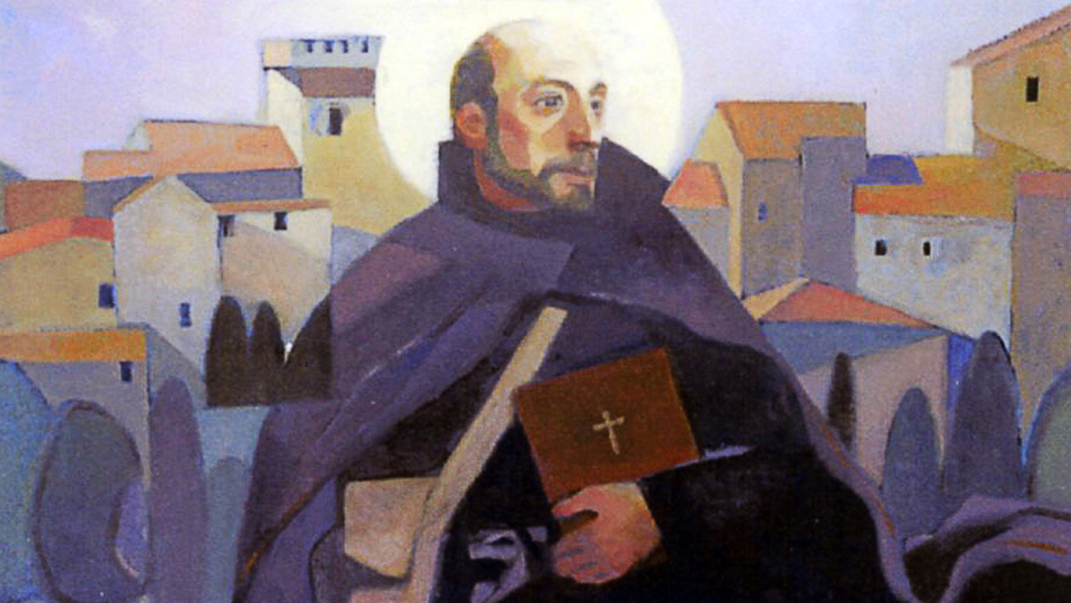
Notes:
Ignatius of Loyola was the master of accompanying people in all sorts of environments.
He was always on the look out for chance conversations which might drop a level and go to a deeper place and he brought Christ to others in a very natural and humble way.
Conversations that had the potential of exploring the spiritual were for Ignatius his primary method to ‘help souls’, or to bring people to the love of God.
Conversations are a key part of the Spiritual Exercises of Ignatius. It is are full of conversations or ‘colloquies’…the retreatant talks with God, with Jesus, with Mary…and then explores these in conversation with their director.
And .Spiritual Conversation was a primary apostolic tool for Ignatius, both in his own life and ministry.
Early on in his ministry, he was studying, and going around ‘preaching’, which he didn’t actually have the authority to do.
He wasn’t learned, nor a priest at this point so the religious authorities of his day were not impressed.
The Dominicans questioned him on what exactly he preached.

Slide 8
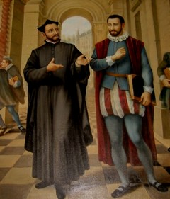
‘We do not preach but we speak familiarly of spiritual things with some people as one does after dinner, with those who invite us.’

Slide 9

Slow to speak
Listen attentively
Be generous in time-giving and interest
Seek the truth in what others are saying
Disagree humbly, respectfully, and thoughtfully
Don’t be too attached to my own opinion or taking sides
Be on the lookout for signs of God, or opportunities for God’s grace to enter

Slide 10
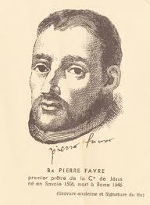
For each person he met, he was a saviour of something deep within that was being lost. He was not eloquent or brilliant; rather he bore, humbly, people’s burdens. To each individual soul he was redemptively attentive. And through this attentive submission to the reality of other people, combined with a passion for their restoration, Favre obtained the charism of spiritual direction, a charism which enabled him to discern and uncover in all whom he met the point at which salvation was coming to them from God.
From Pierre Favre and the Experience of Salvation by Michel de Certeau, The Way, 45/4 (October 2006), 21-40. p31.

Slide 11
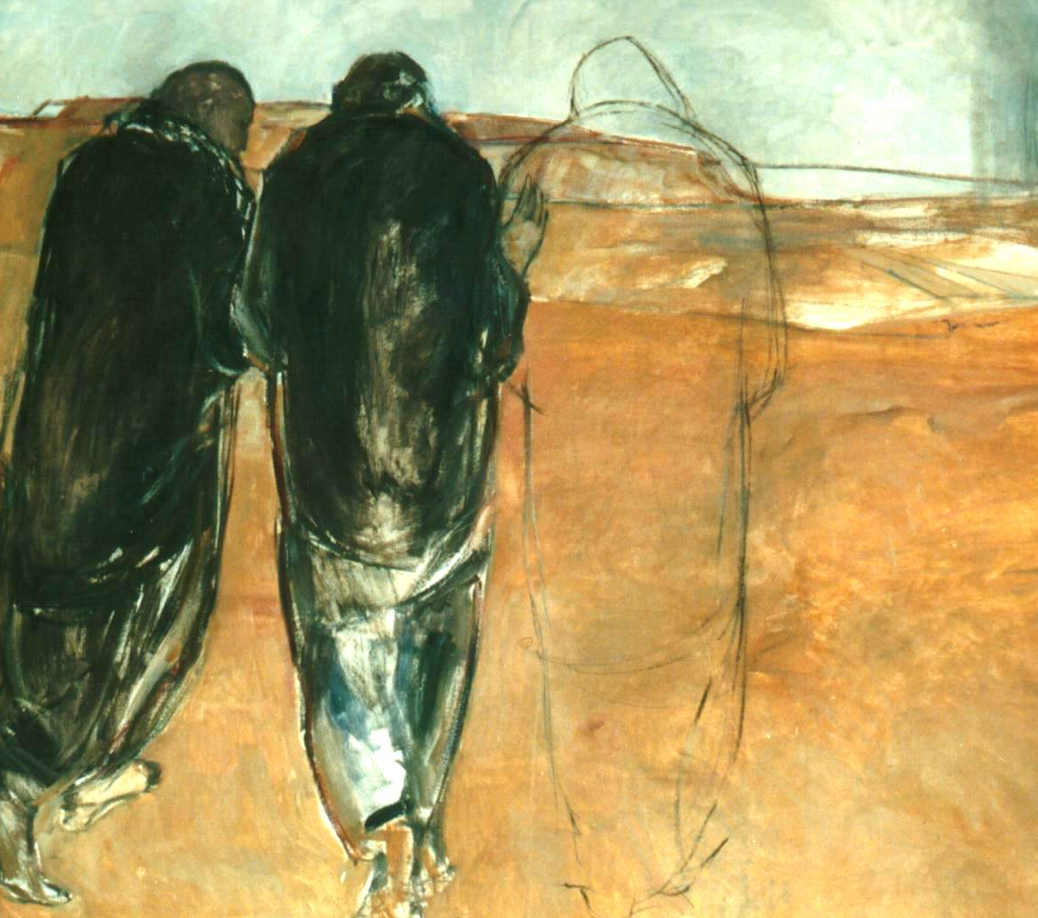
‘On the road to Emmaus Jesus doesn’t tell the two travellers where to start, he invites them to share where they are. And he gradually leads them to become aware that they already possess more than they realise.
And so, their hearts begin to burn within them even before they grasp
that the Risen Lord is the third person in the conversation. Emmaus is the gold standard of Spiritual Conversation.’
Philip Endean SJ

Slide 12


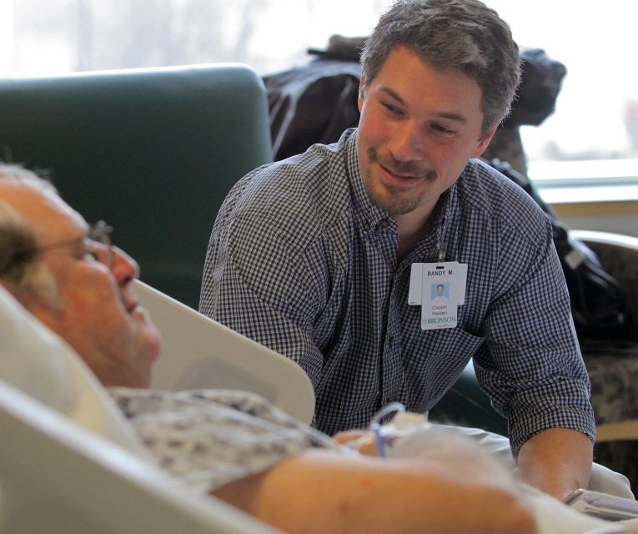
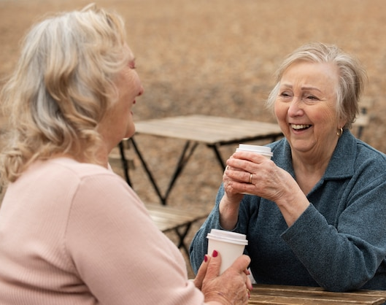
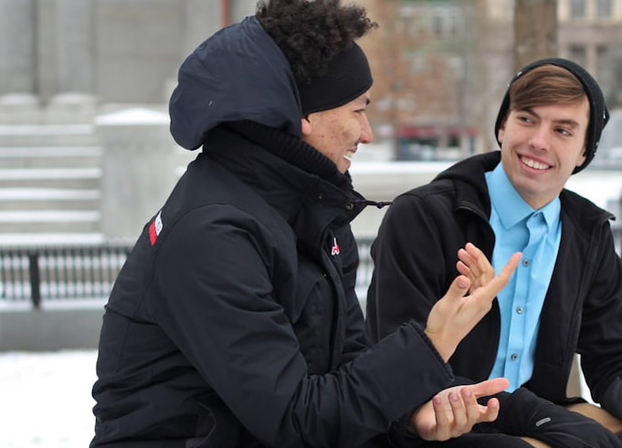
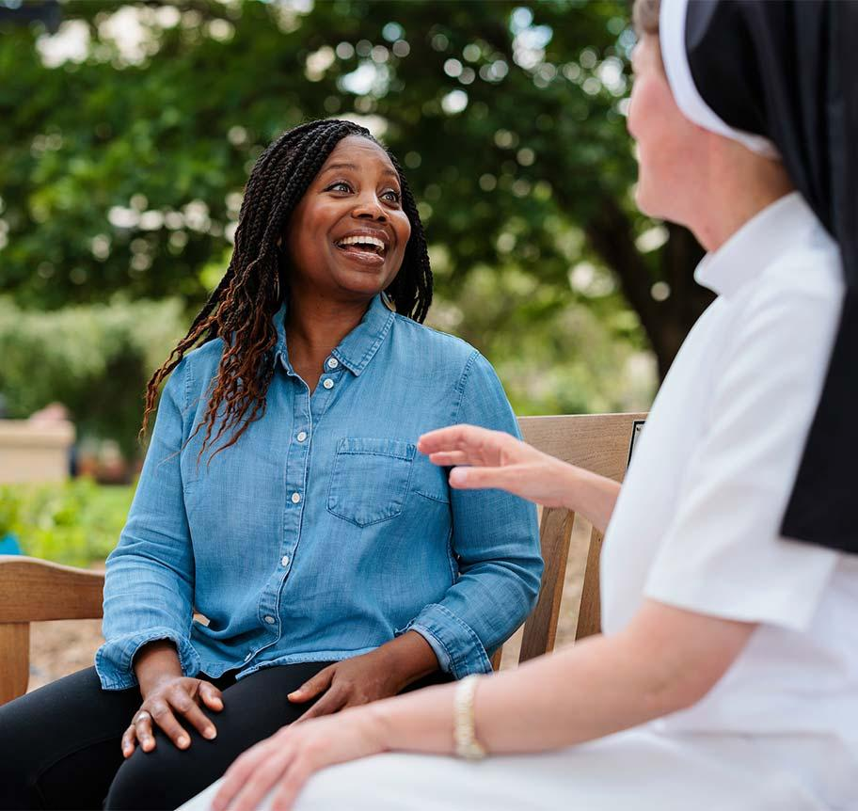
Different Contexts

Slide 13

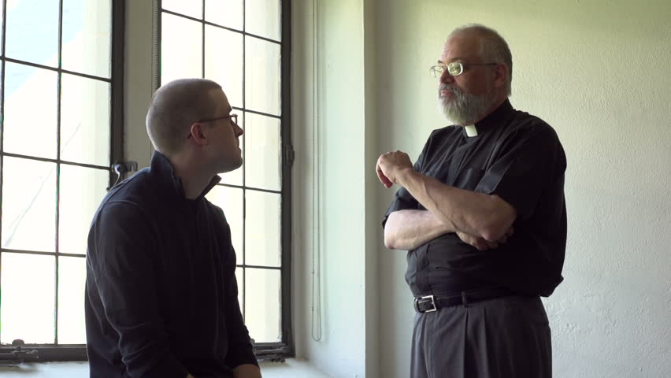

mutual spiritual conversation
a spiritual conversation of a pastoral nature
formal spiritual accompaniment

Slide 14
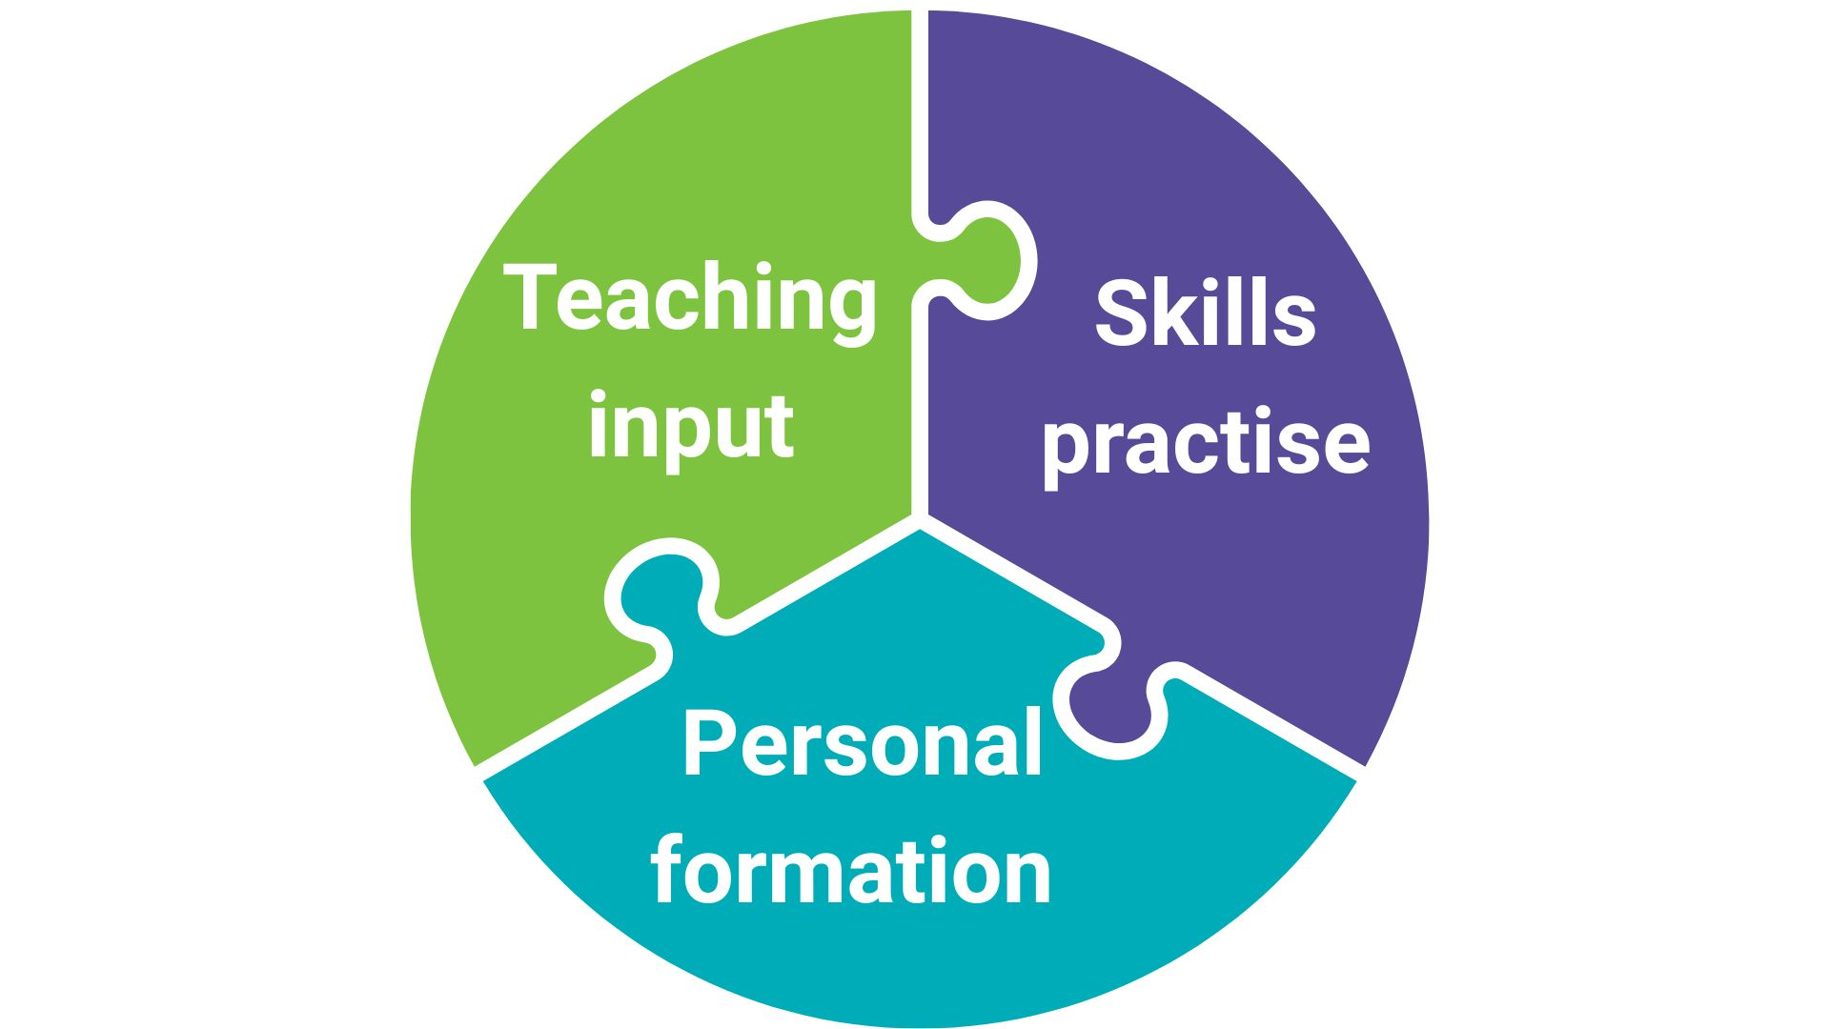
Notes:
This course will weave in TWO MAIN THREADS:
a concrete skills thread, with inputs on listening skills, Ignatian discernment, a model of acc., and practical sessions to try these things out with peers and team and hear their observations.
And a personal/spiritual growth thread: the CORE STORY – focusing on who you are, who God is for you, your sense of how God acts, and what that might be saying about who you are being called to be as an accompanier.
The inputs and skills practice will happen in these large group sessions timetabled (small group work will happen then too).
The second thread of growth will be in your own time in between our modules (Core Story and some short articles).
There are also the contemplative prayer times every day on the course that give space for God to be at work in us, both team and participants and can very much contribute to our personal formation and experience on the course.

Slide 15
First Module
Introductions to course tools
Active Listening Skills
The ‘triad’ listening practice
Practice & reflection before Module 2
Notes:
Module 1 will introduce you to some learning tools and to active listening skills and you will see these skills demonstrated by the team in what we call “fishbowl” examples of spiritual accompaniment. There will be a chance for you tomorrow to informally practice these skills and then on Saturday you will have your first observed triads, where you will take turns to be speaker, listener and observer. There will be more of these to come in modules 2 and 3.
You will be assigned a tutor for the course and meet with your tutor each module and this will take place for the first time on Saturday.
We will also invite you to do some practices and reflection before module 2 so that the learning and reflecting continues in between the modules.
Keep looking at the online course guide as we will be adding to it as we go through each module of the course.

Slide 16
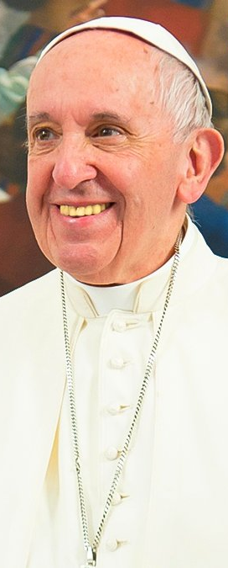
‘Listening is never easy. Many times it is easier to play deaf. Listening means paying attention, wanting to understand, to value, to respect and to ponder what the other person says. It involves a sort of martyrdom or self-sacrifice, as we try to imitate Moses before the burning bush: we have to remove our sandals when standing on the ‘holy ground’ of our encounter with the one who speaks to me.
Knowing how to listen is an immense grace, it is a gift which we need to ask for and then make every effort to practice.’
Pope Francis - 50th World Communication Day 2016

