Slide 1

Practice & Reflection
Spiritual Conversation

Slide 2
Before we next meet
Core Story 2 – Images of God
Reading: James Martin SJ, ‘Finding God in All Things’ (2010)
The Examen prayer
Spiritual Conversation practice & reflection

Slide 3
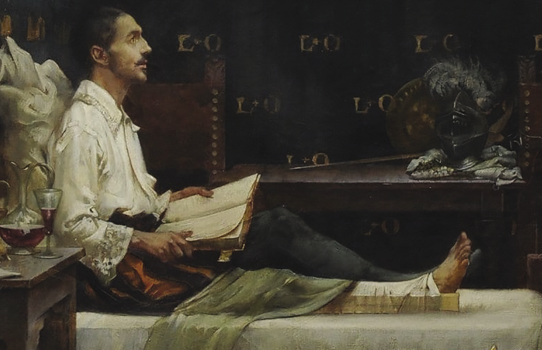
The Examen Prayer
Notes:
The Examen prayer found me some years ago as I walked my dog on a Friday. I thought I had made it up but it’s a keystone of Ignatian spirituality
In the Examen you pray with your own life and gradually notice where God is at work in your life
(We might be more used to the idea of hearing God in Scripture or in Creation and not think of our own life as somewhere where we can also hear God). Out of Ignatius’ daydreams in his convalescence, he realised that the ones about following Christ were a nudge from God and that the more wordly ones were a distraction from this and out of these reflections he developed the Examen or Daily Review as a spiritual exercise to help us become more aware of God’s presence in our lives, to be mindful of those things in our life that bring us life and lead us closer to God and also of the things that have the opposite effect.

Slide 4

Noticing the God moments
Notes:
The Examen/Review of the Day is an invitation to see the “God moments” in our day/week, to notice those life-giving times of joy, gift, love and to remember and relish/relive them.
As we reflect back on our day/week in the Examen, we get a feel for the things of God, the things that bring us life, just as Ignatius did in his day-dreaming and we relish where notice God at work. Our heart is lifted. And in that loving relationship, we can also process the times that were less good and where we were further from God.

Slide 5
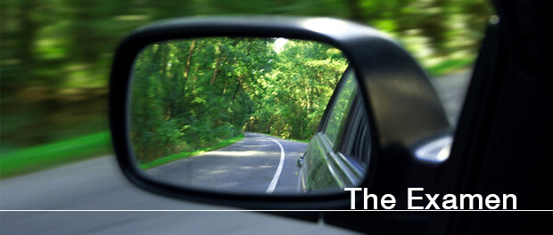
Notes:
The Examen is a rearview mirror on our day/week/year
It’s great for daily prayer but can also be used to reflect back on the last week, month, season, year. It can be prayed at any time of day, not just at night. I pray it in the morning looking back at the previous day. It’s worth experimenting to find the right time for you.
Kierkegaard: “We live life moving forward, but only ever understand it looking backward.
One Jesuit described the Examen as “rummaging for God” amidst everything our lives contain.

Slide 6
The Examen Prayer
Gratitude
Asking for the guidance of the Holy Spirit
Looking back over my daily experience
Asking for forgiveness & healing
Asking God’s help for the future
Notes:
1] St Ignatius believed that gratitude makes us aware of God’s love for us and the Examen begins with a sense of gratitude, rummaging for the gifts that the last 24 hours contains, small and large, and treasuring them. Sometimes we just stay with gratitude for the whole examen.
2] Gratitude and asking for the guidance of the Spirit allow the Examen to be more than self-reflection and instead it becomes prayerful Spirit-led reflection.
3] I replay the day like a movie and look for the God moments
4] I respond to the day, sometimes with more gratitude for something wonderful, sometimes in contrition for something, or for help/healing where I need it. I allow God’s healing love to flow through me and give me peace.
5] The Examen looks forward as well as back and I can ask for grace with something that I know will be a challenge tomorrow.
An Examen made simple is essentially “thank you, sorry, please” and if even this sounds a bit much, simply ask God what God wants to show you today…

Slide 7
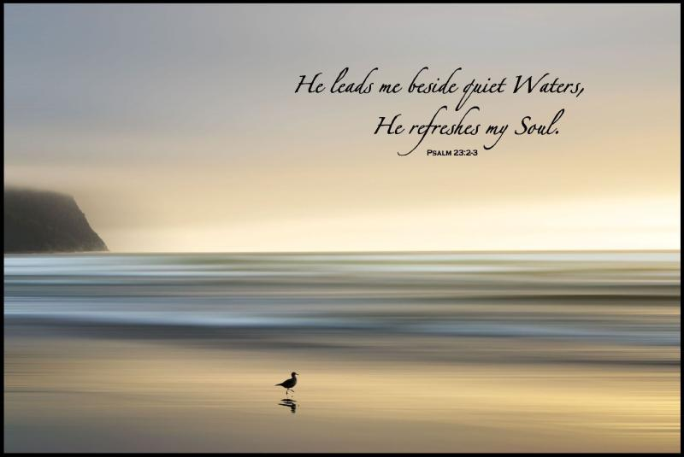
Fruits of the Examen
Notes:
There is always something to pray about! Until you die, you will always have a past 24 hours and feelings about it.
Living life gratefully
Praying from our feelings we are liberated from them, so that we’re not dominated by unattended emotions. We can experience inner healing as we bring our feelings and emotions to God.
As we pray the examen, something will often be revealed, a new insight, that we may have forgotten or overlooked or been blind to earlier…
We learn to face the Lord where we are, as we are and grow in confident that he’s with us at all times.
The Examen is a daily tool of discernment and over time we notice what we are finding consistently life-giving and how the Lord is leading us. That’s why we recommending that you pray with it during this course as you reflect on how God might be leading you at this time.

Slide 8
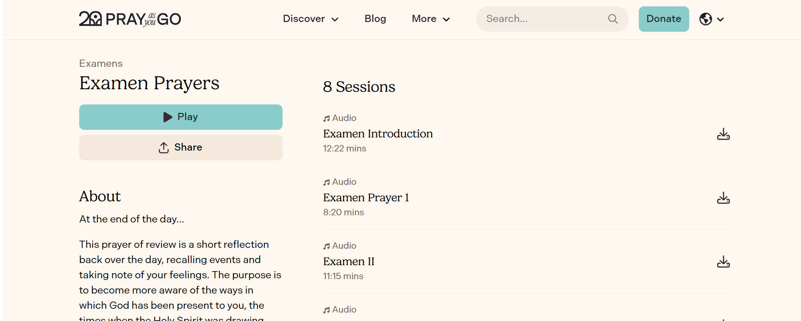
Examen Resources
Notes:
Pray as you Go
- Discover – range of audio examens and an examen of the week every Saturday

Slide 9
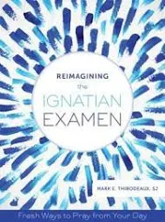
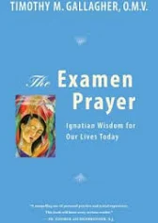
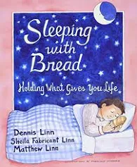
Examen resources
Notes:
Reimagining the Ignatian Examen – Mark Thibbodeaux – also app – 30 themed examens on relationships, emotions, habits, surprises, emotions, spiritual shifts.
The Examen Prayer – in-depth intro to the Examen by Timothy Gallagher
Sleeping with Bread, holding what gives you life – lovely book including how to use the examen in families.

Slide 10
Spiritual Conversation practice before Module 2
Seek opportunities for spiritual conversations, including informal ones, before module 2 and choose 3 to reflect on…
Choose one of these conversations and write a reflection on your experience as a listener and on your use of active listening skills using the reflection form on the course guide
Email it to Clare on cbick@jesuit.org.uk by Friday June 5th

Slide 11
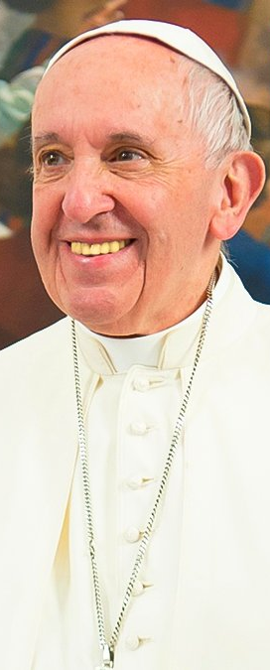
‘Listening is never easy. Many times it is easier to play deaf. Listening means paying attention, wanting to understand, to value, to respect and to ponder what the other person says. It involves a sort of martyrdom or self-sacrifice, as we try to imitate Moses before the burning bush: we have to remove our sandals when standing on the ‘holy ground’ of our encounter with the one who speaks to me.
Knowing how to listen is an immense grace, it is a gift which we need to ask for and then make every effort to practice.’
Pope Francis - 50th World Communication Day 2016
Notes:
“Listening is never easy. Many times it is easier to play deaf. Listening means paying attention…” etc – Listening is costly
“Knowing how to listen is an immense grace, it is a gift which we need to ask for and then make every effort to practice” – and this course is structured to help you do that.
We are invited to stand on the “holy ground” of our encounter with the one who speaks to me – watch for these moments of holy ground in our sessions together – next slide…

Slide 12
