Slide 1
Beyond Good and Evil and the critique of morality
Philosophy Through the Year: Nietzsche
Stuart Jesson, London Jesuit Centre

Slide 2
Morality, responsibility and error in Human, all too human

Slide 3
Morality, responsibility and error
Nietzsche’s account of the origins of moral sentiments that is famously put forward in his book The Genealogy of Morals began much earlier.
E.g. in Human, All too Human:
‘The principal stages in the history of the sensations by virtue of which we make anyone accountable for his actions, that is to say, of the moral sensations, are as follows. First of all, one calls individual actions good or bad quite irrespective of their motives but solely on account of their useful or harmful consequences. Soon, however, one forgets the origin of these designations and believes that the quality 'good' and 'evil' is inherent in the actions themselves, irrespective of their consequences: thus committing the same error as that by which language designates the stone itself as hard, the tree itself as green - that is to say, by taking for cause that which is effect.’

Slide 4
Morality, responsibility and error
(cont’d)
‘Then one consigns the being good or being evil to the motives and regards the deeds in themselves as morally ambiguous. One goes further and accords the predicate good or evil no longer to the individual motive but to the whole nature of a man out of whom the motive grows as the plant does from the soil. Thus one successively makes men accountable for the effects they produce, then for their actions, then for their motives, and finally for their nature.’

Slide 5
Morality, responsibility and error
(cont’d)
‘Now one finally discovers that this nature , too, cannot be accountable, insasmuch as it is altogether a necessary consequence and assembled from the elements and influence of things past and present: that is to say, that man can be made accountable for nothing, not for his nature, nor for his motives, nor for his actions, nor for the effects he produces. One has thereby attained to the knowledge that the history of the moral sensations is the history of an error, the error of accountability, which rests on the error of freedom of will.’ (HH: 39/NR p. 173))

Slide 6
Morality, responsibility and error
So Nietzsche envisages the moral philosophy of someone like Kant emerging at the end of a long series of errors:
Good/bad = effect on me (consequences)
Good/bad = action in itself
Good/bad = motive behind action
Good/bad = character behind motive
And the end result is a philosophy based on blame: we have made humans responsible for being what they are. But if our ‘nature’ is a consequence of external factors, then we cannot be responsible at all…
Hence the history of moral feelings is the history of an error!

Slide 7


Slide 8
Morality, responsibility and error
In his ‘middle period’ (Human, All too Human, Daybreak, The Gay Science) Nietzsche often invokes the contrast between a scientific view of life, and a moral view of life, e.g.:
‘At the waterfall. When we see a waterfall, we see freedom of will and choice in the innumerable turnings, windings, breakings of the waves; but everything is necessary; each movement can be calculated mathematically. Thus it is with human actions; if one were omniscient, one would be able to calculate each individual action in advance, each step in the progress of knowledge, each error, each act of malice.’

Slide 9
Morality, responsibility and error
(cont’d)
‘To be sure, the acting man is caught in his illusion of volition; if the wheel of the world were to stand still for a moment, and an omniscient, calculating mind were there to take advantage of this interruption, he would be able to tell into the farthest future of each being and describe every rut that wheel will roll upon. The acting man’s delusion about himself, his assumption that free will exists, is also part of the calculable mechanism.’ (HH: 106/NR p. 177)

Slide 10
Morality, responsibility and error
So Nietzsche pushes Kant’s insights about free will to their logical conclusion:
Kant:
  free will cannot exist in nature;
  we must be free to be morally responsible;
  therefore freedom is not found in nature but in some ‘noumenal’ realm (free will is a ‘postulate’ of practical reason)
Nietzsche:
  free will cannot exist in nature;
  there is nothing outside nature;
  so there is no free will

Slide 11
Nietzsche’s critique of morality
In contrast, Nietzsche aims to uncover the way in which:
Free will is an illusion;
  means that we cannot be responsible in the way that morality supposes
Our actions are determined by forces that are not fully known to us (‘drives’);
  so we cannot judge actions based on motives…
  or choose to radically change our behaviour, in response to moral injunctions
Different humans have different natures;
  hence what causes one to flourish could weaken or destroy another;
  the ‘universal’ moral commands are really actions that are in the best interests of ‘the herd’; these could well be bad for some individuals
  so ‘morality’ sacrifices the ‘higher types’ for the sake of ‘the herd’

Slide 12
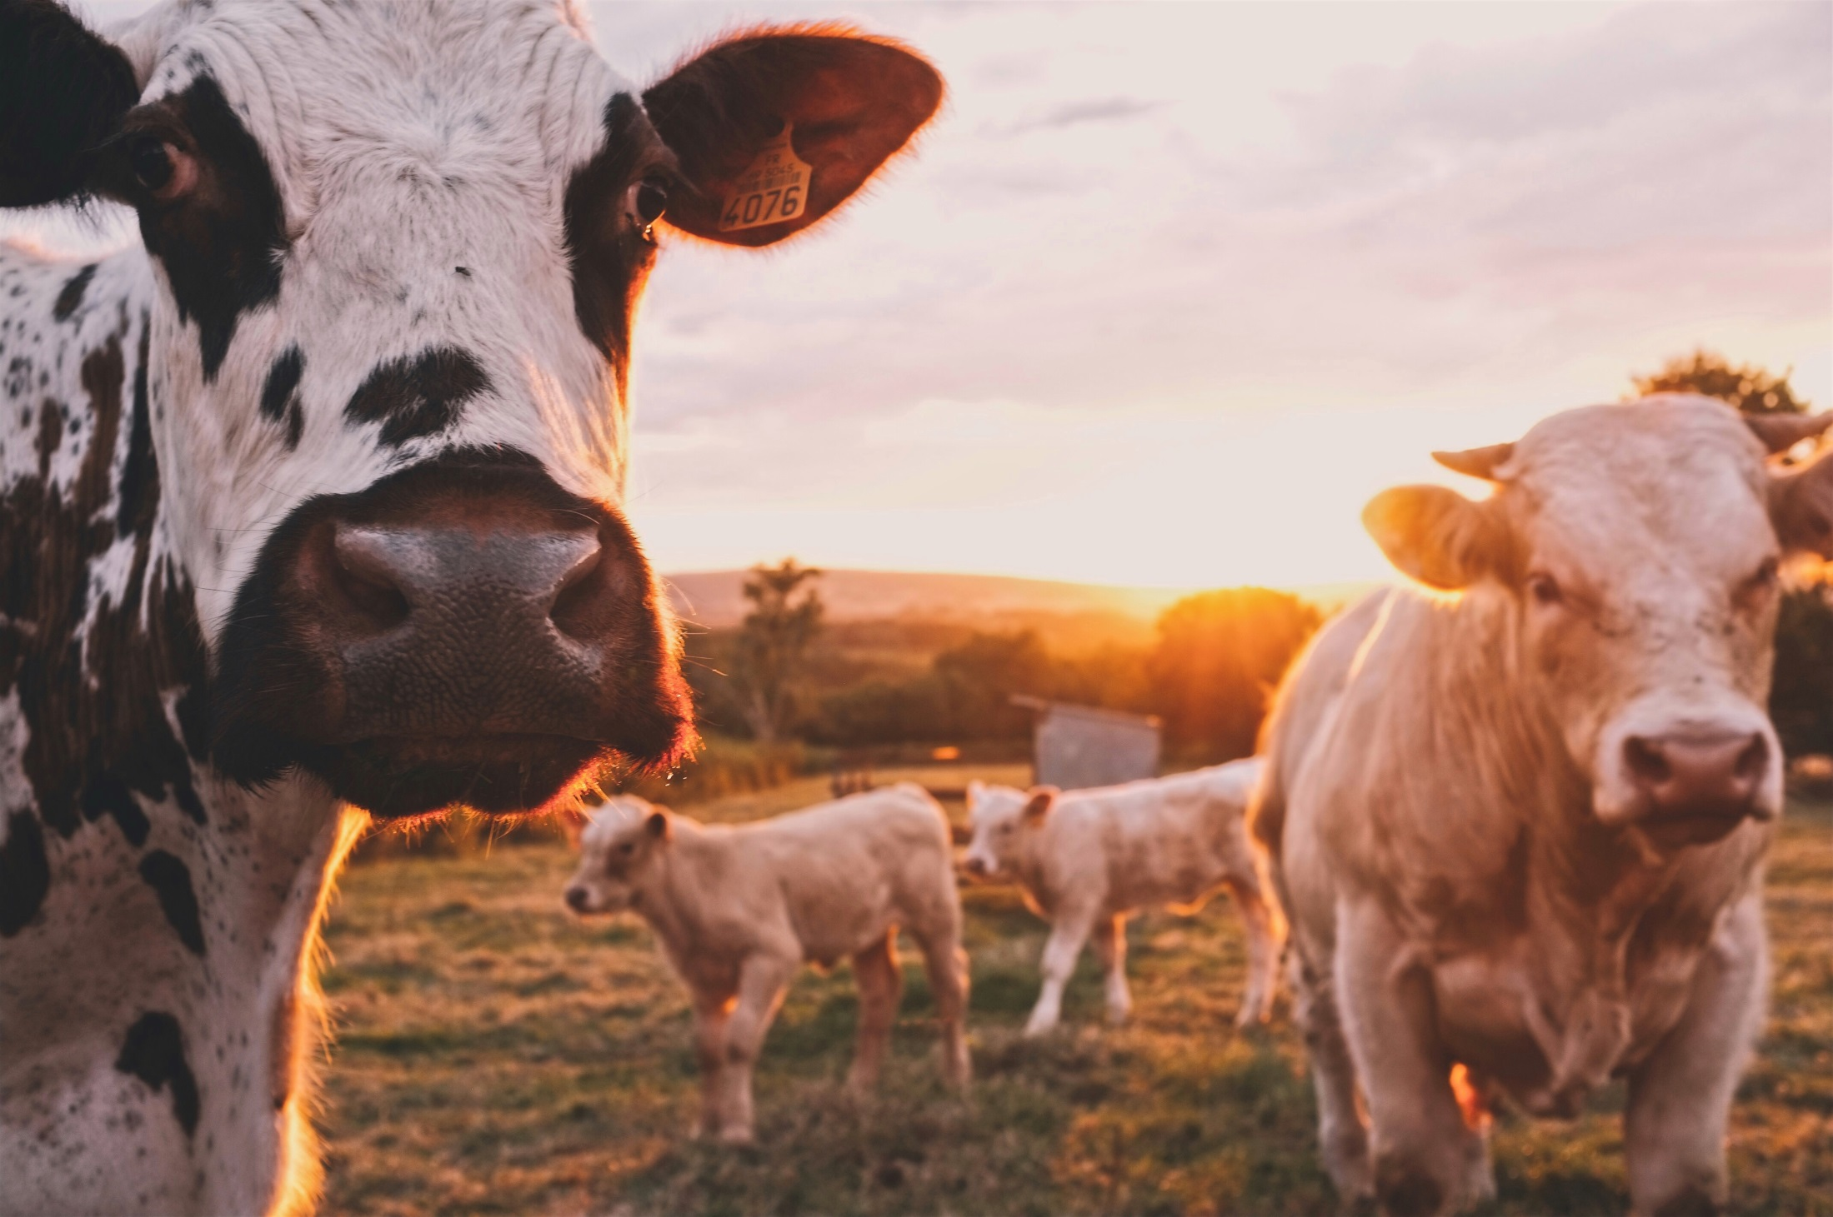

Slide 13

Morality, equality and ‘the death of God’
So-called ‘moral arguments’ begin with a moral intuition/conviction – e.g. moral egalitarianism - and concludes the existence of God as the only possible ground for such conviction…
Nietzsche’s argument moves in the opposite direction:
There is no God;
Without God, there are no grounds for the commitment to moral egalitarianism;
So why be a moral egalitarian?

Slide 14
Morality, equality and ‘the death of God’
‘But with the new morning a new truth came to me; then I learned to say: “What do the market place and the rabble and the rabble noise and long rabble ears matter to me!”
You higher men, learn this from me: in the market place no one believes in higher men. And if you want to speak there, well then! But the rabble blinks “we are all equal.
You higher men” – thus blinks the rabble – “there are no higher men, we are all equal, human is human, before God – we are all equal!”
Before God! – Now, however, this God has died. But we do not want to be equal before the rabble. You higher men, go away from the market place!’ (Z IV: ‘On the higher men’)

Slide 15
Morality, equality and ‘the death of God’
‘The poisonous doctrine 'equal rights for everyone' - Christianity disseminated this the most thoroughly; from out of the most secret corners of its bad instincts, Christianity has waged a deadly war on every feeling of respect and distance between people, which is to say the presupposition of every elevation, of every growth of culture, - it has used the ressentiment of the masses as its main weapon against us, against everything on earth that is noble, joyful, magnanimous, against our happiness on earth ... Granting 'immortality' to every Tom, Dick, and Harry has been the most enormous and most vicious attempt to assassinate noble humanity. [. . .]

Slide 16
Morality, equality and ‘the death of God’
‘Our politics is sick from this lack of courage! - The aristocraticism of mind has been undermined at its depths by the lie of the equality of souls; and when the belief in the 'privileges of the majority' creates (and it will create) revolutions, do not doubt for a minute that it is Christianity, that it is Christian value judgments these revolutions are translating into blood and crimes! Christianity is a rebellion of everything that crawls on the ground against everything that has height: the evangel of the 'lowly' makes things lower ...’ (A 43)

Slide 17
Beyond good and evil

Slide 18
Beyond Good and Evil
Beyond Good and Evil begins with a series of reflections on ‘the prejudices of the philosophers’, and introduces central Nietzschean themes:
The meaning of the ‘the will to truth’
The question of the value of truth for life
The question of the relationship between instinct and conscious thought/reflection

Slide 19
Beyond Good and Evil
‘The will to truth that still seduces us into taking so many risks, this famous truthfulness that all philosophers so far have talked about with veneration: what questions this will to truth has already laid before us! What strange, terrible, questionable questions! [. . . ]Who is it really that questions us here? What in us really wills the truth? In fact, we paused for a long time before the question of the cause of this will - until we finally came to a complete standstill in front of an even more fundamental question. We asked about the value of this will. Granted, we will truth: Why not untruth instead? And uncertainty? Even ignorance?’ (BGE 1)

Slide 20
Beyond Good and Evil
‘The fundamental belief of metaphysicians is the belief in oppositions of values. It has not occurred to even the most cautious of them to start doubting right here at the threshold, where it is actually needed the most- even though they had vowed to themselves "de omnibus dubitandum.’ [. . .] Whatever value might be attributed to truth, truthfulness, and selflessness, it could be possible that appearance, the will to deception, and craven self-interest should be accorded a higher and more fundamental value for all life. It could even be possible that whatever gives value to those good and honourable things has an incriminating link, bond, or tie to the very things that look like their evil opposites; perhaps they are even essentially the same. Perhaps!’ (BGE 2)

Slide 21
Beyond Good and Evil
‘I have kept a close eye on the philosophers and read between their lines for long enough to say to myself: the greatest part of conscious thought must still be attributed to instinctive activity, and this is even the case for philosophical thought. This issue needs re-examination in the same way that heredity and "innate characteristics" have been re-examined. Just as the act of birth makes no difference to the overall course of heredity, neither is "consciousness" opposed to instinct in any decisive sense- most of a philosopher's conscious thought is secretly directed and forced into determinate channels by the instincts. Even behind all logic and its autocratic posturings stand valuations or, stated more clearly, physiological requirements for the preservation of a particular type of life.’ (BGE3)

Slide 22
Beyond Good and Evil
‘We do not consider the falsity of a judgment as itself an objection to a judgment; this is perhaps where our new language will sound most foreign. The question is how far the judgment promotes and preserves life, how well it preserves, and perhaps even cultivates, the type. And we are fundamentally inclined to claim that the falsest judgments (which include synthetic judgments a priori) are the most indispensable to us, and that without accepting the fictions of logic, without measuring reality against the wholly invented world of the unconditioned and self-identical, without a constant falsification of the world through numbers, people could not live- that a renunciation of false judgments would be a renunciation of life, a negation of life. To acknowledge untruth as a condition of life: this clearly means resisting the usual value feelings in a dangerous manner; and a philosophy that risks such a thing would by that gesture alone place itself beyond good and evil.’ (BGE 4)

Slide 23
Beyond Good and Evil
Together, these points add up to a set of difficulties about how to interpret Nietzsche’s subsequent account of the origins of morality:
Does Nietzsche hope to show that his account of morality is ‘truer’ than others?
  If so, why would he expect that knowing its truth would be ‘in the service of life’
Or, does Nietzsche consciously aim to tell a story to persuade the reader of the superiority of his values;
  If so, why should we take seriously the story that he tells, if we do not take seriously the values that he thereby aims to advocate?

Slide 24
Beyond Good and Evil
Later in the book, the section ‘Towards a Natural History of Morals’ tries to show that moral codes, too, are in the service of particular types of life:
‘There are moralities that are supposed to justify their creator in the eyes of others, and other moralities that are supposed to calm him down and allow him to be content with himself; still other moralities allow him to crucify and humiliate himself. He can use some moralities to take revenge, others to hide, and still others to transfigure himself and place himself far and away. There are moralities that help their creator to forget, and others that let him – or something about him – be forgotten. Many moralists would like to wield power and impose their creative whims on humanity; many others (perhaps even Kant himself ) want to make it clear through their morality that “the worthy thing about me is that I can obey – and it should be the same for you as it is for me!” – in short, even morality is just a sign language of the affects!’ (BGE 187)

Slide 25
Beyond Good and Evil
But again, this does not in itself constitute an objection:
‘Every morality, as opposed to laisser-aller, is a piece of tyranny against both “nature” and reason.” But this in itself is no objection; for that, we would have to issue yet another decree based on some other morality forbidding every sort of tyranny and unreason. What is essential and invaluable about every morality is that it is a long compulsion. [. . .] I will say it again: what seems to be essential “in heaven and on earth” is that there be obedience in one direction for a long time. In the long term, this always brings and has brought about something that makes life on earth worth living – for instance: virtue, art, music, dance, reason, intellect – something that transfigures, something refined, fantastic, and divine.’ (BGE 188)

Slide 26
The genealogy of morals

Slide 27
The genealogy of morals
The attempt to give a completely naturalistic account of human existence requires a naturalistic account of moral feelings, beliefs, etc.; of their origins (what accounts for the error?)
But it also allows for a new question – the question of their value:
‘under what conditions did man invent the value judgements good and evil? And what value do they themselves possess?’ (GM, Preface: 3)

Slide 28
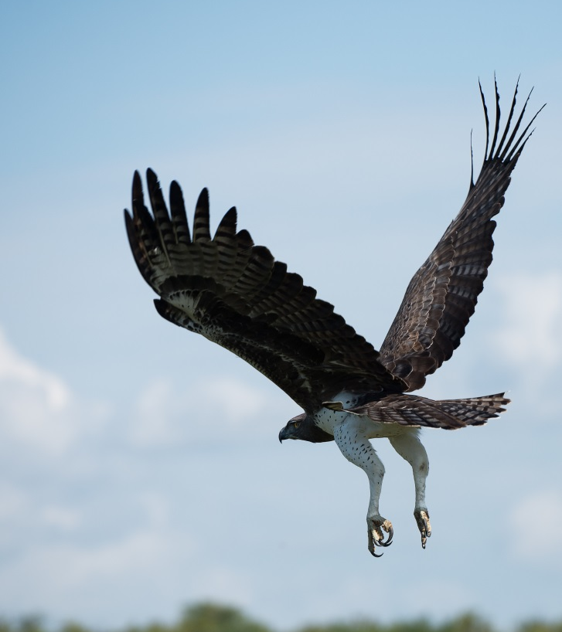
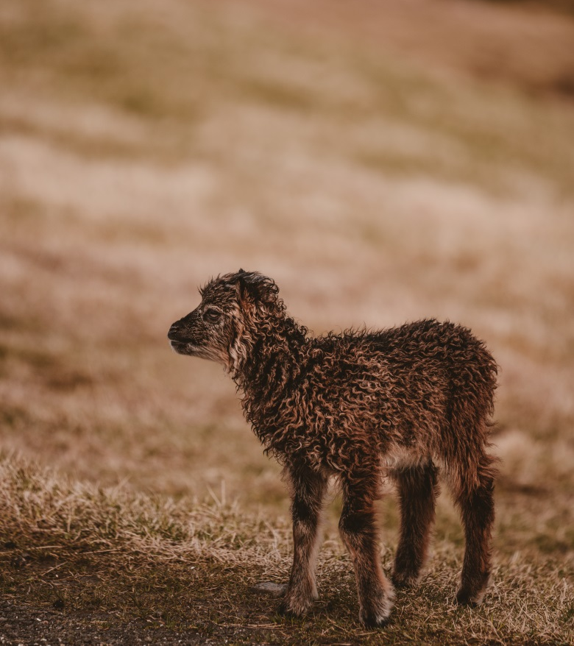
The first essay: ‘ressentiment’
Notes:
Photo by Vincent van Zalinge on Unsplash; Photo by Annie Spratt on Unsplash

Slide 29
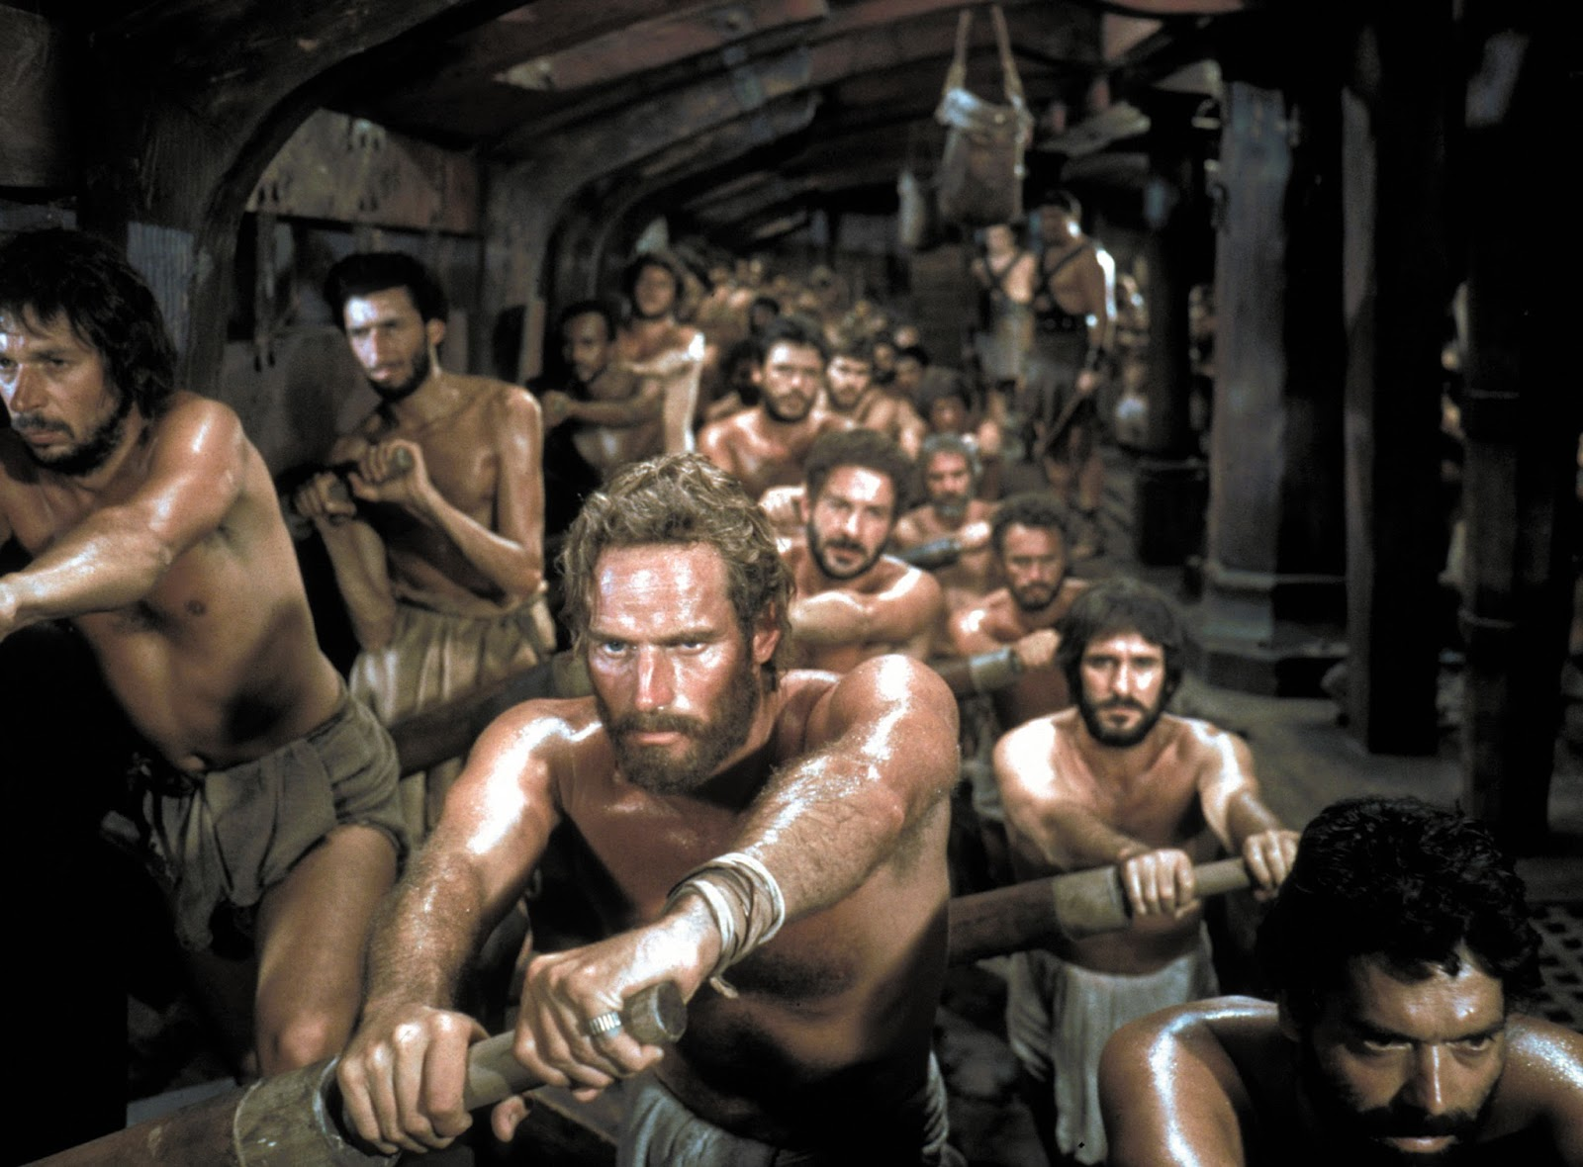
The first essay: ‘the slave revolt in morals’

Slide 30

The first essay: ‘good and bad’ versus ‘good and evil’
Notes:
Photo by Tirza van Dijk on Unsplash

Slide 31
The second essay
In the second essay of the Genealogy, Nietzsche gives a dark and convoluted account of the origins of responsibility, bad conscience and the feeling of guilt. Key concepts:
the emergence of the human as an animal ‘entitled to make promises’;
the link between memory and pain;
the pleasure taken in cruelty;
the internalisation of this pleasure;
‘How much blood and horror is at the bottom of all “good things”!’ (GM II: 3)
Cf. the ‘incriminating link’ (BGE 2)

Slide 32

The second essay: bad conscience and guilt
Cruelty and pleasure; contract and debt;
  Sect. 6 and 8
Culture (‘softening’) and internalisation of cruelty;
  Sect. 16 and 17
Indebtedness to ancestors; origin of religion
  Sect. 19
Judeo-Christian God: indebtedness magnified and combined with bad conscience, to create guilt (existence as such is something from which one needs redemption)
  Sect. 21 and 22.

Slide 33
The third essay
When writing about the Genealogy in Ecce Homo, Nietzsche claims that the Third essay is a ‘commentary on the aphorism that precedes it’…
Does he mean:
The quotation from Zarathusta?
The whole of the first section?
Seems to make more sense to say the latter (see introduction, xv. )

Slide 34

The third essay
‘What is the meaning of the ascetic ideals? [. . .] in the case of the deformed and the disgruntled (the majority of mortals), an attempt to imagine oneself ‘too good’ for this world, a holy form of dissipation, their principal means in the struggle against chronic pain and boredom; in the case of priests, the distinctive priestly belief, its most effective instrument of power, also the ‘very highest’ licence for power; in the case of saints finally, a pretext for hibernation, their novissima gloriae cupido [most recent desire for fame], their rest in nothingness (‘God’), their form of madness.’

Slide 35
The third essay
‘But that the ascetic ideal has meant so many things to man expresses above all the fundamental truth about human will, its horror vacui: it must have a goal – and it would even will nothingness rather than not will at all. –Do you follow? Have you been following? ‘Certainly not, Sir!’ –Then let us start from the beginning.’

Slide 36
The third essay
So, the ascetic ideal/s (e.g. ‘poverty, humility, chastity’), have appeared in various forms, with different meanings and uses:
Artistic/aesthetic
  (e.g. Kant’s idea of ‘disinterested’ appreciation of beauty)
Femininity (?!!)
  The ‘angelic character’ of a beautiful woman…
Philosophical /intellectual
  Ascetic ideals as necessary conditions for progress (a calm mind, freedom from appetite/care)
Religious masses
  Cure for the world, expression of struggle against pain/boredom
Ascetic priests
  Instrument of power
Saints:
  Form of madness; an attempt to fully turn against existence

Slide 37
The third essay
It could easily be supposed that the ‘free spirits’ of Nietzsche’s own time, who renounce traditional beliefs, or authorities, and all belief in another world, are free of the ascetic ideal….
But the climax of the third essay suggests otherwise:
The unconditional will to truth is based on the affirmation of a ‘true’ world beyond appearance;
But this is still a faith; a love of something beyond the world;
So ‘we too, are still pious’ (GS 344 – which GM III quotes from)

Slide 38
The third essay
The book ends with a question. Why has this ideal, in its various forms, been so successful?
It reveals a fundamental truth about the human will:
‘it must have a goal—it would even rather will nothingness than not will at all.’

Slide 39
Why ‘genealogy’?
2RS012 Engaging with Philosophical Texts

Slide 40
Why ‘genealogy’?
Nietzsche claims that his book addresses two questions:
‘under what conditions did man invent the value judgements good and evil?’
‘And what value do they themselves possess?’ (GM 3)
But how are these two questions related? Why would answering the first help to investigate the second?

Slide 41
Why ‘genealogy’?
Nietzsche seems to be in danger of committing the ‘genetic fallacy’:
Is nature, or value, of something connected to its origin?
Nietzsche himself argues that this is not the case!
  ‘Even if a morality has grown out of an error, the realization of this fact would not as much touch the problem of its value.’ (GS 345; see also BGE 2)
But in this case, why does Nietzsche’s ‘genealogy’ matter? How does it help to ask the question of ‘the value of our values’?
  How can Nietzsche avoid the ‘genetic fallacy’?

Slide 42
Why ‘genealogy’?
Perhaps it functions as internal critique? E.g., in the first essay:
altruistic values (selflessness, compassion, humility, etc.) originally arise from ‘ressentiment’
‘ressentiment’ is a suppressed form of revenge against the strong;
but revenge is opposed by the morality of altruism: it condemns itself.

Slide 43
Why ‘genealogy’?
But this view encounters problems:
the ‘critique’ only functions if the origin of a value is determinative of all its subsequent history;
  i.e. if altruism, compassion, humility, etc. are still motivated by ressentiment (cf D 102/3)
but the Genealogy doesn’t show this!
and if it was true, it would go against some of the claims made in the Genealogy (e.g. GM II: 12) – that meanings of external practices (e.g. of punishment) do not stay stable through history.

Slide 44
Why ‘genealogy’?
Another possibility is that Nietzsche is trying to show what ‘morality’ does, over time (its ‘causal powers’ - see Leiter 2002: 177-9):
Central belief is that morality prevents human excellence;
People adopt values which are most conducive to the flourishing of their ‘type’ (see BGE 6; 187);
So perhaps the purpose of ‘genealogy’ is to show how morality has inhibited the flourishing of the ‘higher types’;
  And, to encourage the feeling that morality is something unpleasant and unworthy
But: does the Genealogy actually achieve this?!

Slide 45
Why ‘genealogy’?
Finally, perhaps Nietzsche’s use of genealogical method is subtler, and more rhetorical (see Gemes 2006):
GM 1: ‘We are unknown to ourselves, we knowers; and for good reason’;
The Genealogy acts like a psycho-analyst; unearthing our hidden nature, by working below the level of consciousness;
The Genealogy uses a range of possibly-implausible historical accounts to suck the reader into condemnation of ‘morality’, and then reveals, at the end (GM III: 23), that they, too, are a moralist!

Slide 46
References
ACAMPORA, C. D., & ANSELL-PEARSON, K. (2011). Nietzsche's Beyond good and evil: a reader's guide. London, Continuum.
GEMES, K. (2006). “We remain of necessity strangers to ourselves”: The key message of Nietzsche’s Genealogy, in Nietzsche's On the genealogy of morals: critical essays, ed. Acampora-Davis, C. Lanham, Md, Rowman & Littlefield Publishers.
HATAB, L. J. (2008). Nietzsche's On the genealogy of morality: an introduction. Cambridge, UK, Cambridge University Press.
JANAWAY, C. (2009). Beyond selflessness: reading Nietzsche's Genealogy. Oxford, Oxford University Press.
LEITER, B. (2002). Routledge philosophy guidebook to Nietzsche on morality. London, Routledge.
SCHACHT, R. (2013). ‘Nietzsche’s Genealogy’ in The Oxford Handbook of Nietzsche, ed. Gemes, K. & Richardson, J. Oxford, Oxford University Press.

