Slide 1
LJC Philosophy through the year phenomenology
Week 1: introduction to method
DR SARAH PAWLETT JACKSON

Slide 2

What is Phenomenology?
Phenomenon + Logos: Reasoning about that which appears. [phenomenon – ‘to show itself’]
An exploration of the meaning and structure of experience
A particular methodology of philosophical analysis
An established tradition in the history of philosophy – coming to prominence in the early 20th Century in Continental Europe

Slide 3
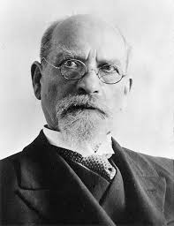
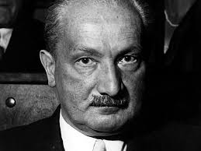
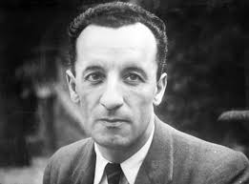
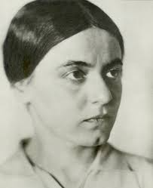
Key figures in phenomenology
Edmund Husserl (1859–1938)
Martin Heidegger (1889–1976)
Edith Stein (1891–1942)
Jean-Paul Sartre (1905–80)
Simone De Beauvoir (1908–1986)
Maurice Merleau-Ponty (1908–1961)
Emmanuel Levinas (1906-1995)
…and many others
Heidegger
Husserl
Merleau-Ponty
Stein

Slide 4
Phenomenological method
Step 1: A careful description of experience as it is given to consciousness
'Phenomenology is the study of structures of consciousness as experienced from the first-person point of view.’ (Woodruff Smith, 2013, Introduction)
'Phenomenology may be characterised initially in a broad sense as the unprejudiced descriptive study of whatever appears to consciousness, precisely in the manner in which it so appears.’ (Moran in Moran & Mooney, 2000, Introduction)
'Phenomenology's first step is to seek to avoid all misconstructions and impositions placed on experience in advance, whether these are drawn from religious or cultural traditions, from everyday common sense, or indeed from science itself. Explanations are not to be imposed before the phenomena have been understood from within.’ (Moran, 2000, p4)

Slide 5
Phenomenological method
Step 2: An analysis of the intelligibility conditions of what is generated in this descriptive process
‘Phenomenology seeks to reflect on the conditions of possibility of experience and cognition.’ (Zahavi, ‘Phenomenology’ in Moran 2008, p663)
A form of transcendental reasoning
Phenomenologists are essentially united in their analyses that consciousness is structured by, for example, temporality, embodiment and intersubjectivity

Slide 6
Husserl’s epochÉ
The epoché or ‘bracketing’ process asks us to suspend or withhold our ‘natural attitude’ to the world
Husserl advocates a methodology which starts with the fact that ‘this life is continually there for me. Continually, in respect of a field of the present, it is given to consciousness perceptually, with the most originary originality, as it itself.’ (Husserl, 1950/1999, p1)
‘All judgements must be derived from experiences ‘in which the affairs and affair-complexes in question are present to me as ‘they themselves.’’ (Husserl, 1950/1999, p13)
‘The epoché entails a change of attitude towards reality, and not an exclusion of reality.’ (Zahavi in Moran, 2008, p670)

Slide 7
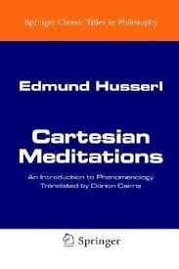
Cartesian meditations
Follows Descartes’ ‘turn to the subject’ in his Meditations on First Philosophy and the discovery of the cogito – of one’s own consciousness – as the foundation for philosophical reflection
But criticises Descartes for not following through on this, and introducing unwarranted assumptions
‘But, no matter what the status of this phenomenon's claim to actuality and no matter whether, at some future time, I decide critically that the world exists or that it is an illusion, still this phenomenon itself, as mine, is not nothing but is precisely what makes such critical decisions at all possible...Moreover, this life is continually there for me.’ (Husserl, 1950/1999, p19)

Slide 8
Intentionality
Intentionality is one of the fundamental structures of consciousness
It refers to the fact that consciousness is always consciousness-of something: subjectivity is always ‘about’ something – it is directed towards the world
This cuts against mind-world dualisms in the history of philosophy
‘The subjectivity disclosed by phenomenological reduction is not a concealed interiority but an open-world relation.’ (Zahavi in Moran, 2008, p664)
‘Subjectivity is not hermetically sealed up within itself, remote from the world and inaccessible to the other. Rather, it is above all a relation to the world.’ (Zahavi, 2001, p163)

Slide 9
Slide Tite
References and Further Reading
Heidegger, Martin (1962) Being and Time, trans. Macquarrie & Robinson, Blackwell
Husserl, Edmund (1950/1999) Cartesian Meditations, trans. D. Cairns, Kluwer
Luft, Sebastian & Overgaard Søren (eds.) (2012) The Routledge Companion to Phenomenology, Routledge
Merleau Ponty, Maurice (1945/2012) Phenomenology of Perception, trans. D.A. Landes, Routledge
Moran, Dermot (2000) Introduction to Phenomenology, Routledge
Moran, Dermot (ed.) (2008) The Routledge Companion to Twentieth-Century Philosophy, Routledge
Moran, Dermot & Mooney, Timothy (2000) The Phenomenology Reader, Routledge
Mulhall, Stephen (1996) Heidegger and Being and Time, Routledge
Noë, Alva (2007) 'The Critique of Pure Phenomenology' in Phenomenology and the Cognitive Sciences, Volume 6, Issue 1-2, pp 231-245
Sartre, Jean Paul (1943/2003) Being and Nothingness, trans. H. Barnes., Routledge
Stein, Edith (1964) On the Problem of Empathy, trans. W Stein, M. Nijhoff
Woodruff Smith, David (2013) ‘Phenomenology’ Stanford Encyclopedia of Philosophy
Zahavi, Dan (2001) ‘Beyond Empathy’, Journal of Consciousness Studies, 8(5–7), 151–67.
Zahavi, Dan (2012) The Oxford Handbook of Contemporary Phenomenology, OUP

