Slide 1
Forgiveness in continental philosophy: gift, aporia and the ‘unforgiveable’

Slide 2
Garrard and McNaughton on unconditional forgiveness
Or, perhaps the ground of unconditional forgiveness is the sense of solidarity:
‘On this account, what is focused on is the fact that the wrongdoer is, after all, one of us; and shared membership in the human community, like shared membership of the same family, provides a reason for forgiveness. Human solidarity is what is doing the work here, and what it is based on is the sense of a common predicament which we all share, and which gives us reason to be concerned for each other. [. . .]’

Slide 3
Garrard and McNaughton on unconditional forgiveness
This goes along with the value of humility:
‘Humility in general has had a bad press since the decline of Christianity, and humility as an element in forgiveness has come to seem particularly objectionable, since it supposedly involves the victim in a less than admirable devaluation of her own status, of the importance of harms and wrongs done to her. And it certainly is important not to devalue the wrong done to any victim, since that runs the risk of excusing the offender. But the role being played by humility on the suggestion under consideration here is quite different from the allegedly objectionable one:

Slide 4
Garrard and McNaughton on unconditional forgiveness
‘what is being proposed is not humility in the forgiver towards her standing as victim of the offence, but humility in the forgiver towards her standing as author of other actions—not humility qua patient, but humility qua agent. If this is right, then we have here a feature of forgiveness which sits well with the claim that our common (and morally frail) humanity provides us with a reason for unconditional forgiveness. We are all in this boat together, and our common condition gives us a reason to be forbearing about each other’s weaknesses and indeed wickednesses, a reason stemming from our awareness of our own.’

Slide 5

Jankélévitch on unconditional forgiveness
Forgiveness is a miraculous happening: like a ‘fleeting shock’ or an ‘imperceptible flickering of charity’. It is ‘an event, a gratuitous gift, and a personal relation with the other’ (Jankelevitch, 2004: 4, 34).
It has nothing to do with understanding:
‘To understand is either to exonerate an innocent person, recognising that there was nothing to forgive, or to become sometimes more indulgent and sometimes more severe with respect to the accused depending on the circumstances.’ Jankelevitch, 2004: 88).

Slide 6

Jankélévitch on unconditional forgiveness
Ultimately, forgiveness has the same logic as love, which is equally ungrounded and unmerited:
‘[T]he scandal of forgiveness and the folly of love have it in common that their object is someone that does not “merit” it. Also, forgiveness does not forgive because of, forgiveness pays no attention to justifying itself and giving reasons, for as concerns reasons, it has none.’ (Jankélévitch, 2004: 94)

Slide 7
Jankélévitch on unconditional forgiveness
So forgiveness is a radically creative action:
‘Above all, forgiveness obeys neither the causality of the loveable, nor the causality of the detestable; it is unleashed neither by a pre-existent value, nor by a counter-value; it trails behind nothing… Not only is it not because the accused is innocent that forgiveness receives him (innocence, on the contrary, rendering forgiveness superfluous), rather it is much more because forgiveness forgives that the guilty person becomes innocent.’ (Jankélévitch, 2004: 145)

Slide 8
Decision, aporia and the ‘unforgiveable’
For Derrida, notions like responsibility and decision leave us with a seemingly insoluble problem. On the one hand, a decision needs to actually do something, so that the moment of decision is outside of law or norm:
‘When I make the machine work, there is no decision; the machine works, the relation is one of cause and effect. If I know what is to be done, if my theoretical analysis of the situation shows me what is to be done – do this to cause that, etc – then there is no moment of decision, simply the application of a body of knowledge, of, at the very least, a rule of norm.’ (Derrida 2002a: 231)

Slide 9
Decision, aporia and the ‘unforgiveable’
So the conditions of possibility for a decision are also the conditions of impossibility: the decision lives by the undecideable:
‘If there is no “experience” of the undecideable at the moment of decision, then the decision will be nothing but the mechanical application of a rule.’ (Derrida 2002a: 232)

Slide 10
Decision, aporia and the ‘unforgiveable’
For Derrida, responsibility goes hand in hand with uncertainty and the anxiety of a ‘bad’ conscience, not with certainty and confidence. The appearance of clear principles that give us the knowledge necessary to negotiate decisions actually allows us to evade the experience of responsibility:
‘If I were to be content to apply a just rule, without the spirit of justice and without in some way and each time inventing the rule and the example, I might be sheltered from criticism, under the protection of law, my action conforming to objective law, but I would not be just.’ (Derrida 2002b: 245)

Slide 11
Decision, aporia and the ‘unforgiveable’
For Derrida, responsibility goes hand in hand with uncertainty and the anxiety of a ‘bad’ conscience, not with certainty and confidence. The appearance of clear principles that give us the knowledge necessary to negotiate decisions actually allows us to evade the experience of responsibility:
‘If I were to be content to apply a just rule, without the spirit of justice and without in some way and each time inventing the rule and the example, I might be sheltered from criticism, under the protection of law, my action conforming to objective law, but I would not be just.’ (Derrida 2002b: 245)
In other words, real ethical responsibility involves moments of decision that can never be fully justified or comprehended, and which remain ‘outside’ any rational scheme.

Slide 12
Decision, aporia and the ‘unforgiveable’
For Derrida, responsibility goes hand in hand with uncertainty and the anxiety of a ‘bad’ conscience, not with certainty and confidence. The appearance of clear principles that give us the knowledge necessary to negotiate decisions actually allows us to evade the experience of responsibility:
‘If I were to be content to apply a just rule, without the spirit of justice and without in some way and each time inventing the rule and the example, I might be sheltered from criticism, under the protection of law, my action conforming to objective law, but I would not be just.’ (Derrida 2002b: 245)
In other words, real ethical responsibility involves moments of decision that can never be fully justified or comprehended, and which remain ‘outside’ any rational scheme.

Slide 13
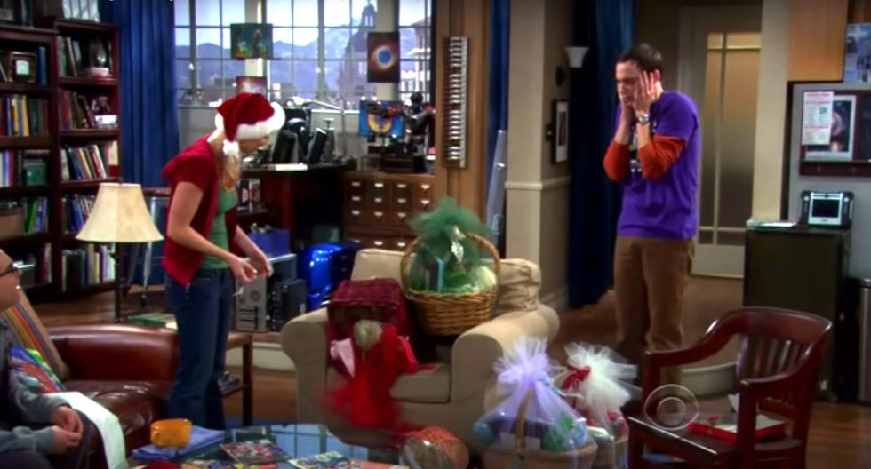
Decision, aporia and the ‘unforgiveable’

Slide 14
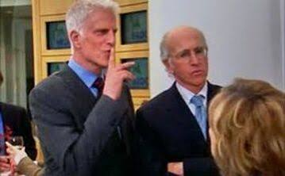
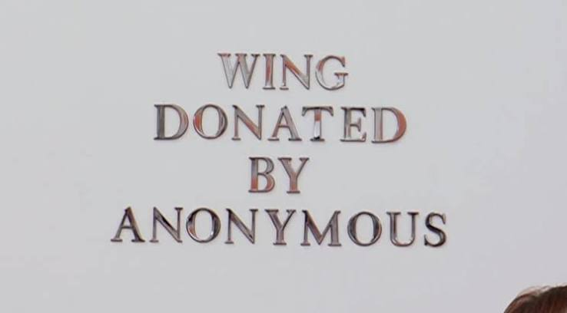

Slide 15
Decision, aporia and the ‘unforgiveable’
For Derrida, gift is another site of ‘the impossible’. A gift is something outside of exchange, and yet in order to be recognised as a gift, the gift must be reinscribed into an exchange:
‘as soon as a gift is identified as a gift, with the meaning of a gift, then it is canceled as a gift. It is reintroduced into the circle of an exchange and destroyed as a gift.’
‘The gift as such cannot be known, but it can be thought of. We can think what we cannot know. Perhaps thinking is not the right word. But there is something in excess of knowledge. We have a relation to the gift beyond the circle, the economic circle, and beyond the theoretical and phenomenological determination. It is this excess which interests me. It is this excess which puts the circle into motion.’

Slide 16
Decision, aporia and the ‘unforgiveable’
For Derrida, forgiveness is ‘impossible’ because, like the gift, ‘forgiveness’ is the promise of something unconditional, something in excess of desert, balance or measure:
‘I shall risk this proposition: each time forgiveness is at the service of a finality, be it noble or spiritual (atonement or redemption, reconciliation, salvation), each time that it aims to re-establish a normality (social, national, political, psychological) by a work of mourning, by some therapy or ecology of memory, then the forgiveness is not pure - nor is its concept. Forgiveness is not, it should not be, normal, normative, normalising. It should remain exceptional and extraordinary, in the face of the impossible: as if it interrupted the ordinary course of historical temporality.’ (Derrida 2001: 21-32)

Slide 17
Decision, aporia and the ‘unforgiveable’
For Derrida, forgiveness follows the logic of the gift; if we lose the sense that forgiveness is in some sense ‘impossible’, we lose it altogether:
‘There is only forgiveness, if there is such a thing, of the un-forgiveable. Thus forgiveness, if it is possible, if there is such a thing, is not possible, it does not exist as possible, it only exists by exempting itself from the law of the possible, by impossibilizing itself, so to speak. . .’ (Derrida 2001a): 48)

Slide 18
Decision, aporia and the ‘unforgiveable’
But there is an unresolvable conflict within the logic of forgiveness, between the aspiration to give unconditionally, and the inevitability of exchange, calculation and economy:
It is important to analyse at its base the tension at the heart of the heritage between, on the one side, the idea which is also a demand for the unconditional, gracious, infinite, aneconomic forgiveness granted to the guilty as guilty, without counterpart, even to those who do not repent or ask forgiveness, and on the other side, as a great number of texts testify through many semantic refinements and difficulties, a conditional forgiveness proportionate to the recognition of the fault, to repentance, to the transformation of the sinner who then explicitly asks forgiveness. And who from that point is no longer guilty through and through, but already another, and better than the guilty one. To this extent, and on this condition, it is no longer the guilty as such who is forgiven.’ (Derrida 2001b: 35)

