Slide 1
HealthierHere Landscape Assessment
2025

Slide 2
Introduction
HealthierHere’s annual Landscape Assessment provides a snapshot in time of community well-being, needs, and priorities in King County
HealthierHere uses the quantitative and qualitative data in our annual assessment to guide engagement and outreach efforts and organizational and program priorities
We encourage our partners to utilize the assessment for similar purposes or for advancing their own efforts as applicable
This 2025 assessment provides updated sociodemographic data for King County and reflects community needs and priorities in the face of significant state and federal landscape changes

Slide 3
Introduction
All people deserve to see themselves represented in data collected about them and for them
HealthierHere acknowledges that that data presented in this report is limited by the methods used and gaps present in the original data collection
This includes how race and ethnicity are categorized on surveys and questionnaires
The way data is collected and represented can lead to the overrepresentation of some communities and the underrepresentation of others
HealthierHere works to intentionally present the data we have access to while ground truthing it with partners and the communities we serve

Slide 4
Sociodemographic Data

Slide 5

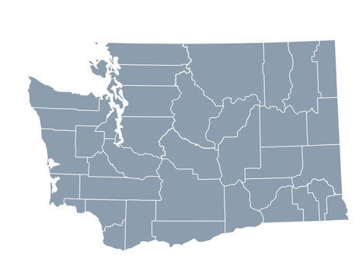


King County at a Glance
Population¹ of 2,411,700
Increase of 1.41% between 2024 and 2025
Home to 29.72% of the state’s residents¹
Highest community needs* related to:
Housing & shelter services
Financial assistance
Food access
Employment
Health Insurance
* Based on data from the HealthierHere Community Hub

Slide 6
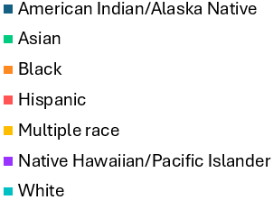
Race & Ethnicity

Slide 7

Immigration & Language
27.1% of the county’s population were immigrants or refugees³ (2024)
compared to 16.1% in WA state
33% of King County residents spoke a language other than English at home³ (2024)
compared to 22.3% in WA state

Slide 8

Income & Employment
8.7% of the population living below the poverty level, though rates were much higher among specific populations⁴:
American Indian/Alaska Native (17.2%)
Black (15%)
Hispanic (14.8%)
Median household income of $122,080⁵
Compared to a median household income of $99,389 in Washington State
30.5% of households with income $200,000 or more
30.5% of households with income under $75,000
67.2% employment rate¹

Slide 9
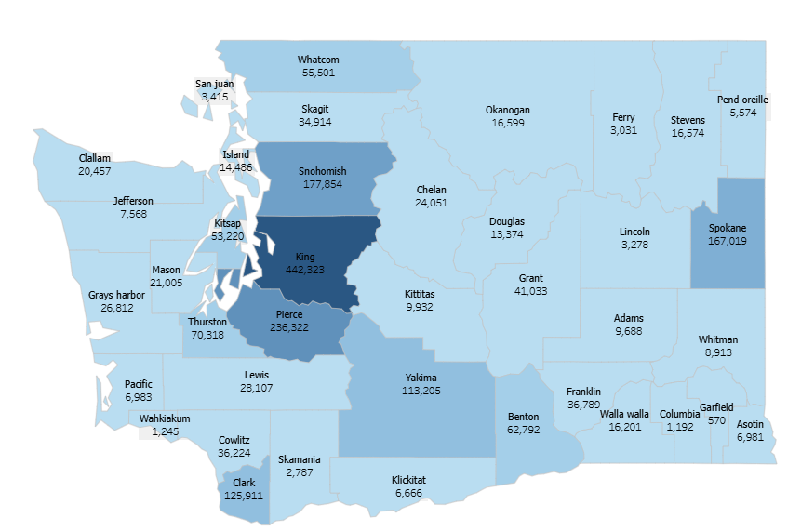
Health Insurance
Almost 20% of King County residents or 442,323 people were eligible for Medicaid in October 2025⁶
Down from approximately 530,000 in May 2023
Makes up 22.9% of the Medicaid population in WA State
In 2024, 5.3% of King County residents were uninsured, though rates of uninsurance are much higher for specific populations⁷:
Hispanic (15.2%)
American Indian/Alaska Native (14.5%)
Native Hawaiian/Pacific Islander (10.1%)

Slide 10

Housing & Homelessness
Department of Commerce⁸ estimates that 52,146 King County residents experienced homelessness or housing instability in 2025
Represents over 25% of the state population experiencing homelessness or housing instability
King County contributed 20,200 new housing units throughout the year, representing 42% of the State’s total additions¹
Median rent in 2024 was $2,110³
40.3% of homes in King County in 2024 were valued at or over $1,000,000³
85.6% of homes valued at or over $500,000

Slide 11
Veteran & Disabled Populations
4.1% veteran population³
10.3% disabled population³
(United States Census Bureau)

Slide 12
Community Hub Insights

Slide 13
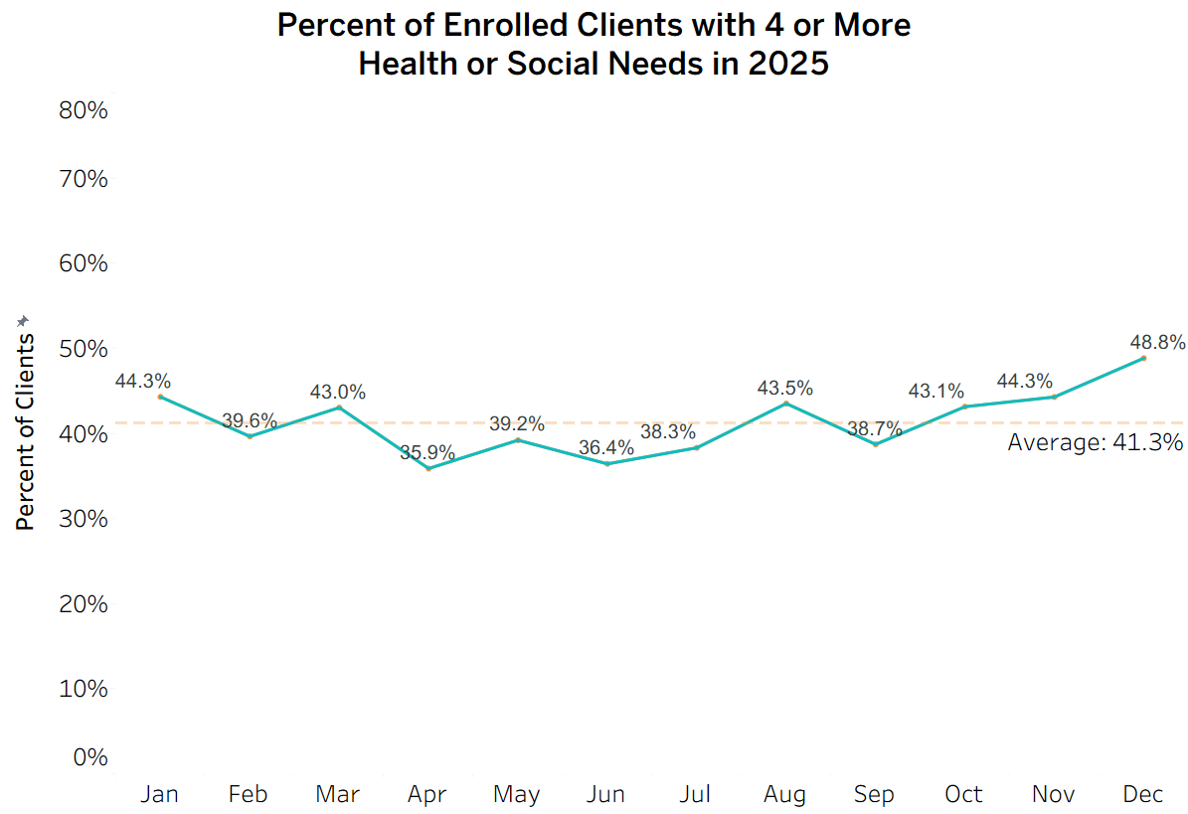
5,190
Clients Enrolled in 2025

Slide 14
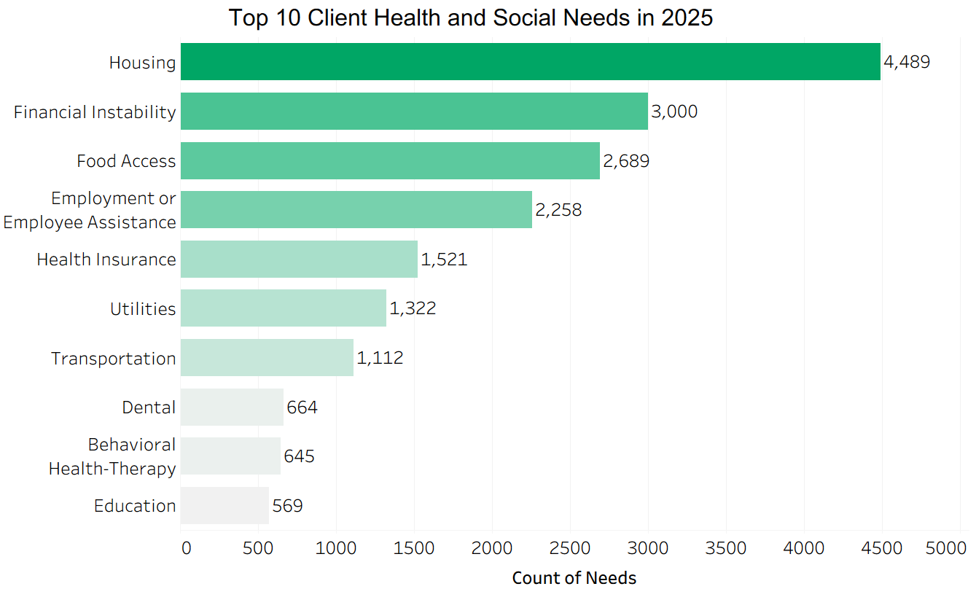

Slide 15
Evolving Needs

Slide 16
Landscape Changes
The needs of our Community Hub clients and the agencies we parter with in King County have evolved over the last year, in part due to the significant landscape changes impacting the health and health related social needs of King County residents including:
The inauguration of Donald Trump in January of 2025, followed by a significant shift in federal policy priorities
The inauguration of Bob Ferguson as Washington State’s new governor in January of 2025
Several Executive Orders issued in January of 2025 rolling back efforts and funding for diversity, equity, and inclusion
Increased ICE activity

Slide 17
Landscape Changes
Medicaid cuts and eligibility changes reducing state funding and instituting work requirements for eligibility
Modifications to SNAP funding and eligibility, reducing the average monthly SNAP benefit for Washingtonians and threatening coverage for families
A 43-day federal government shutdown, the longest in United States history, causing disruptions in public benefits and mass layoffs of government workers
Washington’s significant budget deficit (tens of billions of dollars) during the 2025 legislative session leading to sweeping budget cuts

Slide 18
Focus Group Insights
Focus group conducted in the fall of 2025 with 6 community members from 6 unique organizations, identified via a network sampling approach
Organization perspectives represented:
1. Community Health Center Network (FQHC)
2. Nonprofit Affordable Housing Organization
3. Native-Led Nonprofit Organization
4. Nonprofit Collaborative
5. Nonprofit Youth and Family Services Provider
6. Aging and Disability Services Government Agency
The focus group focused on five main questions, centered around emerging and changing community priorities
Notes:
Focus Group Questions:
How have shifts in federal and state priorities or policies affected the needs and priorities of the communities you serve?
Have you noticed any shifts in the types of health needs or challenges that community members are experiencing as a result of federal or state-level changes?
How have recent federal or state policy changes affected the way your organization or community partners deliver services?
Are there specific groups in the community who have been more affected by these changes than others?
How can HealthierHere, alongside other organizations in King County, collaborate to respond to these community health needs and priorities?

Slide 19

1. Preservation of Services
Health and social service organizations are focused on preserving their current services and benefits while mitigating the effects of federal changes
Organizations have been forced to prioritize one service over another, or have had to abruptly close in some cases
Greatest impacts have come from federal funding cuts
Participants compare their strategies for responding to challenges to those at the beginning of COVID-19
“…I don't think we've had to have such an intricate set of decision making that has such real consequences for health and well- being for a long time. So, it feels very COVID. Some of this very emergency based, reactive.”

Slide 20
2. Housing
Shortages of affordable housing and rising costs of basic needs greatly impacting downstream health and social needs
Increased demand coinciding with a decline in available resources
Current funding and service landscape limits ability to holistically address client needs and upstream causes
Leads to further challenges with client engagement and follow-up and chronic disease management
Lack of affordability is causing difficulty meeting other basic needs like food and medications forcing difficult decisions on families and individuals
“…the things we see in healthcare are the ripple effects...of the housing shortages...When there's not enough housing and when there's not enough shelter beds, it means folks [are] living on the street.”

Slide 21
3. Service Disruptions
Decreased access to services heavily influenced by federal changes
Increased demand on already resource-constrained CBOs
Even when resources are available, people struggle to get timely care due to extensive waitlists and sudden pauses to services
Increased presence of ICE has increased fear and reluctance to access care and services
“And so, what used to be [a] talk about [their] heart failure, diabetes, hypertension or whatnot…may be a 20-minute conversation about their housing…or their family got detained…so it's putting off some medical care in place of solving for the mental health stresses and challenges.”

Slide 22
4. HealthierHere’s Role
HealthierHere can strengthen community convening efforts for
Coordinated advocacy
Cross-sector collaboration
Reduced duplication
Activities HealthierHere can support:
Identify and disseminate talking points for describing the impact of policy changes
Support organizations with changing Medicaid requirements
Develop a centralized, up-to-date resource directory
Identify opportunities for cost-sharing, reduced administrative burden, and leveraging unrestricted funding
“… those are some things we're being asked to provide ... just regular spaces where we can meet, compare notes, talk about the other meeting spaces that we're in or advocacy opportunities that we're aware of...”

Slide 23
References
Washington State Office of Financial Management. Washington population growth slowing. Published June 27, 2025. ofm.wa.gov. June 27, 2025. Accessed November 25, 2025. https://ofm.wa.gov/wp-content/uploads/sites/default/files/public/dataresearch/pop/april1/ofm_april1_press_release.pdf.
Public Health Seattle & King County. King county population dashboard. Published July 2025. Communitiescount.org. Accessed November 25, 2025. https://www.communitiescount.org/population-dashboard
United States Census Bureau. King County, Washington. Data.census.gov. Accessed November 25, 2025. https://data.census.gov/profile/King_County,_Washington?g=050XX00US53033#populations-and-people
United States Census Bureau. Poverty status in the past 12 months. Data.census.gov. Accessed November 25, 2025. https://data.census.gov/table/ACSST1Y2024.S1701?g=050XX00US53033
United States Census Bureau. Income in the past 12 months (in 2024 inflation-adjusted dollars). Data.census.gov. Accessed December 9, 2025. https://data.census.gov/table/ACSST1Y2024.S1901?g=050XX00US53033
Washington State Health Care Authority. AppleHealth Client Dashboard. Washington State Health Care Authority website. Accessed December 9, 2025. https://hca-tableau.watech.wa.gov/t/51/views/ClientDashboard-Externalversion/AppleHealthClientDashboard?%3AisGuestRedirectFromVizportal=y&%3Aembed=y
7. United States Census Bureau. Selected characteristics of health insurance coverage in the United States. Data.census.gov. Accessed November 25, 2025. https://data.census.gov/table/ACSST1Y2024.S2701?g=050XX00US53033
8. Washington State Department of Commerce. Snapshot of homelessness in Washington State for January 2025. Published July 18, 2025. Accessed November 25, 2025. https://deptofcommerce.app.box.com/s/xonalo6msygtcjt0hr7ci7qjg8lug7rc/file/1931358068582

