Slide 1

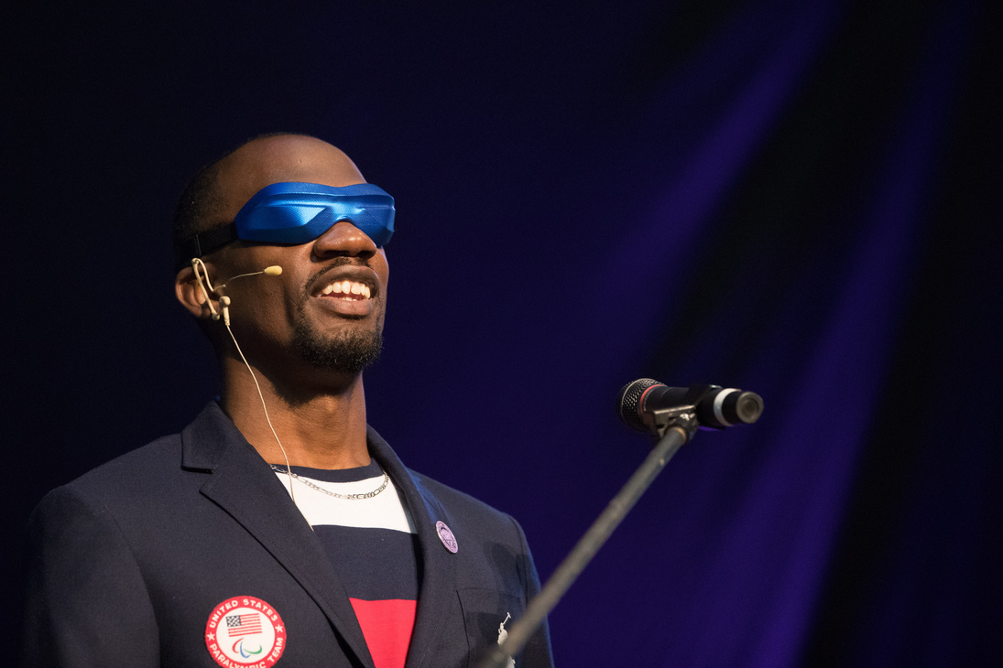
LEX GILLETTE
Speaker │ Advisor│Athlete
Available for:
  Accessibility consulting
  Advisory board participation
  Event accessibility planning
  Executive briefings
  Workshops
  Keynote presentations
  Customer experience consulting
  Inclusive design strategy
Lex Gillette is an accessibility advisor, inclusive experience consultant and Paralympic Champion.
Building Accessibility That Works for Everyone
Accessibility is about creating experiences where every person can participate with confidence, independence, and dignity.
As a world-renowned Paralympic medalist, keynote speaker, and accessibility advisor, Lex Gillette helps organizations design experiences that remove barriers before they become obstacles. His unique perspective combines lived experience as a blind professional, years of advocating for inclusive design, and firsthand collaboration with some of the world's leading organizations.
Why Organizations Work with Lex
As someone who has navigated airports, stadiums, transportation systems, hotels, workplaces, and public spaces without sight, Lex understands how small barriers can dramatically impact the overall experience.
His recommendations are practical, actionable, and grounded in real-world use, not just compliance requirements.
“Lex brings an inspiring and compelling message about becoming the best version of yourself. His own journey and story are ripe with rich leadership insights delivered in a poignant and humbling fashion.”
Meta
858-261-8936
www.lexgillette.com
1741 Eastlake Pkwy, Ste 102, Chula Vista, CA 91915
info@lexgillette.com

Slide 2
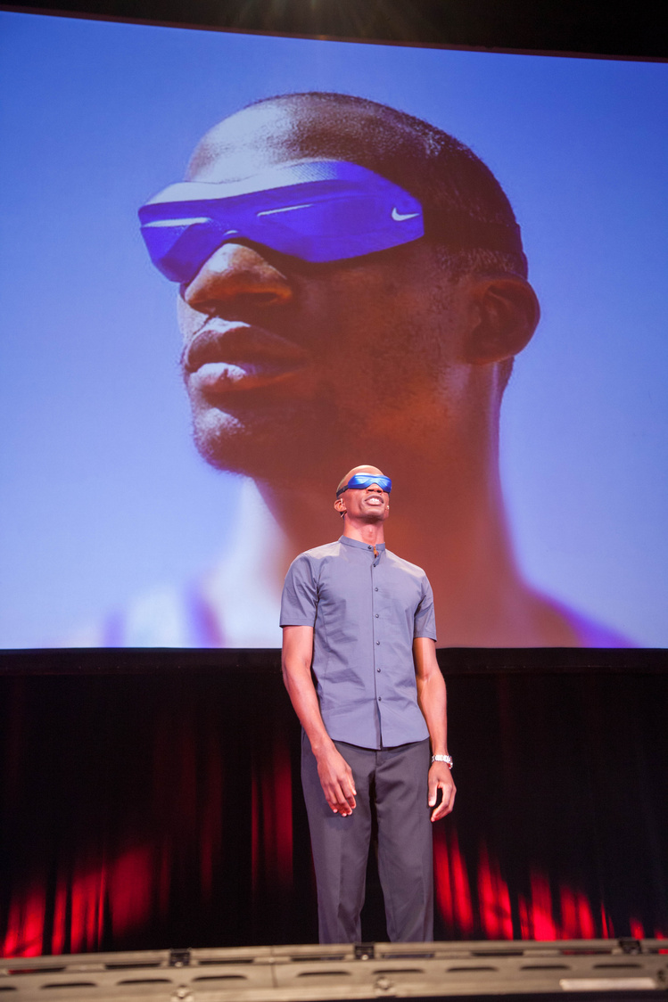
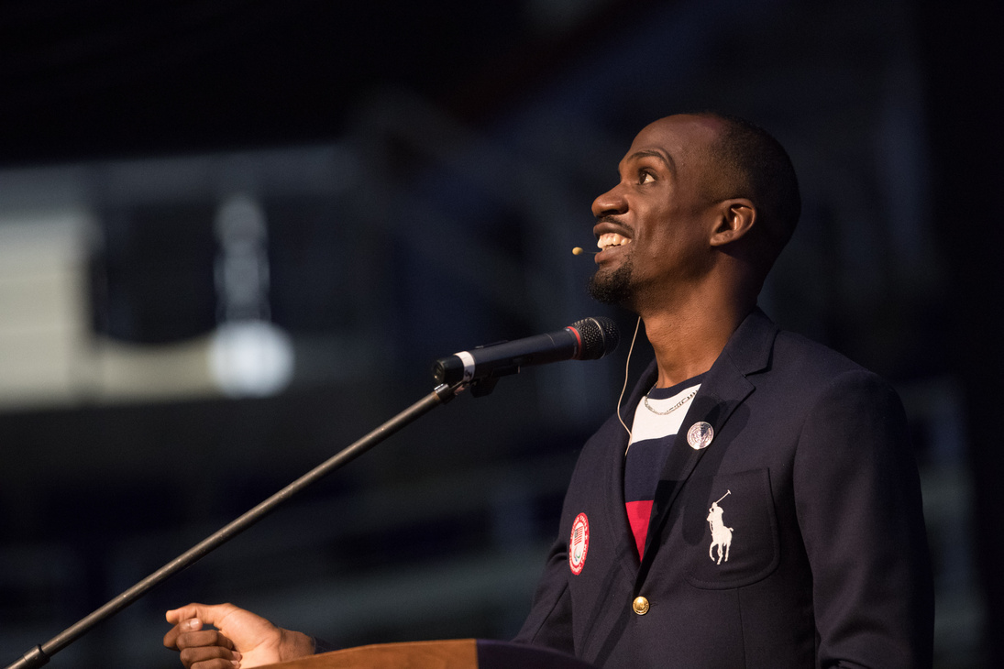
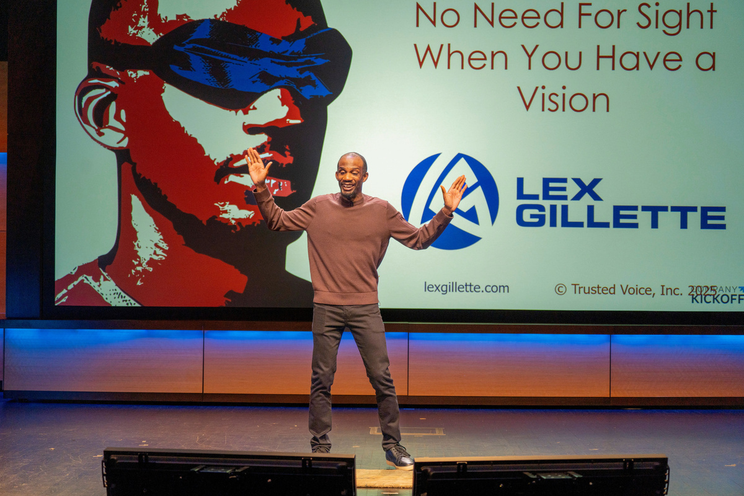
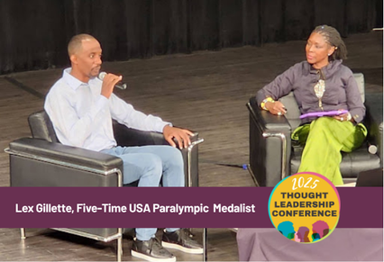
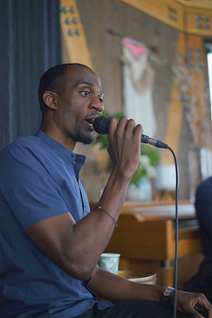
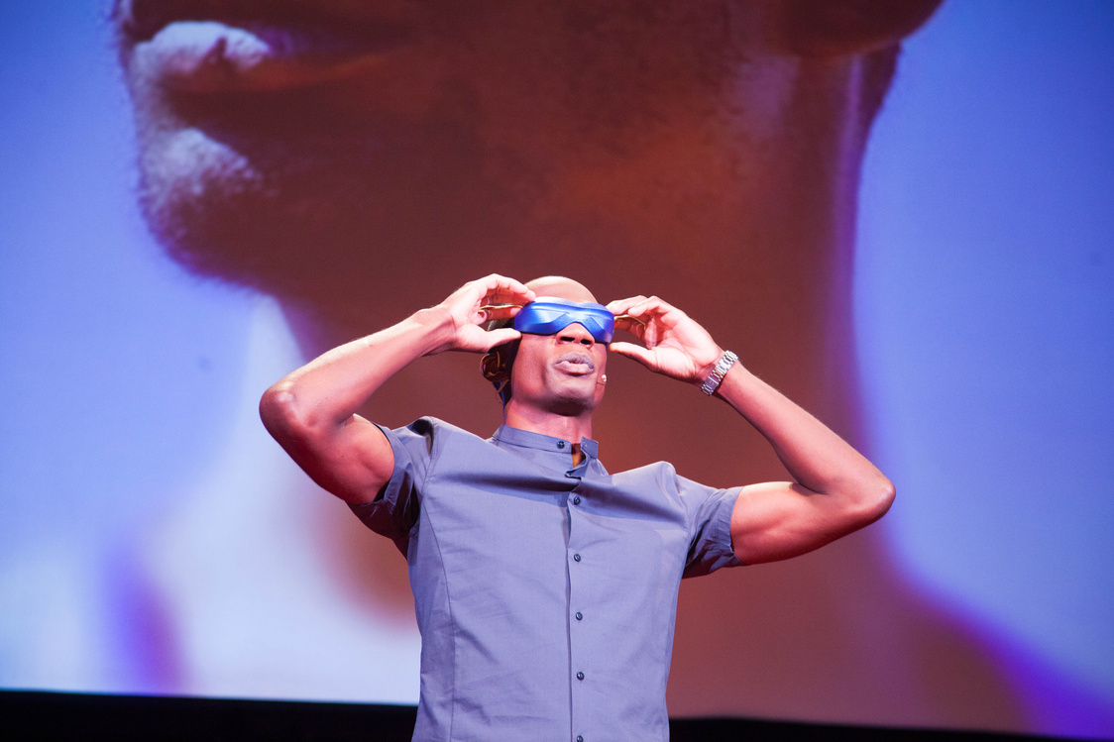



Organizations Lex Has Supported
FIFA 2026 Accessibility Advisory Board Member
As a member of FIFA’s Accessibility Advisory Board, Lex advised on accessibility planning for international football events. His work focused on the complete fan journey, including ticket purchasing and digital accessibility, transportation planning, arrival and venue navigation, wayfinding and signage, security screening, seating experiences, and restrooms and concessions.
United States Olympic & Paralympic Committee (USOPC)
As a Paralympic athlete and advocate, Lex has collaborated with the USOPC on initiatives that advance inclusion and improve accessibility throughout the Olympic and Paralympic movement.
National Organizations, Corporations & Universities
Lex has advised and educated organizations across industries including:
  Fortune 500 companies
  Healthcare organizations
  Educational institutions
  Professional sports organizations
  Government agencies, nonprofits and community organizations
Through keynote presentations, workshops, and consulting engagements, he helps leaders better understand accessibility through the lens of real-world experience.
858-261-8936
www.lexgillette.com
1741 Eastlake Pkwy, Ste 102, Chula Vista, CA 91915
info@lexgillette.com

