Slide 1
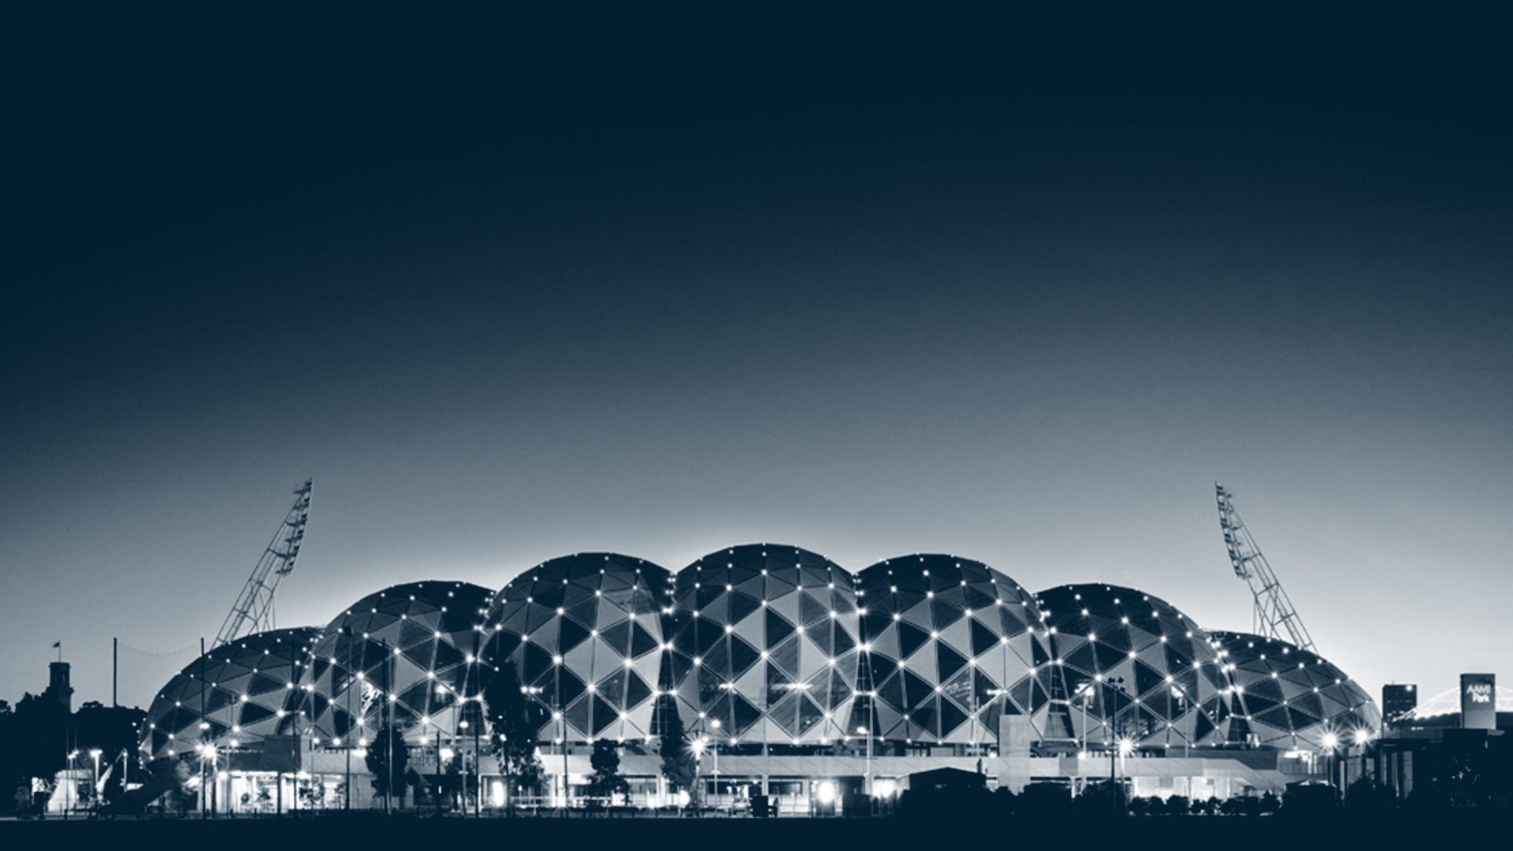


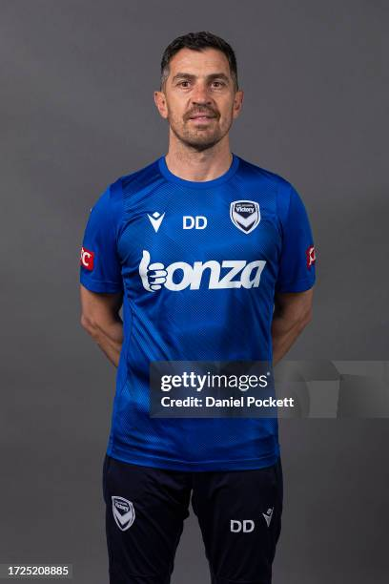
MVFC Co
Identification, Development and Integration of
Goal Keepers in the Youth Space.
Melbourne Victory
Lead - Unite - Connect - Inspire
MVFC Coach Development Webinar 2
ALM Head of Goal Keeping
Davide Del Giovine

Slide 2

AGENDA
Davides’ journey to today:
Professional in Italy
AC Milan academy
Sydney FC
Western Sydney Wanders
MVFC
5) Q&A (pre submitted questions)
3) Open discussion

Slide 3
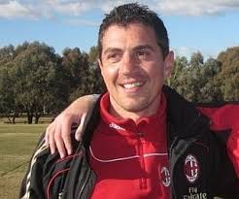
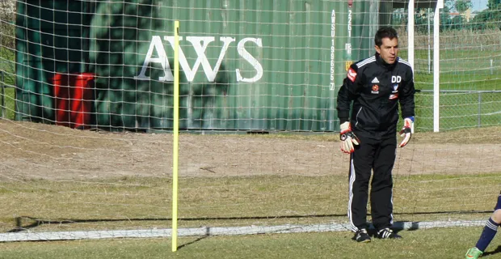
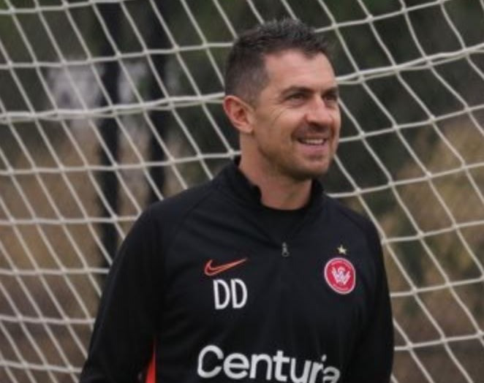

ADD A HE
COACHING JOURNEY TO DATE
Notes:
Your Journey to now as a coach – 10 mins
How did you climb through from your first experience coaching into an A league men’s GK coach.

Slide 4
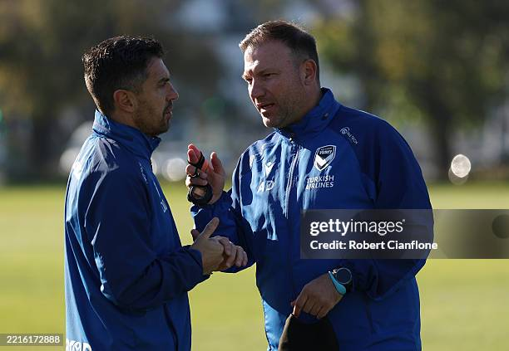
ADD A HE
Q&A
Notes:
Q&A (pre submitted questions) – 60 mins.
Gareth to facilitate. See attached pre submitted questions to date.

