Slide 1

Powerpoint
Template
AS OF DECEMBER 18, 2025​
HHM CPAS

Slide 2
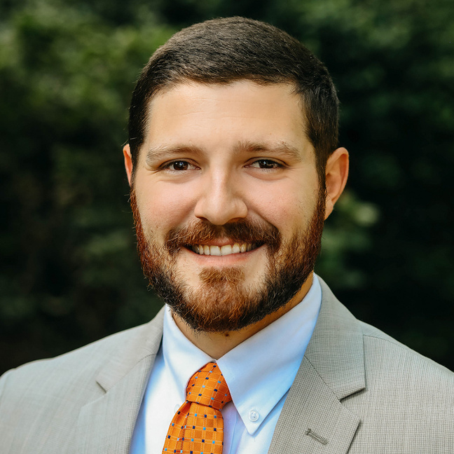
  6+ years of accounting experience
  Manager and Trainer at HHM CPAs
  Lee University, Bachelor of Science, Accounting and Finance
Introduction
Kyle Briner, CPA
Manager
HHM CPAs
kbriner@hhmcpas.com
423.756.7771

Slide 3

  5+ years of automotive accounting experience
  Supervisor at HHM CPAs
  Kansas State University, Bachelor of Science, Business Administration
  The University of Tennessee at Chattanooga | M.B.A. in Finance
  The University of the Cumberlands | B.S. in Accounting and Business Management
Introduction
Jacob Pardue, CPA, MBA
Supervisor
HHM CPAs
jpardue@hhmcpas.com
901.606.4062

Slide 4
Example
Title

Slide 5
EXAMPLE TEXT
  Example text

Slide 6
Example
Title

Slide 7
EXAMPLE TEXT
  Example text

Slide 8
Example
Title

Slide 9
EXAMPLE TEXT
  Example text

Slide 10
Example
Title

Slide 11
EXAMPLE TEXT
  Example text

Slide 12
Example
Title

Slide 13


Conclusion
  Healthy boundaries aren’t always about you in the moment
  It is on you to set your own boundaries, they will not be the same for everyone
  Respect and recognize other’s boundaries
  Hardest thing is to speak up about your boundaries

Slide 14
QUESTIONS?

