Slide 1

Recruiting and Marketing for SRC Members
Facilitators: Kate Travis, Board Member, Connecticut SRC;
Janette Lopez, Board Member, Arizona SRC

Slide 2



Objectives
Identify one new recruitment idea to take back to your state.
Recognize a partnership that could be strengthen.
Explain how to message SRC membership as a leadership opportunity, not just a committee role.

Slide 3
People join missions, not meetings
SRCs are often looking to:
Increase diversity of members (by disability type, geography, lived experience, and background).
Ensure representation from business, labor, community-based organizations, and current or former applicants/recipients of VR.
Build awareness among potential applicants and partners about what the SRC is and why it matters.
Strengthen the pipeline of future members and community champions.

Slide 4
Why I joined
What inspired you to serve on the SRC?

Slide 5
Mandated SRC Members
SILC representative
Parent training and information center representative
CAP representative
Qualified VR counselor (ex officio if employed by DSU)
CRP representative
Business, industry and labor representatives (4!)
  One from the state WIB
Disability advocacy groups

Slide 6
Mandated SRC Members – continued
Current or former applicants or recipients of VR services
Section 121 representative (if applicable)
State educational agency representative
Director of designated state unit

Slide 7

Activity: The outreach menu
At your table, brainstorm and fill in your “Outreach menu” together. Think creatively – mix and match ideas!
1. Identify up to four audience groups (e.g., business leaders, VR client, community organizations)
2. For each audience, discuss and note:
Best outreach method (e.g., social media, local events, word of mouth, partnerships)
Key message or hook – What’s your “wow” factor that gets their attention?
Barriers – What challenges might you face reaching this group?
Step 3: Be ready to share one idea from your table with the group!
Notes:
Encourage each table to share their best “pitch” or single recruitment idea.
Debrief Questions:
1. What creative ideas came up at your table?
2. What’s one new message or method you hadn’t thought of before?
3. How could your state adapt these ideas with your VR partners?
4. What resources or support would make recruitment easier?

Slide 8

Debrief
What outreach approaches overlap across states?
What’s one new message or method you hadn’t thought of before?
How could your state adapt these ideas with your VR partners?
What resources or support would make recruitment easier?
What’s your key message or “hook”?
Why should someone want to join your SRC?
What makes it meaningful, impactful, or rewarding?
Notes:
Encourage each table to share their best “pitch” or single recruitment idea.
Debrief Questions:
1. What creative ideas came up at your table?
2. What’s one new message or method you hadn’t thought of before?
3. How could your state adapt these ideas with your VR partners?
4. What resources or support would make recruitment easier?

Slide 9



Recap
Recruitment = Storytelling + partnerships + follow-up
Every SRC member is a recruiter
Start small: One message, one outreach channel, one ambassador

Slide 10
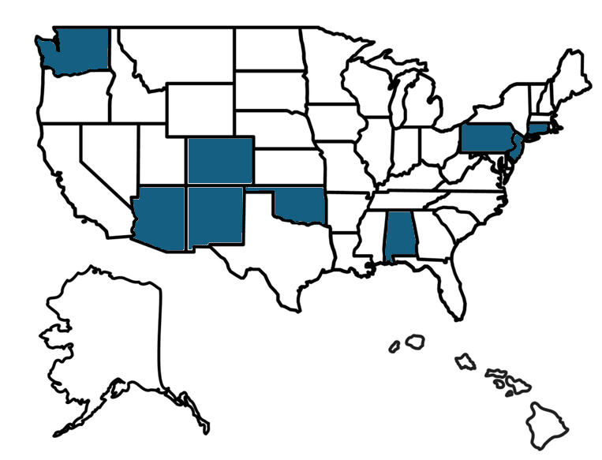
NCSRC
  Board member recruitment and onboarding!
  Current representation from:
    Washington
    New Jersey
    Connecticut
    Oklahoma
    Colorado
    Pennsylvania
    Alabama
    New Mexico
    Arizona
https://www.ncsrc.us/
10

Slide 11
Thank you!
11
Notes:
Divider Slides 2

