Slide 1

NCSRC 20th Anniversary
NCSRC Board Members

Slide 2
History
In November 2005, a group shared lunch at the CSAVR conference in San Diego discussing the benefits to establishing a national organization to support training and development of SRCs.
The National Steering Committee was created, with the support of the Rehabilitation Services Administration, and started convening bi-monthly national conference calls.
Overtime members were asking for additional training, so they started meeting in person for half day the day before the CSAVR conference.
As the strategic plan, goals, networking interests, and educational needs evolved, after two years the half day training shifted to a full day.

Slide 3
History
By 2007, as a result of the dedication and commitment of SRCs, the conference was now being held on Saturday and Sunday prior to CSAVR conference.
Topics covered at conferences generally included:
SRC Basics
Strategic Planning
Leadership development
Best practices
Member recruitment
Orientation
Bylaws
Policy
Notes:
Strategic Planning
Leadership development
Core values
Best practices
Member recruitment
Orientation
Bylaws
Policy

Slide 4
History
NCSRC partnered with the Institute on Rehabilitation Issues to publish the “The State Rehabilitation Council-Vocational Rehabilitation Partnership” in 2011.
First resource of its kind to provide guidance on how SRC and VR program should work together.
Overview of History and Law
SRC Basics
Business Practices
Implementation of Responsibilities
SRC Resources
Notes:
The IRI History – Partnership with RSA, CSAVR, and George Washington University Technical Assistance and Continuing Education Center.
The primary purpose of the Institute on Rehabilitation Issues (IRI) was to develop publications for use in training and technical assistance for vocational rehabilitation (VR) counselors, consumers, administrators, and other partners in the VR process.
IRI publications provide a unique perspective on emerging issues in vocational rehabilitation as both the topics and the content are developed by practitioners. For more than fifty-five years, the IRI was a national forum for discussing the important challenges facing the State Vocational Rehabilitation (VR) Services Program. It is the longest running event of its kind in the rehabilitation field, and one of the longest in the human services profession. The Rehabilitation Services Administration (RSA) sponsored the IRI in collaboration with representatives from the State VR agencies, consumer groups, and other stakeholders in the VR program, in order to develop a linkage between knowledge development and practitioner utilization

Slide 5
History
WIOA Reauthorization in 2014 – No funding for Institute on Rehabilitation Issues (IRI) or Technical Assistance and Continuing Education (TACE).
The IRI “SRC-VR Partnership” needed to be updated – NCSRC took the lead to develop a writing team, that included 7 original writers. (2 TACE staff, 2 State Directors, SRC members or VR Liaisons)
In 2019, two publications were released:
SRC-VR Partnership Under WIOA
Guidebook for SRC Chairpersons, Members, and Administrators
In 2020, pandemic shifted away from in person conferences to virtual meetings/trainings a few times/year
In Fall 2022, NCSRC returned to in person conferences.
Notes:
The IRI History – Partnership with RSA, CSAVR, and George Washington University Technical Assistance and Continuing Education Center.
The primary purpose of the Institute on Rehabilitation Issues (IRI) was to develop publications for use in training and technical assistance for vocational rehabilitation (VR) counselors, consumers, administrators, and other partners in the VR process.
IRI publications provide a unique perspective on emerging issues in vocational rehabilitation as both the topics and the content are developed by practitioners. For more than fifty-five years, the IRI was a national forum for discussing the important challenges facing the State Vocational Rehabilitation (VR) Services Program. It is the longest running event of its kind in the rehabilitation field, and one of the longest in the human services profession. The Rehabilitation Services Administration (RSA) sponsored the IRI in collaboration with representatives from the State VR agencies, consumer groups, and other stakeholders in the VR program, in order to develop a linkage between knowledge development and practitioner utilization

Slide 6
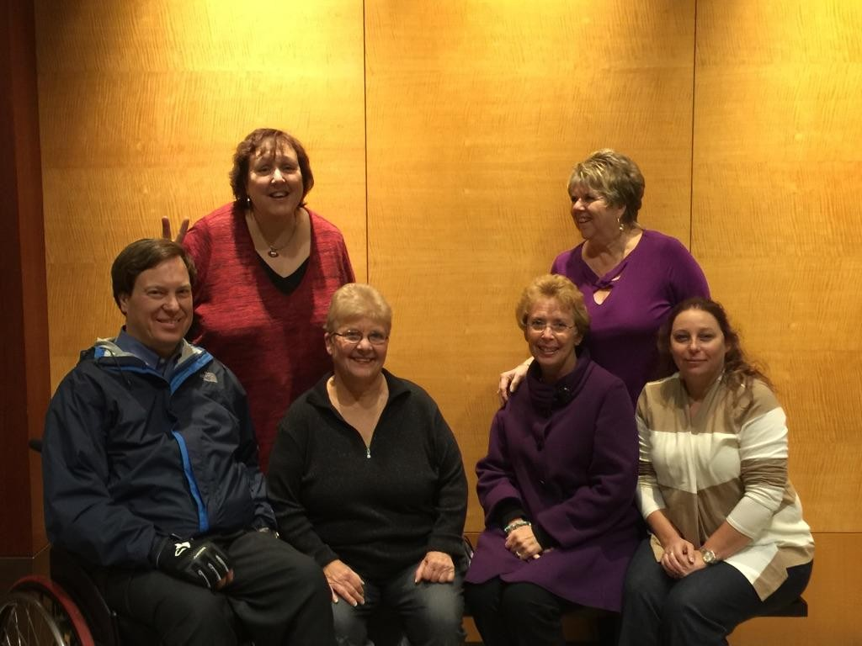
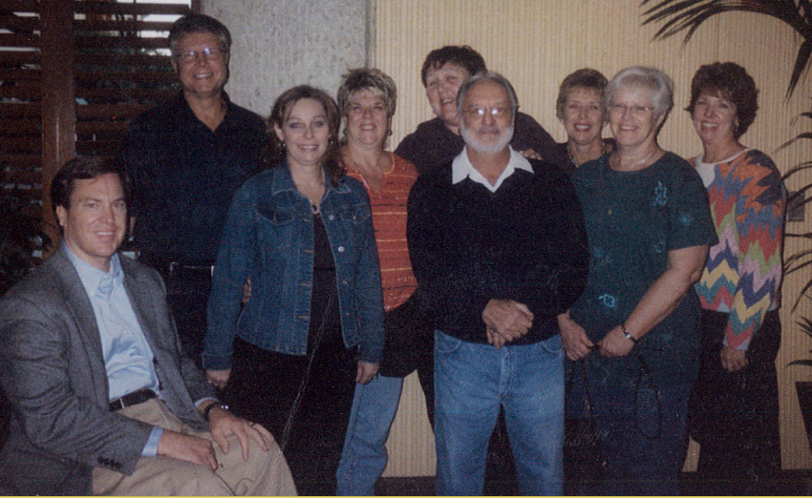
Over the Years

Slide 7
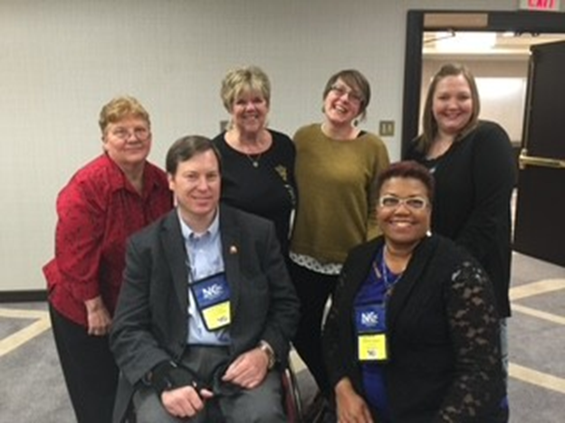
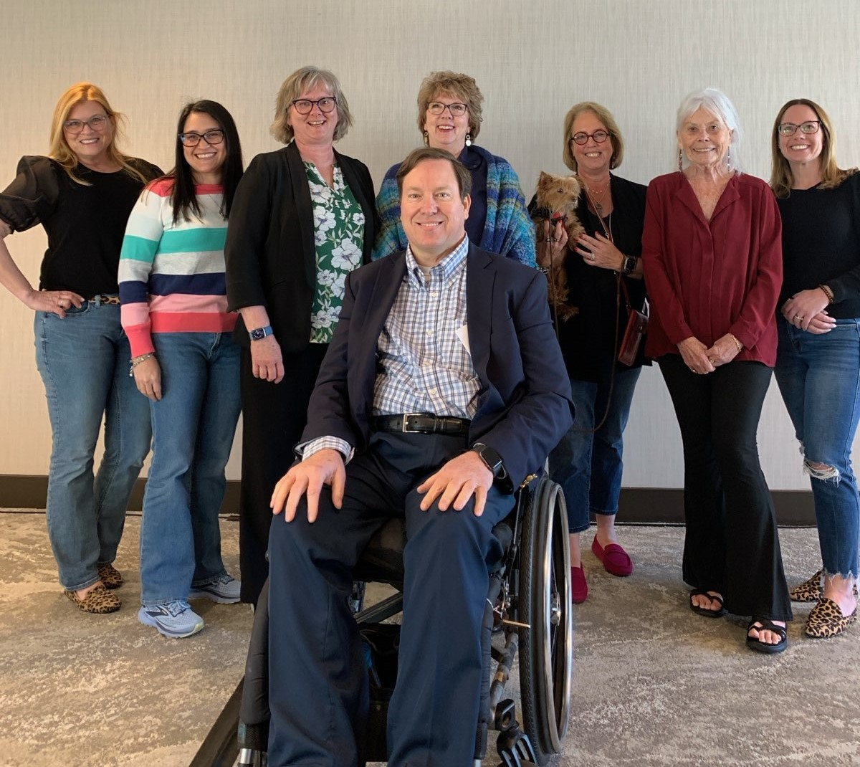
Over the Years

Slide 8
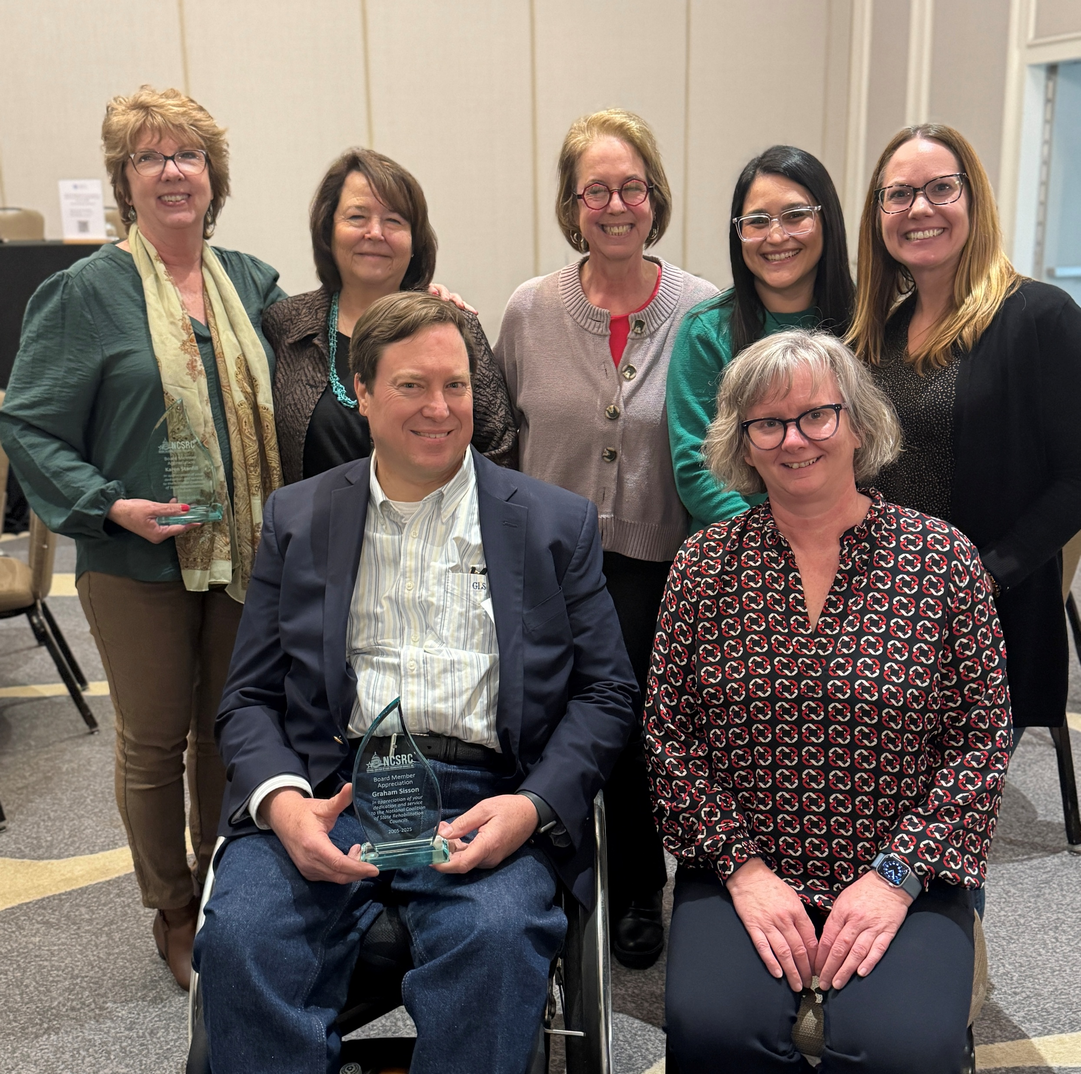
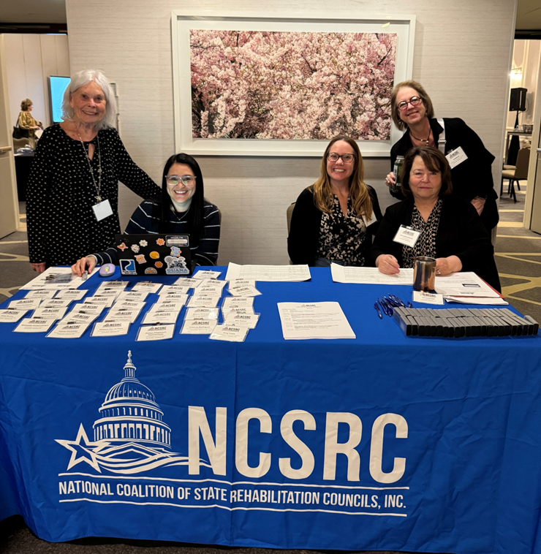
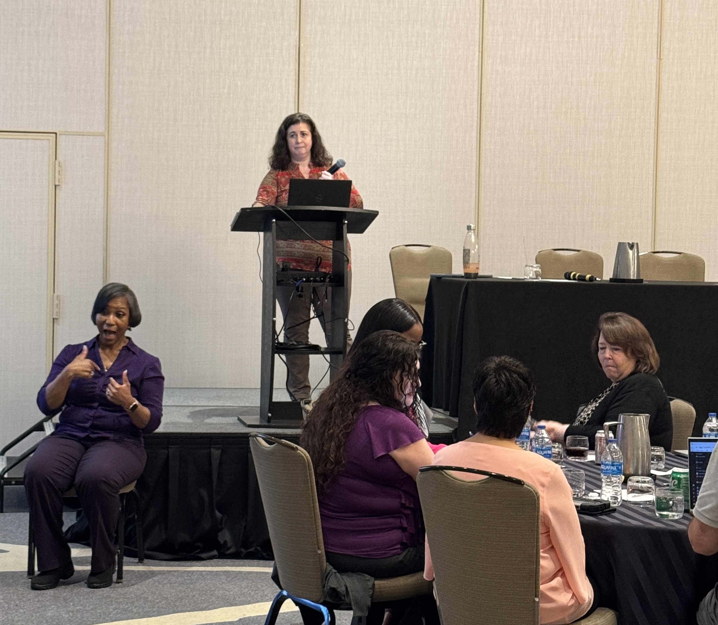
Over the Years

Slide 9
Present Day
In 2025, we are celebrating our 20th Anniversary!
Long standing Board members retired/retiring:
Graham Sisson – Founding Board Member
Karen Stanfill – Founding Board Member
Pat Tomlinson
Tom Jennings
Bernadine Chavez
New Leadership
President – Shelby Satko
Vice-President – Kerri
Treasurer – Theresa Hamrick (ex officio) - Founding Board Member
Secretary – Julia Barol

Slide 10
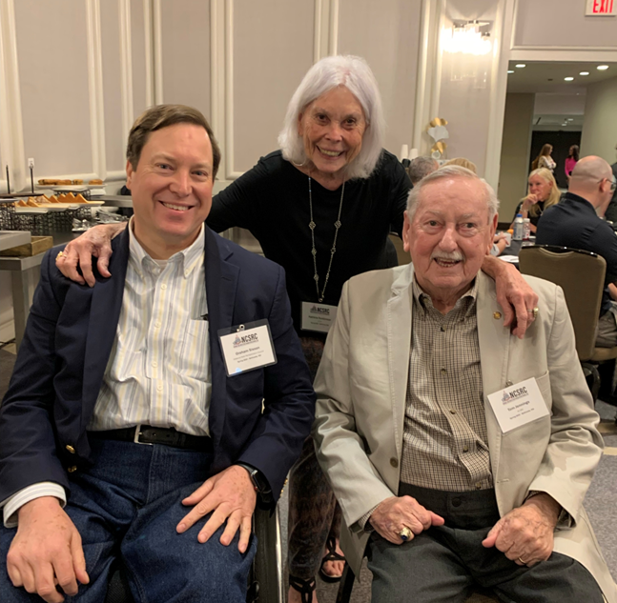
Honoring Pat & Tom

Slide 11
Present Day
In 2025, we are in a season's change.
Board member recruitment and onboarding
Representation from:
Washington
New Jersey
Connecticut
Oklahoma
Colorado
Pennsylvania
Alabama
New Mexico
Arizona

Slide 12
Present Day
Primary Goals continue to be:
Increase the capacity of SRCs through education & training.
Enhance the NCSRC infrastructure at regional and national levels.
Establish partnerships which build a stronger alliance, while advocating on behalf of the public vocational rehabilitation system.
Host two conferences each year
Spring – Washington DC
Fall – location varies
Strong partnership with CSAVR
Looking to preserve the future of VR, ensure NCSRC is set up for future success, onboarding new board members, and build strong partnerships

Slide 13
NCSRC Website Resources
Resources - https://www.ncsrc.us/resources-for-srcs
Annual Reports – Look at SRC reports from other states
Guidebooks
State Rehabilitation Council Chairpersons, Members, and Chairpersons (Blue Book)
SRC-VR Partnership Under WIOA (Yellow Book)
WIOA Resources
Rehabilitation Services Administration Resources
Legislative Advocacy for SRCs

Slide 14
NCSRC Website Resources
SRC Member Training - https://www.ncsrc.us/src-member-training
SRC Training Series – VRTAC-QM
SRC Strategic Planning – Sample planning docs, PowerPoint, etc.
SRC Orientation Package
Includes several modules that provide an overview Rehabilitation Act of 1973 - Vocational Rehabilitation Services & SRC Regulations
Past Meeting Materials – Conference Presentations

Slide 15
Looking to the next 20 years
Notes:
Support bi-annual virtual meetings/training
Inquiries- discussion
What resources and tools are you interested in?

