Slide 1



FUNDRAISING PROGRAM
The Sweetest Partnership Around
Raise Money for your DECA chapter WITH TRADITIONAL COOKIE DOUGH FUNDRAISING

Slide 2
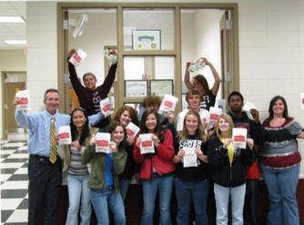
Otis Spunkmeyer and DECA
Otis Spunkmeyer and DECA – partners for more than 32 years
Otis Spunkmeyer is proud to sponsor the SBE Academy, providing scholarships to students
Ads in DECA Direct
Executive Mentor Program at ICDC
Providing judges for ICDC competitions

Slide 3
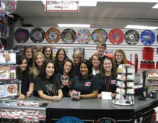
Fresh baked cookies in the
School Store and Much More!
Ideas for making money with Otis Spunkmeyer fresh baked cookie program
  After and in-between classes
  Breakfast before class
  School activities around campus
  Target parent events on campus
  Try selling to teachers by the dozen for the teacher lounge
  Advertise though word of mouth, flyers, school website, Twitter, Facebook, Instagram and other social networks, and take-home letters to parents
The profit potential of fresh baked cookies is nearly 50% and will help fund a variety of your chapter’s activities

Slide 4
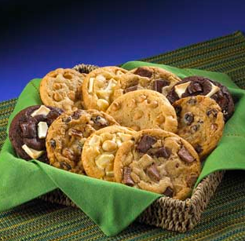
Fresh Baked Cookies…..Yum!
Free oven with proof of 3 cases per month
Free display case with proof of 3 cases per month
POS available to print
Cookie accessories available for purchase
  Cookie jars
  Cookie boxes
  Cookie bags
Special pricing program when using Foodservice Distributors

Slide 5

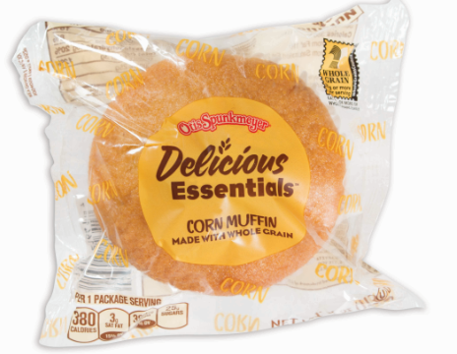
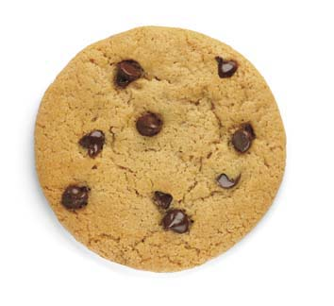

Nutritional Challenges
Otis Spunkmeyer developed the Delicious Essentials brand to meet the USDA Smart Snacks regulations with a line of whole-grain foods; from Frozen Cookie Dough to individually wrapped Muffins.
Meets Smart Snacks

Slide 6




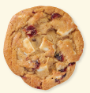
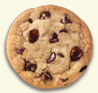
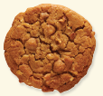



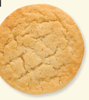
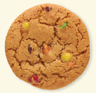
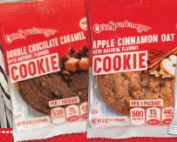
Otis Spunkmeyer Cookie Portfolio
An upscale, high inclusion all-butter cookie dough; perfect for operators who want to serve only the finest cookies.
The #1 frozen cookie dough in America, Sweet Discovery is loaded with the finest ingredients. The cookies bake consistently with a uniform look across every flavor.
Cookie dough with a home-baked look and taste. Less uniform and more imperfections to bake with a hand-made appearance.
Premium Tier
Made with 100% Sweet Cream Grade AA Butter
2 Sizes (2oz & 3oz)
6 Flavors
Mid-Tier
Butter/Palm Oil Blend
2 Sizes (1.5oz & 3oz)
4 Flavors
Thaw & Serve: 1.33oz
Chocolate Chunk
Gourmet Tier
Butter/Margarine Blend
3 Sizes (1.33oz, 2oz, & 4oz)
18 Flavors
Smart Snacks
Cookie dough for the cost sensitive operator. The right choice for high-volume applications, including tray feeding.
Cookie recipe is made to meet the Smart Snack school requirements, including being high in whole grain, lower in fat and sugars..
Convenient Thaw & Serve cookies. No
baking required.
Bulk & IW
Butter/Margarine Blend
Bulk 2oz, 3 Flavors
Individually Wrapped
2 Sizes (2 & 4oz)
4 Flavors
Value Tier
Palm Oil / Margarine Blend
3 Sizes (1oz, 2oz, 2.5oz)
6 Flavors
K-12 - 51% Whole Grain
Palm Shortening Blend
4 Sizes (1oz, 1.5oz, 1.85oz)
5 Flavors

Slide 7

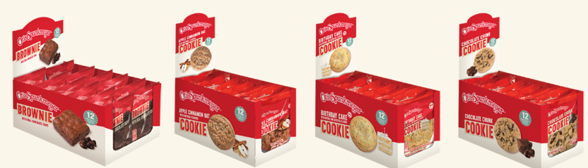
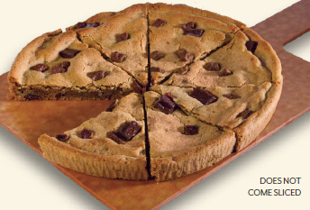
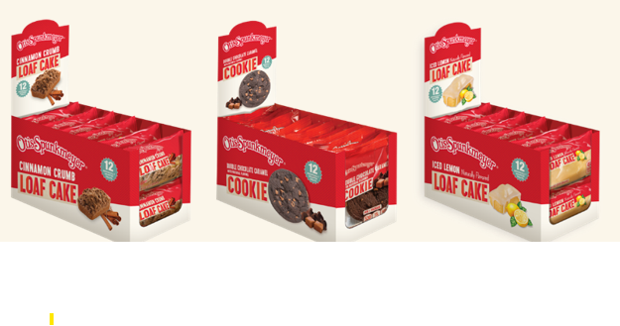
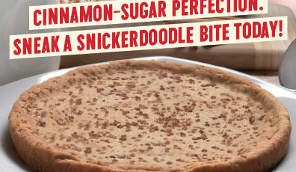
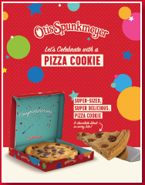
Otis Spunkmeyer Cookie Portfolio
NEW
Irresistible individually fully baked wrapped cookies, loaf cakes and brownies now available in a caddy pack. Packed 2-12 count 4oz cookies; 4-12 count 3oz brownies; 2-12 count 4oz loaf cakes.
Introducing the Otis Spunkmeyer 8” Pizza Cookie! Pre-baked in 2 flavors, packed 24-11.4oz cookies. Celebration boxes are available for purchase from the Otis ovens website.
These are not whole grain and do not meet Smart Snacks.

Slide 8
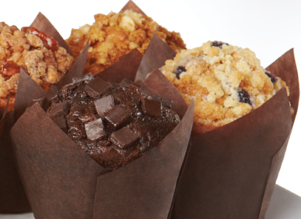
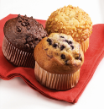
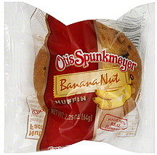
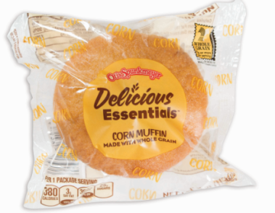
Otis Spunkmeyer Muffin Portfolio
Smart Snacks
Supreme Muffins
Super-Premium Quality
Otis Spunkmeyer Muffins (IW)
Premium/Gourmet Tier
3 sizes: (2.25oz, 4oz, 6.5oz)
Delicious Essentials
Meets K-12 Smart Snacks Requirements
Otis Spunkmeyer Muffins (Bulk)
4oz - 5 flavors – Blueberry Crumb Cake, Decadent Chocolate Chunk, Triple Berry Whole Grain, Apple Cinnamon Pecan, Banana Bread
2.25oz
Premium/Gourmet Tier
6 Flavors & variety pack
8 Flavors & variety pack: Wild Blueberry, Banana Nut, Chocolate Chip, Apple Cinnamon, Double Chocolate Chip, Lemon Poppy Seed, Corn, Cheese Streusel
Made with 51% Whole Grains
Available in 6 flavors
2 sizes (2oz & 4oz)
2 oz. contains 1 creditable grain ounce equivalent
4 oz. contains 2 creditable grain ounce equivalents (used for breakfast entrees)
Wild Blueberry, Banana Nut, Harvest Bran, Double Chocolate Chip, Apple Cinnamon, Corn
Blueberry, Banana, Double Chocolate Chip, Apple Cinnamon, Corn, Chocolate Chip
Notes:
Why sell for each tier

Slide 9
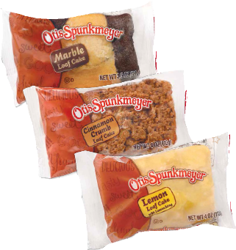
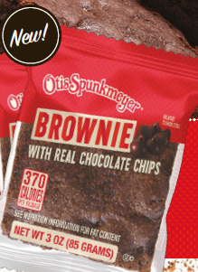
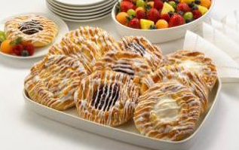
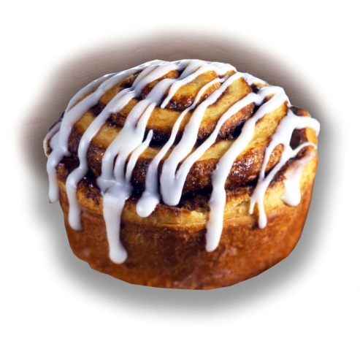
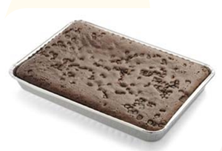
Other Otis Baked Goods
Danish
Thaw & Serve
Cinnamon Rolls
Thaw & Serve
Cinnamon Rolls with Icing Cup 40/6.5oz
Brownies
Double Fudge Chocolate Chip Brownie quarter sheet 8/40oz
Loaf Cakes
Packed: 24/4oz
Grab n Go
3 Flavors: Lemon, Marble, Cinnamon Crumb
Individually wrapped
Honey Glazed Cinnamon Rolls 60/4.4oz
La Francaise Bakery Brand
La Francaise Bakery Brand
Variety: Apple, Cheese, Raspberry 16/1.25oz
Variety: Apple, Cherry, Cheese 72/2.75oz
Variety: Cherry, Cheese 84/2.25oz
Variety: Apple, Cheese, Raspberry 24/2.75oz
Cream Cheese Iced Cinnamon Rolls 60/4.4oz
Thaw & Serve Individual Wrapped Brownie 48/3oz
Notes:
Why sell for each tier

Slide 10

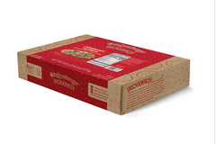
Sell More – Make more
Selling our 2.5 lb boxes of pre-portioned cookie dough is a great way to make money for your chapter
  No upfront costs to you
  A variety of Otis Spunkmeyer flavors
  288/1.1oz
  Well recognized – everyone loves the Otis Spunkmeyer brand
Otisspunkmeyer.com/fundraising/contact for more information

Slide 11

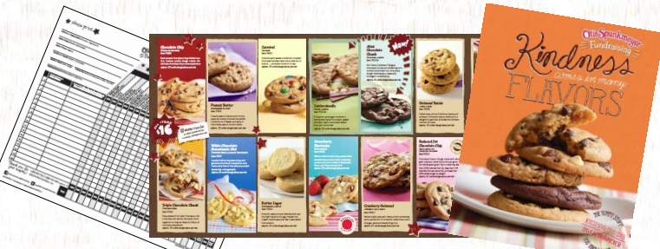
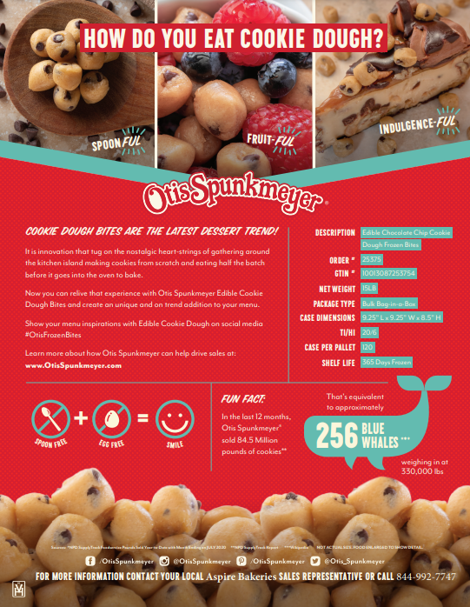
How it works
We have dedicated fundraising partners across the country who want to help you raise money for your DECA Chapter!
Every DECA student can sell to family and friends
Put a catalog and order form by your register in your school store
Extend your sale, 2 weeks-3 weeks to reach maximum profits

