Slide 1


Slide 2
Vision
To create a better future for children and young people by equipping teachers, support staff and pupils with the skills and confidence to to use technology and AI safely, responsibly and effectively.

Slide 3
Guiding principles
Personalised learning
AI can enhance learning through targeted tasks and feedback
Reduce workload
AI can reduce workload in aspects such as admin, lesson preparation and marking.
AI won’t replace everything
AI should not replace everything such as writing and hands on learning.
Growth mindset
AI can help teachers, leaders, pupils to innovate and improve current performance.
AI should support, not replace teachers. It will always take a human connection to teach. The role of AI is to enhance and support.

Slide 4
Our AI strategy (draft)
2025
2026
2028
20XX
AI Working Party
AI Foundations
Rapid development
AI enabled education
Policy
Baseline survey data
Brief guidance documents
Staff CPD - some apprenticeships on AI
Develop AI curriculum for pupils
AI test and trial
AI curriculum in schools
Impact of AI apprenticeships
Implement and embed AI into operations and strategy
Joined up data
Evolution of workforce
Engage with sector and DFE led rules and regulations

Slide 5
2025 aims
Establish a working party
Create an AI policy
Survey staff and pupils about their understanding of AI
Create basic guidance documents for pupils, parents and pupils
Enrol staff on Digital or AI apprenticeships

Slide 6
2025 Working Party
28 members
All schools and teams.
3 meetings
Collaborative work
Next steps - to be continued in 2025-26 with opt out and relaunch for new members

Slide 7
2025 AI policy
Draft completed with Working Party
With Shalene for roll out to Headteachers

Slide 8
Insights from staff survey
📊 Key Insights from the Survey Data - 118 completed from all schools
1. Respondent Roles
A wide range of roles are represented, including Senior Leaders, Middle Leaders, Teachers, Administrators, Learning Support, and Central Team members.
The most common roles are Middle Leaders and Teachers.
2. Confidence in Understanding AI
Confidence levels range from 1 (low) to 5 (high).
A significant number of respondents rated themselves 4 or 5, indicating strong confidence in understanding AI.
3. Knowledge of AI in Education
Most respondents describe their knowledge as basic or well-informed.
A few respondents indicated they could train others on AI.

Slide 9
Insights from staff survey
4. AI Tools Mentioned
The most frequently mentioned tools include:
ChatGPT
Gemini
Oak Academy Aila
TeachmateAI
Microsoft Copilot
Claude
Canva AI
5. Perceived Benefits of AI in Education
Commonly cited benefits include:
Generating lesson plans
Marking student work
Analysing data and identifying learning gaps
Personalising learning
Supporting students with SEND

Slide 10
Insights from staff survey
6. Concerns About AI
Top concerns (to be visualized after fixing the error) include:
Data privacy and security
Over-reliance on technology
Potential bias or inaccuracies
Equity of access for students
Job security for staff
Environmental impact
7. Training and Interest
Most respondents have not received formal training on AI.
However, there is a high level of interest in learning more about using AI effectively.
Next steps - 2025-26 CPD for all staff to increase all staff awareness and develop skills. Remeasure in summer 2026.

Slide 11
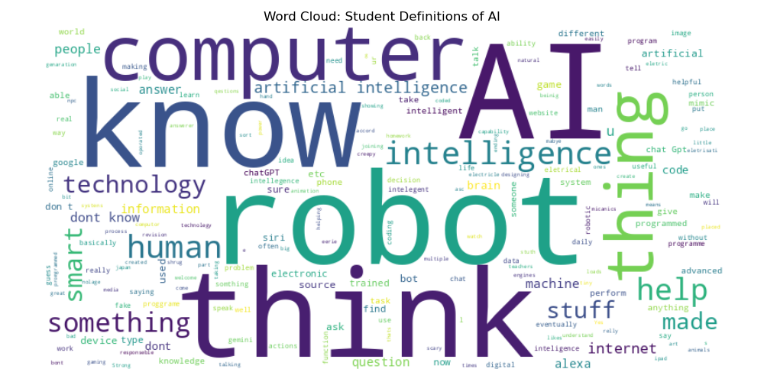
Insights from KS2 survey
This word cloud highlights the most frequently used terms by students when defining Artificial Intelligence

Slide 12
Insights from KS2 survey
304 pupils completed this from 2 primaries - Dulwich Hamlet and Loughborough
Students are curious and excited about AI, though many haven't deeply thought about it.
Most students have interacted with AI tools like Alexa or ChatGPT.
AI is commonly associated with phones, tablets, video games, and the internet.
Benefits include quick access to information, help with learning, and fun.
Concerns include misinformation, over-reliance, cheating, and safety/privacy issues.
Many students want to learn more about how AI works.

Slide 13
Insights from secondary survey
📊 Overview of the Dataset 814 students completed it from Charter North and Charter East
Topics Covered: Awareness, understanding, usage, attitudes, concerns, and interests related to AI.
Data Type: Combination of quantitative (Likert scale) and qualitative (free-text) responses.
1. Awareness and Understanding
All respondents appear to have heard of AI.
Average self-rated understanding of AI (on a scale of 1–5): → Mean score: 3.67
2. AI Usage
Majority have used AI tools, such as: ChatGPT (OpenAI), Google Assistant / Bard, Siri Snapchat AI
Main uses: Homework/studying, Asking general questions, Entertainment/fun

Slide 14
Insights from secondary survey
3. Confidence & Attitudes
Most students feel confident using AI safely.
Agreement levels (out of 5):
"AI is useful in everyday life": generally high.
"I feel confident using AI tools": moderate to high.
"AI should be used in schools": mixed opinions.
"I am worried about how AI might be used in the future": increasing concern.
4. Perceived Benefits - Common responses include: Faster work, Easier access to information, Efficiency, Help with learning and studying
5. Concerns - Most frequent concerns: Job displacement, AI safety (e.g., hacking, privacy), Over-reliance or lack of human involvement

Slide 15
Next steps: Charter AI curriculum
The insights from the secondary curriculum showed that pupils are interested in learning about:
How AI works
Creating or training AI
AI in schoolwork
Responsible AI use
How to spot fake news

Slide 16
2025 Guidance documents
Staff
Parent
Secondary pupil
Notes:
All available for adavies@tcset.org.uk

Slide 17
Digital / AI apprenticeships
Sign up from:
East Dulwich
North Dulwich
Teaching School

Slide 18
2026
a) Roll out an AI CPD to ensure that all staff understand the basics of AI, its potential, and its limitations.
b) Pilot AI tools in a controlled environment, focusing on administrative tasks such as scheduling, note-taking, and data analysis. ‘Test and trial’
c) Develop a sustainable methodology for safely onboarding and rolling out new AI technology.
d) Develop a governance framework for ethical and effective AI usage, addressing the need for data privacy and algorithmic transparency.
e) Develop an AI curriculum for pupils

Slide 19
2028 - ?
Deploy AI-driven interventions targeting Key Stage 4 outcomes, ensuring rapid identification and support for at-risk students.
Implement AI tools to support cost and workload reduction across administrative and operational processes, mitigating budget pressures.
Ensure that we embed consideration for AI into all other strategic initiatives that are in design or live, notably including our approach to assessment as this becomes digitised.
Review and restructure our IT service to ensure we are set up to support positive AI usage and respond to upcoming rapid development.
Identify AI tools with the potential to enrich curriculum delivery, conduct pilots in specific subjects to assess their effectiveness and scalability and develop guidance for educators on integrating AI their role.

Slide 20
20XX
a) Ensure that the initial steps we take and tools we use lead to a joined up data set that will be critical to achieving the long term vision.
b) Strategically plan for evolution of our workforce in response to emerging AI technologies that reshape roles.
c) Engage in sector wide and DfE led AI initiatives in order to influence and stay close to emerging AI laws and expectations put upon schools.

Slide 21

Use Copilot or Gemini
Our schools are either Microsoft or Google.
We advise you to use Copilot or Gemini on our licenses where possible. But do not put names or personal data in. This does allow you to put lessons / work in because this protects IP because it does not learn from your prompts. Microsoft accounts will soon have A3 licenses which will have even better safeguards for data.
You can also turn learning off in ChatGPT in settings which is useful at home too.

Slide 22
How to use… Chat GPT
What is it?
ChatGPT is an artificial intelligence chatbot developed by OpenAI. It's designed to understand and generate human-like text based on the input it receives. You can think of it as a very advanced virtual assistant.ChatGPT is powered by large language models (LLMs), primarily based on the GPT (Generative Pre-trained Transformer) architecture. These models are trained on vast amounts of text data from books, websites, and other sources to learn patterns in language.
Tips on how to use:
Find activity ideas in seconds
Get ready made practice questions
Adapt your materials to work for your group
Craft model answers
Get effective explanations and step by step examples
Test student understanding and avoid misconceptions
https://teachingwithchatgpt.org.uk/explore
⚠️ Be careful
Always review and verify content generated by AI.
Avoid over-reliance; use it to support—not replace—professional judgment.
Never put personal data into ChatGPT
Turn off ‘Improve the model for everyone’ in settings so that you don’t give your data to train the model.

