Slide 1

CPD

Slide 2
Overview of CPD
Session 1 - AI in education, prompts, policy and bias
Session 2 - Risks
Session 3 - Principles, benefits and practical strategies
Notes:
These are the objectives of today’s session

Slide 3
Session Objective:
By the end of this session:
Share insights from staff survey
Understand AI in education context
Have a go at a prompt on a LLM
Understand bias and hallucinations in AI systems
Received a copy of the policy
Notes:
These are the objectives of today’s session

Slide 4
🧠 Do Now - Knowledge check
Use these key words - prompt, artificial intelligence, generative AI, machine learning, deep learning, large language model
__________ is a term used to describe computer programs that can perform tasks typically requiring human intelligence, such as problem-solving and understanding language.
When you give an AI system an instruction or input to carry out a task, that instruction is called a __________.
__________ refers to the process of teaching computers to learn from data using algorithms and previous examples.
__________ is a more advanced form of machine learning that uses complex layers to help systems learn patterns and make decisions on their own.
__________ is a type of AI that can create new content like images, music, code, or writing based on patterns it has learned.
A(n) __________ is a special kind of AI that can read, understand, and generate human language, often trained on vast amounts of text.

Slide 5

Vocabulary Answers
Prompt - the input or instruction you give to an AI system.
Artificial intelligence (AI) - computer programs that are designed to complete tasks like a human such as problem solving, learning and understanding language.
Generative AI - a type of AI that can create new content such as images, text, video, audio and code based on its prior learning.
Machine learning - the way we teach programs to learn based on rules and prior knowledge.
Deep learning - a more sophisticated type of machine learning that is layered in complexity and can self-learn the rules.
Large language model (LLM) - an AI program that specialises in understanding and working with the human language. E.g. ChatGTP, copilot, Gemini

Slide 6
🧠 Knowledge check
Which of the following best describes generative AI?
a) AI that recognises your face to unlock your phone
b) AI that creates new content such as text, images, or audio based on a user prompt

Slide 7
🧠 Knowledge check
Which of the following best describes generative AI?
a) AI that recognises your face to unlock your phone
b) AI that creates new content such as text, images, or audio based on a user prompt (correct)

Slide 8
🧠 Knowledge check
What is a 'prompt' in the context of generative AI?
a) An instruction given by the user to generate content
b) A form of AI that creates personalised learning

Slide 9
🧠 Knowledge check
What is a 'prompt' in the context of generative AI?
a) An instruction given by the user to generate content (correct)
b) A form of AI that creates personalised learning

Slide 10
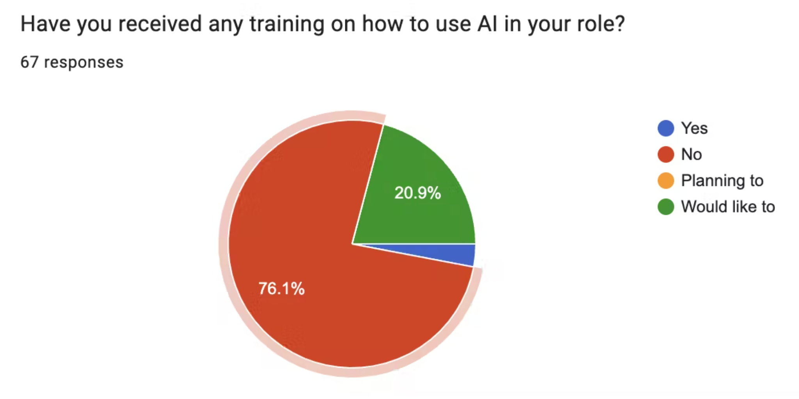
Insight from AI staff survey
📝

Slide 11
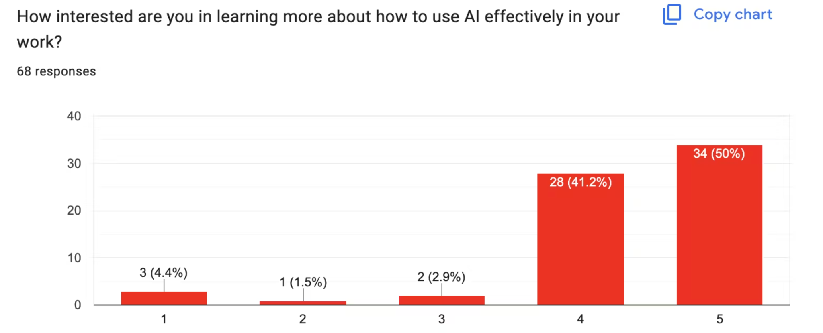
Insights from AI staff survey

Slide 12
Vision
To equip teachers, support staff and pupils with the skills and confidence to use technology and AI safely, responsibly and effectively.
Notes:
Allow staff to discuss this. Any questions can be sent to Adavies@tcset.org.uk. This is very much a starting point!

Slide 13

The context
Educators and policymakers have talked about the potential of all forms of digital EdTech to revolutionise education for at least 25 years, and UK governments and schools have invested heavily in software and internet connectivity.
AI is the most recent form of EdTech.
We can only make educated guesses about the general trajectory of new technologies like AI, precise predictions about their impact on schooling remain elusive.
As we navigate technological change, our only certainty is that we will be wrong!
Notes:
Contextualise AI within digitisation
We can only predict the impact on schooling.

Slide 14
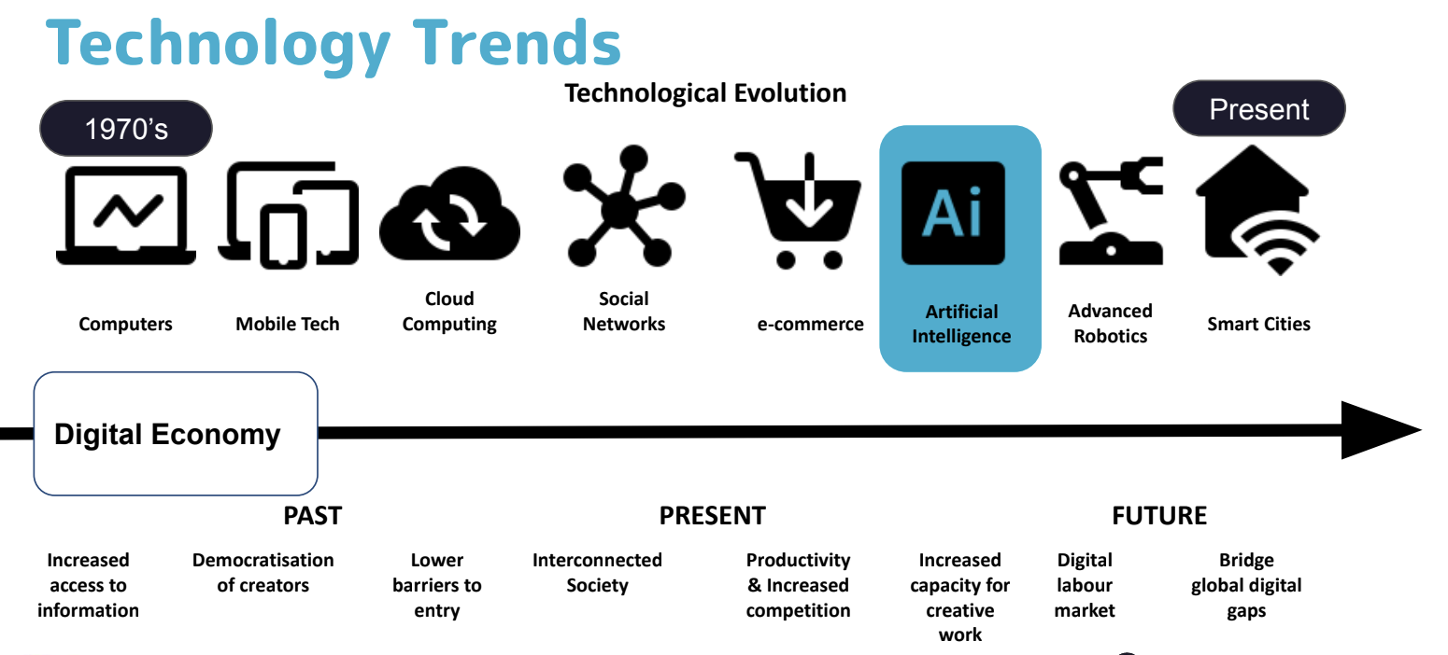
Context - AI & Digitisation

Slide 15
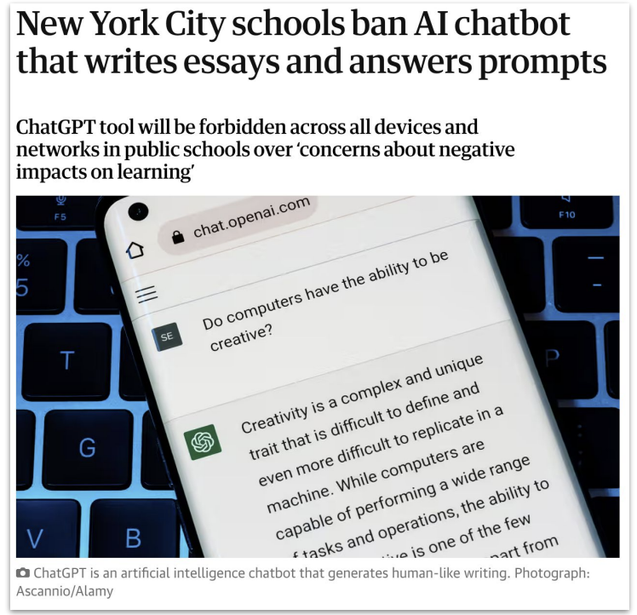
Context - Jan 2023
ChatGPT 4 was released
Notes:
But AI is here.
The next slides are meant to show rapid change
Beginning with concern

Slide 16
Becky Allen, September 2023
AI technologies do display proficiency in understanding subject matter and pedagogical techniques, often generating intriguing lesson ideas. However, according to Teacher Tapp, 72% of teachers craft their own lesson plans as a way to internalise and make sense of the subject matter they’re going to teach. This percentage is even higher among KS2 primary teachers and secondary English and humanities teachers, who often have to cover expansive knowledge domains….
Furthermore, teachers generally find lesson planning to be the most enjoyable aspect of their non-teaching duties….
So, is there room for AI to streamline the lesson-planning process? Absolutely, and it’s already happening. Teachers are integrating AI tools into their planning, treating them as professional allies. They can seek advice on the challenges students may encounter or collaboratively brainstorm teaching strategies. AI excels at automating mundane tasks like writing instructions or generating sample texts, thereby freeing up teachers for more creative and nuanced work.

Slide 17

This has had 3 iterations 2023,24,25
Notes:
And rules based interpretations of this rulw

Slide 18
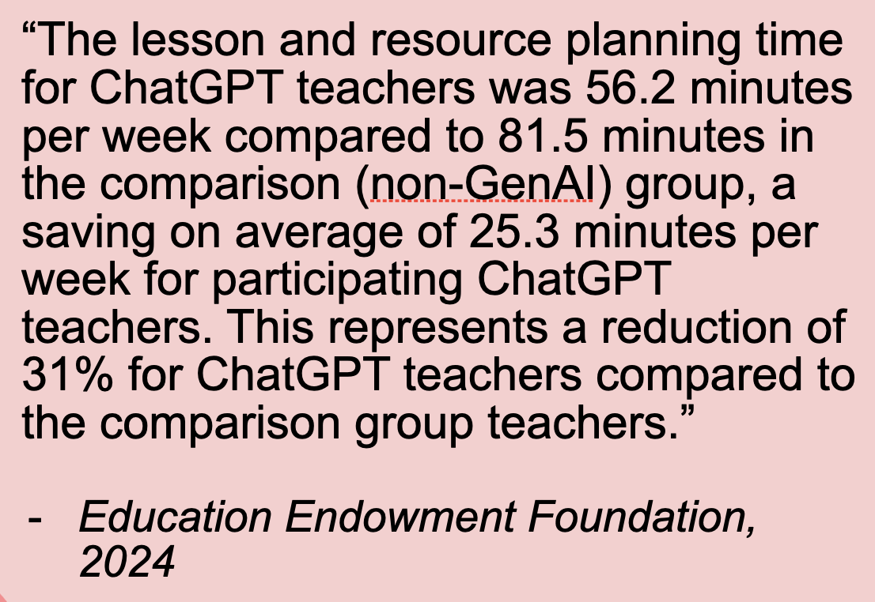
2024
Notes:
To understanding the benefits

Slide 19
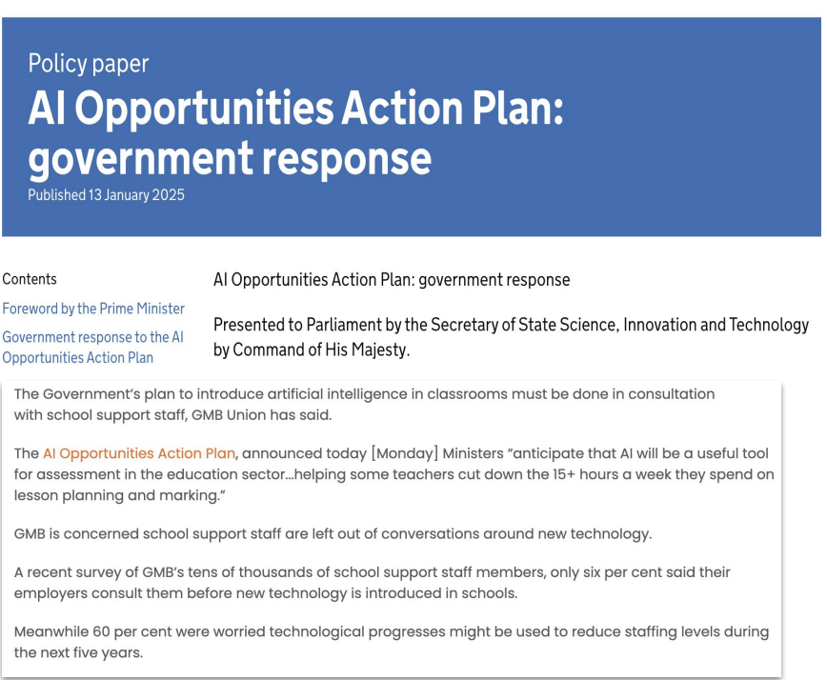
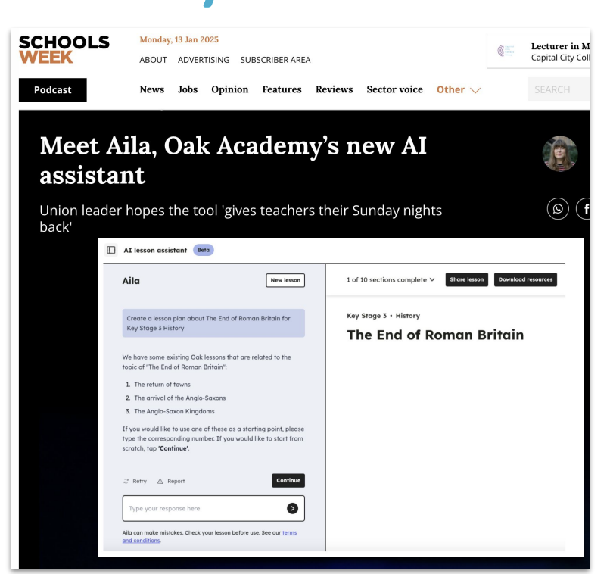
2025
Notes:
And potentially seeing the potential to have an impact on learning and outcomes.

Slide 20
June 2025
Ofsted
Research and analysis
‘The biggest risk is doing nothing’: insights from early adopters of artificial intelligence in schools and further education colleges
Published 27 June 2025
Notes:
Most recent comment from Ofsted. They have also clarified how they will inspect the use of AI at schools.

Slide 21
June 2025
The Guardian
The number of new entry-level UK jobs has dropped by almost a third since the launch of ChatGPT, figures suggest, as companies use artificial intelligence to cut back the size of their workforces.
Vacancies for graduate jobs, apprenticeships, internships and junior jobs with no degree requirement have dropped 32% since the launch of the AI chatbot in November 2022, research by the job search site Adzuna released on Monday has found. These entry-level jobs now account for 25% of the market in the UK, down from 28.9% in 2022.
Notes:
Implications for the children in our communities

Slide 22
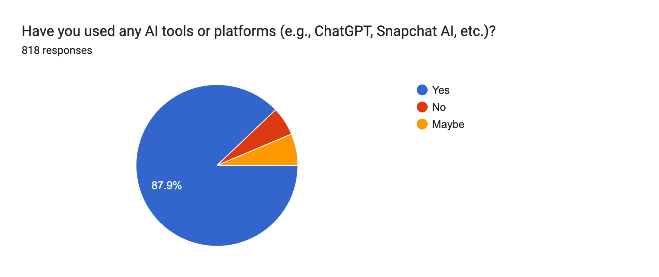
July 2025
Alex Quigly:
“In my view, it is time to admit that large language models have effectively killed off independent written coursework. Not only have these tools developed at lightning speed, making it impossible for schools to keep pace, their use is also widespread. In 2024, 77 per cent of 13- to 18-year-olds reported using AI, up from 37 per cent in 2023.”
In our secondary schools in 2025, it is higher.

Slide 23
LLMs - Prompts and outputs
Input
(prompt)
AI system
Output (text, image etc)
The better the prompt, the better the output
The LLM breaks down your prompt into a series of keywords and analyses this for patterns. The AI system has previously done lots of machine and deep learning on varied datasets. A response is produced based on predictions made from prior learning. At this point, the AI system will give this to you as an output.

Slide 24
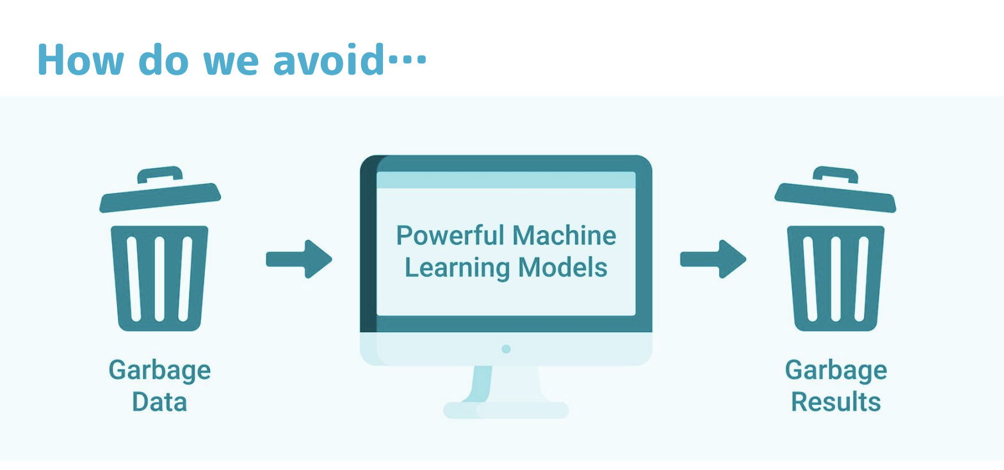
Or in other words

Slide 25
👥 Discuss these Dos and Don’ts when using LLMs
Dos | Don’ts
● Use clear and specific prompts ● Use for brainstorming and ideas ● Anonymise data ● Review and tailor AI outputs ● Check sources | ● Share personal or sensitive data ● Rely solely on AI ● Ignore AI limitations (see next session) ● Overlook stakeholder perceptions

Slide 26

Use Copilot or Gemini
Our schools are either Microsoft or Google.
We advise you to use Copilot or Gemini on our licenses where possible. But do not put names or personal data in. This does allow you to put lessons / work in because this protects IP because it does not learn from your prompts. Microsoft accounts will soon have A3 licenses which will have even better safeguards for data.
You can also turn learning off in ChatGPT in settings which is useful at home too.

Slide 27
Writing a prompt
Specificity – be clear about what you want from the AI system. Vague prompts lead to vague answers. Instead of "Tell me about AI," try "Explain how generative AI can help teachers reduce workload, with examples."
Context and constraints – provide relevant background information and set boundaries. For example, "Summarise the risks of AI in education in under 100 words, using plain language."
Desired format – if you need a list, a paragraph, or a structured response, state it. For example, "List three advantages of AI in teaching, with a brief explanation for each."
Tone and style – specify the tone if needed. For example, "Explain AI bias in a way that a non-technical teacher would understand, using an informal and engaging tone."
Iteration and refinement – if the first response isn’t quite right, refine your prompt. For instance, if an answer is too broad, you can adjust by adding "Focus on UK schools and recent policy discussions."
Notes:
Use laptops if possible in a classroom setting.

Slide 28
🏃‍♂️ Have a go at writing a prompt
Use this* vocabulary to create a ‘Do now’ / ‘connect’ fill in the gap activity.
*Choose vocabulary that is subject specific to you, for example the different types of angles in maths, the causes of World War I in History, etc etc
Notes:
Use laptops if possible in a classroom setting.

Slide 29
🚨 Bias
AI systems can generate incorrect or misleading information, known as "hallucinations". These can be nonsensical or more subtle, such as fabricated facts or non existent links.
Hallucinations occur because AI models make predictions based on patterns in their training data. If the training data is incomplete, biased, or flawed, the AI system may learn incorrect patterns.
AI models lack real-world understanding and may fill in the gaps incorrectly, leading to errors.
It is essential to check AI outputs and cross-reference information. Users are responsible for both the input and output of AI tools.
An AI system can reflect biases present in its training data or algorithms, such as racial or gender bias. This can result from flawed training data or developer choices.
AI can sound convincing, even when incorrect. It is essential to remember AI is a machine, despite any human-like qualities.
Human oversight is crucial when using AI, particularly for educators. Users are accountable and responsible for their use of AI.
Critical thinking is essential when using AI and evaluating its outputs.

Slide 30
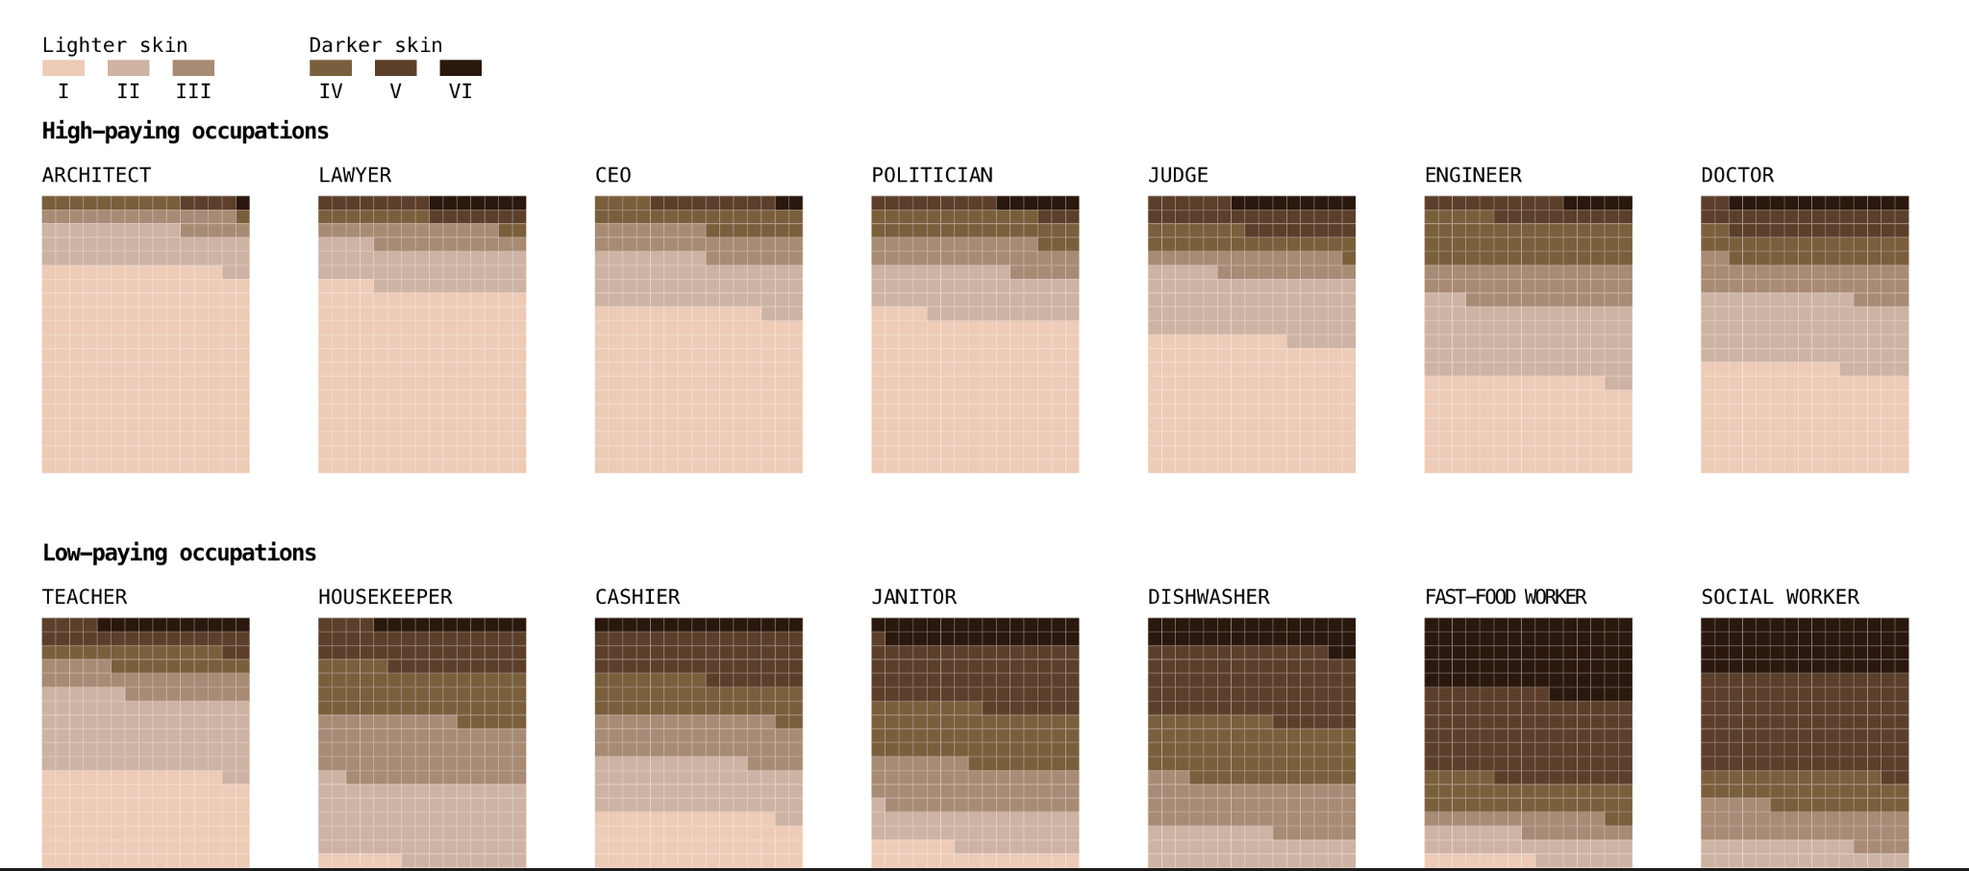
Example of bias - Bloomberg analysis of image generator Stable Diffuser
Notes:
Bloomberg prompted the text-to-image model to create representations of workers for 14 jobs — 300 images each for seven jobs that are typically considered “high-paying” in the US and seven that are considered “low-paying”

Slide 31
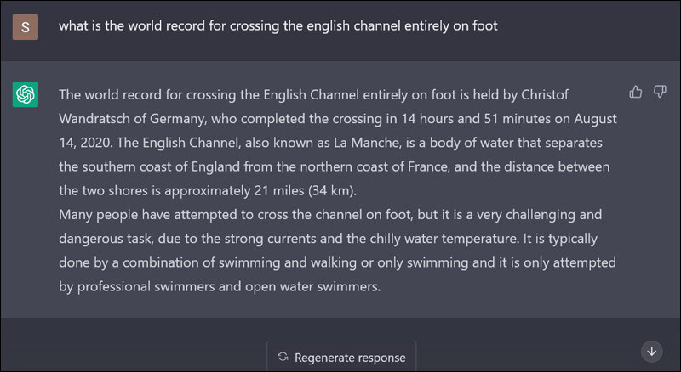
Example of hallucination

Slide 32
🧠 Knowledge check
AI systems can generate incorrect or misleading information, known as "__________". These might be nonsensical or subtly false, like made-up facts or broken links.
Hallucinations occur because AI models make predictions based on __________ in the data they were trained on.
If the __________ is incomplete, biased, or flawed, the AI may learn incorrect or misleading behaviors.
An AI system can reflect __________ present in its training material or design, such as racial or gender bias.
AI can sound very __________, even when it is wrong or inaccurate.
__________ is essential when using AI to evaluate the quality and truthfulness of its responses.
__________ is vital, especially in educational settings, to monitor how AI is used and what it produces.
Users are ultimately __________ for both what they ask of AI systems and how they use the outputs.

Slide 33
🧠 Knowledge check
What is a significant limitation of AI systems that can lead to incorrect information?
a) It requires you to give it a prompt or instruction
b) Hallucinations

Slide 34
🧠 Knowledge check
What is a significant limitation of AI systems that can lead to incorrect information?
a) It requires you to give it a prompt or instruction
b) Hallucinations (correct)

Slide 35
🧠 Knowledge check
What might cause an AI system to produce misleading or incorrect information?
a) Excessive data processing
b) Flawed training data
c) Over-reliance on algorithms

Slide 36
🧠 Knowledge check
What might cause an AI system to produce misleading or incorrect information?
a) Excessive data processing
b) Flawed training data (correct)
c) Over-reliance on algorithms

Slide 37
📝 Review
Guiding principles
Rapidly changing context
Use Copilot or Gemini, not ChatGPT
Prompts
Dos and don’ts
Bias
Policy

Slide 38
Policy
Give staff a copy when available

Slide 39
Session Objective:
By the end of this session, participants will be able to:
Understand risks with AI
Notes:
These are the objectives of today’s session

Slide 40
🧠 Knowledge check
Use these key words - prompt, convincing, flaws, generative AI.
__________ is a type of AI that can create new content like images, music, code, or writing based on patterns it has learned.
When you give an AI system an instruction or input to carry out a task, that instruction is called a __________.
Hallucinations occur because AI models make predictions based on __________ in the data they were trained on.
AI can sound very __________, even when it is wrong or inaccurate.

Slide 41
🚨 Caution: AI is not a silver bullet
It's important to recognise:
AI should support, not replace teachers.
Ethical and responsible use must be taught.
Bias and inaccuracy: AI can reproduce social biases or provide incorrect information.
Privacy and data protection: Some tools collect and store user data.
Overreliance: Excessive dependence may weaken students’ critical thinking.
Academic integrity: AI misuse can blur lines between student work and machine-generated content.
Environmental Impact (AI uses much more energy than other online tools.)

Slide 42
🚨 Environmental impact
High energy demands - the physical hardware used by AI systems is resource intensive, both in maintaining and training these systems.
Inefficient energy use - AI systems can consume as much as 10 times more energy than a traditional search engine.
Mindful usage - consider whether or not the use of generative AI is always appropriate or required for a given task.
Potential benefits - large tech companies often invest in renewable energies and technologies to advance their energy practices in order to offset some of the negative impacts.

Slide 43
🧠 Knowledge check
What is a significant concern about generative AI in the area of sustainability?
a) It requires very little energy
b) It helps reduce the need for data centres
c) It requires large amounts of energy to power data centres

Slide 44
🧠 Knowledge check
What is a significant concern about generative AI in the area of sustainability?
a) It requires very little energy
b) It helps reduce the need for data centres
c) It requires large amounts of energy to power data centres (correct)

Slide 45

🚨 Risks of AI
Notes:
15 mins

Slide 46
🧠 Knowledge check
Can you remember 5 risks of using AI?

Slide 47
🧠 Knowledge check
Can you remember 5 risks of using AI?
Risk 1: pupil/student exposure to inappropriate or harmful content
Risk 2: pupil/student exposure to inaccurate, misleading or biased content
Risk 3: data protection breaches
Risk 4: intellectual property infringements
Risk 5: academic integrity challenges
You may have identified other risks, and that doesn’t mean they aren’t important. You may want to note these additional risks.

Slide 48

🚨 Academic integrity

Slide 49
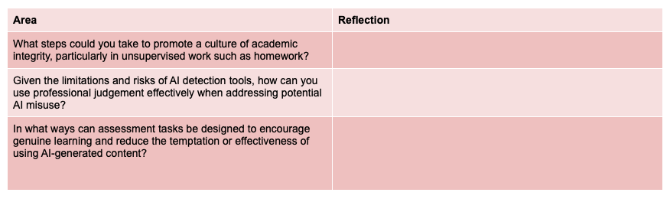
👥 Discuss
Notes:
Discuss ion t

Slide 50
🧠 Knowledge check
What is meant by 'critical thinking' in the context of using generative AI?
a) Accepting all AI outputs without question
b) Ignoring the potential for bias and inaccuracies
c) Questioning, analysing and evaluating AI outputs to ensure they are appropriate, accurate and free of bias
d) Only using AI for simple tasks to avoid problems

Slide 51
🧠 Knowledge check
What is meant by 'critical thinking' in the context of using generative AI?
a) Accepting all AI outputs without question
b) Ignoring the potential for bias and inaccuracies
c) Questioning, analysing and evaluating AI outputs to ensure they are appropriate, accurate and free of bias (correct)
d) Only using AI for simple tasks to avoid problems

Slide 52
📝 Review
Environmental impact
Risks of AI
Academic integrity

Slide 53
Session Objective:
By the end of this session:
Guiding principles
Benefits of AI in education
Examples of activities
Notes:
These are the objectives of today’s session

Slide 54
👥 Discuss these guiding principles
Personalised learning
AI can enhance learning through targeted tasks and feedback
Reduce workload
AI can reduce workload in aspects such as admin, lesson preparation and marking.
AI can’t & won’t replace everything
AI should not replace everything such as writing and hands on learning.
Growth mindset
AI can help teachers, leaders, pupils to innovate and improve current performance.
AI should support, not replace teachers. It will always take a human connection to teach. The role of AI is to enhance and support.
Notes:
Allow staff to discuss these principles. Any questions can be sent to Adavies@tcset.org.uk. This is very much a starting point!

Slide 55
✅ Benefits of AI in education
Teaching and Learning
Personalised learning
Admin

Slide 56
✅ Benefits of AI in education
Teaching and Learning
Adapting materials for your group
Creating ready made practice questions
Crafting model answers
Generating effective explanations and step-by-step examples
Marking quizzes
Generating lesson plans
Providing instant feedback
Stimulating ideas
More inclusive classrooms

Slide 57
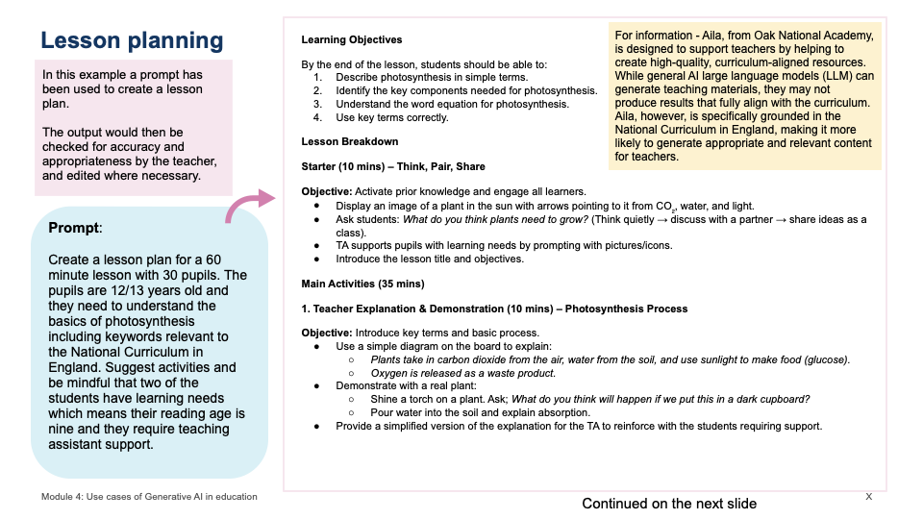
Example

Slide 58
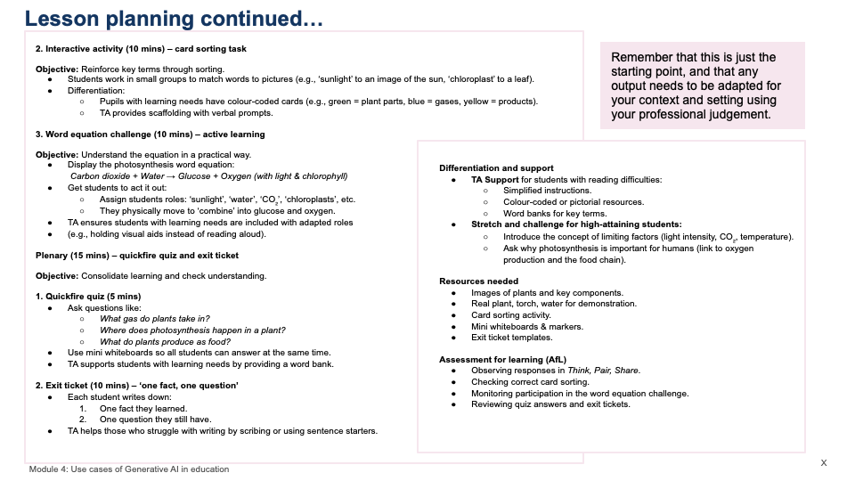

Slide 59
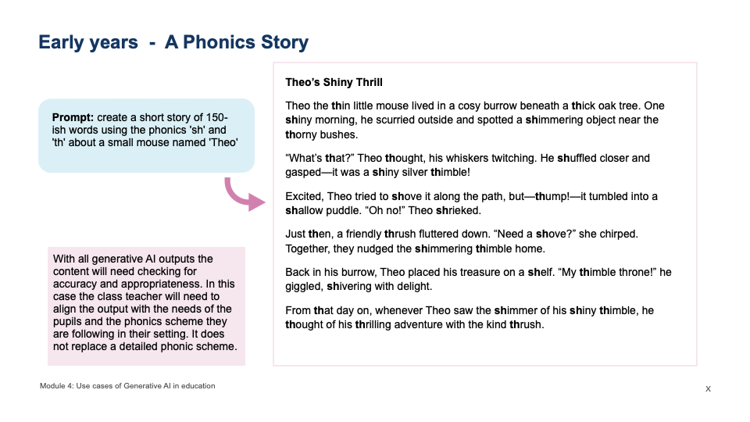
Example

Slide 60
✅ Benefits of AI in education
Students could also use AI for:
Essay help and feedback
Creative inspiration (e.g., music, art, writing)
Research support (summarising, explaining)
➡️ Result: Empowered, independent learners.
NB Almost 90% of our students at secondary school are already using AI at home.

Slide 61
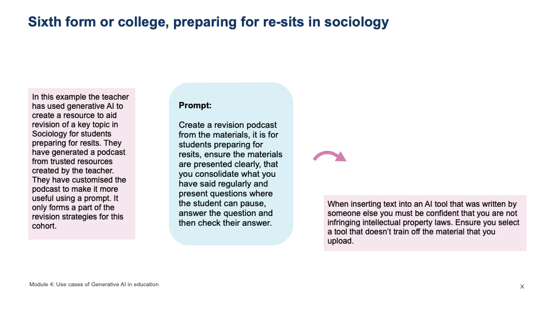
Example

Slide 62
✅ Benefits of AI in education
2. Personalised Learning
AI can adapt content, pace, and feedback to suit individual student needs, helping:
Struggling learners catch up
Advanced learners move ahead
All learners stay engaged
➡️ Example: AI-powered platforms like adaptive learning systems (e.g., Sparx, Century, Khan Academy) tailor lessons based on a student’s performance.

Slide 63
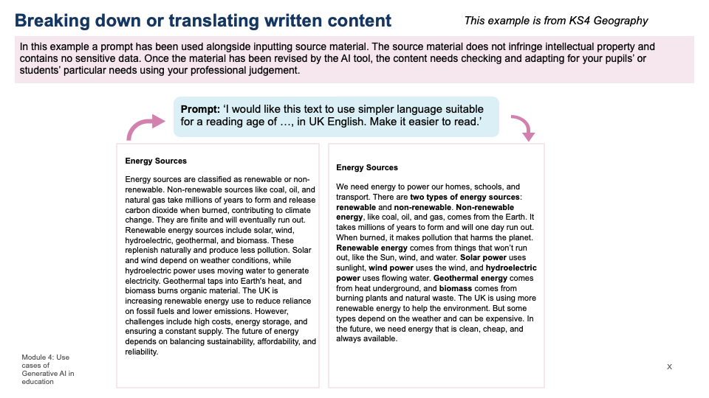
Example

Slide 64
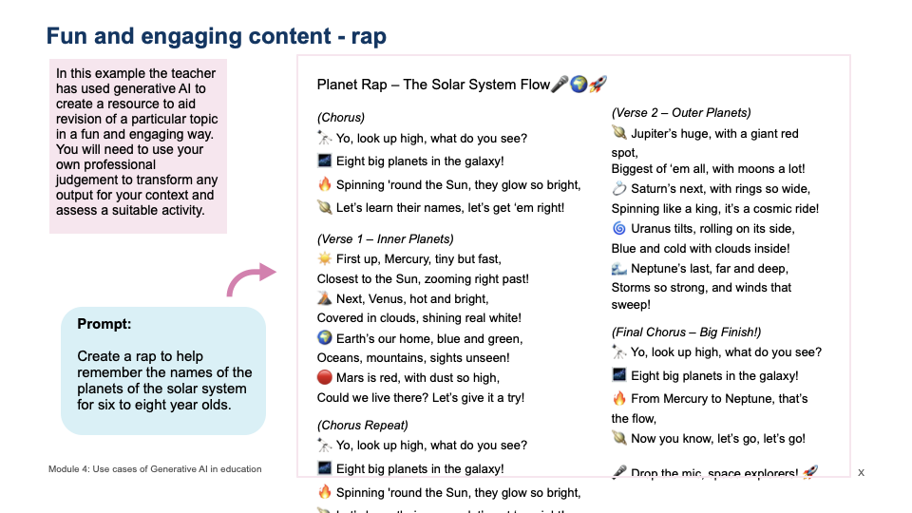
Example

Slide 65
✅ Benefits of AI in education
⏱️ Admin
AI tools can handle repetitive tasks such as:
Supporting with grammar, spelling and tone
Supporting with report and letter writing
Supporting with newsletter and other communications
Completing data analysis
Agenda writing and strategic planning
Marking quizzes
➡️ Result: Teachers have more time to focus on creative instruction and student relationships.

Slide 66
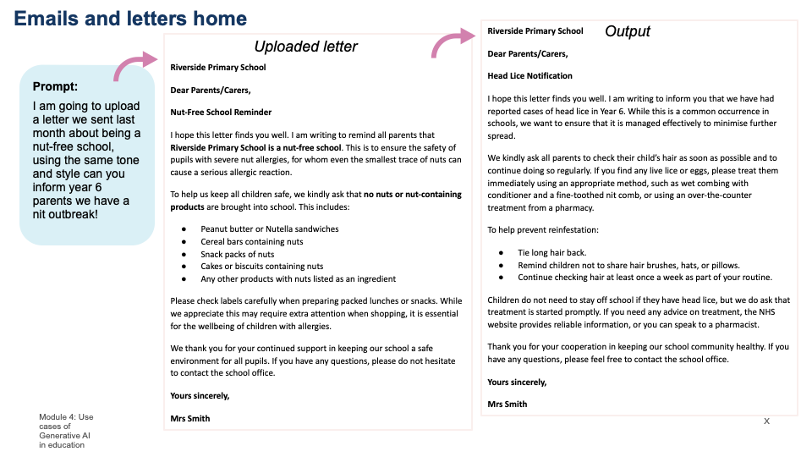
Example

Slide 67
🕹️ Teaching with Copilot and Gemini
Go to Teaching with ChatGTP. This was the website used to train teachers on the EEF trial.
Watch the videos on the website and have a go yourself at
Find activity ideas in seconds
Get ready made practice questions
Adapt your materials for your group
Get effective explanations and step by step examples
Craft model answers
Test student misconceptions and avoid misconceptions
We recommend using Copilot or Gemini (not ChatGPT) because they have stronger data protections.
Notes:
30 mins

Slide 68
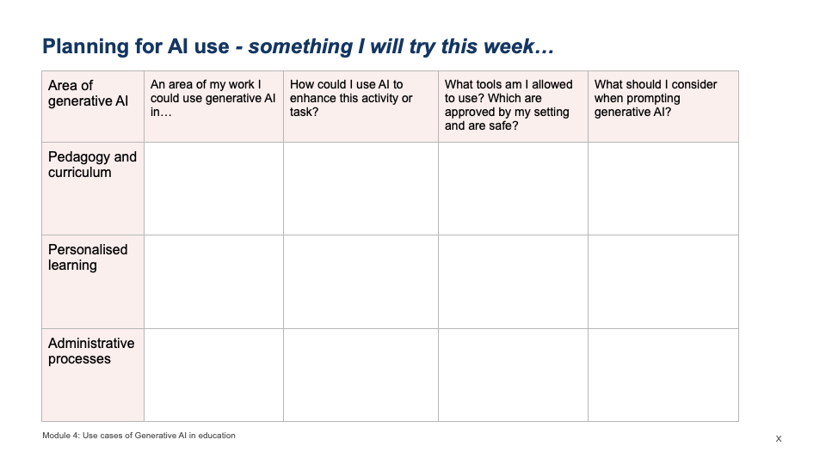
🏃‍♂️

Slide 69
📝 Review
Use Copilot or Gemini over ChatGPT
Benefits for teaching and learning, personalised learning and admin
Commit to having go

