Slide 1
2025-2026

Slide 2
New Family Engagement Pilot
1st November – 17th December
Domains | Pupils | Employees | Families
Headline Engagement | Value | Value | Value
 | Commitment | Commitment | Commitment
 | Satisfaction | Satisfaction | Satisfaction
Cognitive Engagement | Behaviour | Behaviour | Behaviour
 | Value of school |  | Value of education
 |  | Wellbeing and Workload
 | Drive | Drive and Development | Drive
 | Agency | Agency | Agency
Emotional Engagement | Enjoyment | Enjoyment of role | Enjoyment
 | Inclusion | Inclusion | Inclusion
 | Teacher relationships | Leadership | Leadership
 |  | Line Management | Teachers
 | Peer Relationships | Peer Relationships
Behavioural Engagement | Effort | Effort | Effort

Slide 3
Census windows
Autumn
Spring
Summer
It is possible to complete 3 cycles of data collection each year
Live benchmarks are created for each census.
Trust and school leaders compare their scores like for like – compared to similar settings or even year groups
ALL schools in TCSET complete pupil and employee engagement in Autumn term. These are optional for Spring and Summer

Slide 4


Engagement monitoring
It’s a sustained practice
Ownership for engagement at every level and agency to act.
It’s a sustained practice, not a survey
Opportunities to discuss your school’s findings with Maddie will be useful to allow you to understand the feedback better and decide how to act upon it
There is a pilot family engagement platform coming
Methodology is grounded in research
Methodology is grounded in the research and uses best practice from across sectors
It measures a holistic range of drivers with clear actionable insights.

Slide 5

Feedback cycle
Quick wins and adjustments
In year medium term changes
Longer term strategic planning
Notes:
This cycle continues term to term, year to year providing consistent data to help in the short, medium and long term.
With each census return, the aim isn’t to fix everything in the report, or to rest on your laurels for the things that have gone well. It’s to have a clear view of the challenge at hand and make well informed decisions on what and who you prioritise.
You aren’t going to ever have nothing to fix – it’s not the nature of the job we are in, managing, educating and supporting people is a messy thing that doesn’t stand still. Quick wins – acute issues that have arisen where there is a clear and easy solution to implement – doesn’t take more than one department to fix.
In year medium term changes – see this as course adjustment for your existing strategy or in year interventions for groups that need it most. Longer term planning should always be a feature of each census – how are trends across the school, phases and trust level feeding into your strategic planning.

Slide 6

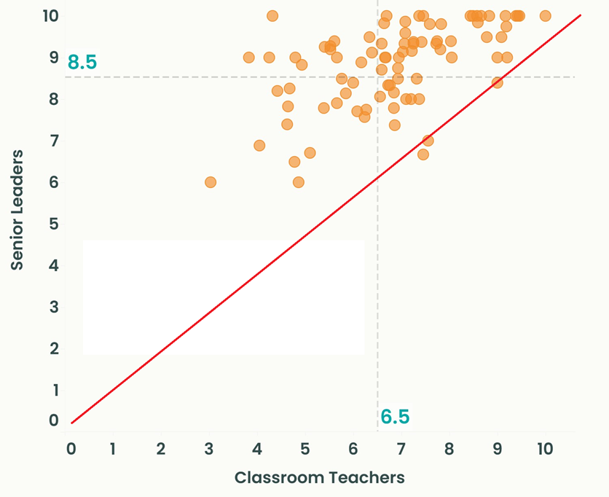
What should we learn from the research?
Schools with higher leadership scores have higher engagement scores.
Quality of leadership, specifically buy-in to strategy is the most influential factor in retention, above workload, pay and wider working conditions.
Employees with higher buy-in are 20% points more likely to reject outside offers of employment.
Employees who don’t buy into the strategy are also most likely to feel unable to voice concerns.
Second to leadership and management, those with quality relationships with colleagues, feel part of the team and like those they work with have a higher commitment to their job.
Senior leaders score consistently more highly than their employees.

Slide 7
Effective use of the data from our research cohort:
Effective use of engagement data shares common features:
Curiosity over defensiveness: Leaders who approach challenging data with genuine interest in understanding create conditions for improvement,
Stakeholder involvement: Including pupils and staff in interpreting data generates better insights and stronger buy-in,
Look for disconnects: Gaps between different perspectives (staff/pupil, leader/teacher) often reveal the most important learning,
Celebrate and challenge: Data can affirm strengths whilst revealing surprising areas for growth,
Targeted action: Specific data points can drive focused interventions with measurable impact,
Patience with complexity: Understanding data takes time – rushing to solutions often misses deeper insights.
“The whole team’s using the data to steer what we do. The staff got quite into it — especially when we showed them what had changed between autumn and spring. That made it real.”
— Lipson Cooperative Academy
Effective use of engagement data shares common features:
Curiosity over defensiveness: Leaders who approach challenging data with genuine interest in understanding create conditions for improvement,
Stakeholder involvement: Including pupils and staff in interpreting data generates better insights and stronger buy-in,
Look for disconnects: Gaps between different perspectives (staff/pupil, leader/teacher) often reveal the most important learning,
Celebrate and challenge: Data can affirm strengths whilst revealing surprising areas for growth,
Targeted action: Specific data points can drive focused interventions with measurable impact,
Patience with complexity: Understanding data takes time – rushing to solutions often misses deeper insights.
"We didn't set out to 'fix' the data – we set out to understand it, This approach led to meaningful changes that improved spring scores significantly”.
- Nancy Cook, Rockcliffe Primary School

Slide 8
November census window 2025-26
10th to 28th November

Slide 9
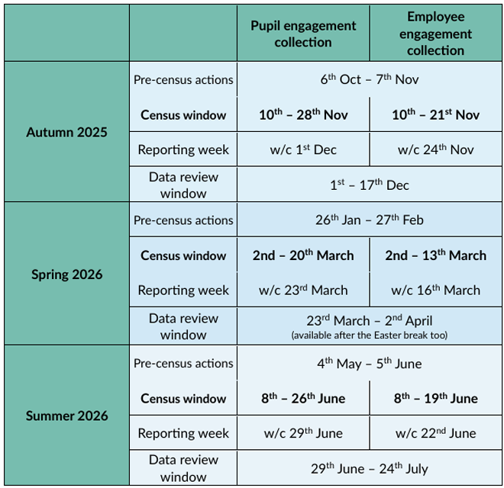
Key Dates 2025/26
First census window opens on 10th November
2 weeks for employees
3 weeks for pupils (extending for one week past the employee window)

Slide 10
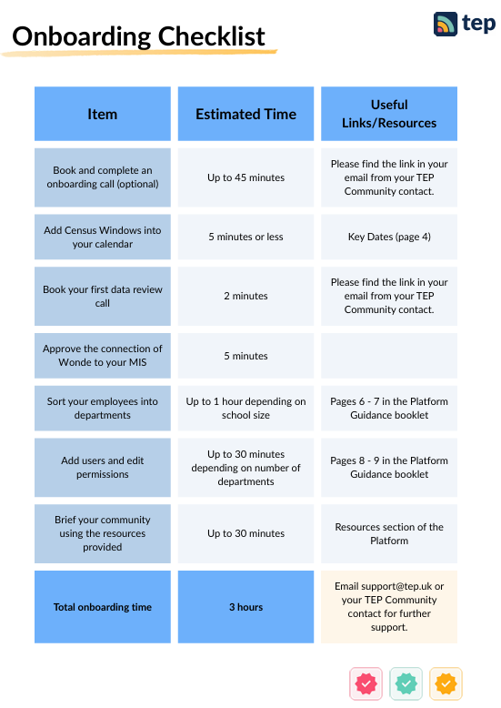
Pre-census actions

Slide 11
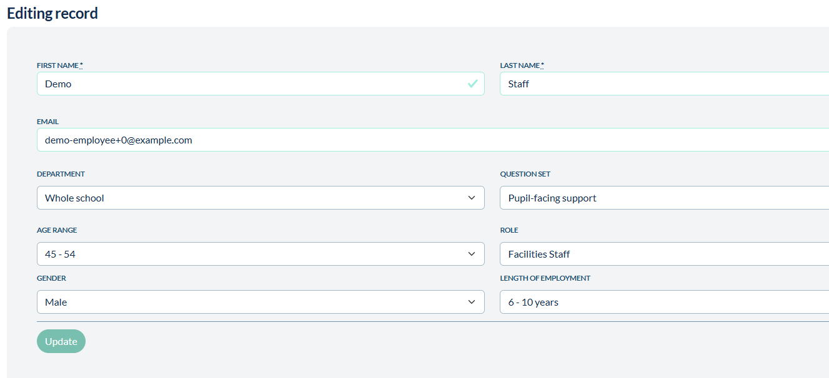


Platform preparation
Preparing for the census
School lead to check information pulled from MIS
Set up and assign departments for employees
Review and edit question set allocations
Checking for work email addresses
Making part-time staff (e.g. exam invigilators) inactive
Guidance can be found in the ‘Resources’ tab on the Platform

Slide 12

Briefing your team
Preparing for the census
Briefings for pupils and employees (and members of staff who will be facilitating the pupil survey) can be found on the Platform.
Please brief stakeholders about the upcoming survey, this leads to higher response rates.
All resources to support briefing can be found in the Resources section of the Platform

