Slide 1
Spotting patterns and trends
Using TEP data across your trust, and supporting your school leaders to do the same

Slide 2
This session
FOR TRUST LEADERS
How multiple windows work together
Tips for interpreting your data
Building engagement practice
The operational rhythm

Slide 3
Tips for interpreting your data
These tips work at trust, school and department level

Slide 4
How multiple windows work together
ONE WINDOW, TWO, OR THREE
ONE CENSUS WINDOW
A snapshot
An unexpected change isn’t always a call to action: if something surprises you, wait until it appears in another census window. Something that occurs in one window may simply be a reaction to a specific event.
Look for quick wins to feed back to stakeholders, and things to celebrate.
TWO WINDOWS
A direction
Identify if a question, driver or group has changed over multiple census windows. Is it becoming more positive or more negative?
Understand when a snapshot becomes a trend by looking at the distance from benchmark: what was the difference last census? How does it compare?
THREE OR MORE WINDOWS
A trend
Use the benchmark comparison over multiple windows. If something was below benchmark, and the distance from benchmark is widening, you’ve identified a trend.
Identify your strategic priorities using consistent trends. Use termly TEP data to evaluate the impact of your interventions.
When using TEP data to make strategic changes, we advise using data from multiple census windows to identify drivers, groups or questions that are consistently below benchmark. Something that is below benchmark in one window may not remain below benchmark.

Slide 5
Check where your sample is representative
RULE 1
85%
the target for employees and students
If your overall response rate is below 85%, some groups within your stakeholder community are likely to be underrepresented. Review which groups you might be missing and be conscious of who your analysis excludes.
Response rate is also a signal of engagement in its own right. It tells you whether people believe the exercise will be lead to results.
Feeding back insights and decisions is what keeps response rates up over time, and the response rate is what keeps the analysis complete.
BOOSTING RESPONSE RATES
Keep the 85% expectation across every school. You can keep on top of live rates throughout the census on the Collect page.
TEP tip: a friendly competition between teams and between schools can be effective in driving responses (a chocolate as a prize works well!).

Slide 6
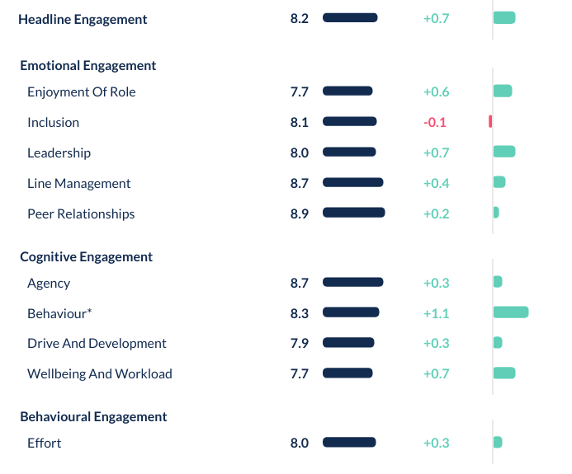
Make use of the difference from benchmark
RULE 2
Nationally, wellbeing and workload and enjoyment of role are typically the lowest-scoring drivers. Raw scores alone will likely send you to the same three drivers every term to work on.
This is the power of benchmarking: you can identify areas where your approach is working, so this work can be continued. It can also help highlight groups or drivers that may need a little attention.
“Before using TEP our workload and wellbeing was always coming out lowest, and we always took action around workload and wellbeing. We did a significant amount of work with the staff. And we're thinking, but what does this look like against the national picture? For all it was our lowest score, it was the most positive difference between ourselves and national.”
PETER HAYWARD, HIGH TUNSTALL COLLEGE OF SCIENCE

Slide 7
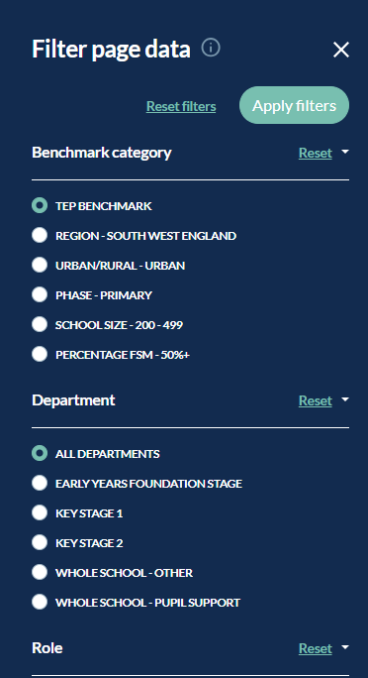
Understand the range beneath the average
RULE 3
Advocates
Passives
Challengers
The national distribution is a third advocates, a third passives and a third challengers. A challenger group is expected and normal. What is important is the proportion of each group compared to the national.
Your average score tells you where the middle sits. It does not tell you whether your community is clustered around that middle or split. Two schools with an identical average can look completely different through the APC distribution.
Use your report, and the filters in the explore page, to investigate the advocates and challengers:
  Which roles or departments have more challengers?
  What do our advocates look like?
  Which drivers or questions differ from benchmark?
Advocates highlight where great practice is happening in school. Challengers may indicate pockets of discontent.

Slide 8
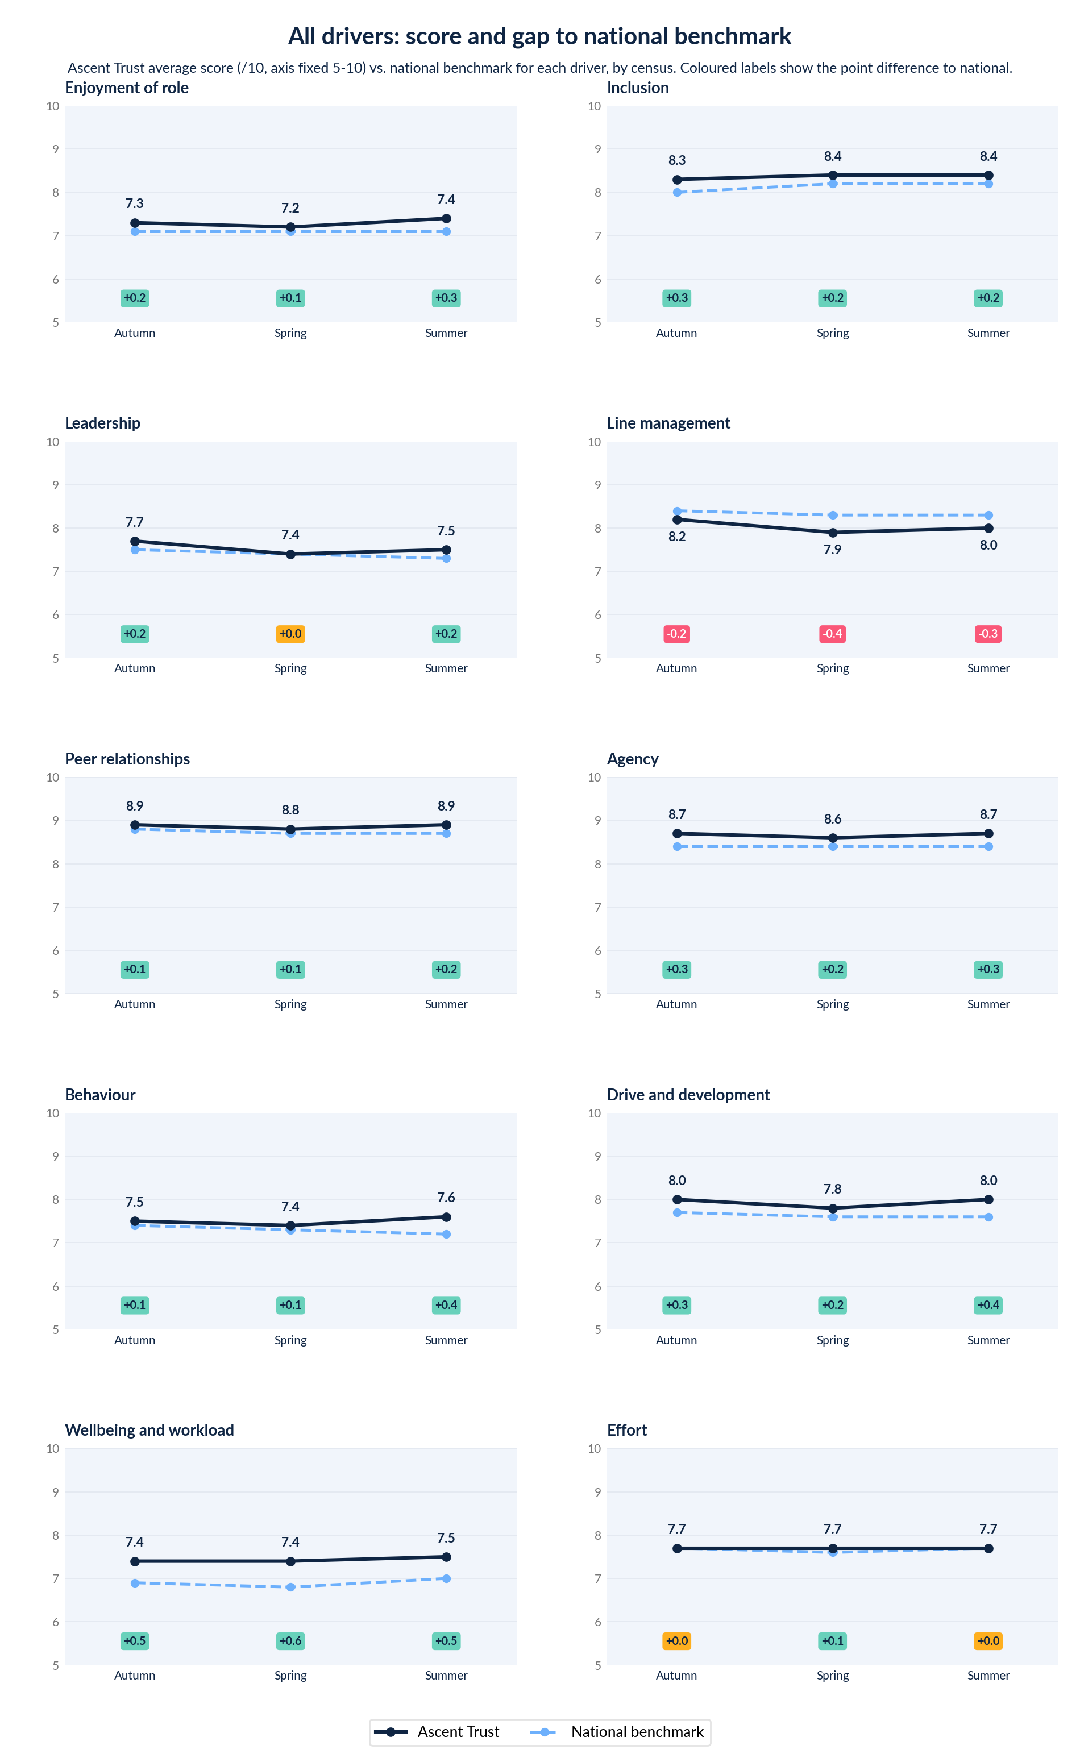
Use data from more than one census window to inform big changes
RULE 4
“What we're trying to move towards is a slightly more nuanced approach where we look at surveys over time, because we keep talking to our leaders about the fact that one survey is but a snapshot… TEP are working with us on how we might do that and how we might use that as measure for our business functions.”
CHRIS MARKS, DANES EDUCATIONAL TRUST
Danes have been building their engagement practice over time: moving from identifying their position in comparison to the benchmark, to monitoring the direction of travel, to using each census to check on focus areas and KPIs.
Something that appears once and does not return is not a trend. Something below benchmark across three consecutive windows is.
Flag areas with a consistent or declining difference from the benchmark for action planning. Celebrate areas that are consistently above benchmark – this is a real success.

Slide 9
Building engagement practice with school leaders
LIGHT-TOUCH ANALYSIS
01
Check the response rate
Below 85%, be conscious of which stakeholder groups may be under-represented. A low response rate can be a metric of engagement in its own right.
02
Use the benchmark
Which groups, drivers or questions are in line with national, and where are your scores furthest from it?
03
Identify target groups or drivers
Celebrate the successes and keep doing what’s working. Use the benchmarking and APC to identify 2 or 3 areas that may need more attention.
04
Track over time
Use the next census window to check in on your target areas. If something surprised you last census, has it emerged as a trend? If you made any changes, have they shown up in TEP?
TEP provides action planning slide decks to support leaders in identifying and monitoring priority areas. There’s also a slide deck for feeding back the feedback to stakeholders: maintaining buy-in helps keep the response rates robust.
Termly data gives you a faster check on whether what you did worked.

Slide 10
Building engagement practice

Slide 11
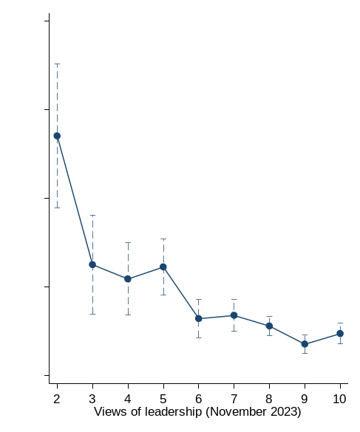
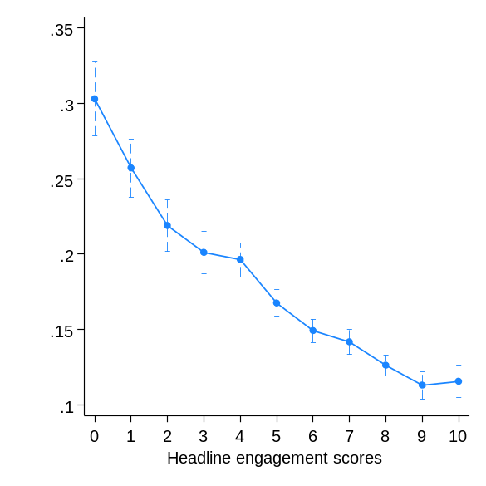
Engagement as a lead indicator of school outcomes
THE CASE FOR TERMLY DATA
CASE STUDY: DANES EDUCATIONAL TRUST
One school had three consecutive years of improving academic outcomes. Over the same period, TEP showed both employee and student engagement declining.
School and trust leadership were able to act early:
They audited the behaviour policy
Employee and student working groups were given time to discuss changes with the leadership team
Employees and students were aware of changes before they were fully rolled out
The curve stopped falling and turned back upwards before outcomes were affected.
TEP’s national research shows the link between employee scores on the leadership driver and probability of looking for outside employment.
Pupil groups with higher scores for headline engagement are less likely to be persistently absent.

Slide 12
Case study: High Tunstall College of Science
USING THREE WINDOWS TO IDENTIFY TRENDS
Based in Hartlepool, High Tunstall have been using TEP to monitor their employee engagement since 2023, and their pupil engagement since 2025.
PRIORITISE USING THE BENCHMARK
Spring 2025: wellbeing and workload scores at High Tunstall were moving each term. Originally well above benchmark, their score becoming less positive and steadily closer to benchmark.
IDENTIFY TARGET GROUPS
Filtering in the explore page identified one department whose data was significantly lower than the others.
INVOLVE STAKEHOLDERS
They workshopped it with the department and realised that a year 11 mock paper sat immediately before a holiday with the data deadline shortly after. The department were left with no option but to mark over the half-term break.
TARGET INTERVENTION
They rewrote the assessment and reporting calendar for the whole school: three data drops became two, year groups staggered, and a fortnight's marking time before every data entry.
“We did not just change it for that faculty, because if it works for that faculty, it works for all faculties.”
PETER HAYWARD, HIGH TUNSTALL COLLEGE OF SCIENCE

Slide 13
Embedding engagement practice with considered support
EMBEDDING ENGAGEMENT
TEP can provide guidance on using data from 3+ census windows to inform your KPIs, as well as training your Middle Leaders and Governors. Reach out to your Community Lead for more information.
Build TEP data prompts into school KPIs
Used well, TEP data can be an effective way of recognising consistency, progression and focus areas for development to build into KPIs. It's important to use TEP census data to make an achievable, bespoke goal for each school. One school's target might be maintaining scores above benchmark, while another could be to bring two specific drivers up to national benchmark.
Use termly check-ins to identify trends
Identify priorities to track over the year, rather than analysing each census as a standalone and in full. Evaluate the success of interventions using particular questions or by filtering into specific groups.
Distribute ownership of TEP data across Middle Leadership
Adding middle leaders to the platform to establish ownership of their department’s data will help target action at a granular level. Use our Middle Leader Training Pack to build understanding of using termly data to support decision-making.
Share ownership of TEP data with school governors
Stakeholder engagement can be a responsibility of governance. Use TEP’s Governor Training Pack to support governors in using TEP data and asking their school leaders useful and supportive questions.

Slide 14
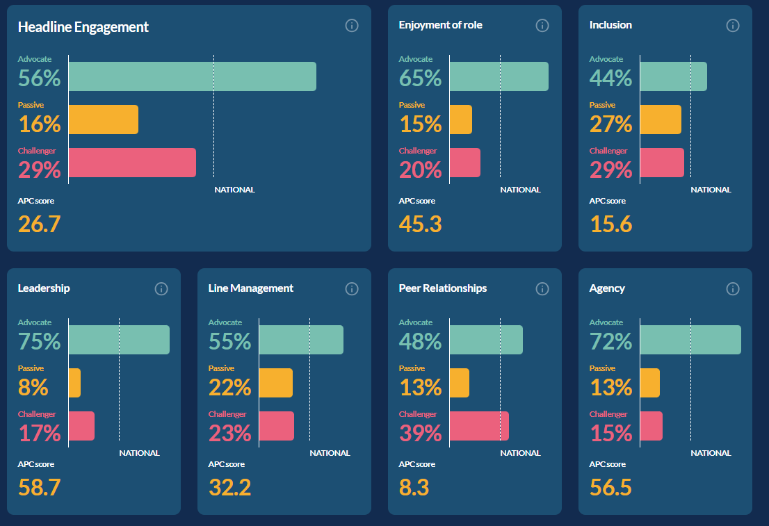
Adding middle leaders to TEP
EMBEDDING ENGAGEMENT
RECOMMENDED PERMISSIONS
Can manage employee records – middle leaders will be able to edit roles or question sets within their teams if they spot any errors
Can see employee results (restricted to their department) – watch the video for instructions. Middle leaders will be able to access driver, question and role filters for their department, and view benchmark comparisons and APC distribution.
Can see student results – optional. Student results can’t be limited to a department but might be useful for triangulation.
Can see and respond to comments – comments can’t be filtered by departments. We don’t advise sharing all employee comments with middle leaders.
Tutorial video: Adding middle leaders to view only their department

Slide 15
Building the operational rhythm
WHAT YOU LEAD
BEFORE
Brief stakeholders
Briefing materials are in the resources section. Check the directory is current and time is allocated across the full window.
DURING
Monitor response rates
The Collect page shows rates by department and year group, and schedules reminders to people who have not responded.
AFTER
Explore and action plan
45 minutes to an hour with the leadership team, using the action planning deck in the resources section.
AFTER
Feed back the feedback
Ten minutes of headlines and next steps is enough to close the loop and protect the next response rate.
TRUST LEAD
Keep the expectation that every school briefs before every window.
TRUST LEAD
Share rates across schools during the window to collect 85% response rates.
TRUST LEAD
Ask each school what they are prioritising, monitoring and tweaking after each window.
TRUST LEAD
Feed back on themes, not on the most recent window line by line.

Slide 16
Golden rules, and TEP Support
TO TAKE AWAY
Support from TEP
Live spotlight sessions and the exploring data video tutorials are in the resources section of the platform, alongside the briefing, action planning and feeding back materials.
Case studies are at tep.uk.
If you want help working out what your data is telling you is a priority, submit a support ticket - the Community Team will be happy to help.
Curiosity over defensiveness
A challenger group is statistically normal and can inform further investigation.
Stakeholder involvement
Ask the group the data points at.
Look for disconnects
Between groups, between departments, and between what you expected and what came back.
Find things to celebrate
Your advocates are where good practice is happening and can be shared more widely.
Patience with complexity
Wait one more window before acting on any insights you wouldn’t have expected to see.

