Slide 1



INFOBLOX
Confidential, unpublished property of Cigna. Do not duplicate or distribute. Use and distribution limited solely to authorized personnel. © 2018 Cigna
Confidential, unpublished property of Cigna. Do not duplicate or distribute. Use and distribution limited solely to authorized personnel. © 2025 Cigna

Slide 2

Speaker:
Rayed Aldohami
Client Manager – Cigna KSA

Slide 3
Agenda:
- Cigna in ME Region, KSA and TPA.
- Direct access, members cards and reimbursement.
- Main benefits and exclusions.
- Cigna Envoy application.
- Help lines and Customer Service.
- Questions and Answers.
Notes:
Objective: To modify our pitch presentation- deliver a customer centric presentation with forward looking design while representing local updates.

Slide 4

Our local capabilities makes sure we understand your needs.
In the Middle East for over 20 years.
ME regional team of over 1,000 Cigna Healthcare employees.
Over 150,000 customers in the Middle East across 800+ client relationships.
ME regional Customer service, claims reimbursement, clinical case management/preapproval, compliance, eligibility.
We stay close to you, with a global network of over 1.8 million health care professionals, clinics & facilities. 5,000+ local network of providers in the region.
Confidential, unpublished property of Cigna Healthcare. Do not duplicate or distribute. Use and distribution is limited solely to authorized personnel.
Notes:
Synchronizes with next image highlighting local energy & youth
https://arabsstock.com/en/photos/image-60679-saudi-arabian-gulf-woman-using-laptop-computer-university

Slide 5
Cigna Insurance Saudi Arabia - powering progress in the KSA with global healthcare expertise and local knowledge.
Rely on Cigna Insurance Saudi Arabia to make health and wellness simple.
Breaking ground by becoming the first international health insurer to receive a branch license in Saudi Arabia.
Who is TCS?
Building upon 18 years of experience providing international health and wellness services for companies in Saudi Arabia.
Count on impeccable service for employers, brokers, and employers.
Cigna Insurance Saudi Arabia has partnered with Total Care Saudi (TCS) is a leading Third Party Administrator (TPA) in the Kingdom of Saudi Arabia.
TCS is dually licensed and accredited by the Saudi Arabian Monetary Agency (SAMA) and the Council of Cooperative Health Insurance (CCHI).
TCS contracts with over 2500 healthcare providers in KSA
Focusing on wellness creates healthier employees – and bottom lines.
Leveraging technology makes it easier for employees to access health support and information – 24/7.
Feel confident knowing you are backed by a company with 189 million customers around the world.

Slide 6
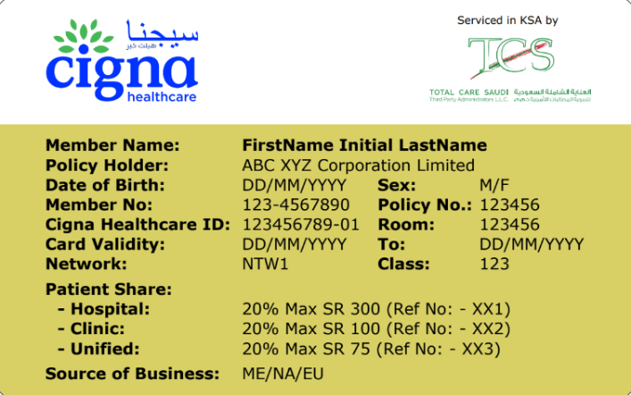
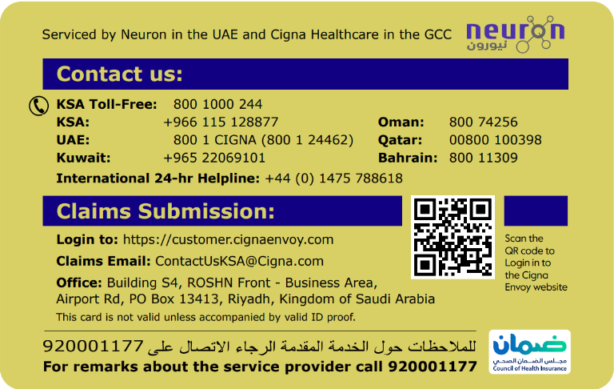
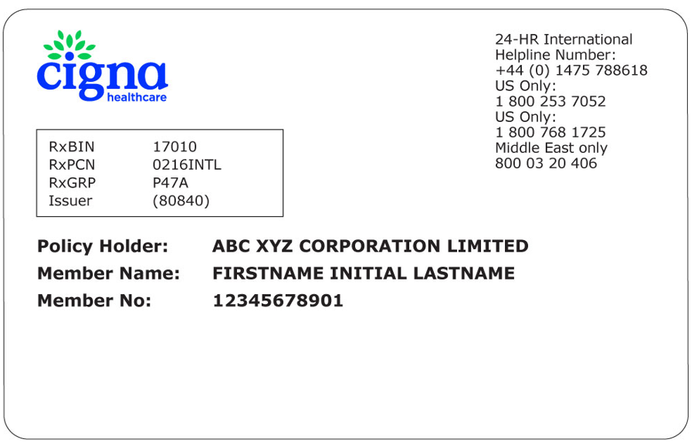
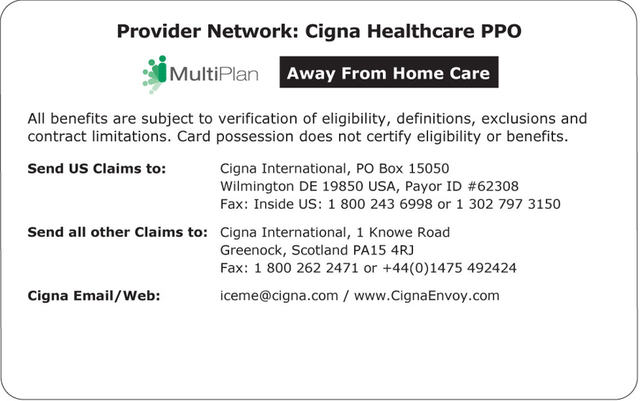
Membership cards
Within KSA and GCC
International
To be used to access care outside the GCC.
The card will give access to direct billing within the Cigna Healthcare international network.
Can be downloaded using the Cigna Envoy application.
To be used within GCC for accessing care on direct billing.
To request another soft copy of the card, send an email to ContactUsKSA@Cigna.com

Slide 7
Wherever you go…we’ll be there for you.
  Over
  2,500 providers
  in the Kingdom.
  Cashless access
  to healthcare – in and out-patient direct billing.
  SMS notifications
  in the KSA to help you track pre-authorization requests.
  Dedicated clinical team monitor cases to provide support for:
High cost, complex medical conditions and long-term admissions.
Second opinion through the decision support program.
Chronic condition management.
In hospital nurse case management.
Wellness requirements.
Visit our in-network medical providers:
Pre-approvals are arranged by the network medical provider.
Direct payment facility.
No claim forms to fill, no documents to send.
Get convenient access to medication

Slide 8
Quick guide: reimbursing a claim.
Step 1:
Collect the right documents
Must have
Invoices
Payment receipts/ proof of payments
Diagnosis (i.e. ‘blood tests due to fatigue’, ‘severe and ongoing headache’, ‘routine dental check-up’)
If applicable
Medical Report
Prescription
Breakdown of treatment (i.e. x-rays, scan, laboratory test, physiotherapy, etc.)
Discharge summary for inpatient cases (hospital stays)
Step 2:
Submit your
claim
Option 1: Preferred option
Log into your Cigna Envoy portal, submit the claim and make sure you upload all the documents.
You can even submit claims using the mobile app by simply scanning or taking a photo of the required documents.
Option 2: Via email
Fill the claims reimbursement form for each patient.
Scan the claim reimbursement form, and the applicable documents from the list
Email the scanned documents to ContactUsKSA@Cigna.com
Claims should be submitted no later than 3 months following treatment. TAT 15 working days
For status on your reimbursement claim - follow up on www.cignaenvoy.com or use the Cigna Envoy mobile app to check your claim status.
Complete bank account details must be provided so we can process your claim as soon as possible.
Notes:
Updated Image- to highlight experience

Slide 9


THE SCOPE OF YOUR HEALTHCARE PLAN
Annual Limit
SAR 1,000,000
per year of insurance
Area of Cover
Area: IV
Emergency out of area cover
Covered Up to 30 days per trip
Cover
Outpatient, Inpatient, Maternity, Dental & Vision
Network
VIP
Common Exclusions
Cosmetic treatment
Laser Eye Correction
Experimental Treatment
Incidental Expenses
Injuries arising from professional sports
Confidential, unpublished property of CIGNA. Do not duplicate or distribute. Use and distribution limited solely to authorized personnel.

Slide 10

Benefit Overview
Inpatient
Covered
Outpatient Consults
Co-pay:
Nill
Prescribed Drugs & Dressings
Inside KSA
Branded medication
Nill
Generic medication
Nill
Outside KSA
Nill
Complementary and alternative treatment
Covered
Maternity
Covered:
SAR 15,000
Newborn care covered up to 30days.
Dental
Covered up to SAR 7,500 per year of insurance
Examinations, scale, polish 2 visits per year of insurance. X-rays, Crowns, bridge. Orthodontic treatments only for members under the age of 18 years old. Page 24
Vision
Covered up to SAR 3,000 per year of insurance – Page 25
This is a high-level overview of the benefits, please refer to your member handbook to view all the benefits.
Confidential, unpublished property of CIGNA. Do not duplicate or distribute. Use and distribution limited solely to authorized personnel.

Slide 11
Benefit Overview
Psychiatric care
SAR 50,000
Hearing and vision tests
Covered
We pay for one annual eye test and hearing test for dependent children under the age of 15.
IEAP – Level 2
Telephonic counselling - 6 visits per event – Page 18
Circumcision for newborn
baby boys
Up to SAR 500 per year of insurance.
Obesity
SAR 15,000
per year of insurance
.

Slide 12
Chronic medication refill program and delivery services –
Continuous care effortlessly
You can attain your chronic medications by contacting us through
Managing chronic conditions should be effortless. Our chronic medication program will help you get more convenient access to medication.
Here's how we help you through our medication refill service.
Email
Phone
Easy access to Chronic medication
Hassle free health management.
Keeping you up to date via SMS notification.
ContactUsKSA@Cigna.com
800 100 0244
Medical prescription can extend 1-9 months back
Home address & mobile number of the insured
Dispensing of the medications
could be up to 3 months or till
the policy expiry date

Slide 13
International Employee Assistance - We are here to support you.
Professionals are ready to assist you with any issue that matters to you and your family.
Topics include, but are not limited to:
Improving family communication
Harmony between work and home life
Managing life changes
Handling stress
Surviving the loss of a loved one
Managing anxiety and depression substance use
Bullying and harassment managing workplace pressure couples’ support
Parenting
Caring for an elder
Access is easy & Free
The service is confidential
You’re supported
Telephonic and face to face counselling: 6 session per event included
Live assistance always available

Slide 14

ConnectForHealth
The monthly wellbeing webinars series
Cigna Healthcare, as your health and wellbeing partner, brings to you monthly webinars where experts share their knowledge and advice on topics that can help you manage your wellbeing and establish healthy habits.
Accessible to all Cigna Healthcare brokers, clients and members.
Bringing experts to you.
Calendar is built based on your asks.
You can view recording of missed webinars.
Some of the topics we have covered
Coping with stress and depression
Financial planning & the basics of investing
Ramadan: Healthy habits during fasting
Benefits of Yoga

Slide 15

Your points of contact
  Help lines
KSA toll-free Customer Service number 800 1000 244
Out KSA Customer Service number +44 1475 788618
  Customers service email address ContactUsKSA@Cigna.com
Customer inquiries
Certificate of coverage document
Insurance cards
Help access care
Following reimbursement claims
Resolve members issues
Helpline numbers can also be found on your cards and web portal
Notes:
https://arabsstock.com/en/photos/image-29820-meeting-saudi-arab-gulf-co-workers-their-workplace-discussing

Slide 16


Presentation
Group Life & Disability Insurance
16

Slide 17
Presentation
Insurer | GIG
Policy period | 01/07/2026 – 30/06/2027
Area of Cover | Worldwide excluding Sanctioned Countries
Entry age | Minimum: 18 years Maximum: 64 years
Cessation Age | 65 Years
Free cover – GL | SAR 1,250,000
Free cover – PPTD | SAR 1,250,000
Salary basis | Basic
Group Life (GL) | 2 times of insured annual salary
Accidental Death (AD) | 2 times of insured annual salary (Double indemnity)
Temporary Total Disability (TTD) | 100% of insured salary
Permanent Partial / Total Disability (PPTD) | 2 times of insured annual salary
Passive War | Covered for Death and PPTD excluding Lebanon, Syria, Iraq, Afghanistan, Palestine, Libya, Yemen, Ukraine, and any country where war or warlike operation takes place
Exclusion | Active participation in War or war-like operations Nuclear, biological and chemical weapons and/or devices Criminal act, Any adventure, dangerous or hazardous sports or activities Aviation, gliding or any form of aerial flight other than as a passenger Suicide, Alcohol or drugs abuse, Mental and/or nervous disorders, HIV infection, (AIDS) or an AIDS related conditions
Claims Submission | 1. Your company has to inform your GIG contact in writing within 180 days. 2. GIG will acknowledge receipt within 2 working days and will ask for the required documents. 3. Your company will deliver all requested documents to GIG in order to complete the file. 4. GIG will take a final decision on the claims settlement within 5 working days. 5. The payment to your company will be realized within 10 working days.
16

Slide 18

Presentation
16

Slide 19
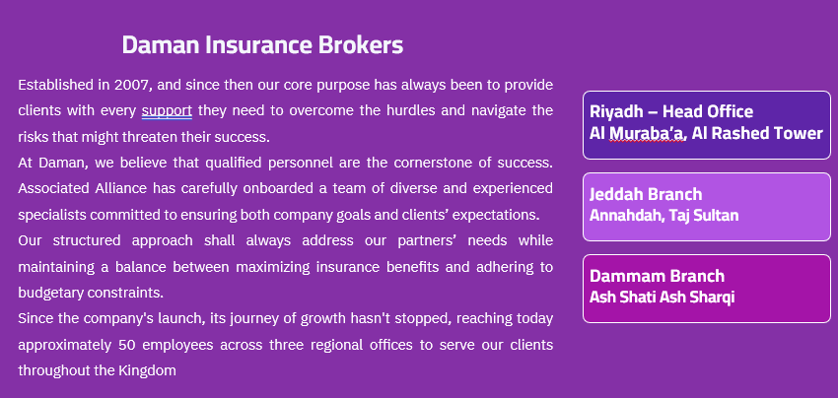
Presentation
17

Slide 20
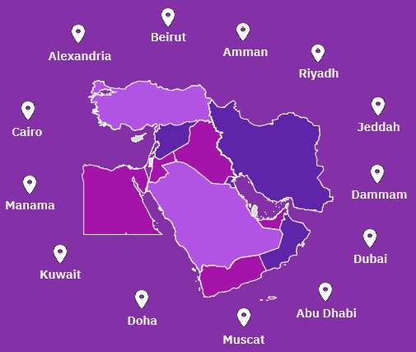
Presentation
18

Slide 21
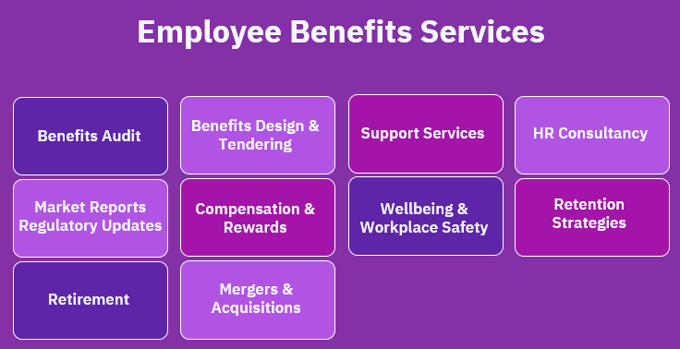
Presentation
Retention Strategies
19

Slide 22
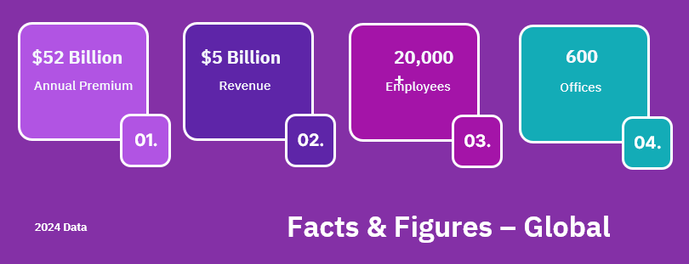
Presentation
04.
20

Slide 23
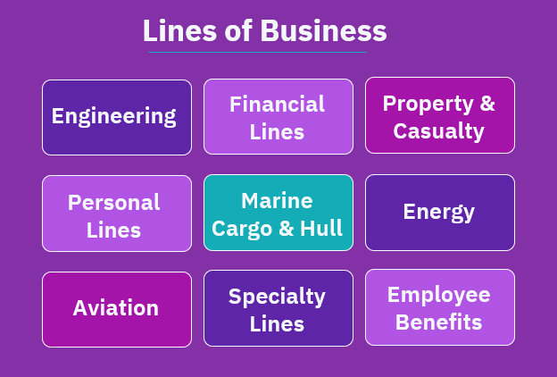
Presentation
21

Slide 24

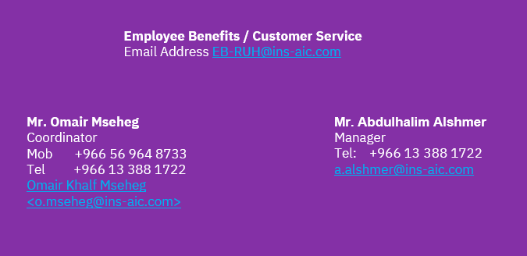
Presentation
Points of Contact
22

Slide 25

Presentation
23

