Slide 1



The Planning for
the Future Initiative

Slide 2


When a worker is injured on the job, it doesn’t just affect them. It affects their entire family.

Slide 3

These injuries can come at any time, when children are grown up and even when they’re still quite small.

Slide 4

We can help these kids no matter how old they are.

Slide 5

We give kids a chance at a better future.
Kids’ Chance of America provides a pathway for kids affected by a workplace injury to pursue their dreams by empowering a network of 50 state organizations that provide college and trade school scholarships.

Slide 6
Since 1988, Kids’ Chance organizations have awarded more than 11,000 scholarships totaling over $42 million. But we can’t stop there, as thousands of kids each year need help.

Slide 7

Our Planning for the Future initiative helps us identify eligible applicants – especially those who are not yet old enough to think about higher education.

Slide 8
Submission
Check-In
Referral
Applicant
Recipient
Here’s How It Works

Slide 9

Jen is 6 years old. Her dad suffered a fall at work that paralyzed him.

Slide 10

A case worker – or other frontline member of the workers’ comp community – tells Jen’s mom about Kids’ Chance.

Slide 11

A few months later, the company handling her dad’s case and his employer send Jen’s mom information on Kids’ Chance.

Slide 12
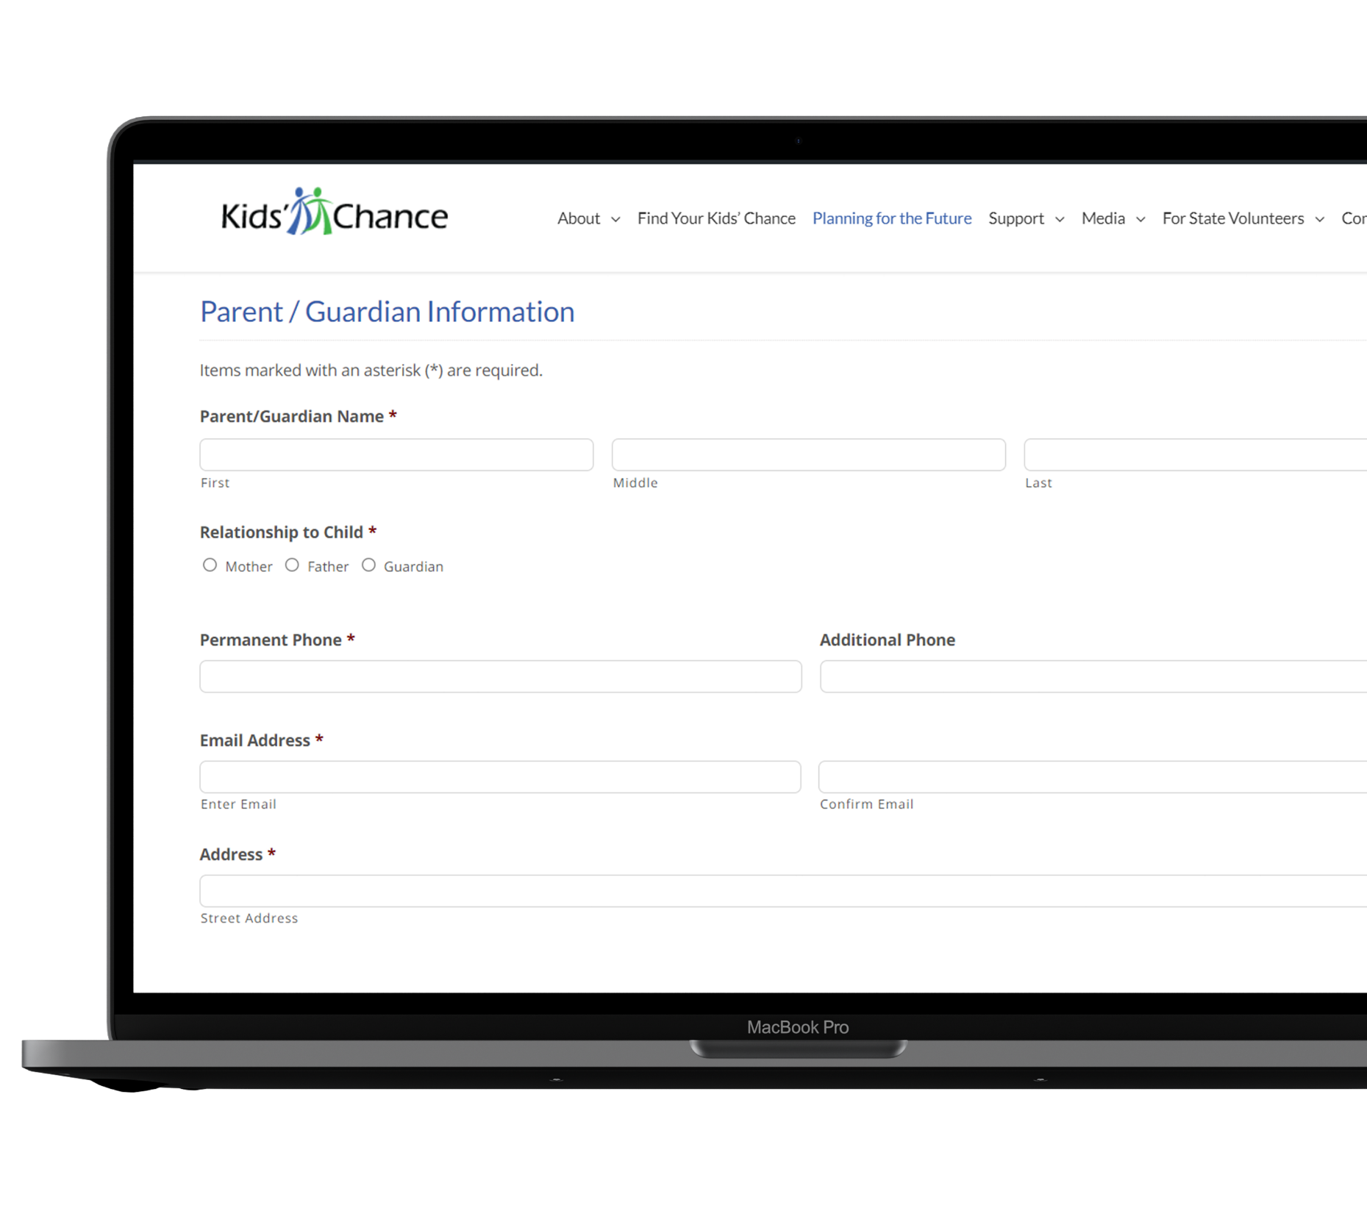
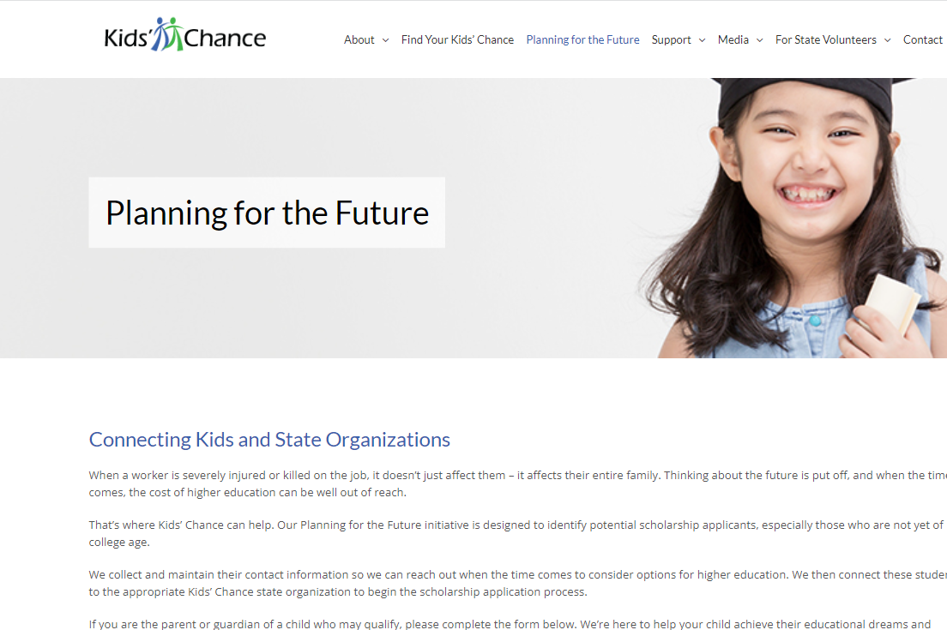
Jen’s mom visits the Kids’ Chance website and goes to the Planning for the Future landing page.

Slide 13
Then she scrolls down the page and completes the form. Jen and her mom are now in our system.

Slide 14
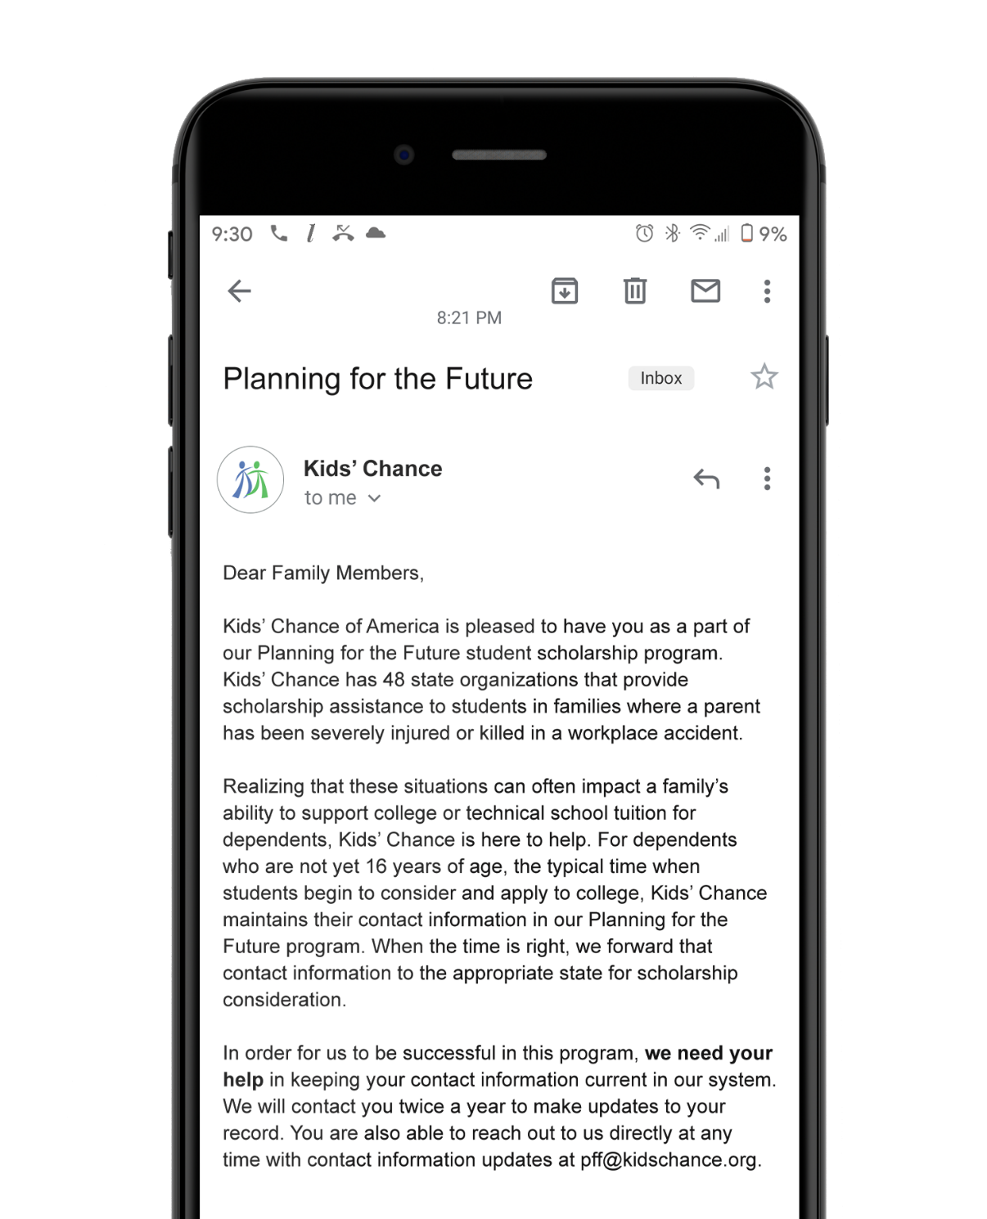
We reach out to Jen and her mom twice a year to keep their information up to date.

Slide 15
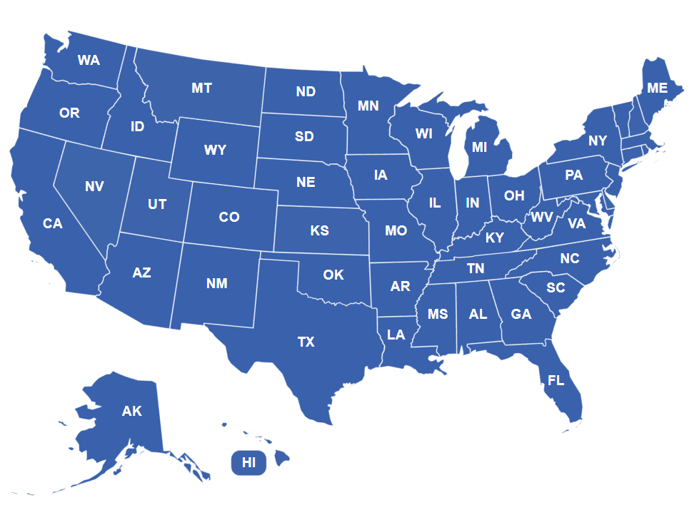
When Jen turns 16, we connect her to the Kids’ Chance in the state where the claim was filed.

Slide 16

The state organization can now reach out and encourage Jen to apply for a scholarship.

Slide 17

Other Things to Know

Slide 18

Who’s eligible?
We provide scholarships to kids whose parent was injured on the job. They need to have a workers’ compensation claim number.

Slide 19

Are scholarships for 4-year colleges only?
No. In fact, all post-secondary education including vocational training, associates degrees, etc. are eligible.

Slide 20

Do states have other referral sources?
Yes. In addition to Planning for the Future, each state has other referral sources.

Slide 21

With your help, we can find more eligible kids and steward them toward their state.

Slide 22
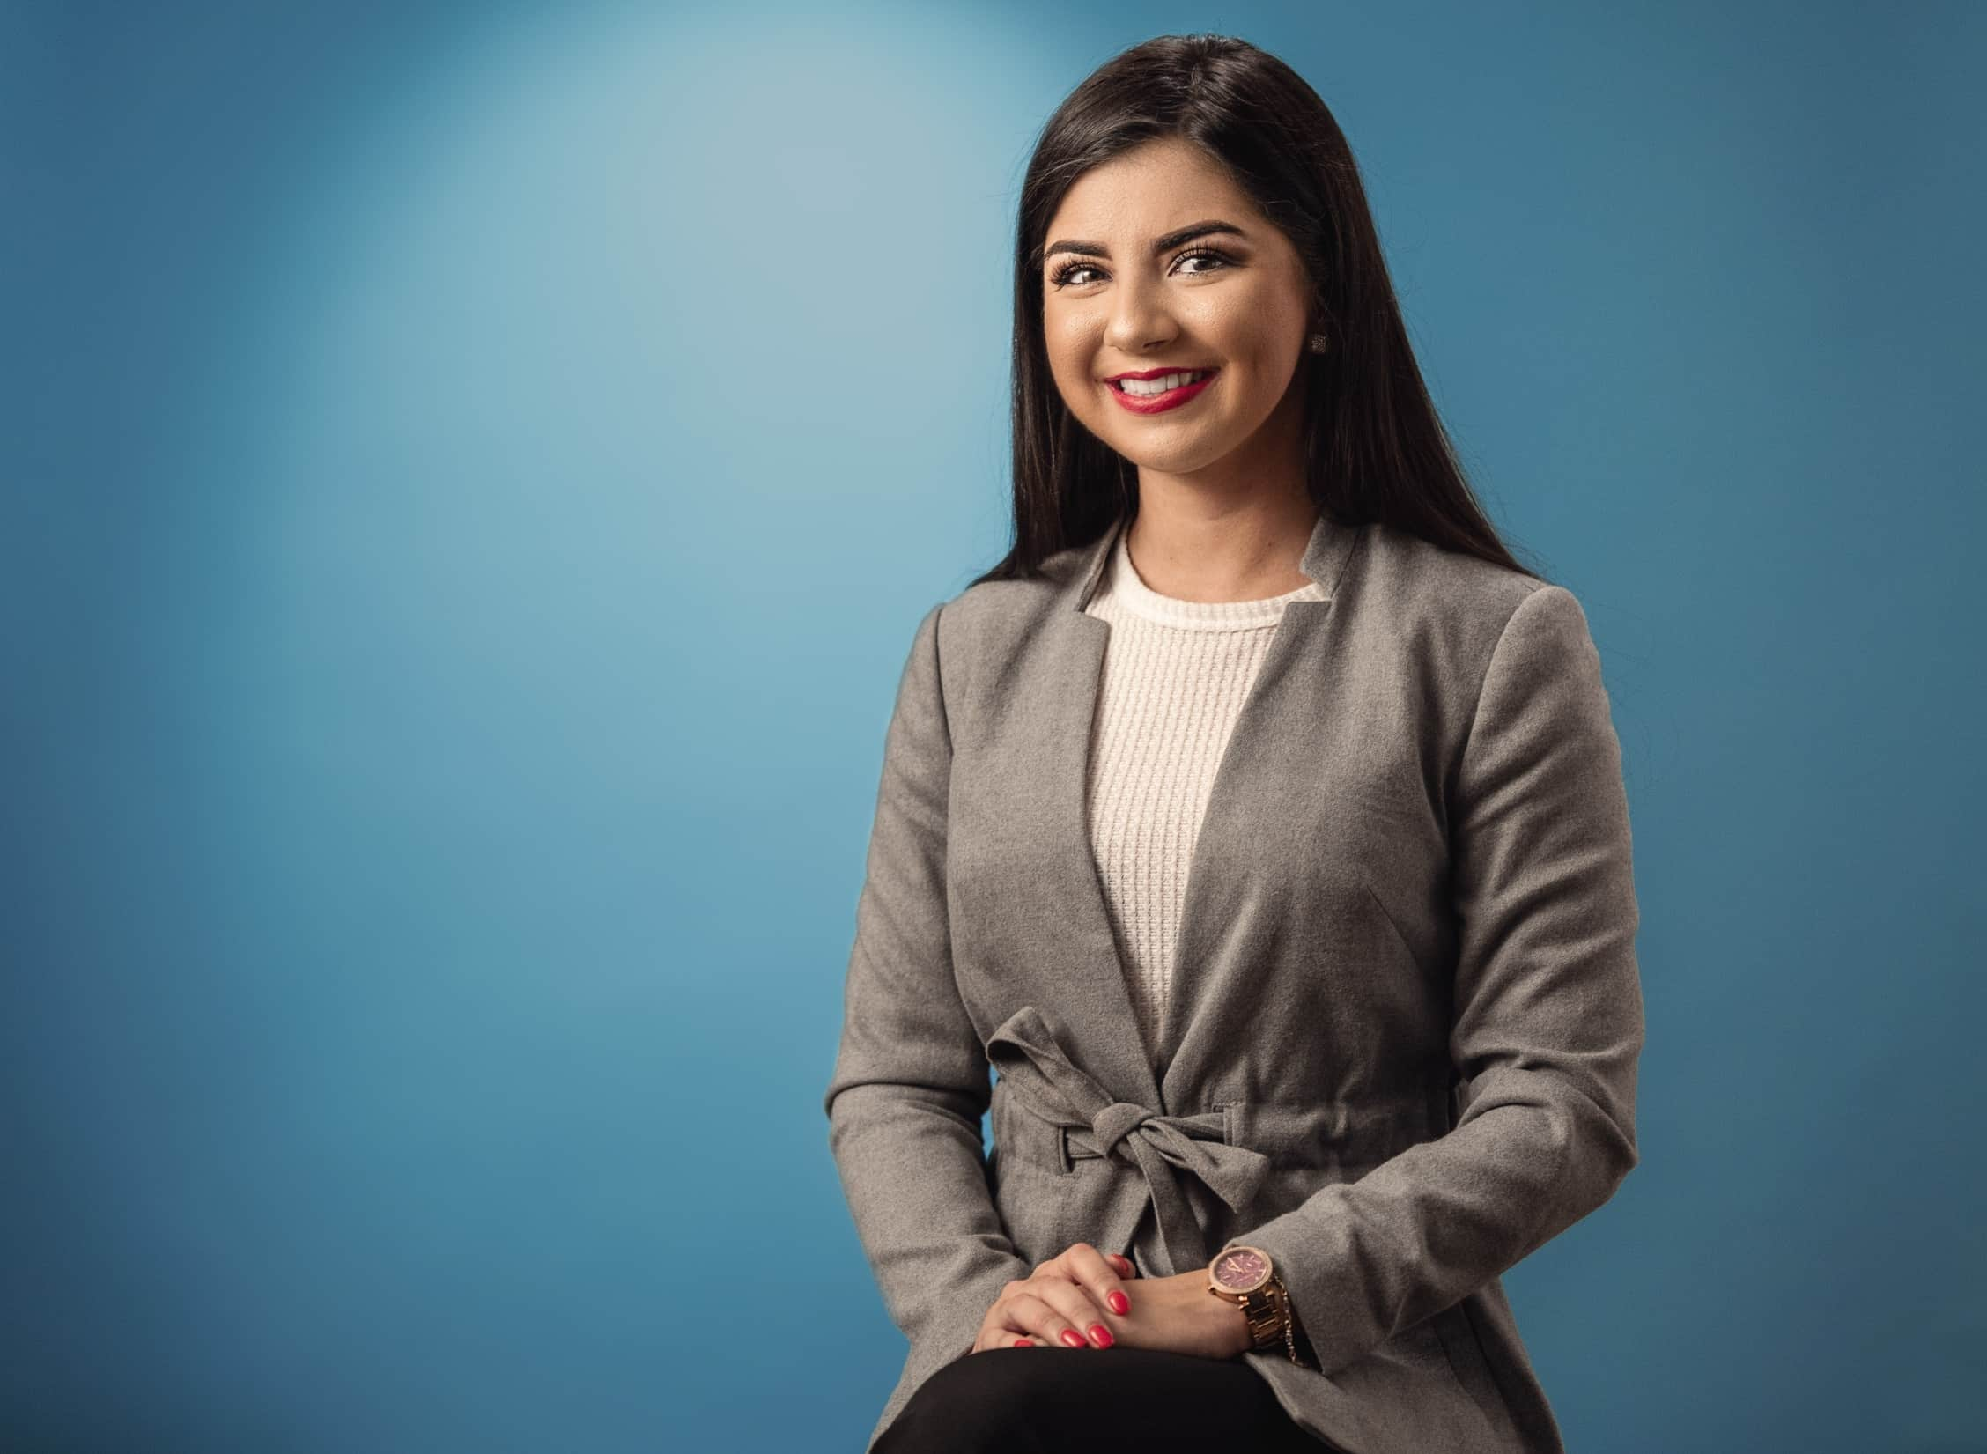

“I know I say thank you, but that’s not enough. There are no words that express the gratitude that not only I, but my family have for this organization.”
Gabriela
Kids’ Chance of Florida

Slide 23

Thank You
We are extremely grateful to our donors, volunteers and advocates. Without their generous support, none of our accomplishments would be possible.

Slide 24

















Thank you to our national partners
You’re in good company

Slide 25






Connect with Us
401-405-4028
admin@kidschance.org
www.kidschance.org

