Slide 1

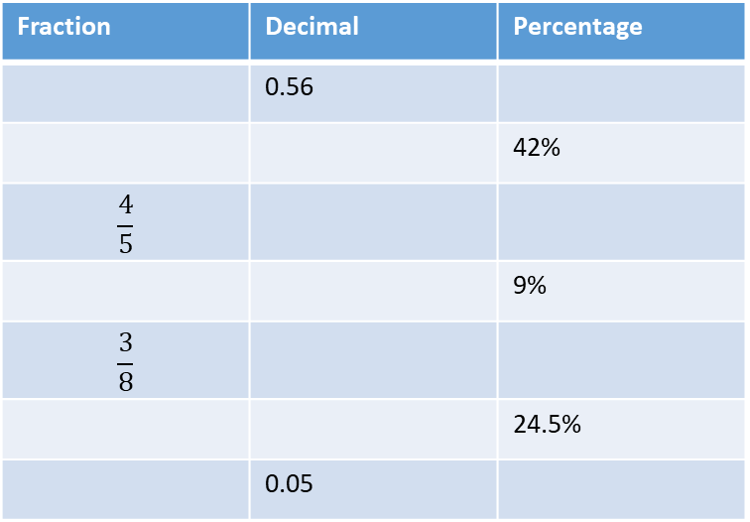
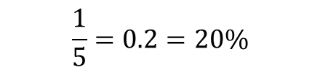

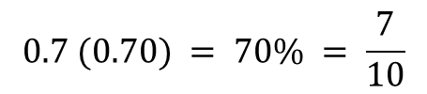
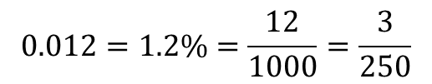


Converting Fractions, Decimals, Percentages and Mixed Numbers (F)
Examples:
$$0.7 (0.70) = 70\% = \frac{7}{10}$$
$33\%=\frac{33}{100}=0.33$
$$\frac{1}{5}=0.2=20\%$$
$$0.012=1.2\%=\frac{12}{1000}=\frac{3}{250}$$
$$\frac{15}{4}=3\frac{3}{4}$$
$$2\frac{4}{5}=\frac{14}{5}$$
Remember: Always do the inverse to check your answer is correct!
Q1) Complete the table
Fraction | Decimal | Percentage
 | 0.56
 |  | 42%
$$\frac{4}{5}$$
 |  | 9%
$$\frac{3}{8}$$
 |  | 24.5%
 | 0.05
Q2) What is 0.56 as fraction? Give your answer in it’s simplest form.

Slide 2


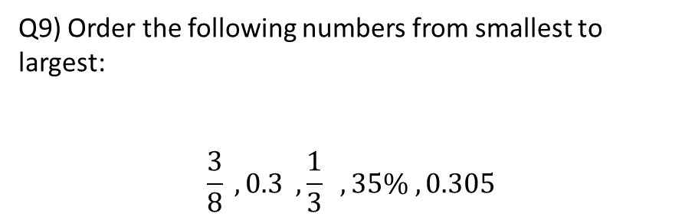
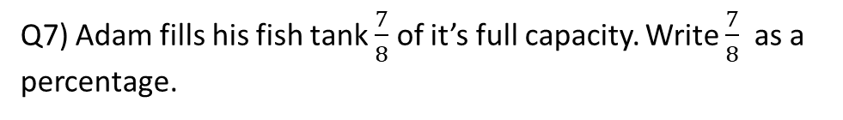
Q3) What is 68% as a decimal?
Q4) Change $\frac{19}{7}$into a mixed number.
Q5) Change 4$\frac{2}{3}$ into an improper fraction.
Q6) Write the number 3.5 as a mixed number.
Q7) Adam fills his fish tank $\frac{7}{8}$ of it’s full capacity. Write $\frac{7}{8}$as a percentage.
Q8) Jenny feeds her dog 0.4 tins of dog food each day. How many tins will she need to feed them over 5 days?
Q9) Order the following numbers from smallest to largest:
$$\frac{3}{8} , 0.3 , \frac{1}{3} , 35\% , 0.305$$
Ask Absolute -

