Slide 1






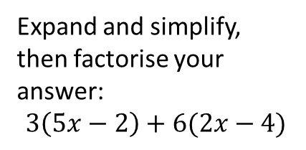

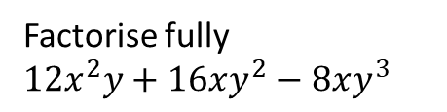



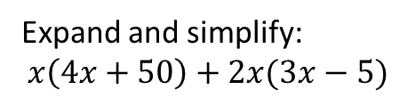

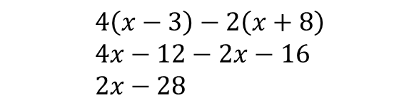
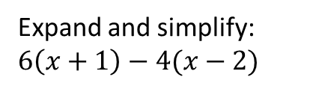
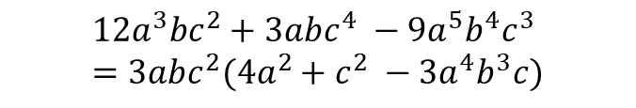
Expanding and Factorising Single Brackets
Examples:
$$x\left(x+7\right)= x^{2}+7x$$
$$3x+12=3(x+4)$$
$$4y\left({2y}^{2}−3\right)=8y^{3}−12y$$
$$12x^{2}−2x=2x(6x−1)$$
$$4\left(x−3\right)−2\left(x+8\right) \\ 4x−12−2x−16 \\ 2x−28$$
$$12a^{3}bc^{2}+3abc^{4} −9a^{5}b^{4}c^{3} \\ =3abc^{2}(4a^{2}+c^{2} −3a^{4}b^{3}c)$$
Remember: Multiply everything on the outside by everything on the inside when expanding brackets. When factorising, take out the largest possible factors.
Q1)
Q2)
Q3)
Q4)
Q5)
Q6)
Factorise fully: ${3x}^{2}+9x$
Q7)
Q8)
Q9)
Q10)
$$2g(3h+9i)=$$
$$5y(2y−7)=$$
Expand and simplify:
$$x\left(4x+50\right)+2x(3x−5)$$
$$4ab^{2}(3b+7a)=$$
Factorise fully $12x^{2}y+16xy^{2}−8xy^{3}$
Fully factorise: $12ab+8b$
Expand and simplify, then factorise your answer:
$$3\left(5x−2\right)+6(2x−4)$$
Expand and simplify: $6\left(x+1\right)−4(x−2)$
Factorise fully:$14x^{2}−21x$

Slide 2




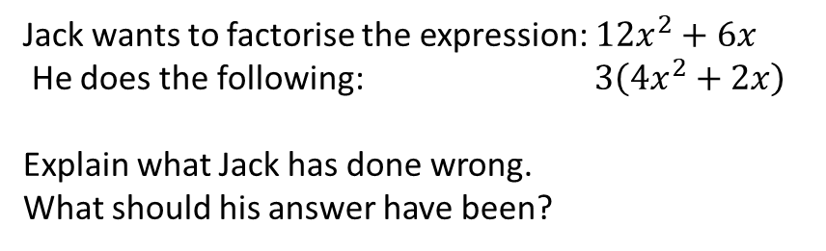
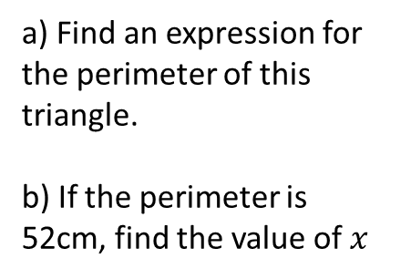
Q11)
Q12)
Q13)
a) Find an expression for the perimeter of this triangle.
b) If the perimeter is 52cm, find the value of $x$
$$3(x−2)$$
$$4(2x−5)$$
Jack wants to factorise the expression: $12x^{2}+6x$
He does the following: $3\left(4x^{2}+2x\right)$
Explain what Jack has done wrong.
What should his answer have been?
$$5{(y}^{2}+8)$$
$$10(y^{2}−3)$$
a) Write an expression for the perimeter of the rectangle.
b) Factorise your answer as much as possible
Ask Absolute -

