Slide 1
Pitch Deck

Slide 2
Cyber Attacks Are Growing Exponentially:
Is Your Enterprise Protected?
A reactive, short-sighted approach to IT and cyber security can potentially cost your organization money, time, and data. And, these threats are growing every day.
$10.5 Trillion
The total amount of cybercrime damages expected every year over the next five years.
15%
The year-over-year increase in cybercrime damages expected over the next five years.
60%
of small to mid-sized businesses fail within six months of a cyberattack.

Slide 3
We live in a world where cyber attacks have become one of the single biggest threats to enterprise company growth.

Slide 4
We live in a world where cyber attacks have become one of the single biggest threats to enterprise company growth.
And these attacks are growing exponentially.

Slide 5
In this world, there are organizations who win, and those who lose.
Those winners are determined by who prepares and who simply reacts.
PROACTIVE
$3.81 million¹
The average amount saved via Security Driven AI, representing the best cost mitigation (80% cost difference)
REACTIVE
$4.24 million²
The average cost of a data breach in 2021, up from $3.86 million in 2020.
1, 2: https://purplesec.us/resources/cyber-security-statistics/#Cybercrime

Slide 6
But cyber attacks lose their power when their intended victims align the pieces for a total Cyber Transformation.
Cyber Fitness
Cyber Resilience
Cyber Strategy

Slide 7
How to survive as an enterprise organization in today’s precarious cyber landscape.
THE OLD WORLD
Reactive Security
Narrow, product-based services
A reactive approach to threats
Out-of-the-box solutions
THE NEW WORLD
Cyber Transformation
Cyber Fitness
Cyber Resilience
Cyber Strategy
Expertise in enterprise-level strategy
Product agnostic consulting
White glove cyber security solutions
Holistic IT solutions across the entire adoption cycle
Security and engineering talent staffing
Constant threat vigilance
People-first approach

Slide 8
“GenuineXs’ efforts stood out from the competition. They demonstrated great skill in communicating on technical solutions and scoping projects that made sense for our organization. They are a breath of fresh air in a highly competitive market, and we are excited to continue our relationship forward.”
CISO/ Head of Infrastructure
Investment Company, NYC

Slide 9
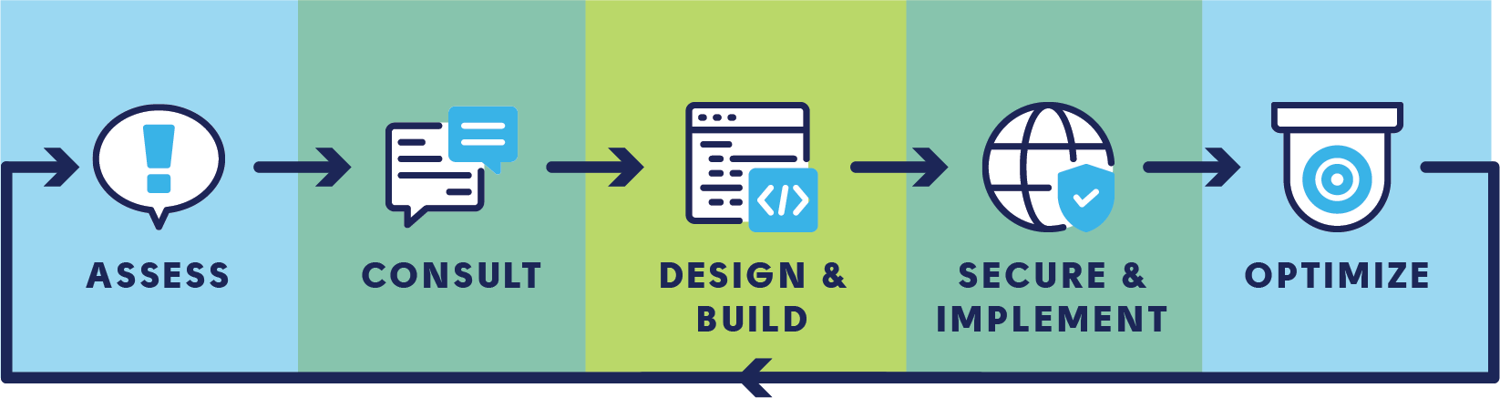
Cyber Security Consulting - “Solutions”
Advanced Incident Detection and Response
API Security & Threat
Data Protection
Continuous Identity Verification Solutions
Cyber Strategy
Cyber Fitness and Resiliency
Cyber Risk
Complete Compliance Certification
Secure Transformation
Zero Trust

Slide 10
IT Services - “Offerings”
Cloud Security Services
IoT and Critical Infrastructure Security Services
Specialized Cyber and Technology Engineering Services
Staff Augmentation
Data Governance, Privacy, and Protection
Network and Technology Services
Identity Management and Continuous Identity Verification
Application and API Security and Services
Risk Management and Compliance Services
Threat Management
Managed Services

Slide 11
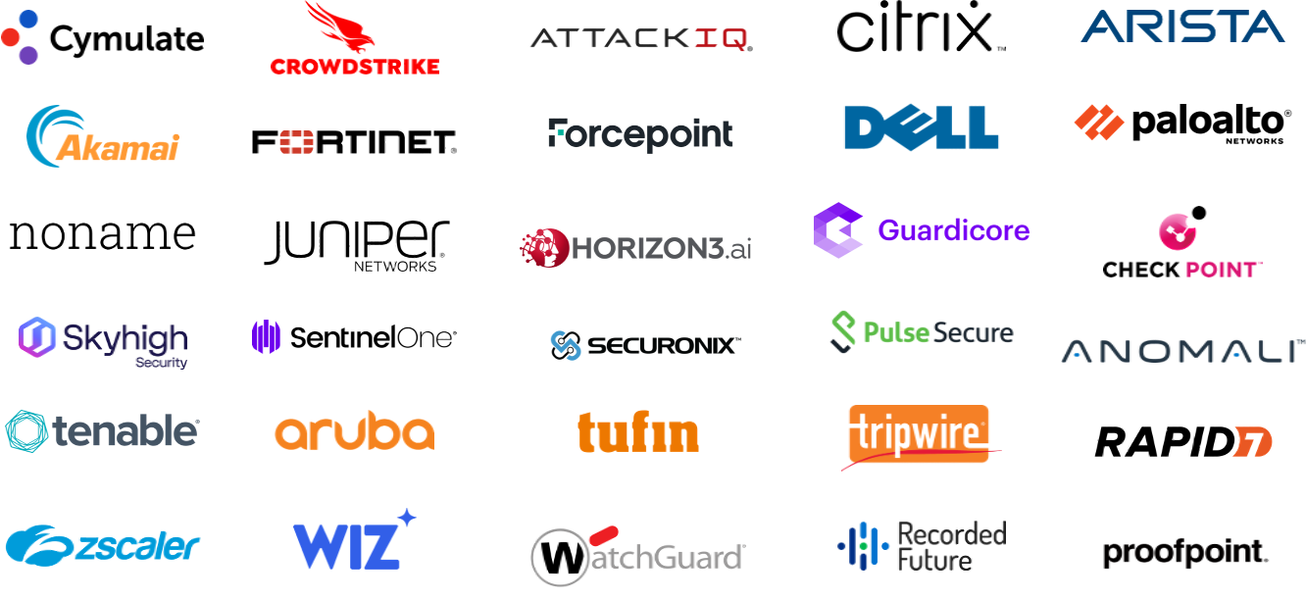

Slide 12
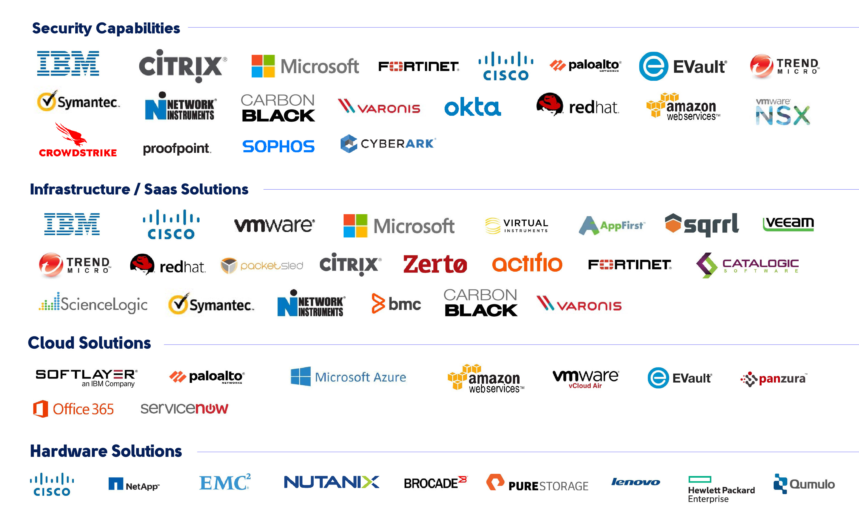

Slide 13
Lock Down Your IT & Cyber Security Strategy. Unlock Your Organization’s Real Potential.
GenuineXs is a cyber-first security, engineering, and services partner helping the world’s most exciting enterprise organizations optimize their entire IT lifecycle for the modern world.

Slide 14
Your trusted guides to lead you out of cyber vulnerability and into Cyber Transformation
ABOUT US
GenuineXs is a cyber-first technology partner creating holistic IT & Security solutions for enterprise companies. We help the planet’s most exciting organizations lock down their technology and unlock their potential in the modern world. We are:
Experts in enterprise-level strategy
Product agnostic
Minority-Woman owned

Slide 15



v
MEET THE TEAM
Jessca Gonzales
CEO & FOUNDER
Eric Beerman
HEAD OF PARTNERSHIPS
Cliff Segal
VICE PRESIDENT OF COMMERCIAL SALES

Slide 16
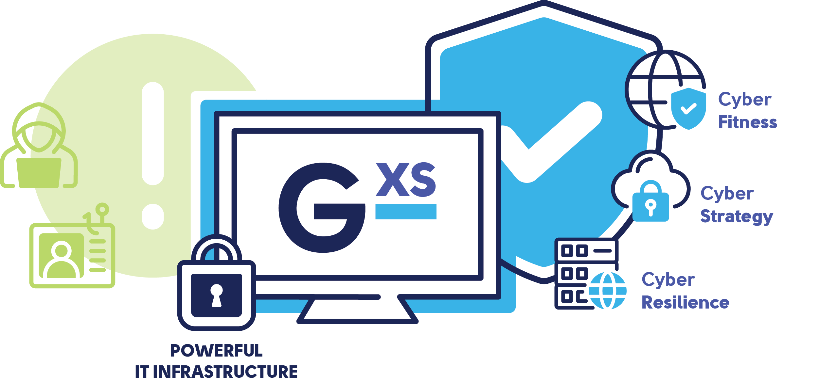
Fortune 500 VP Sec Ops
Create a bulletproof IT infrastructure while streamlining operations so your enterprise organization can focus on what matters most: Growth. GenuineXs is a cyber-first security, engineering, and services partner who will guide you out of cyber vulnerability and into Cyber Transformation. That means:
  Cyber Fitness. We get the right security and engineering talent in the right seats to prevent misconfiguration and onboarding stress.
  Cyber Strategy. We create custom solutions based on your organization's specific threat landscape to mitigate security risk and unlock business potential.
  Cyber Resilience. Using a holistic, product-agnostic approach, we optimize your entire IT lifecycle so staying ahead of threats feels effortless.

