Slide 1

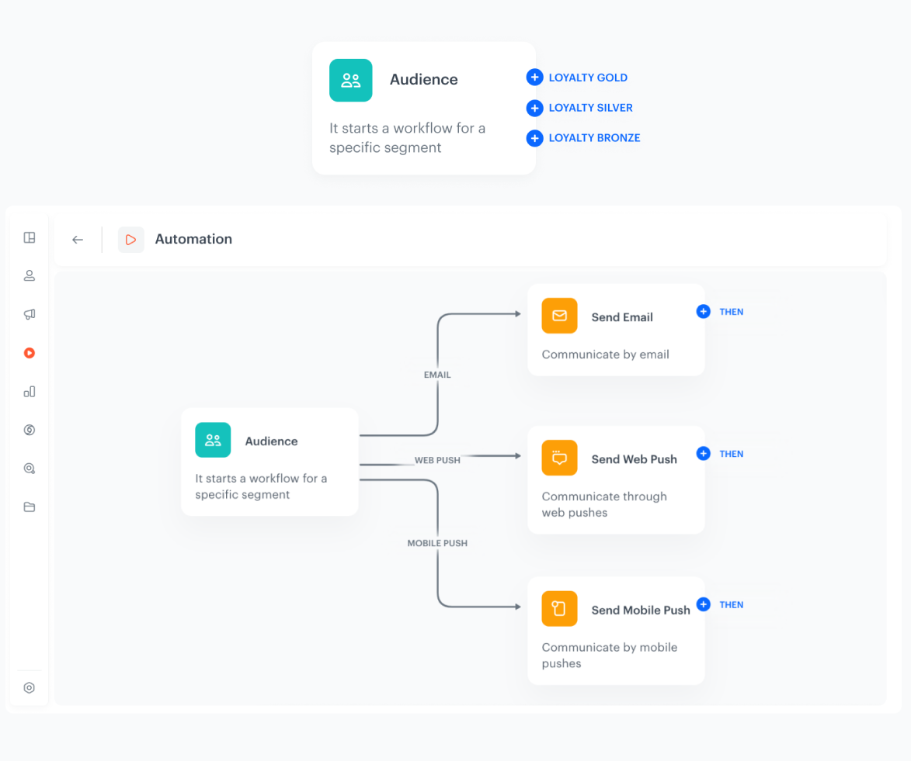

Segment-based branching
Smarter Prioritization and Optimization
Segment-based branching lets you split one workflow into multiple paths — one for each subsegment in your segmentation.
How does it work
Each path can have its own logic and priority order — allowing you to manage audience complexity without duplicating workflows.
Think of it as Air Traffic Control for your campaigns: every audience group follows its own flight path, and top-priority segments are cleared for takeoff first.
Key Benefits
Hyper-personalized targeting
Deliver the right message to the right group and manage the prioritization
Smarter workflow logic
Split your journeys per subsegment without duplicating workflows
Faster adaptation to change
Easily update your logic when subsegments change, without rebuilding workflows from scratch.
TIP: This feature works best when your segmentation contains up to 10 subsegments and is based on rich behavioral or transactional data.

