Slide 1
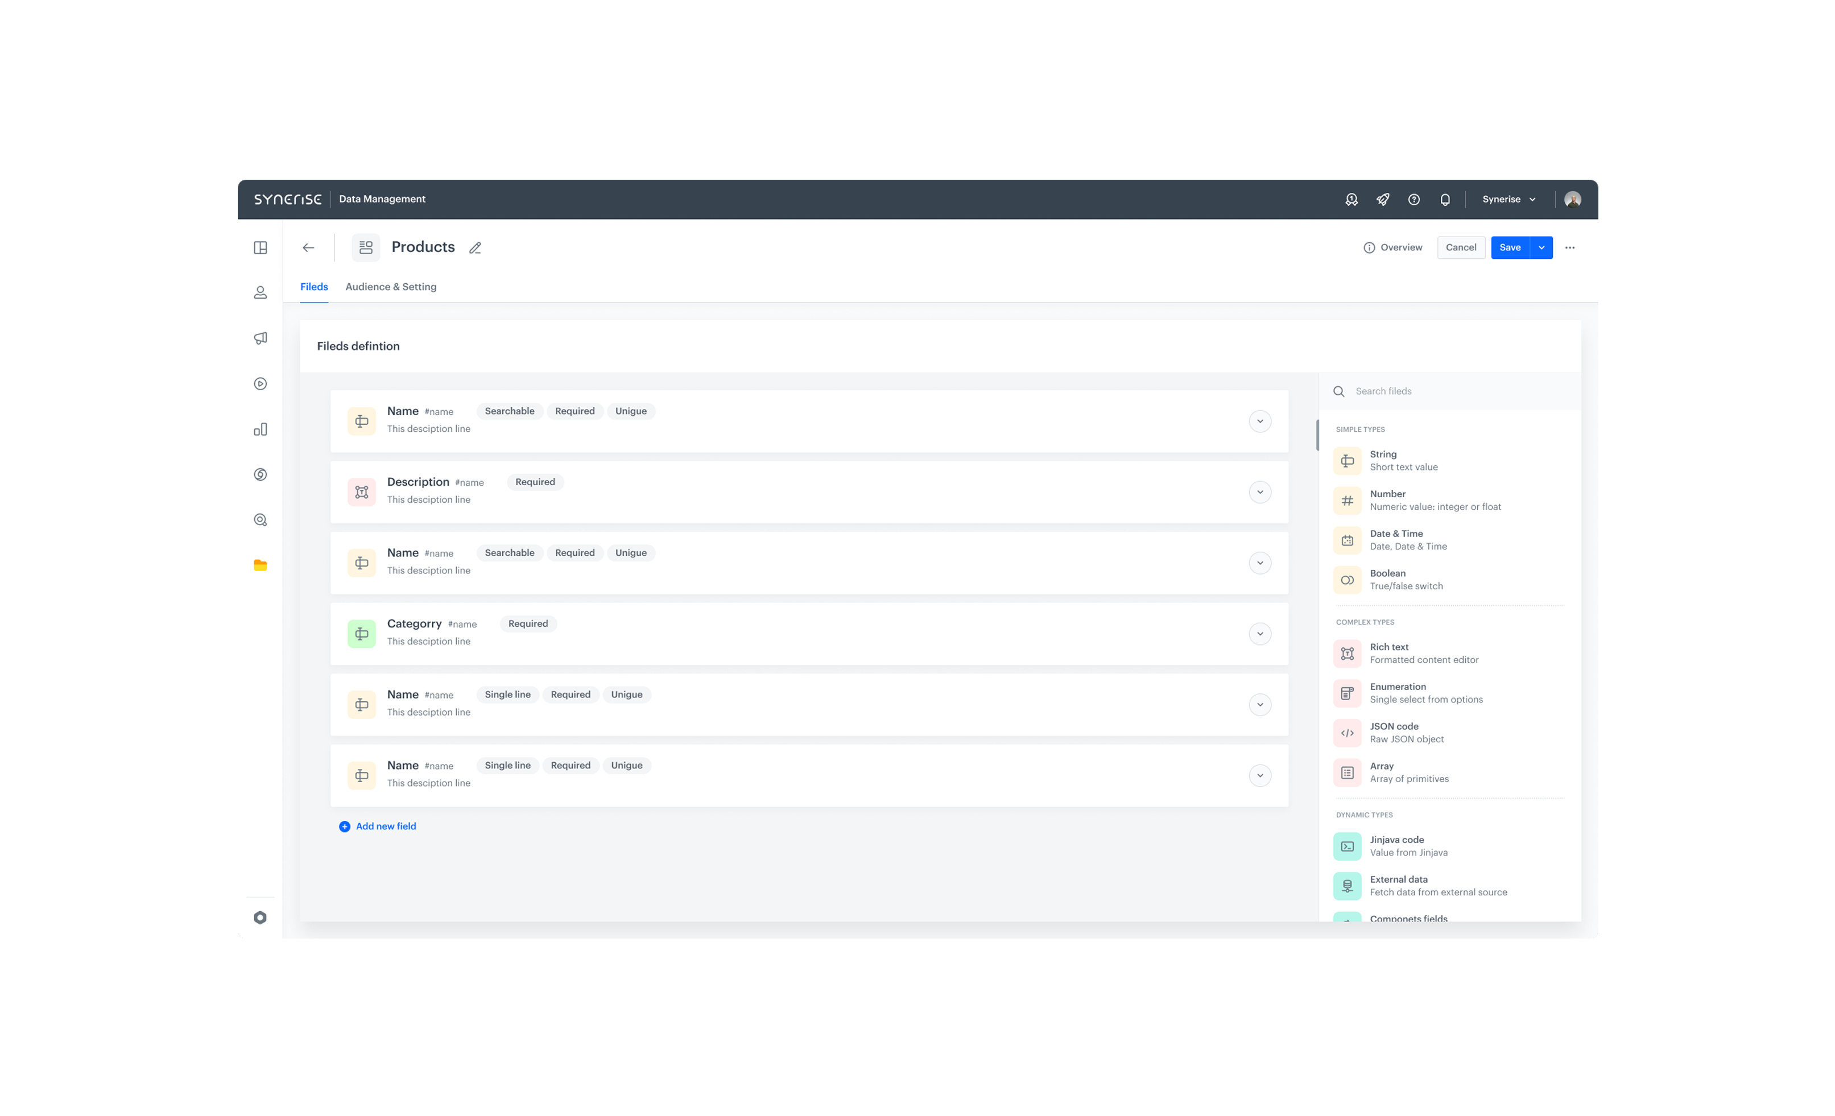


Feature / Module
Brickworks
Real-time, low-code behavioral AI-native CMS
How does it work
Brickworks is a schema-based behavioral CMS integrated into the Synerise ecosystem. It empowers you to build completely custom data structures — from loyalty programs and full-scale item catalogs to any custom integration— using your business logic. It gives you complete schema flexibility, native AI personalization, single API call across any digital channel touchpoint — all with a low-code setup and API-first architecture.
Key Benefits
Low-Code Setup
Design schemas visually or via API — build exactly what your business needs, fast. Perfect for both business users and product teams.
Unified Content & Context in One Schema Connect CRM, ERP, PIM, and internal logic into a single content model — then deliver it all in one real-time API call across all channels.
AI-Native Personalization Built In No plugins, no glue code. Native Synerise AI powers segmentation, recommendations, and real-time content adaptation out of the box.

