Slide 1

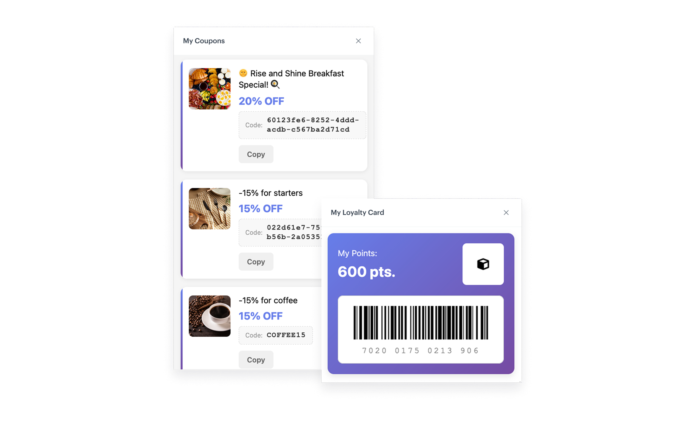
Feature / Module
New In-app loyalty templates
New predefined in-app templates—designed to help you launch key loyalty features
How does it work
With the new templates, you can quickly implement essential components such as a digital loyalty card that shows real-time point balances and a personalized promotions catalog, all within your mobile app interface. No need for building features from scratch—just configure, style, and launch.
Both templates are built to help you reduce operational overhead and accelerate time-to-value, while ensuring consistency with your brand and marketing logic.
Loyalty Card template
A unique, automatically generated barcode based on the customer identifier for scan-at-checkout identification
Real-time point balance, based on a dynamic expression
Fully styled, branded layout – ready to configure in minutes
Promotions Catalog template
Dynamic list of coupons pulled from your promotion catalog
Easy copy-to-clipboard option for each code
Limit on visible coupons for a user

