Slide 1

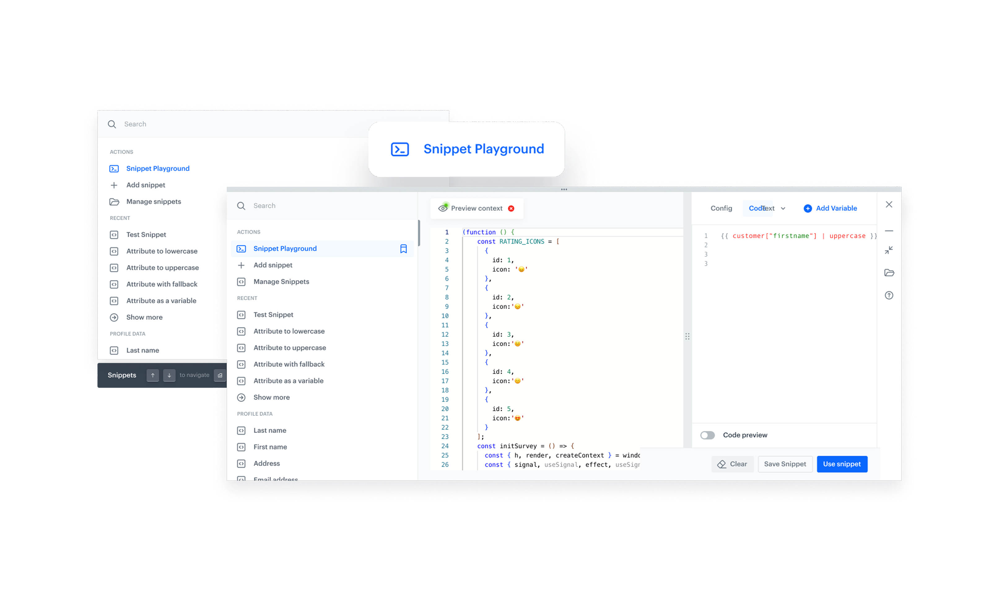
Feature / Module
Snippet Playground
Craft and preview content in real-time anywhere in the platform
How does it work
The Snippet Snippet Playground lets you test and preview the content you’re currently working on without entering a campaign editor or running a full workflow. It gives you a working draft of your content that’s always within reach — accessible from anywhere in the platform via a keyboard shortcut
What’s New
The Snippet Widget, which hosts Snippet Playground, can now be opened from anywhere in Synerise using a keyboard shortcut
(Cmd + / or Ctrl + /).
This ensures that the Playground is always within reach, regardless of which module you are currently working in.
Widget with playground becomes a dedicated workspace for testing and previewing snippets alongside the content you’re currently working on — without entering a campaign editor, modifying the full campaign template, or triggering the entire workflow.

