Slide 1

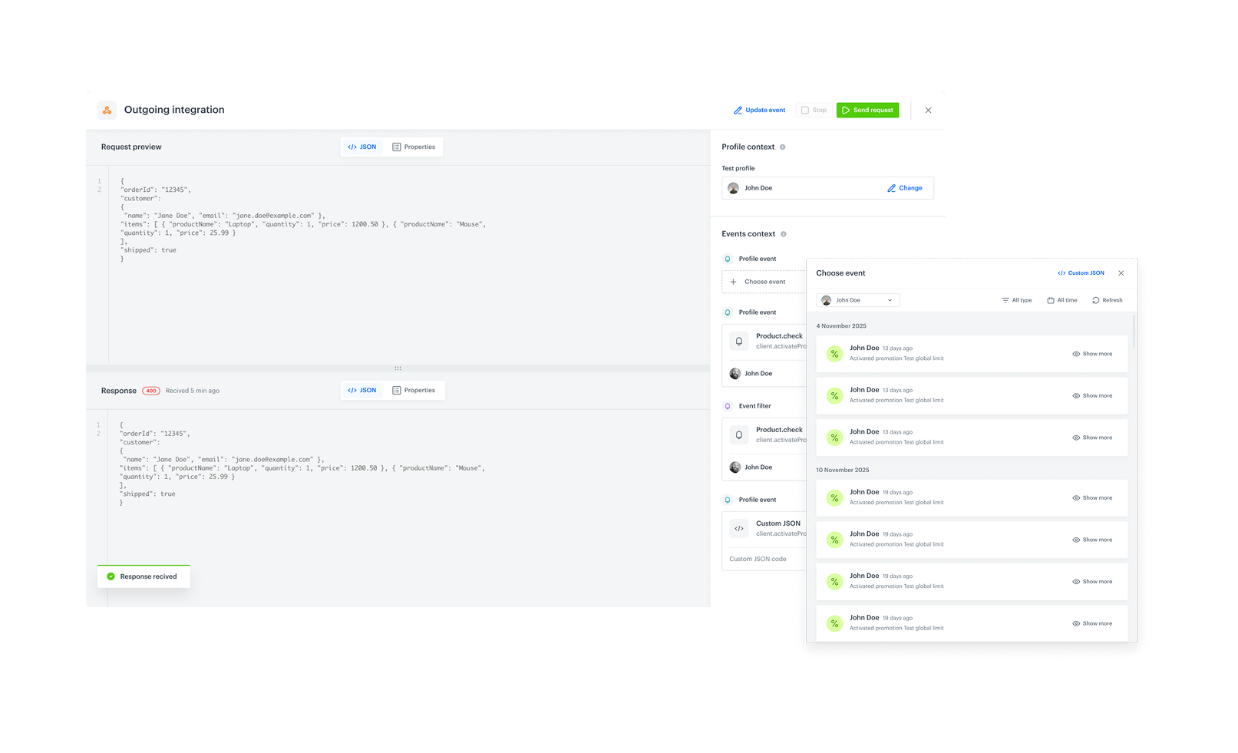




Feature / Module
Reverse ETL for Redshift & PostgreSQL
Managing data across multiple platforms often means working with sometimes disconnected systems. When your operational data lives in one database, transactional records in another, and event streams elsewhere, creating a unified view becomes a challenge. Reverse ETL for Redshift and PostgreSQL help unifying your data without the complexity.
How does it work
We've added two new integrations to Automation Hub: Amazon Redshift and PostgreSQL. Build complete data flow workflows without writing code. Connect securely, parameterize queries with dynamic Jinjava tags (e.g., fetch data since last run), schedule syncs on-demand or recurring, and monitor every step with built-in logs. Use the retrieved data to populate catalogs, enrich profiles, or power automations, all from one place.
Key Benefits
Unified customer view
Bring external data into Synerise for richer profiles and smarter targeting.
Low-code Automation
Use SQL and Jinjava to customize sync logic without heavy development.
Scalable & Secure
Enterprise-grade connections for growing data needs.
Check our newest Product Update ->

