Slide 1

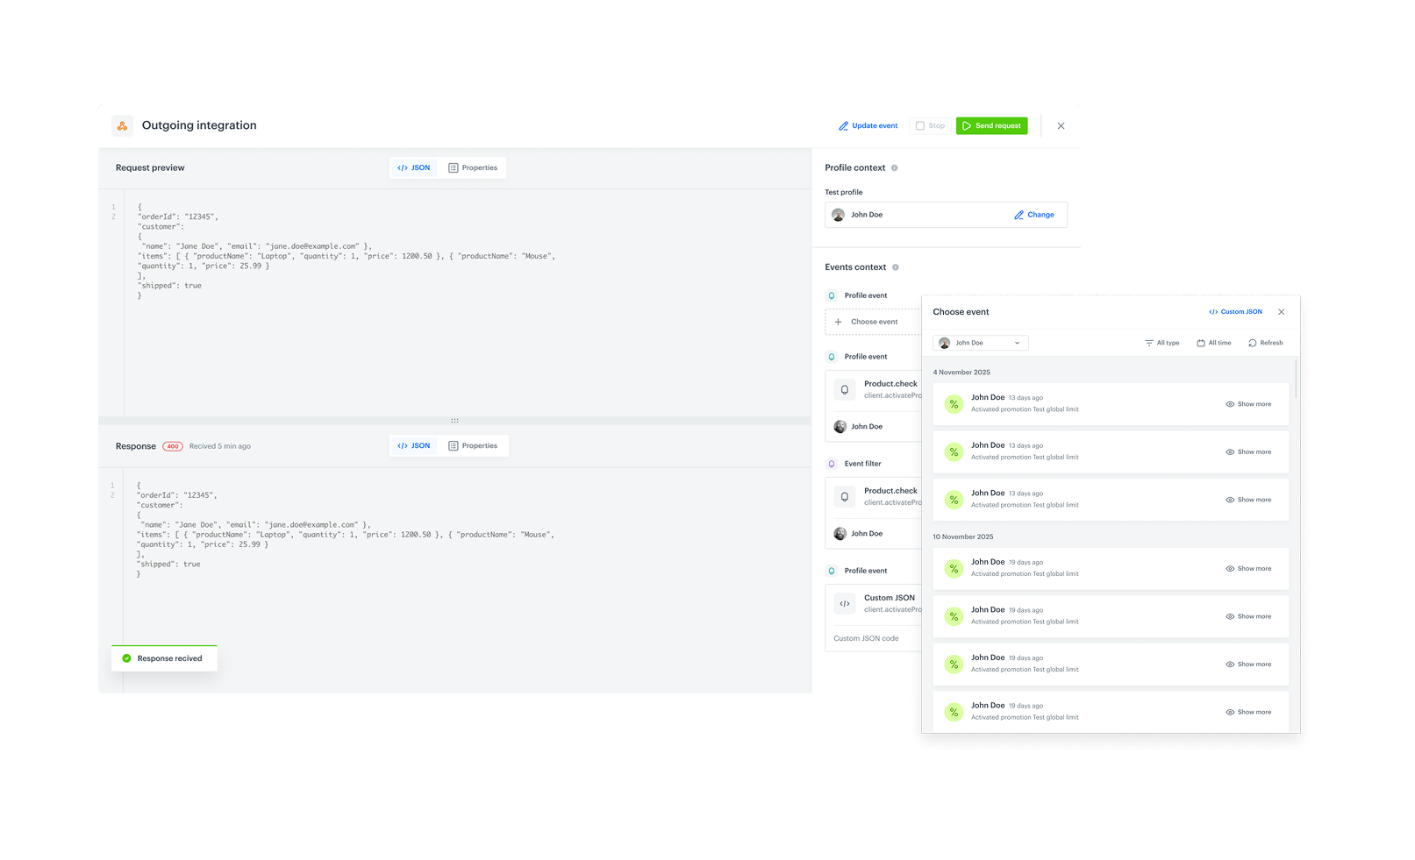
Feature / Module
Testing outgoing integrations
Validate configuration, connection and your request body - before you go live.
How does it work
We’re introducing a powerful new capability in Automation: the option to send a test request in outgoing integrations - both for predefined integrations and custom HTTP-based outgoing integrations.
You can now fully verify your setup - from connection and configuration to dynamic variables rendered from event context - without launching a workflow.
What’s New
When configuring an outgoing integration, you’ll now see the option to Send test request.
This opens a dedicated test builder that allows you to supply the integration with the full data context required to execute the test, such as:
selection of the profile context (only Test Profiles allowed)
selection of an event context
rendering of dynamic values - used in the request (based on the event context)
preview of the outgoing request and response
immediate saving of the response as an event in Assets
No need to manually trigger workflows or send real events just to validate filters or logic.

