Slide 1

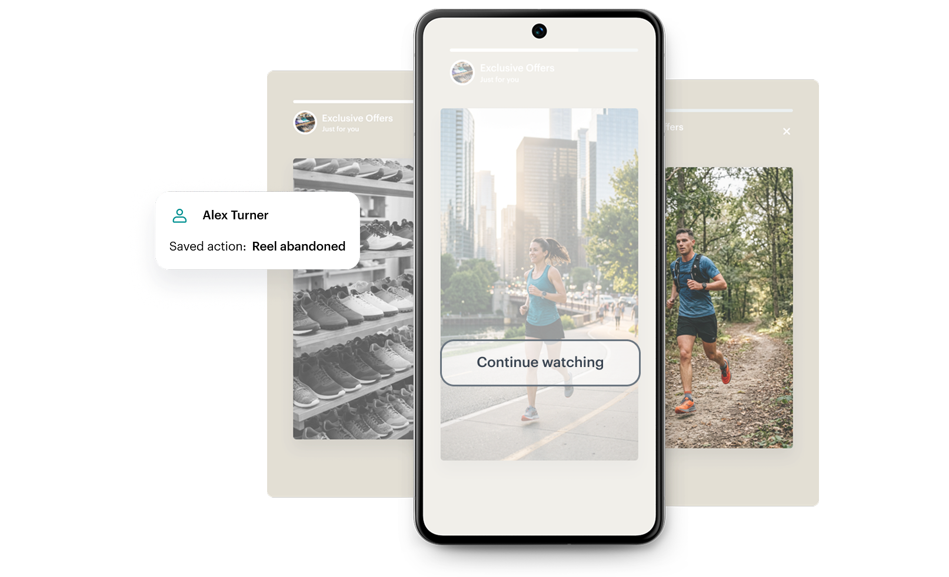

Feature / Module
Dedicated on-device storage for in-app communication
In-app experiences work best when they're fast, contextual, and personalized. In-App Storage introduces a dedicated, on-device data layer for campaign-specific information. Store and retrieve data directly in the app environment.
How does it work
This system stores user-specific data as simple key–value pairs linked to individual user accounts rather than devices. This ensures that each user’s progress, preferences, and personalization remain separate, even if multiple people use the same device. Data can be saved, retrieved, updated, or deleted as needed, and it can also be fully cleared when a user logs out or resets their preferences.
Key Benefits
Continuous context across sessions
Build logic that remembers user actions and adapts instantly.
Native-level performance
No backend dependency; store and retrieve campaign data directly in the app, eliminating server calls, API latency, and network dependency for instant user experiences.
Smarter personalization
Fine‑tune story versions, CTAs, visibility rules, and content states based on real interactions.
Check our newest Product Update ->

