Slide 1

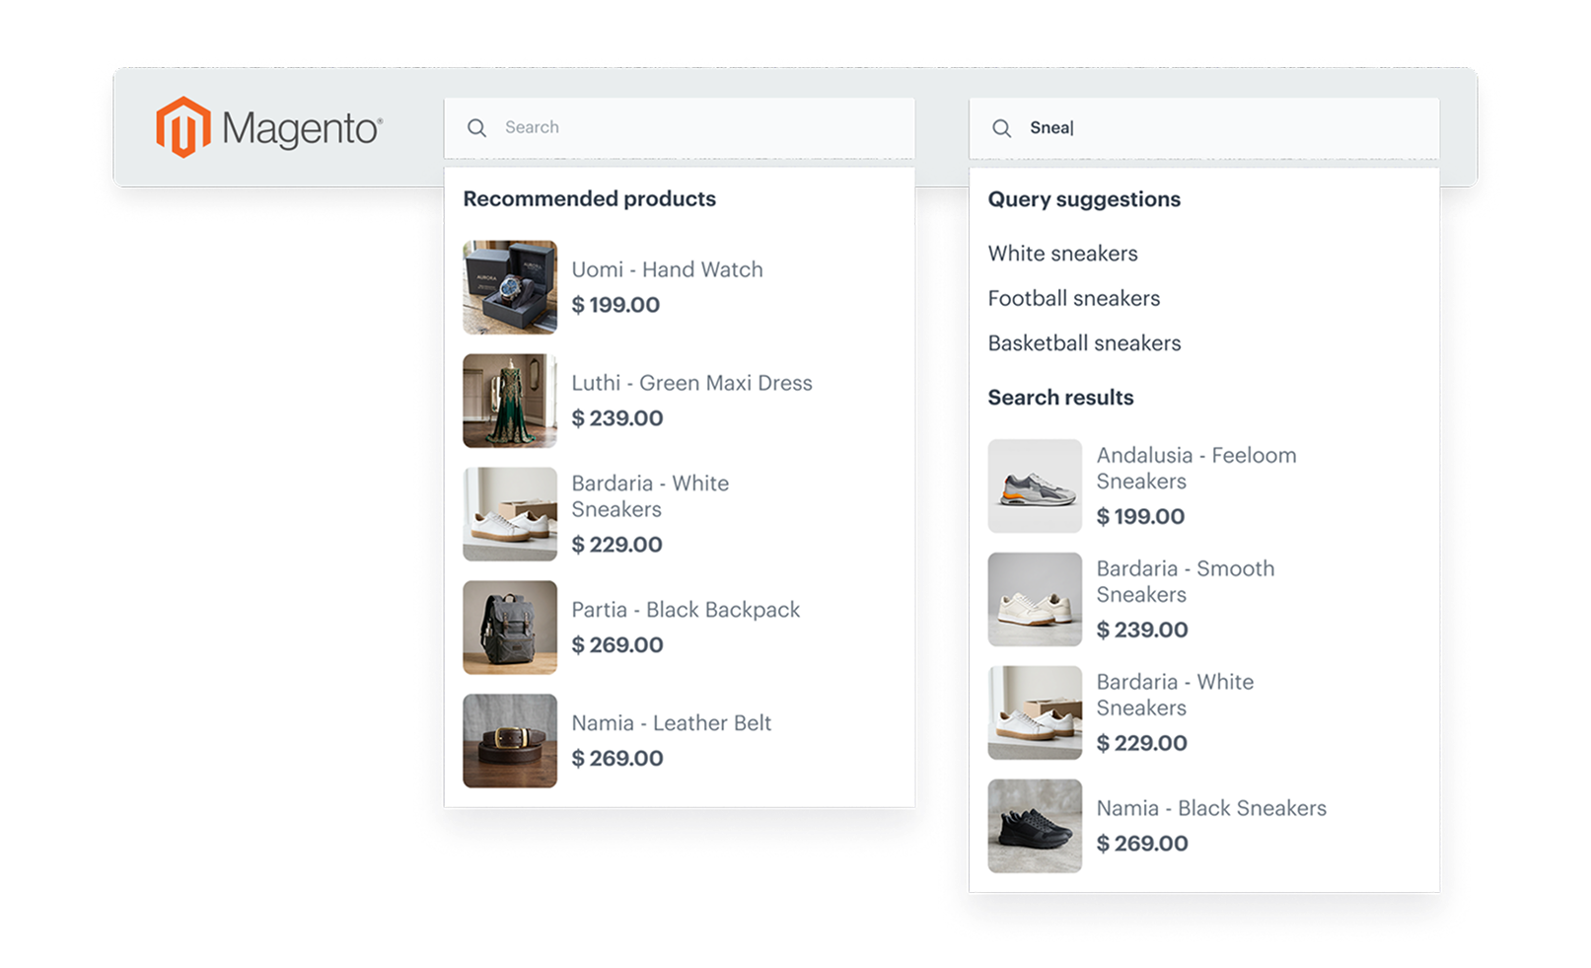
Feature / Module
Next-level AI Search in Magento plugin
With the latest update to the Synerise Magento plugin, implementing AI-powered search becomes significantly more powerful while remaining easy to configure.
How does it work
The update introduces four major capabilities that transform search from a simple lookup into a product discovery engine:
Suggestions for search autocomplete
Popular and last searched for zero-state and no-results pages
Recommendations for zero-state and no-results pages
Search listing
All of these can be configured directly inside the Magento plugin - no complex implementation required.
Why it matters
With these improvements, the Synerise Magento plugin makes it possible to implement a fully featured AI-powered search experience with minimal effort.
All directly inside the plugin.
The result: better product discovery, stronger engagement, and higher conversion from search.

