Slide 1













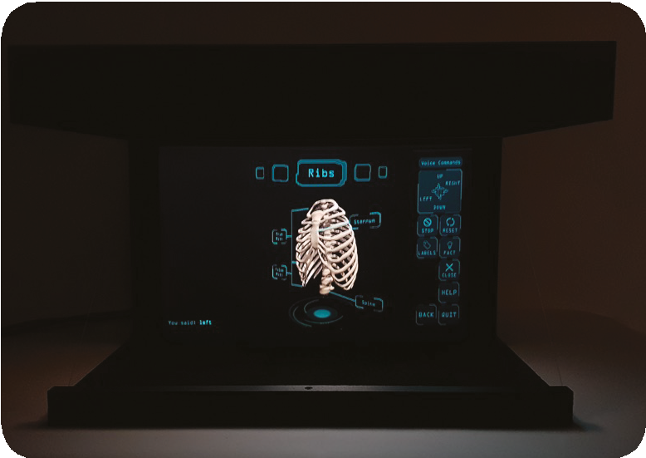

Applying to
MSc MEDICAL VISUALISATION & HUMAN ANATOMY
Images: Felicity Herrington, Msc Medical Visualisation & Human Anatomy 2021
A Programme accredited by

Slide 2

Application Form
MSc Medical Visualisation & Human Anatomy is an interdisciplinary programme, with applicants from science, arts, and other backgrounds. Your application will be forwarded to assessors when you have submitted:
A completed postgraduate application form
A personal statement Uploaded a video statement
You may additionally, and optionally, submit portfolio works or link to an online portfolio within your statement.
However, a portfolio is not a required part of the application process.

Slide 3

Application Form
Your application will be forwarded to assessors when you have submitted:
A completed postgraduate application form
A written personal statement
A pre-recorded video statement
In addition you will also need to submit
Two references
Evidence of academic qualifications
If English is not your first language evidence of English Language proficiency (IELTS certificate or equivalent)
A copy of your passport (if applicable)
Where possible submit all this information with the application
More information on accepted English language qualifications is available on GSA website: https://www.gsa.ac.uk/study/graduate-degrees/how-to-apply/

Slide 4
Personal Statement Guide
Written & Video
Your personal statements should provide a concise, critical self-evaluation of your work and the reasons for wishing to join your chosen programme at The Glasgow School of Art. What makes you passionate about this subject? Why do you want to study with us? What can you bring to the class?
Written statement has a limit of 500 words max.
Video statement should be approx. 3 minutes long.
The video statement should only feature a statement delivered to camera, without editing. The use of AI to enhance the video statement is completely forbidden.
The focus of the video statement is on you - so please do not intercut with images or video of portfolio works. We simply want to hear you speak about what you have achieved so far, why you wish to join our programme at The Glasgow School of Art, and why you think you will excel on our programme.

Slide 5
Assessment Criteria
Application Form
Transcript (relevance of courses and grades)
References

Slide 6
Assessment Criteria
Academic Qualiﬁcations and
Academic Qualifications/ Relevant Experience
Good first degree in a range of relevant subjects (e.g. related Design discipline, Computing, Animation, Heritage, Art, Game Development, or others that include programming or scripting) or equivalent professional experience
We aim to interview all applicants who meet (or are likely to meet) academic criteria of good first degree or equivalent professional experience and achieving a satisfactory score in initial review.
A ʻGood first degreeʼ is UK Upper 2nd (2:1) class degree or international equivalent. For candidates with very closely aligned undergraduate courses and/or notable additional experience, this requirement may be relaxed.
We review personal statements for interest and motivation to study at the School & evidence of knowledge and interest in the programme.

Slide 7
Assessment Criteria
Review Criteria
Review criteria scored from 1 (Very Poor) to 7 (Excellent) Criteria are your ability to
Apply practical skills
Apply analytical and conceptual skills Communicate about your work & put it into context
Demonstrate an interest in the programme and specialist area applied for
All students meeting academic criteria and achieving a satisfactory score in portfolio review will be interviewed.

Slide 8
Assessment Criteria
Interview Assessment Criteria
For candidates with strong portfolio & video statement, an offer may be made without interview; Anyone receiving an offer without interview is welcome to arrange a short 1-1 online meeting to meet the programme leader and discuss the programme.

Slide 9
Questions
Any Questions?
If you have any questions about the application process, you can contact the Academic Support team at:
SITOperations@gsa.ac.uk
You can also contact the programme leader
Dr Matthieu Poyade m.poyade@gsa.ac.uk

Slide 10









