Slide 1
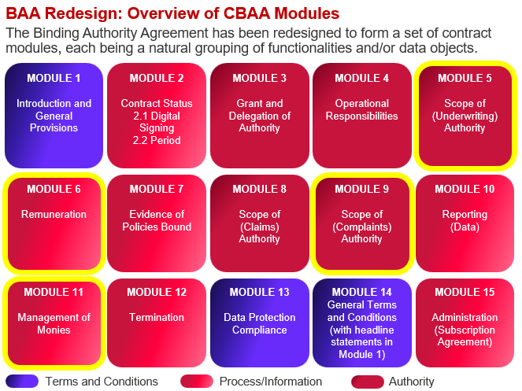
Overview & Purpose of the Consultation
What?
Participants are to review 2nd Drafts of 4 of the 15 CBAA Modules
The 4 modules have been created by Axiome Partners in collaboration with the LMA DA Wordings Group and are a work in progress
We strongly advise you review M6 & M11 first, followed by M9
M5 will be released in a couple of weeks with video guidance
Participants are to provide their feedback using the feedback forms provided on lmadare.co
Notes:
The re-design of the BAA means that ther contract has been split into 15 modules.
The 4 modules that are part of this consultation are 5 etc.
You can review simpler modules first to get accustomed to the formatting and approaches we have used – doing the best we can using Word
M5 has extra complexities and so for this a special guidance video will be recorded and made available on the website

