Slide 1
Computable Binding Authority Agreement
(CBAA)
Project Overview & M1 Deep Dive
21st July 2026
Notes:
I imagine most of you are already familiar with the CBAA programme but for those who are not it is a programme sponsored by the LMA DAC which kicked off in September 2023 and has been funded by the LMA Board.
While this will be a high level overview, in May last year we started a ‘deep dive’ engagement series for DA Managers, CHs and Brokers so please do encourage your DA teams to read our monthly newsletter to find out about past events and those coming up to understand what we are doing in more detail.

Slide 2

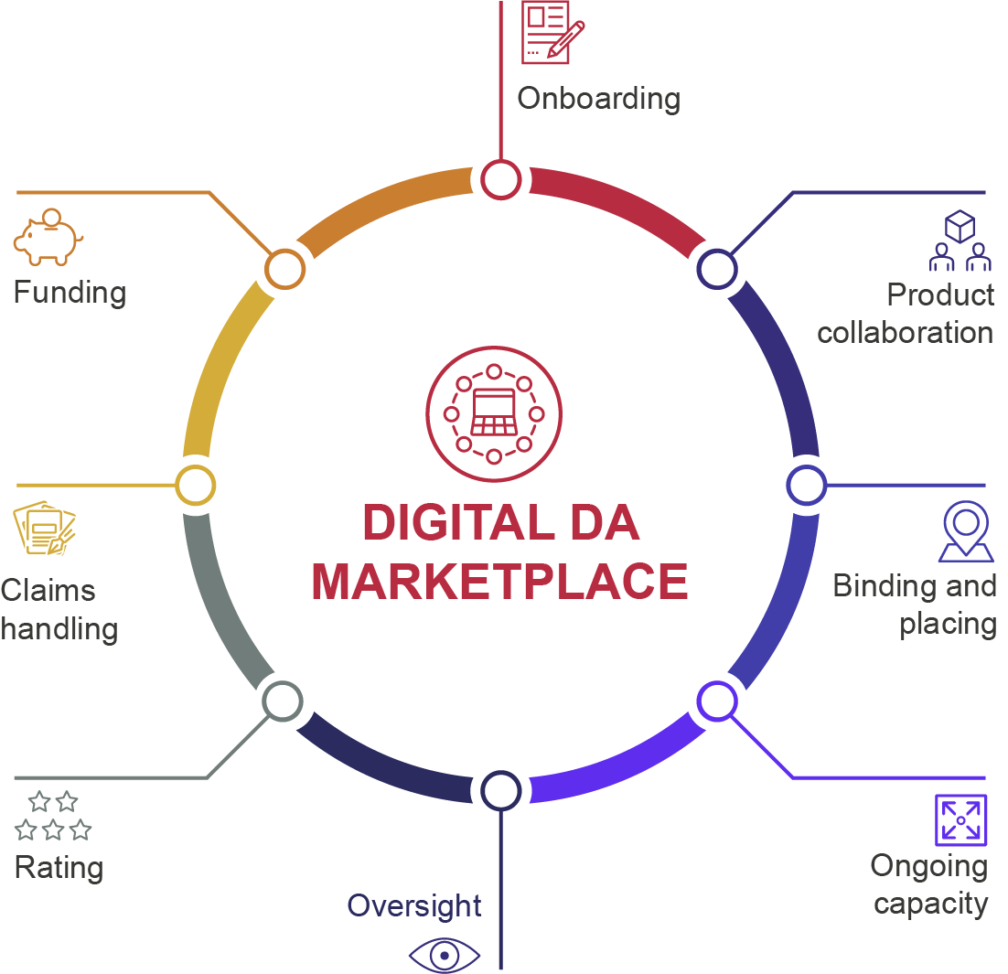

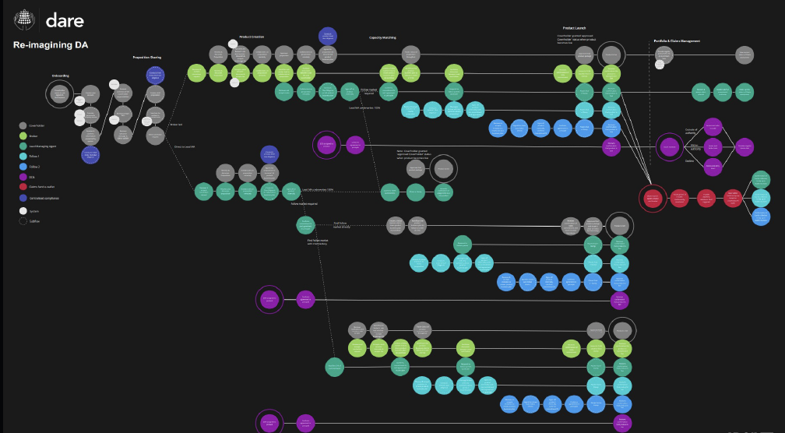
Delegated Authority Re-imagined (DARE)
In 2021, an end-to-end Vision for a Digital DA Marketplace – created by the DA community, for the DA community.
Broker Coverholder
A credible discovery process
Claims Representatives
9
14
Managing Agent representatives
Independent consultants
174
12
Coverholders
Brokers
75
32
64 concepts grouped into 8 key areas
Notes:
Whenever I speak about the CBAA I just like to draw everyone back to DARE, a vision for a Digital DA Marketplace that was created with the market in 2021. Work on the CBAA is not happening by accident and is not a random exercise, the CBAA is the first step to realising the Vision we created.
It is the first step in sorting out DA Data once and for all

Slide 3
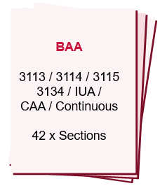
Design & Build of a Computable Binding Authority Agreement (CBAA)
Desire for a digital DA marketplace
Out of date binding authority contract documents
2 Key Intentions:
Re-draft the contractual language to reflect current practice and market needs.
Turn that language into data from which digital contracts can be created.
Notes:
So why is the CBAA our first step? Firstly we have a desire for a digital marketplace and also a variety of very out of date BAA model wordings that need an overhaul, so why not kill two birds with one stone – therefore the project has 2 key intentions
This consultation focuses on the re-draft of the contractual language but you will also see how we have restructured the binder Agreement for a digital world and the impact this has on the contractual wording

Slide 4
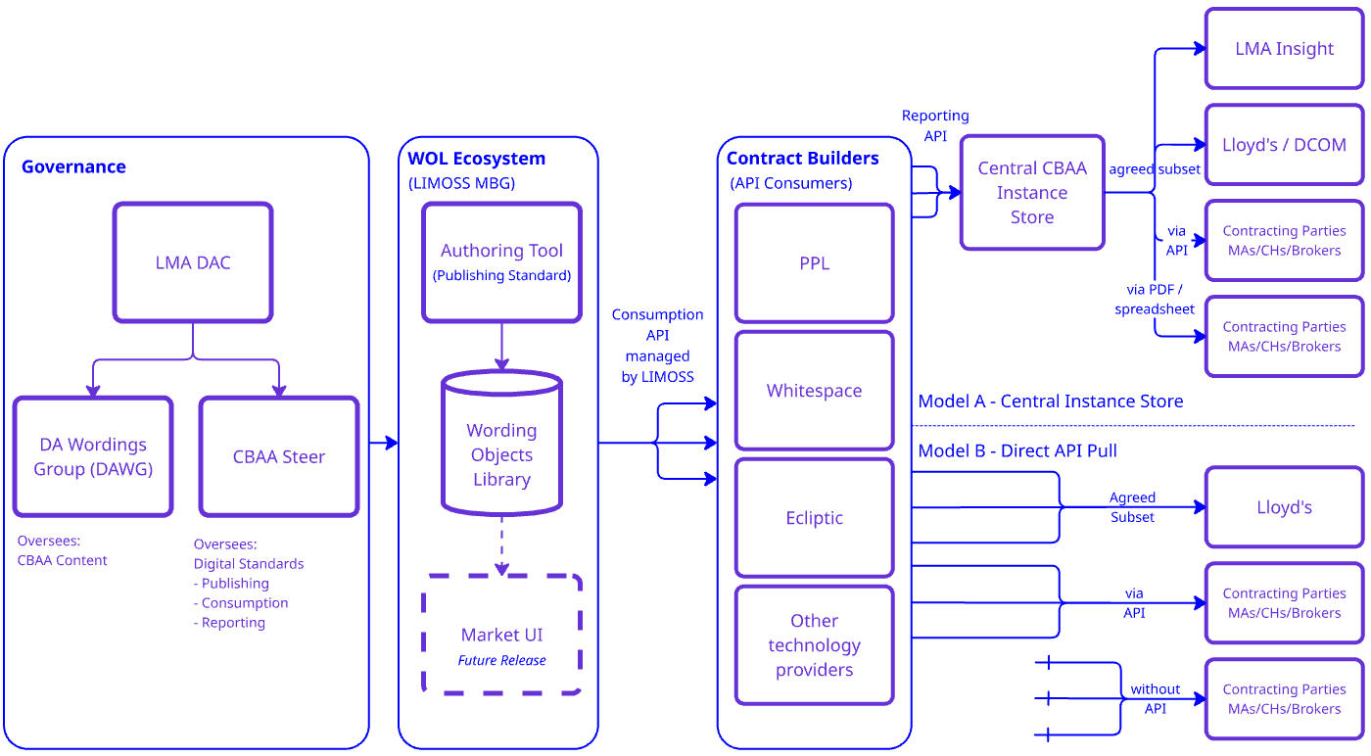
Overview of Key CBAA Components

Slide 5
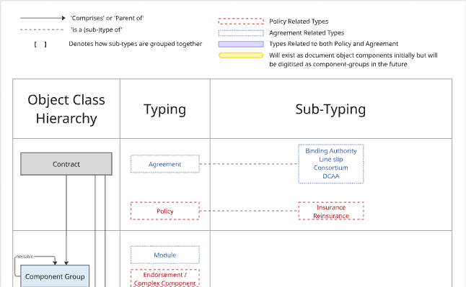
The WOL and the LMA Wordings Information Model
The WOL is built upon the Information Model and ensures all wordings adhere to the framework.
*The picture in the purple box is a link, click and you will be taken to the full Information Model in Miro

Slide 6
CBAA Programme Delivery summary
CBAA Analogue Model Wording (Jul 26)
Provides DA community with the opportunity to get comfortable with the new contractual language before that language ‘goes digital’ and is embedded in the system. No expectation to use the wording in its analogue form, but with more accurate, robust provisions some may wish to.
CBAA Model Wording External Legal Review (Completed by Q4 26)
By Andrew Schutte from Keoghs, commencing mid-July as a joint instruction by a consortium of London Market associations.
Wording Objects Library (Completed by Q2 27)
Build is progressing well. Consumption API for Contract Builder vendors ready for testing September 26. Expected GO LIVE for WOL Q2 27 when v1 of the digital CBAA will be published. Any changes post this publication will be via the full change governance process.
Contract Builders
The programme is NOT delivering a central contract building solution for CBAAs. The WOL Consumption API will be available to any Contract Builder vendor who signs up to the WOL conditions of use, a key condition being to make CBAA instances built with their tools available to contracting parties and Lloyd’s via the CBAA Reporting API. Timelines update in Q4.

