Slide 1
We are creating a Single Binding Authority Agreement Model Wording for London, that can be used interchangeably between and across markets, classes and territories.
CBAA Modules & How to Read Them
The single model wording can be used for Company only binders, just as it can be used for Lloyd’s, Lloyd’s Europe or for mixed market binders.
60% of language can remain consistent across all markets, classes and territories, and the intention is for the London market to adopt this language as standard.
40% of the language will vary based on certain conditions, with a few clauses warranting the option for bespoking.
Notes:
There is no perfect way to communicate the language/clause variations, short of building the system itself, so I will now walk you through the approaches we have taken within the drafts created in Word that are being used within the consultation.

Slide 2
CBAA Modules & How to Read Them
Drafting & Design Principles agreed with LMA DA Wordings Group (highlights)
Revising, expanding or removing language to reflect current and future practice and market needs
Adopting simplified plain language where possible
Using market/class/territory agnostic language wherever possible to support smoother changes in capacity​
Embedding standard (often mandatory) endorsements in the main body of the wording​
Embedding variables (such as those held in the schedule today) within the main body of the wording where appropriate​
Constructing the contract so that it will include only in-force language​
Aligning with industry standards (CDR, ACORD GRLC etc.)​
Clearer & contractual assignment of roles and responsibilities of key DA operational processes to enable value driven remuneration
Establishing and adhering to a drafting guide to ensure consistent use of terminology throughout​

Slide 3
CBAA Draft Modules & How to Read Them
Each Module has:
an ‘ALL VARIATIONS’ version
one or more completed examples
The ‘ALL VARIATIONS’ version shows all the possible clauses that can be selected for a Module.
The examples show what a completed Module would look like when the appropriate variations have been selected.
Notes:
I will now talk you through how the Information Model has been applied to the Word versions of the Modules.
Your review and feedback should be on the all variations version but you may look at this and be a little confused so the examples
So now I will pick up on what I mean by all variation versions

Slide 4
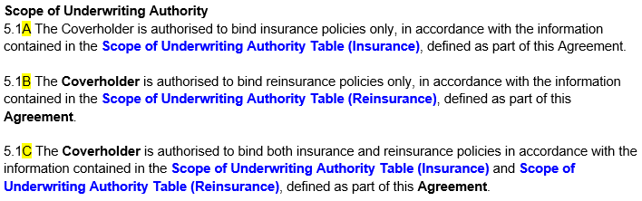
Clause Variations – are clauses that are mandatory but where a number of variations exist.
If a clause has variations, the clause number will be consistent but different variations are indicated by a highlighted letter A/B/C etc.
Only a single variation of the clause will be included in a CBAA instance.
The variation to be included will be based upon certain conditions and included automatically or the Contract Creator may have a choice.
Notes:
I will now talk you through how the Information Model has been applied to the Word versions of the Modules.

Slide 5
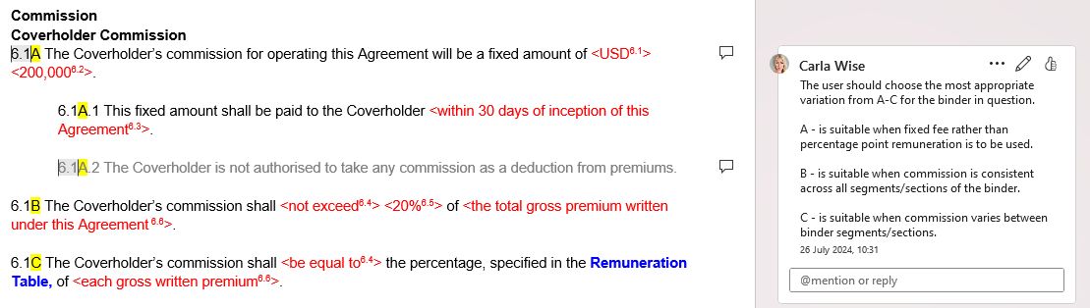
A comment has been added to the first instance of the clause number with an explanation of the conditions for inclusion. Sometimes it will simply be Contract Creator/user choice.
Some variations have additional provisions that are specific to that particular variation, these are indicated using the variation letter. In the example only 6.1A has additional provisions.

Slide 6
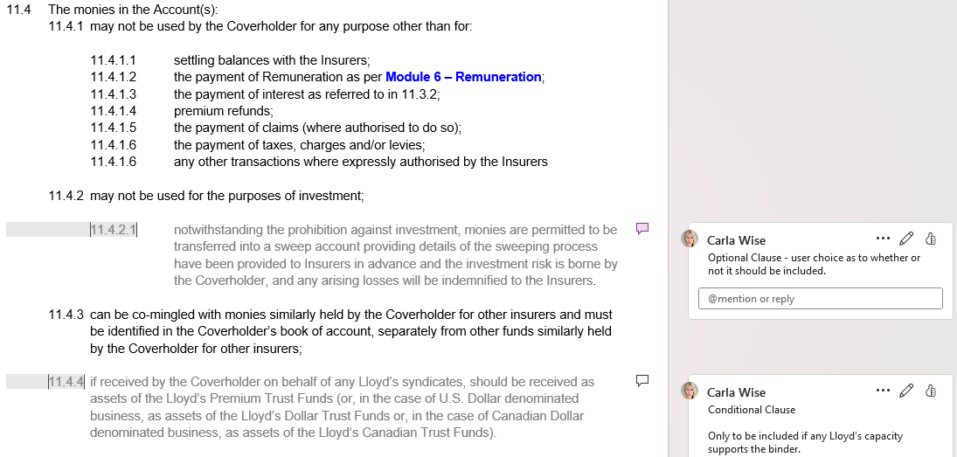
Optional and Conditional Clauses are shown in darkest grey.
They will only be present in some CBAA instances.
They are either automatically included because certain conditions are true, or the Contract Creator may have a choice.
A comment will be added to the clause number with an explanation of the conditions for inclusion. Sometimes it will simply be Contract Creator choice.
Notes:
Any greyed out clause that is optional or conditional will have a comment to explain conditions for inclusion.

Slide 7
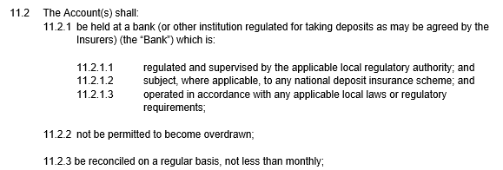
Text Objects
Any numbered clause in the CBAA is a single text object. The examples shown are simple text objects.
A single text object from M6
A group of 7 text objects from M11
Text Objects are grouped together to form components or sub-components
Text objects can have other types of digital objects within them…

Slide 8

Embedded Variables are indicated in red non-bold and appear within the contract text.
Embedded Variables are contract specific and will usually be selected by the Contract Creator, sometimes they may be decided by the application of built-in rules. Embedded Variables are usually selected from a dropdown list in the CBAA creation process but could be inserting a number or percentage, for example.
Notes:
Although embedded variables will flow as they do here in the final version of the contract and how they will appear in the examples we share, be equal to 30% is actually 2 connected variables, as is 20 business days
Sometimes they may be free text
The idea of using red is to make contract specific elements stand out

Slide 9

Within ‘ALL VARIATIONS’ Modules, Embedded Variables are always presented as a single example of the variable and shown between angle brackets < >.
Both examples below contain 3 Embedded Variables each.
Notes:
Not exceed could alternative read ‘be equal to’ as in the previous example

Slide 10

To understand how the Embedded Variable is populated mouseover the footnote and this information, along with the Embedded Variable Number and Name, will be displayed.
Embedded Variable Name
Footnote & Embedded Variable Number
Mouseover Pop-up Box
2 variations for Embedded Variable 6.4
Note that within ‘example’ draft Modules, footnotes and angle brackets do not appear so that the example reflects more closely the look of the final Agreement produced.
Notes:
So the drafts shared, that contain all contract variations
(or in the case of a ‘pick from a list’ to view the other options on that list)

Slide 11

Referenced Objects are indicated in blue bold; the detail of the referenced object will be displayed in a separate window when the user clicks on the text. There are 2 types of referenced object:
Table Objects
a Data Structure where all variables are fully reportable
Insurers Bank Account Details Table

Slide 12
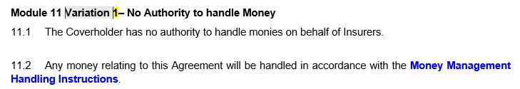
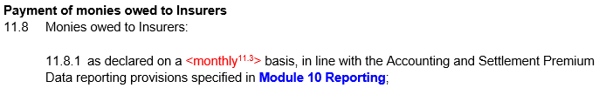
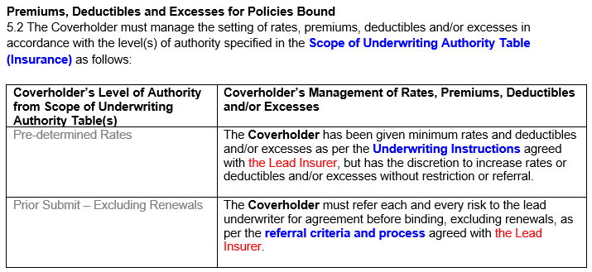
Referenced Objects are indicated in blue bold, there are 2 types of referenced object:
Document Objects
usually referred to as an ‘Annex’ or ‘Instructions’ this is a PDF attachment, content will not be digitised at this stage.
Blue Bold Text is also used when there is a link back to another part of the Agreement.

Slide 13
The detail of the referenced object will be displayed in a separate window when the user clicks on the text.
Document Objects
Table Object
Within some Module examples, an example of each Table or Document Object referenced is included at the end of the Module.

Slide 14
There are 3 types of Guidance Object:
Defined Terms – are black non-bold with all words that are part of the term capitalised.
6.2A The Coverholder is not authorised to allow any part of their Commission to any Producing Intermediary.
‘Coverholder’, ‘Producing Intermediary’ and ‘Commission’ are the 3 defined terms in this example.
Definitions of Defined Terms will appear within a pop-up if you click the Defined Term, they will also all appear collectively in ‘Module 15 – Definitions’.
Within some ‘ALL VARIATIONS’ Modules draft definitions appear within the comments. Not all definitions have been created, all definitions will be available with CBAA digital publication in the WOL in Q2 27.

Slide 15
Technical Guidance will be displayed within a pop-up or in a new tab when the user mouseovers the ‘i’ icon.
Within some ‘ALL VARIATIONS’ Modules draft guidance appears within the comments. Not all technical guidance has been created, full guidance will be available with CBAA digital publication in the WOL in Q2 27.
Notes:
MRC Guidance doc of today
To confirm you will not see any guidance or definitions within the modules we are sharing – that will be overlayed later and included as part of the 3rd draft

Slide 16
Other Considerations When Reading the Modules
Numbering in the Word versions is for ease of reference only – numbering for instances will be dynamic and applied in the contract creation process
Some changes may be needed once we have conducted the external legal review
Definitions, guidance and list of values for and names of embedded variables need to be finalised

