Slide 1



Top Issues Poll
January 2026

Slide 2
Summary
The top issue spontaneously mentioned by islanders was ‘Cost of living’.
The most important issue for islanders (most and other important issues combined) was ‘Cost of living’, followed by ‘Faith in Government’, ‘Housing’ and ‘The Hospital’.
Mentions of ‘Cost of Living’ increased by 18% on last year. ‘Faith in Government’ has risen by 11% and three places to be the 2nd most mentioned issue in 2026. Mentions of ‘Poverty/inequality’ rose by 10%.
For all age brackets ‘Cost of living’ was the most important issue; a higher % of 17 to 34 year olds mentioned ‘Housing’ (77%), compared to those 55+ (49%). A higher % of those 55+ mentioned ‘Faith in Government’ (60%) compared to 17 to 34 year olds (42%).
The most important issue in the UK is ‘Immigration’, followed by the ‘Economy’, ‘Healthcare’, ‘Defence’ and then ‘Prices/inflation/cost of living’; in Jersey ‘Cost of living’ is the top issue.
1,422 islanders completed the poll, either online or with a street interviewer.

Slide 3
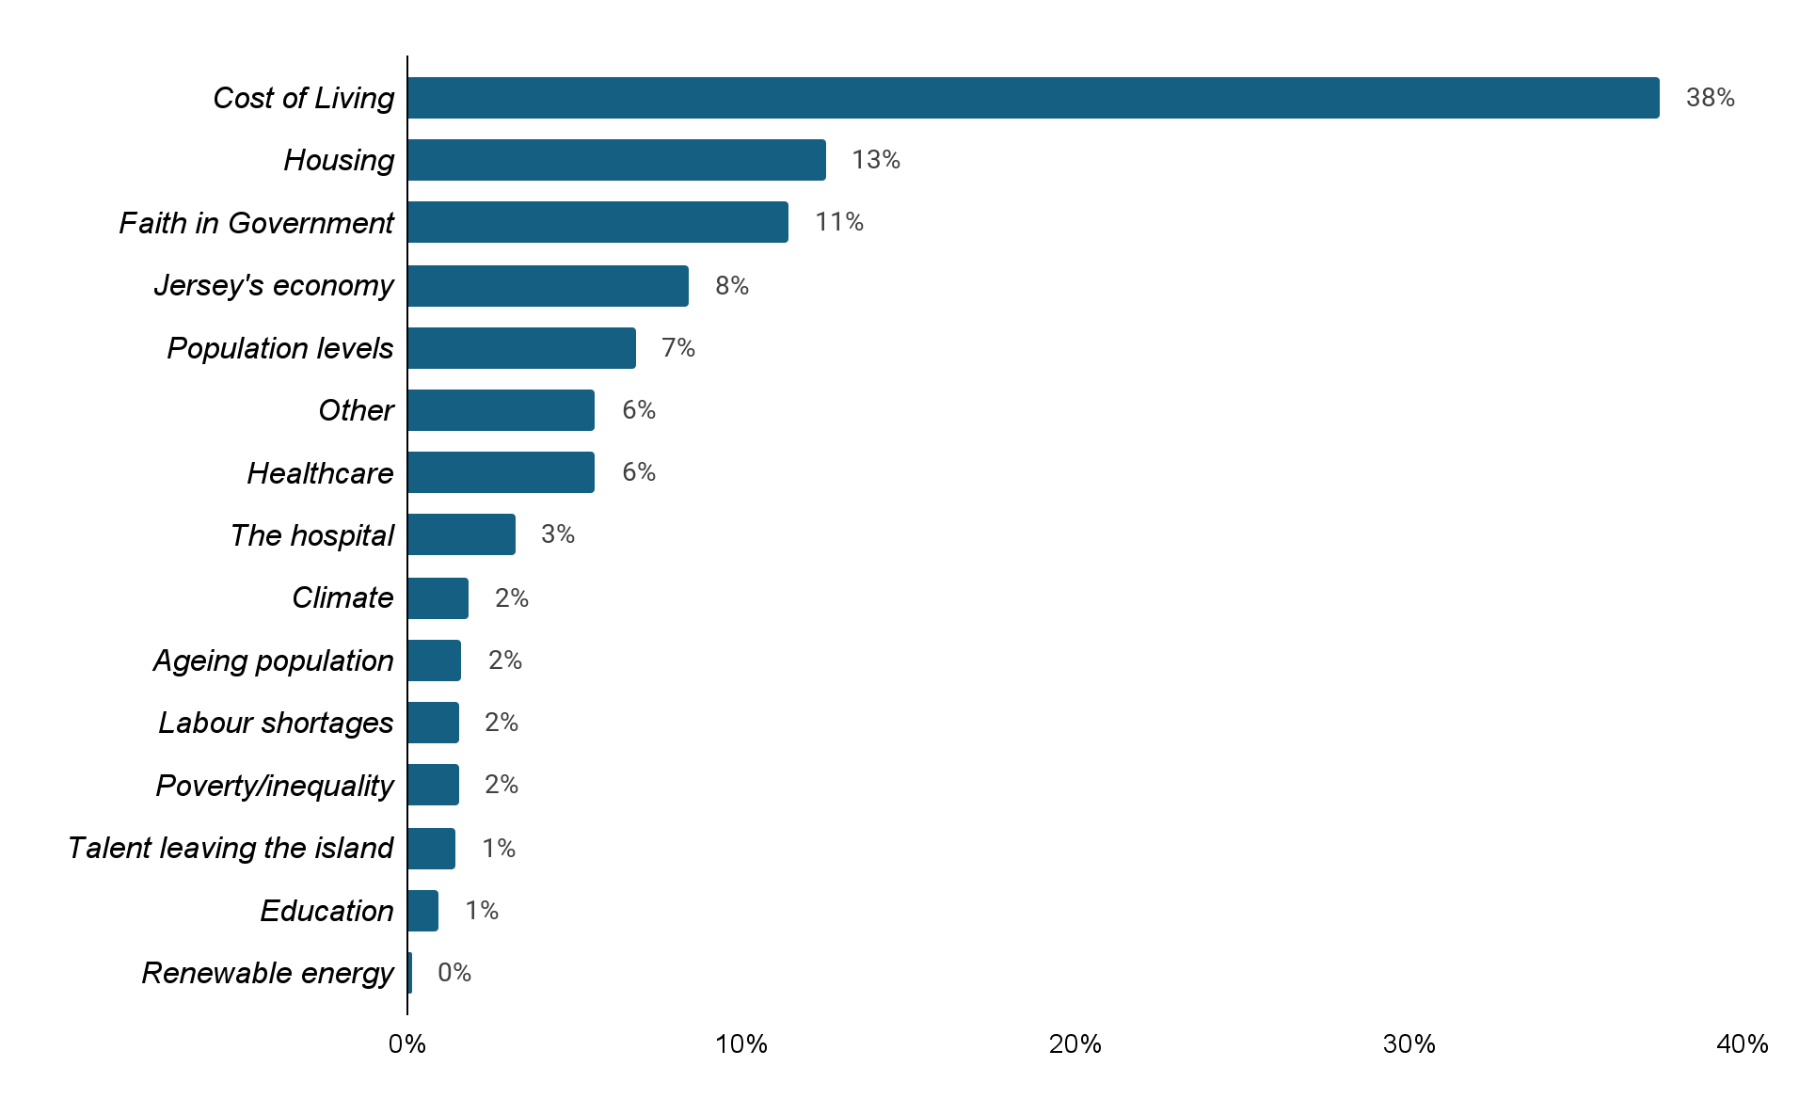
Top issues: Jan 2026
What do you see as the most important issue facing Jersey today?
Spontaneous open-ended question
Other included: ‘Transport’ , ‘Island connectivity’ and
‘Lack of activities’.

Slide 4
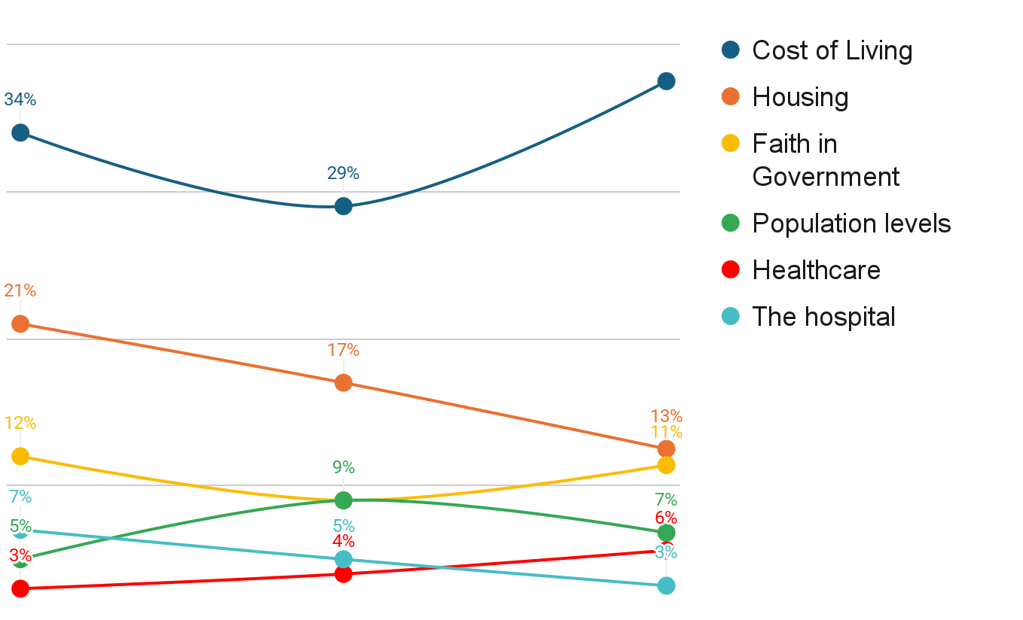
Top issues: Jan 2026
What do you see as the most important issue facing Jersey today?
Spontaneous open-ended question trends over 3 years
38%
2024
2025
2026

Slide 5
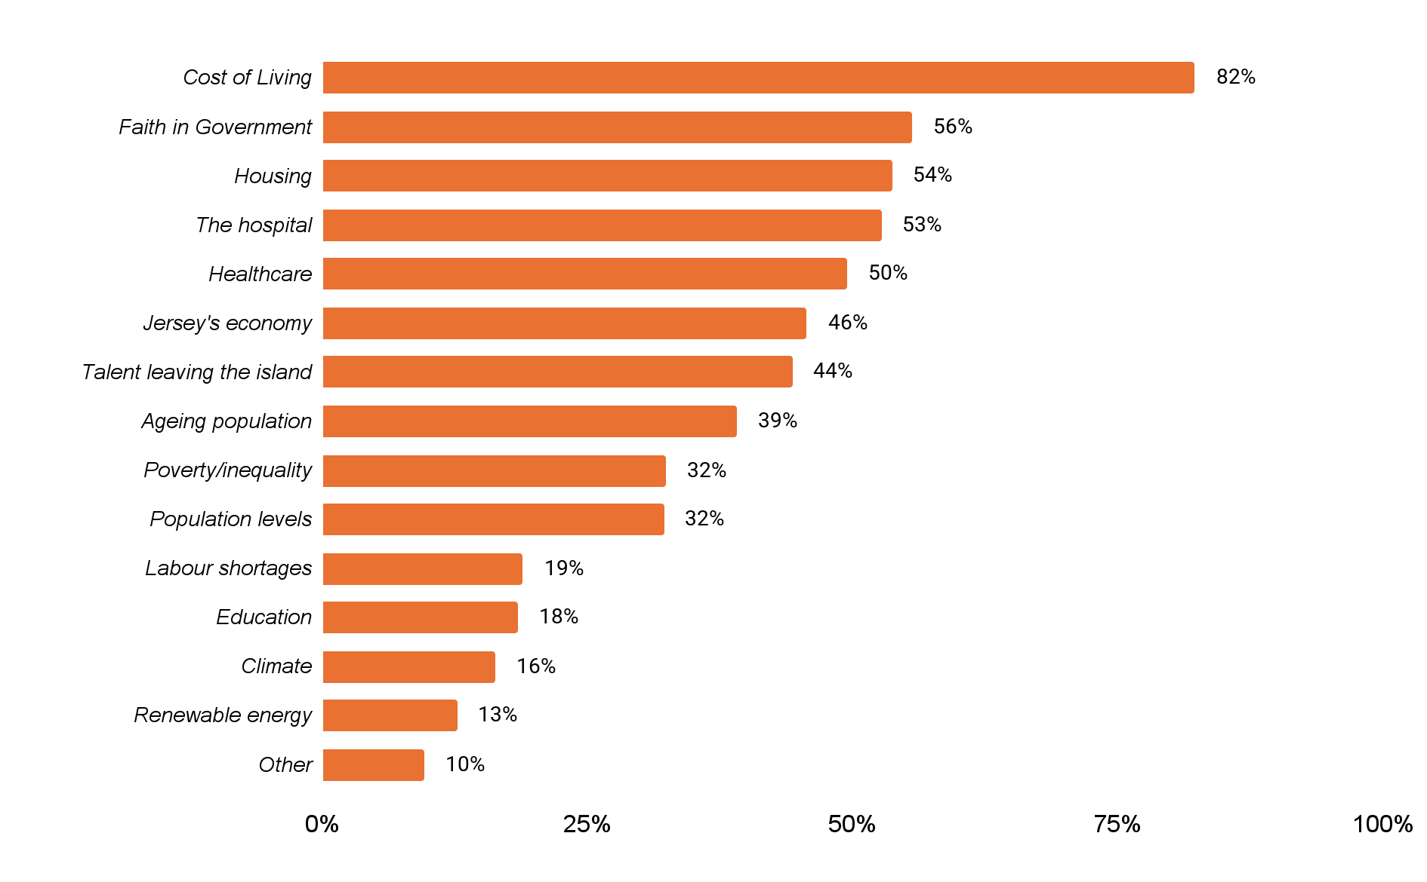
Top issues: Jan 2026
What do you see as the most/other important issues facing Jersey
today?

Slide 6
Top issues: 2026 vs 2025
2026 top mentions | % mentioned | % points change | Position change
1 - Cost of living | 82% | ↑18% | No change
2 - Faith in Government | 56% | ↑11% | ↑3
3 - Housing | 54% | ↓5% | ↓1
4 - The hospital | 53% | ↑2% | ↓1
5 - Healthcare | 50% | ↑1% | ↓1
6 - Jersey’s economy | 46% | - | New entry
7 - Talent leaving the island | 44% | ↑8% | No change
8 - Ageing population | 39% | ↑3% | ↓2
9 - Poverty/inequality | 32% | ↑10% | ↑1
10 - Population levels | 32% | ↓1% | ↓2
11 - Labour shortages | 19% | ↑1% | ↑2
12 - Education | 18% | ↓1 | ↓1
13 - Climate change/Environment | 16% | ↓3% | ↓1
14 - Renewable energy | 13% | - | No change

Slide 7
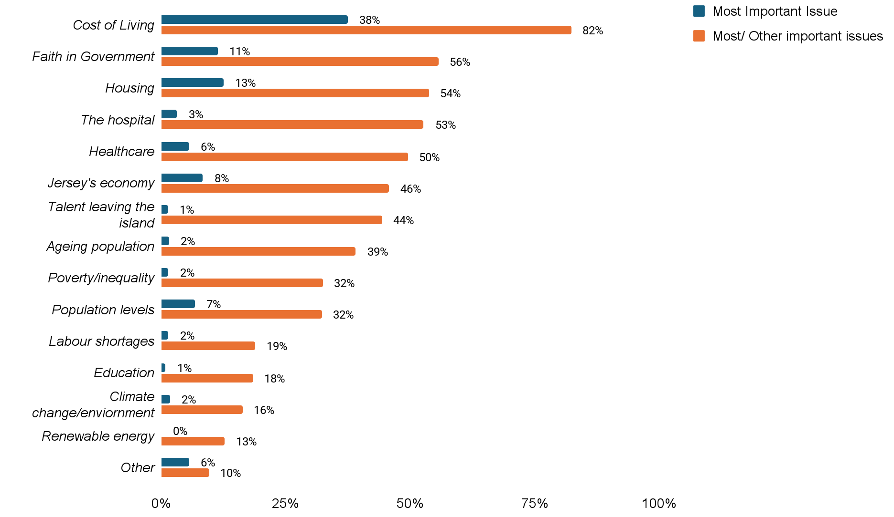
Top issues: Jan 2026
What do you see as the most/other important issues facing Jersey today?

Slide 8
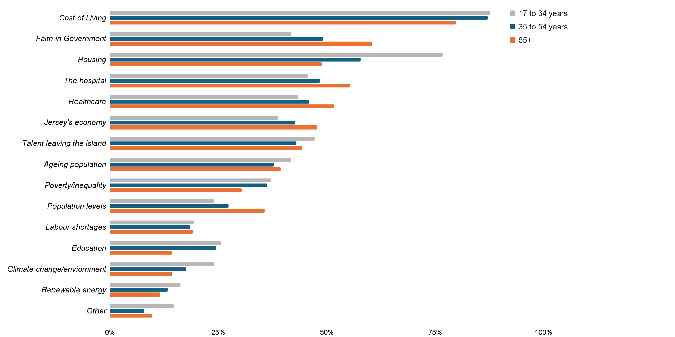
Top issues: Jan 2026
Most/other important issues by age group

Slide 9
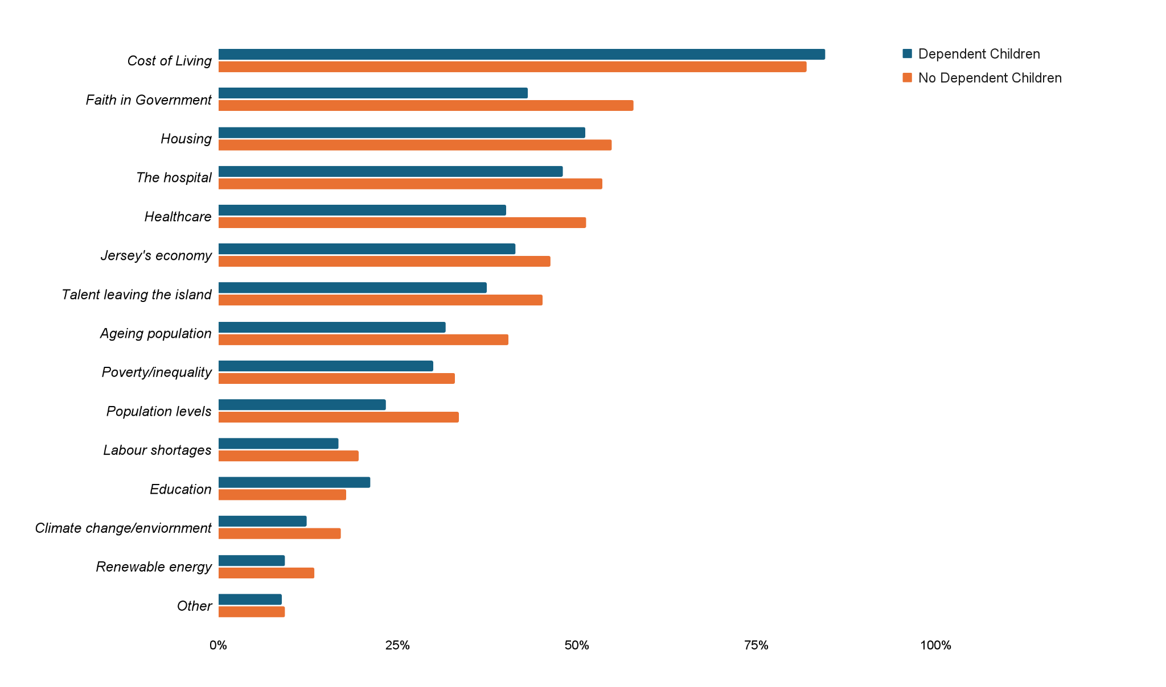
Top issues: Jan 2026
Most/other important issues by dependent children (yes/no)

Slide 10
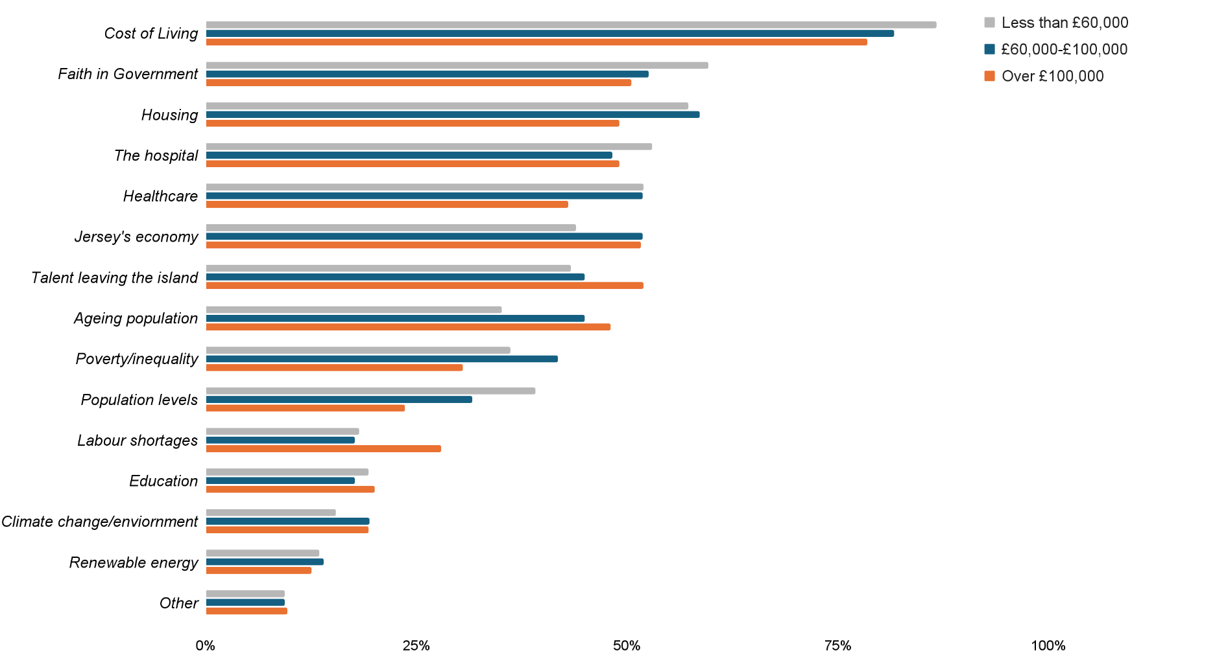
Top issues: Jan 2026
Most/other important issues by household income

Slide 11
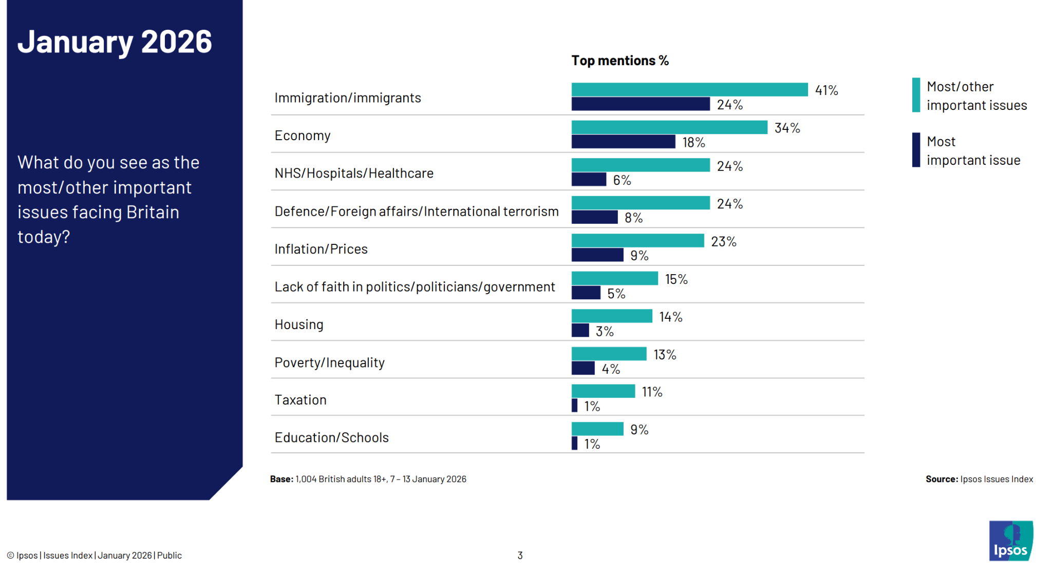
Top issues: Jan 2026
Ipsos Issues Index, Jan 26 - most/other important issues facing Britain today:

Slide 12
APPENDIX

Slide 13
Scope, Sample and Methodology
The poll scope was islanders aged 17 and over
The sample was islanders aged over 17 who were on 4insight’s online panel of over 6,100 which is reasonably representative of islander's demographics, supplemented by random sampling by 4insight’s professional street interviewers
The methodology of the poll was a short structured online survey with one unprompted open-ended question regarding the most important top issue followed by a question on other important issues. Three demographic questions were included to enable cross tabulations to be produced to see if there were any variations in responses by:
  Age
  Family structure; single, single with a dependent child under 16, in a partnership, in a partnership with a dependent child under 16, divorced/separated, widowed, prefer not to say or other
  Total household income level before tax and social security by grouping
The online survey was supplemented by CAPI, street interviewers with iPads doing random face-to-face interviews
The survey responses were quality checked and cross tabulations prepared
1,422 islanders completed the survey in total

Slide 14
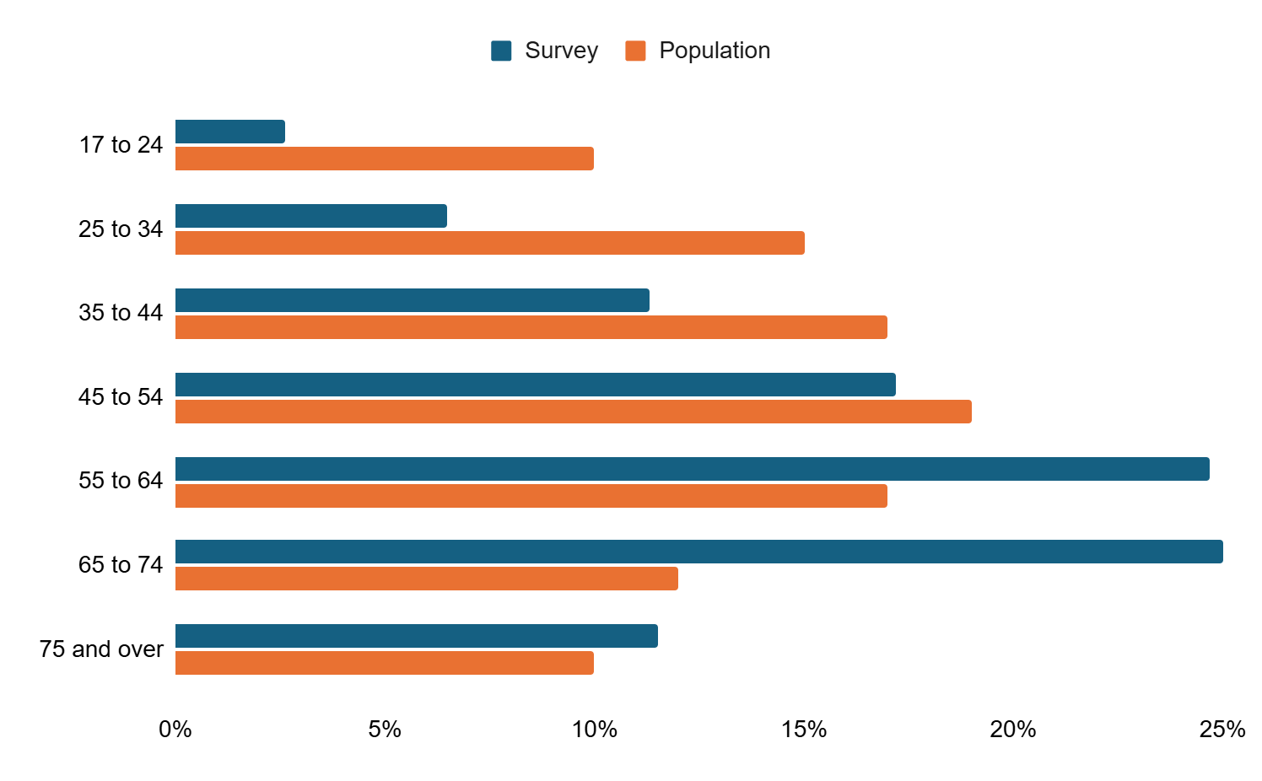
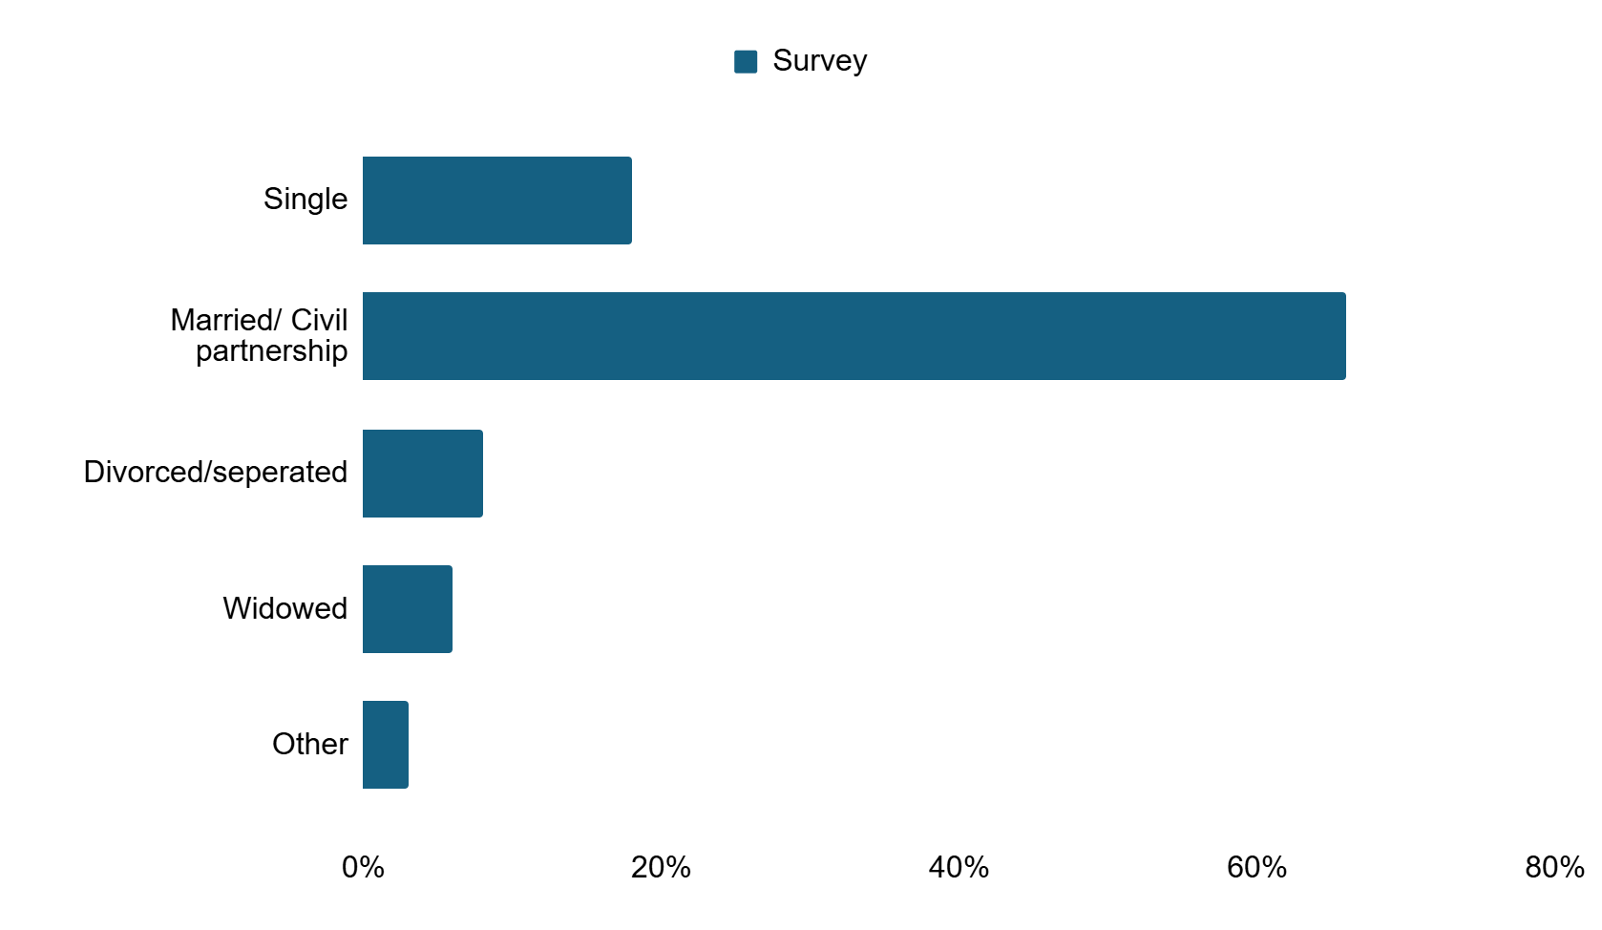
Demographics
Respondents Age : Survey respondents vs Population (from 2021 census)
Marital and civil status: Survey respondents
*Population statistics reflect adults aged over 16 whilst the survey reflects adults aged 17 or over

Slide 15
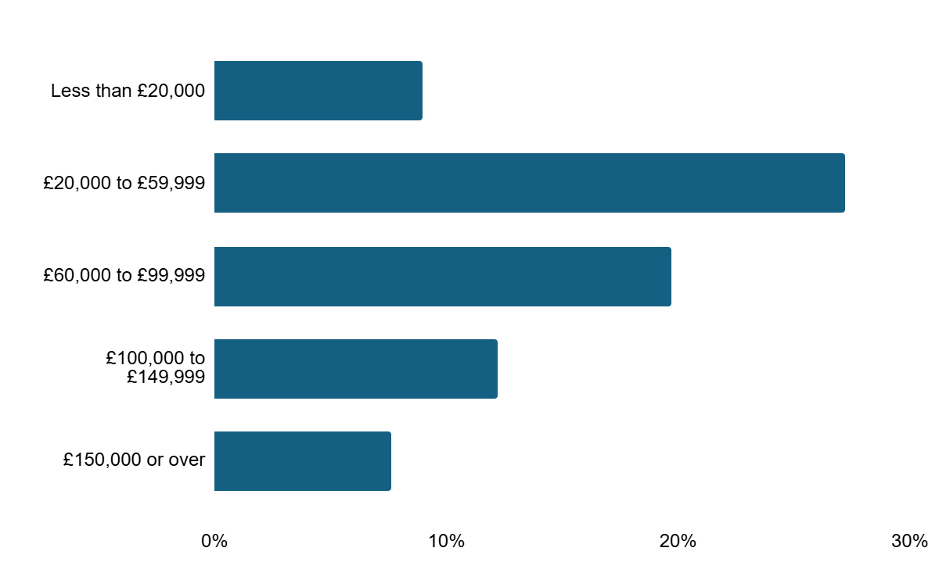
Demographics
Gross household income: Survey respondents

