Slide 1

Year 6 Spring 1 Home Learning menu:
How do people help each other when natural disasters challenge them?
Please complete red home learning on Seesaw every week ready for Friday morning.
To develop your understanding of our Learning Enquiry this half term, we have provided 6 optional activities to choose from. We will celebrate these pieces of learning with Dojos as well as sharing as a class. You can send work through Seesaw or complete on paper and bring in to school for our display.
Our hope is that every child completes at least 3 out of the 6 options on the menu by the half term.
Grammar Complete the weekly task on Seesaw using the text and pen tools. We will mark this together every Friday morning. | Maths Complete the weekly task on Seesaw using the text and pen tools. We will mark this together every Friday morning.
Spellings Complete the weekly task on Seesaw using the text and pen tools. We will have a spelling test every Friday morning. | Reading Aim to read your AR book for at least 20 minutes every day and record it in your Reading Record. Children will have the opportunity to complete quizzes in class. Certificates and rewards will be given for ‘Words Read’. Can you get to 1 million words by the summer?

Slide 2
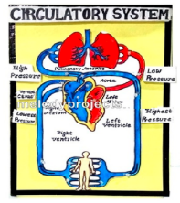
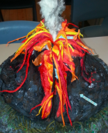
Year 6 Spring 1 Home Learning menu:
How do people help each other when natural disasters challenge them?
English Write an explanation text to explain how and why a natural disaster occurs: earthquake, volcano, tsunami or hurricane. Can you draw a diagram to go with it? Don’t forget to label it. This can be completed on paper for our class display. | Big Idea Active citizenship: Everyone can use their voice, knowledge and skills for the good of others. Do some research about charities that raise money for victims of natural disasters. Have you got some ideas about how we could raise money for a charity supporting this cause? Make a poster with your information and ideas. | Science Create a poster that gives advice on how to look after our hearts. Can you draw a picture of the human heart and label it? How does the circulatory system work? Can you draw a diagram with labels?
Geography Can you create a localised map showing areas within the UK that have experienced natural disasters? What natural disasters are we at risk of in Torquay? How can we prevent the impact of natural disasters? | RE Retell a story that we have read in our RE lessons: The Great Flood: Noah’s Ark Or The 10 plagues of Egypt Present it as a written story or a storyboard with pictures. | DT We will be learning about volcanoes within our geography lessons. Can you create a 3D model of a volcano? Can you make it erupt? Film a video and upload to Seesaw.

