Slide 1





Third Party Authorization
Jan 2024

Slide 2
Third Party Authorization Matrix
Action | Individual IAA | View Access Only | Joint IAA (for couples only) | Limited Trade Auth | Full Trade Auth | SCHW / Fidelity Durable POA | Durable POA
Access/Discuss Information | No | Yes | Yes | Yes | Yes | Yes | Yes
Trading | No | No | Yes | Yes | Yes | Yes | Yes
Disburse Funds / Withdrawals | No | No | No | No | Yes | Yes | Yes
Update Account Information (Contact Info, address, phone number) | No | No | Yes, unless custodian restricts | No | No | Yes | Yes
Change linked bank information | No | No | No | No | No | Yes | Yes
Change Beneficiaries | No | No | No | No | No | Maybe | Maybe
Power Continues After Incapacity | N/A | No | Yes, but will need POA | No | No | Yes | Yes
Account Type Restrictions (different rules based on account types) | No | No | No | No | No | Yes (Trust for example) | Yes (Trust for example)

Slide 3
Capita Joint IAA vs. Individual IAA

Slide 4
A Joint Investment Advisory Agreement (IAA)
Allows These Activities:
Discuss ALL accounts in HH (AR, PC, Ad Hoc)
Access account information
Change/Update some account information (Phone, Address, Contact info, etc.) NOTE: No bene or bank info
Discuss and provide trading instructions

Slide 5
A Joint Investment Advisory Agreement (IAA)
DOES NOT Allow These Activities:
Withdraw or disburse funds from account (Must obtain verbal authorization from the account holder)
Execute or change beneficiary information
Change bank account information
Place any account type restrictions on account

Slide 6
Capita Joint IAA vs. Individual IAA in conjunction with Custodian Authorization Levels

Slide 7
In practice how does it work:
View Access if they want to see everything in one login in Schwab.
LTA is probably not helpful for Capita. A Joint IAA is the same.
Attorney Drafted POA applied to Custodian with shorter form
Works like a Durable POA but with only the Schwab Form
Most of the time we will be able to change contact info in Salesforce and at the custodian, but if a signature is required, this flips to a “No” and the owner must sign.
Works for most things until they want to withdraw $
FTA is the minimum to request withdrawals
Action | Individual IAA | View Access Only | Joint IAA (for couples only) | Limited Trade Auth | Full Trade Auth | SCHW / Fidelity Durable POA | Durable POA
Access/Discuss Information | No | Yes | Yes | Yes | Yes | Yes | Yes
Trading | No | No | Yes | Yes | Yes | Yes | Yes
Disburse Funds / Withdrawals | No | No | No | No | Yes | Yes | Yes
Update Account Information (Contact Info, address, phone number) | No | No | Yes, unless custodian restricts | No | No | Yes | Yes
Change linked bank information | No | No | No | No | No | Yes | Yes
Change Beneficiaries | No | No | No | No | No | Maybe | Maybe
Power Continues After Incapacity | N/A | No | Yes, but will need POA | No | No | Yes | Yes
Account Type Restrictions (different rules based on account types) | No | No | No | No | No | Yes (Trust for example) | Yes (Trust for example)
If a spouse is experiencing incapacity, the Joint IAA powers remain, (discuss & trade), but it is time to get a POA because a withdrawal will eventually be needed. A Joint IAA does not authorize a withdrawal.

Slide 8
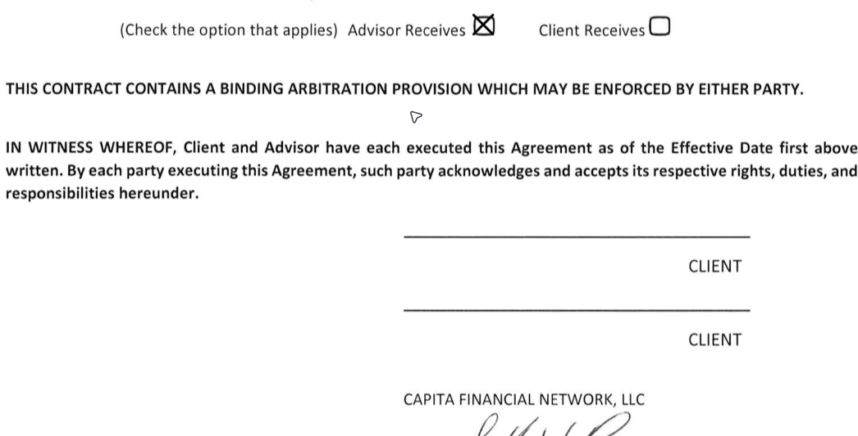
Form Tips
 | Individual IAA | View Access Only | Joint IAA (for couples only) | Limited Trade Auth | Full Trade Auth | SCHW / Fidelity Durable POA | Durable POA
Only one signature here
Both Spouses/Partners Sign
Both Spouses/Partners Sign

Slide 9
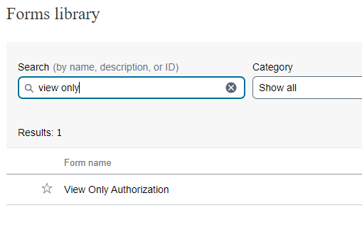
Form Tips
 | Individual IAA | View Access Only | Joint IAA (for couples only) | Limited Trade Auth | Full Trade Auth | SCHW / Fidelity Durable POA | Durable POA
Type This
(This is the form at Schwab)

Slide 10
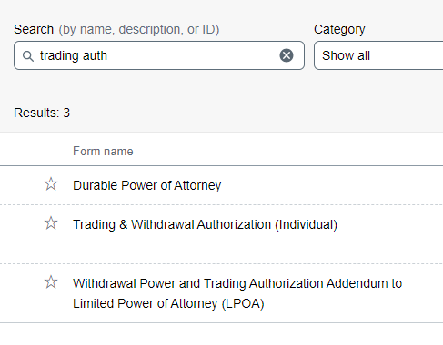
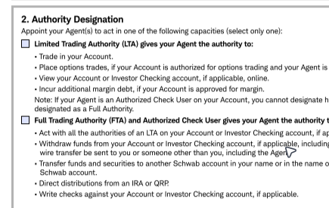
Form Tips
 | Individual IAA | View Access Only | Joint IAA (for couples only) | Limited Trade Auth | Full Trade Auth | SCHW / Fidelity Durable POA | Durable POA
Type This
Choose Limited or Full on the form.
(Same form, for Limited & Full)
Do not use this LPOA for third party access. It is meant to authorize an Investment Advisor like Capita, not their family member or friend.

Slide 11
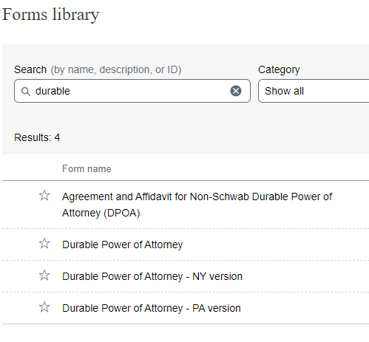
Form Tips
 | Individual IAA | View Access Only | Joint IAA (for couples only) | Limited Trade Auth | Full Trade Auth | SCHW / Fidelity Durable POA | Durable POA
Use these three forms when you do not have a fully executed durable power of attorney document from an estate planner.
You can authorize an individual to have all the same rights as a fully executed durable POA without the official legal document.
This only applies to their account with Schwab.
Type This
This form for all States except NY & PA

Slide 12
Form Tips
 | Individual IAA | View Access Only | Joint IAA (for couples only) | Limited Trade Auth | Full Trade Auth | SCHW / Fidelity Durable POA | Durable POA
Type This
Remember…
Use this shorter form when you already have a fully executed durable power of attorney document from an estate planner.
To add an existing Durable POA to Schwab

