Slide 1
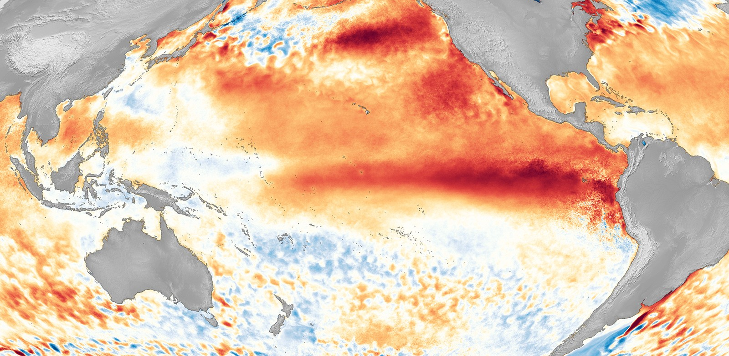
Image credit: NOAA
Notes:
The ocean is a beast – anomalies in SSTs drive global temperature variability: El Nino years are warmer than La Nina years. Because we know this region is so important for global temperatures, my work started off being called ...

Slide 2
On the pattern effect and its implications for future warming Gergana Gyuleva
COPE Project kick-off Meeting
4th July 2023
Image credit: NOAA

Slide 3
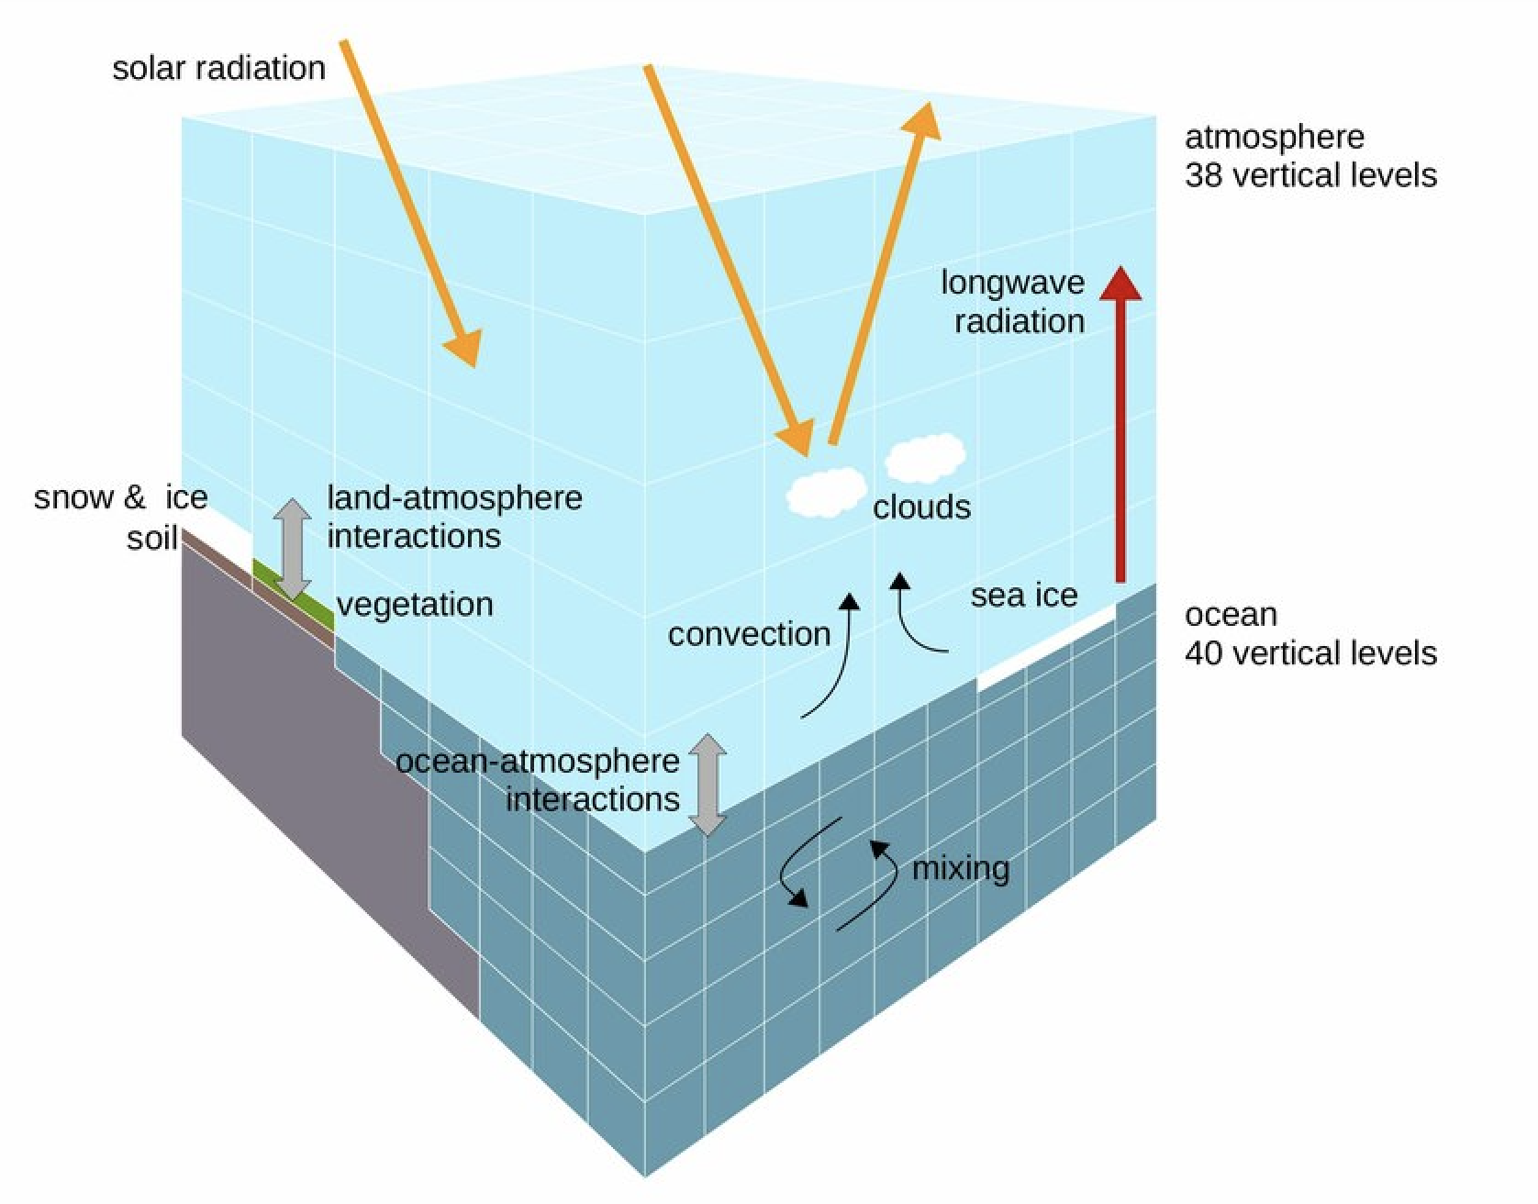
Background: What data are we using?
Earth System Models
Newest generation: CMIP6
(Coupled Model Intercomaprison Project Phase 6)
→ Roughly 30 different Earth System Models
Maurun, D. (2023), Springer
Notes:
We use two main metrics to quantify future warming, because they are useful and they help us evaluate models against each other. However since first estimates of ECS in 1979, the assessed range (in blue) has largely stayed unchanged. TYpically ECS is estimated from models by doing 4xCO2 experiments, letting the model run to equilibrium, and seeing what the temperature change is.
Only recently in AR6, Sherwood et al. 2020 managed to raise the upper bound, by looking atmulitple lines of evidence. However, they were unable to lower the uppper bound.
We want to reduce this uncertainty of how much climate will warm given a co2 concentration. Policy-relevant.

Slide 4
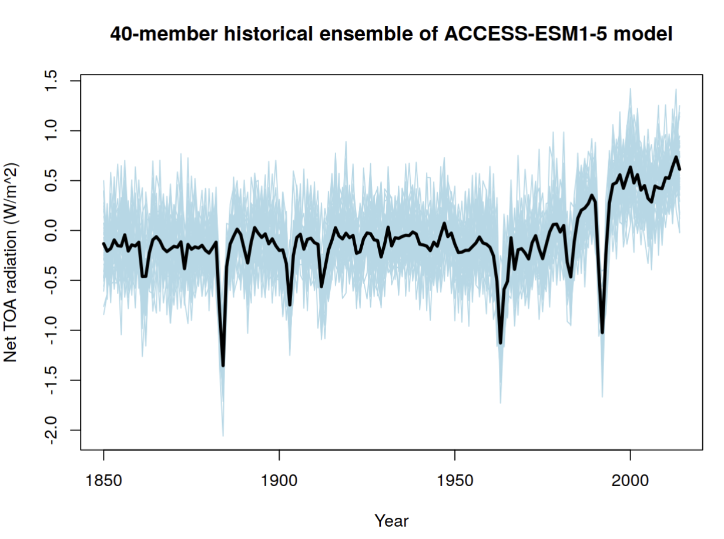
Background: What data are we using?
Single-model Ensemble Simulations
Internal Variability
Forced Response
Notes:
We use two main metrics to quantify future warming, because they are useful and they help us evaluate models against each other. However since first estimates of ECS in 1979, the assessed range (in blue) has largely stayed unchanged. TYpically ECS is estimated from models by doing 4xCO2 experiments, letting the model run to equilibrium, and seeing what the temperature change is.
Only recently in AR6, Sherwood et al. 2020 managed to raise the upper bound, by looking atmulitple lines of evidence. However, they were unable to lower the uppper bound.
We want to reduce this uncertainty of how much climate will warm given a co2 concentration. Policy-relevant.

Slide 5
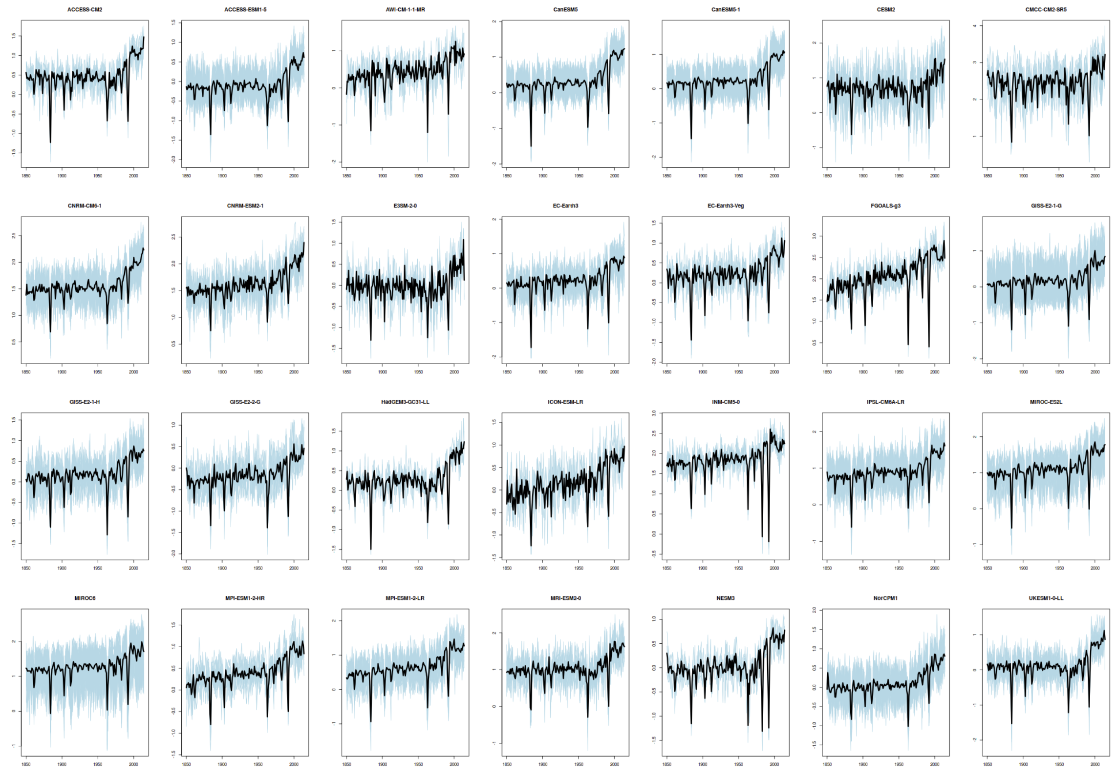
Background: What data are we using?
Multi-model ensemble
28 CMIP6 models
Notes:
We use two main metrics to quantify future warming, because they are useful and they help us evaluate models against each other. However since first estimates of ECS in 1979, the assessed range (in blue) has largely stayed unchanged. TYpically ECS is estimated from models by doing 4xCO2 experiments, letting the model run to equilibrium, and seeing what the temperature change is.
Only recently in AR6, Sherwood et al. 2020 managed to raise the upper bound, by looking atmulitple lines of evidence. However, they were unable to lower the uppper bound.
We want to reduce this uncertainty of how much climate will warm given a co2 concentration. Policy-relevant.

Slide 6
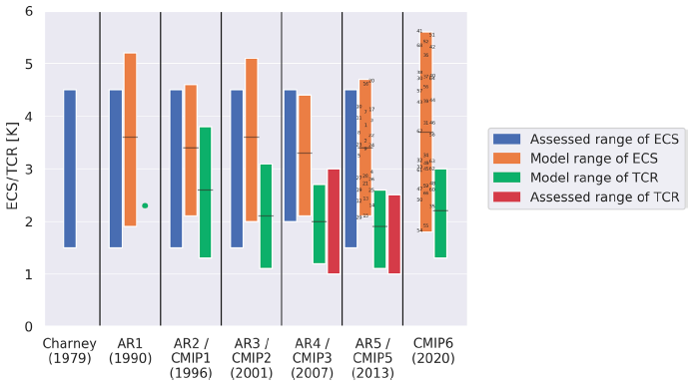
How much will future climate warm?
AR6
ECS: Equilibrium Climate Sensitivity
TCR: Transient climate response
Adapted from Meehl et al. 2020, Sci. Adv.
Notes:
We use two main metrics to quantify future warming, because they are useful and they help us evaluate models against each other. However since first estimates of ECS in 1979, the assessed range (in blue) has largely stayed unchanged. TYpically ECS is estimated from models by doing 4xCO2 experiments, letting the model run to equilibrium, and seeing what the temperature change is.
Only recently in AR6, Sherwood et al. 2020 managed to raise the upper bound, by looking atmulitple lines of evidence. However, they were unable to lower the uppper bound.
We want to reduce this uncertainty of how much climate will warm given a co2 concentration. Policy-relevant.

Slide 7
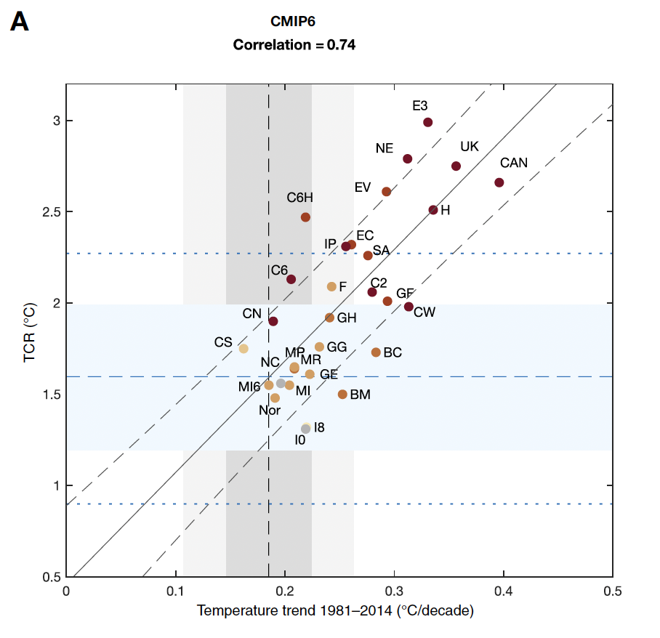
Historical constraints on future warming
“Models that warm more during the historical period will most likely also warm more in future”
Tokarska et al. 2020, Science

Slide 8
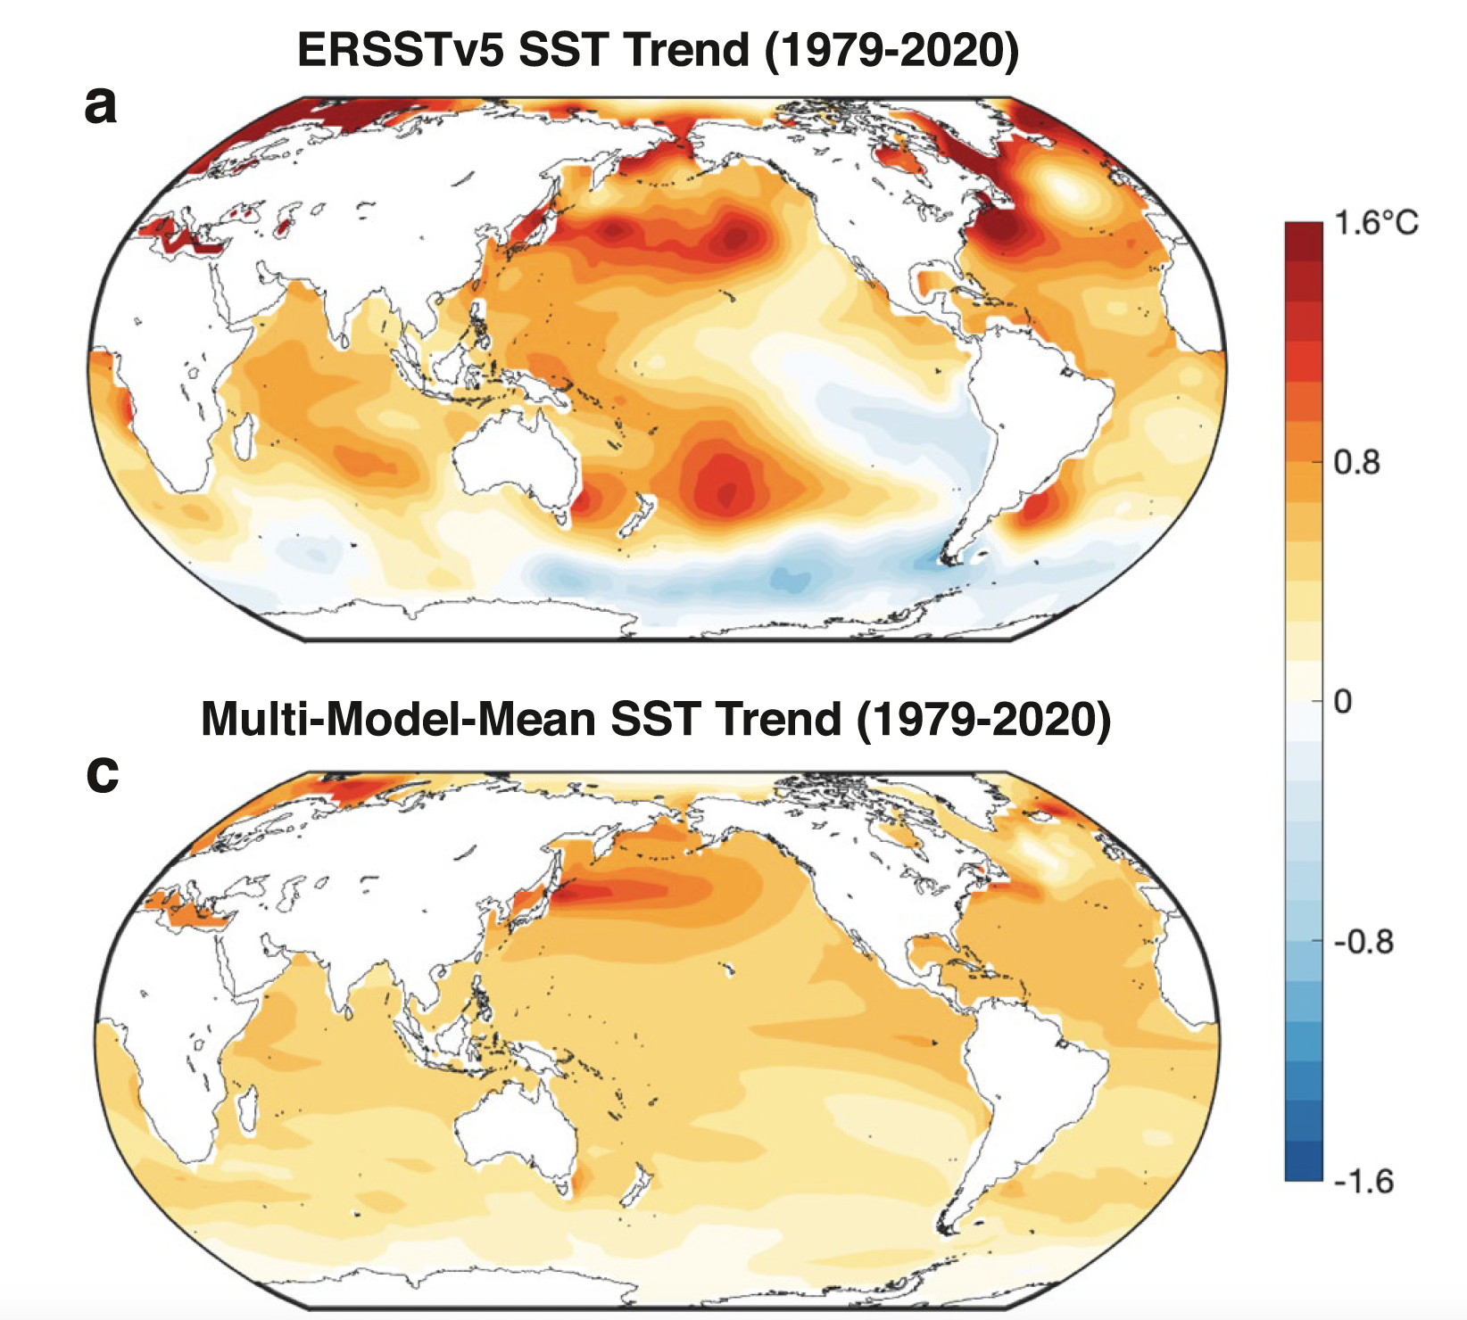
Observed versus modelled historical warming
Observed pattern:
More negative feedbacks
Simulated pattern (CMIP6):
More positive feedbacks
Wills et al. 2022, GRL

Slide 9
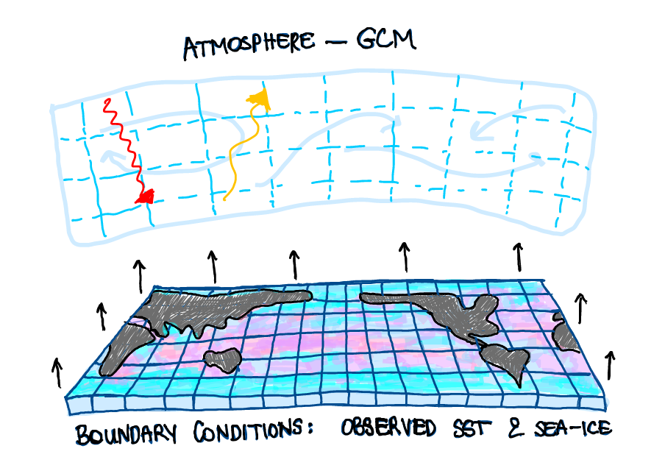
How do we know the SST pattern matters?
AMIP – piForcing experiments
Andrews et al. 2018, GRL
Zhou et al. 2020, Nature
Models reproduce the observed historical net TOA radiation when forced with observed SSTs & sea-ice!

Slide 10
Good news?

Slide 11
Historical constraints on future warming
“Models that warm more during the historical period will most likely also warm more in future”
Problem:
What if this is “just by chance”?
Tokarska et al. 2020

Slide 12
The Big Question: Is the model-observation mismatch in SST patterns a result of internal variability, or are models misrepresenting the forced response?

Slide 13
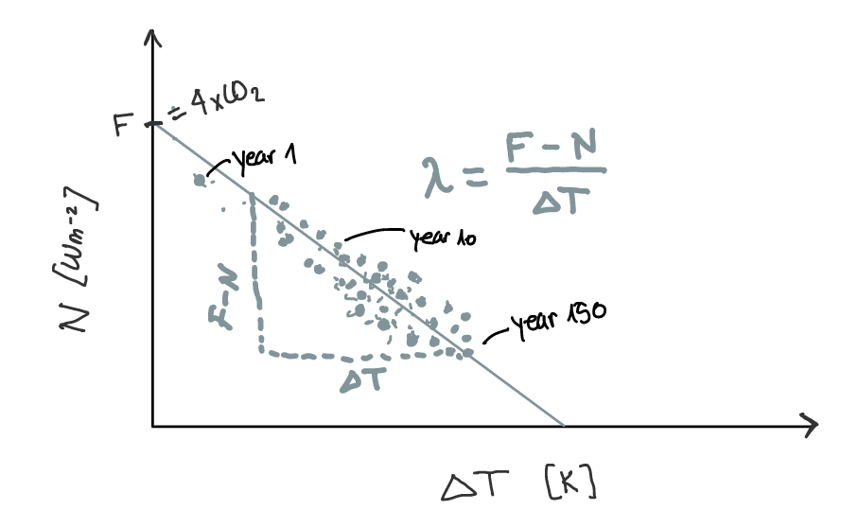
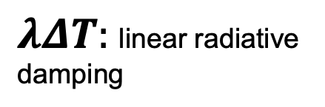
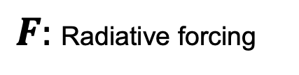
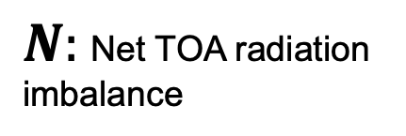
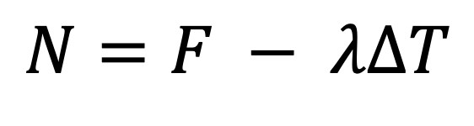
Closing Εearth’s energy budget
$$N=F − λΔT$$
$N:$Net TOA radiation imbalance
$λΔT:$linear radiative damping
$F:$Radiative forcing
After Gregory et al. 2004, GRL
Notes:
Traditional approach was to say: TOA imbalance is given by what is a forcing, F, coming from solar radiation, volcanic eruptions, or GHG emissions, and a response term, Lambda DT, which is how th esystem reacts to the forcing. The system reacts to the forcing by warming up and as it warms up, it radiates energy off to space

Slide 14
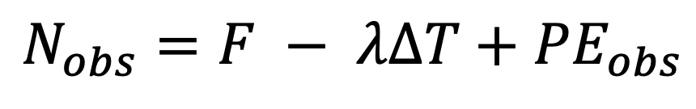
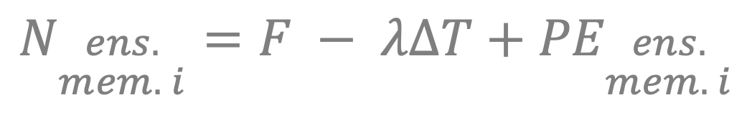
We believe the real world behaves like this:
$$N_{obs}=F − λΔT+{PE}_{obs}$$
FORCED
UN-FORCED
$$N_{\begin{aligned}ens. \\ mem. i\end{aligned}}=F − λΔT+{PE}_{\begin{aligned}ens. \\ mem. i\end{aligned}}$$
Notes:
They tried to close TOA radiation budget with climate model simulations and compare that to `ceres observations, showing that once you account for the “pattern effect”, you get a reconstruction much closer to the observations. YAY.
The core of my MS thesis was inspired from this approach, and I will guide you through the steps in which Zhou et al closed the radiation and how we are trying to close the radiation imbalance.

Slide 15
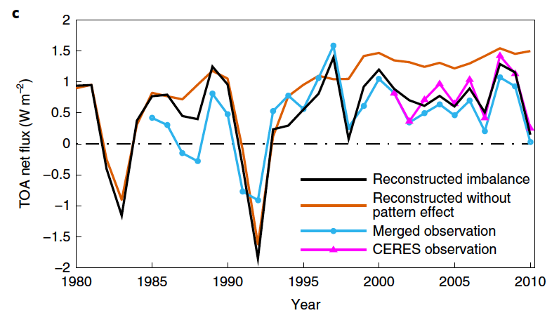
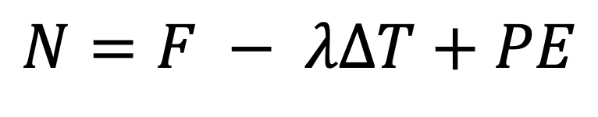
Question
$$N=F − λΔT+PE$$
Is this unforced?
Zhou et al. 2020, Nature Climate Change
Notes:
To answer this question we need to first define what PE even means in the energy balance framework… but how do we do that?

Slide 16
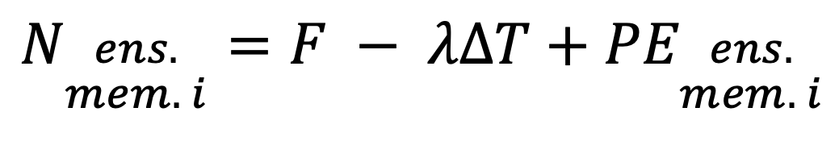
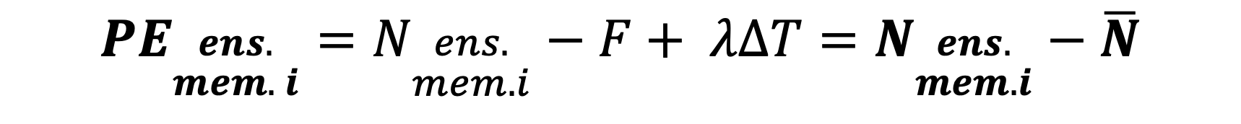

Defining predictand and predictors for statistical model
$$N_{\begin{aligned}ens. \\ mem. i\end{aligned}}=F − λΔT+{PE}_{\begin{aligned}ens. \\ mem. i\end{aligned}}$$
Single member:
If PE in models is solely due to internal variability…
$$\overline{N}=F − λΔT$$
Ensemble mean:
$${PE}_{\begin{aligned}ens. \\ mem. i\end{aligned}}=N_{\begin{aligned}ens. \\ mem. i\end{aligned}}−F+ λΔT=N_{\begin{aligned}ens. \\ mem. i\end{aligned}}−\overline{N}$$
Notes:
To answer this question we need to first define what PE even means in the energy balance framework… but how do we do that?

Slide 17
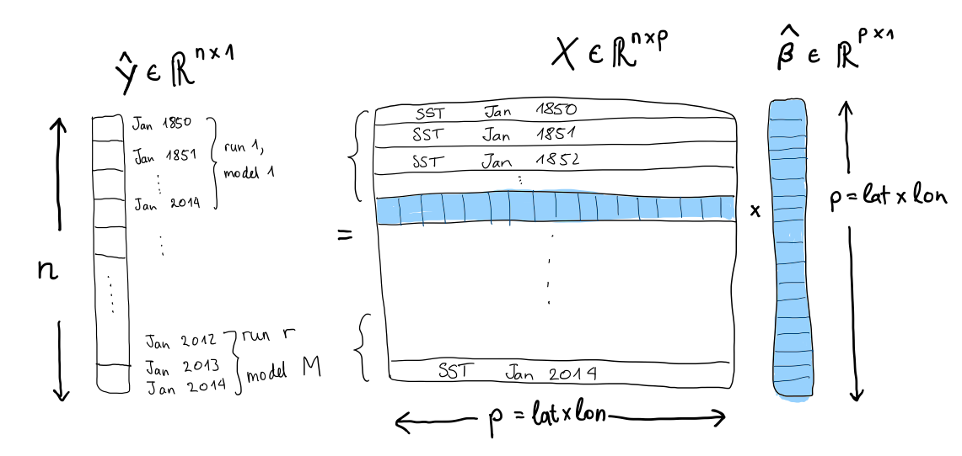

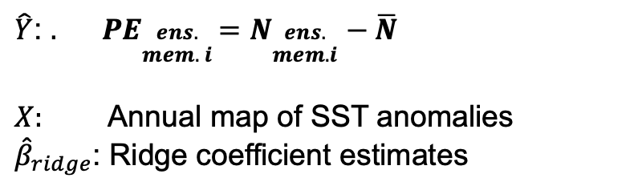
Defining predictand and predictors for statistical model
$\hat{Y}$: ${. PE}_{\begin{aligned}ens. \\ mem. i\end{aligned}}=N_{\begin{aligned}ens. \\ mem. i\end{aligned}}−\overline{N}$
$X:$ Annual map of SST anomalies
${\hat{β}}_{ridge}$: Ridge coefficient estimates
$$\hat{Y}=X {\hat{β}}_{ridge}$$
Notes:
They tried to close TOA radiation budget with climate model simulations and compare that to `ceres observations, showing that once you account for the “pattern effect”, you get a reconstruction much closer to the observations. YAY.
The core of my MS thesis was inspired from this approach, and I will guide you through the steps in which Zhou et al closed the radiation and how we are trying to close the radiation imbalance.

Slide 18
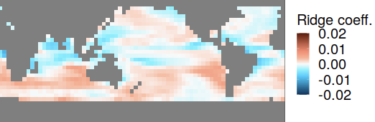
”Interpretable” coefficients
Notes:
They tried to close TOA radiation budget with climate model simulations and compare that to `ceres observations, showing that once you account for the “pattern effect”, you get a reconstruction much closer to the observations. YAY.
The core of my MS thesis was inspired from this approach, and I will guide you through the steps in which Zhou et al closed the radiation and how we are trying to close the radiation imbalance.

Slide 19
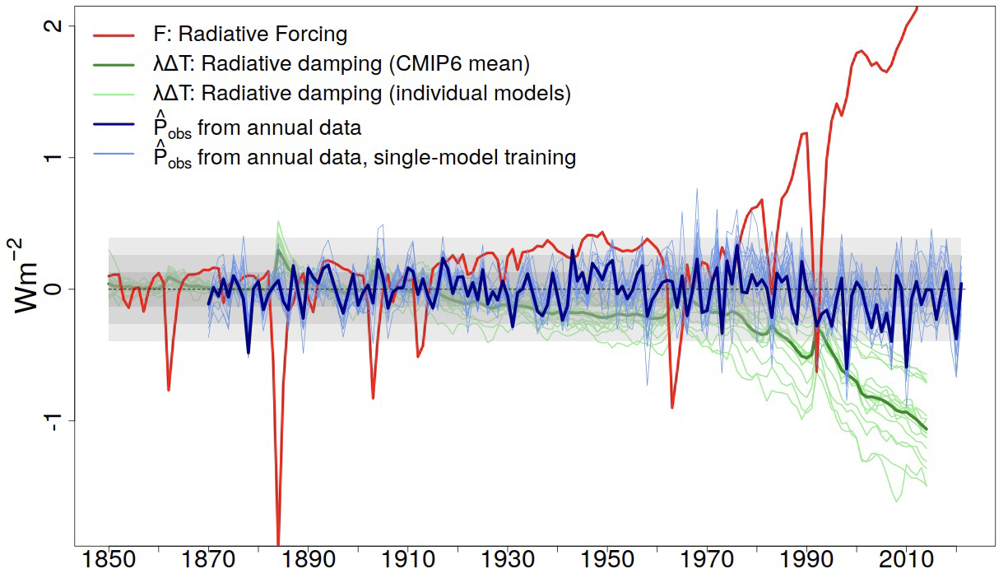
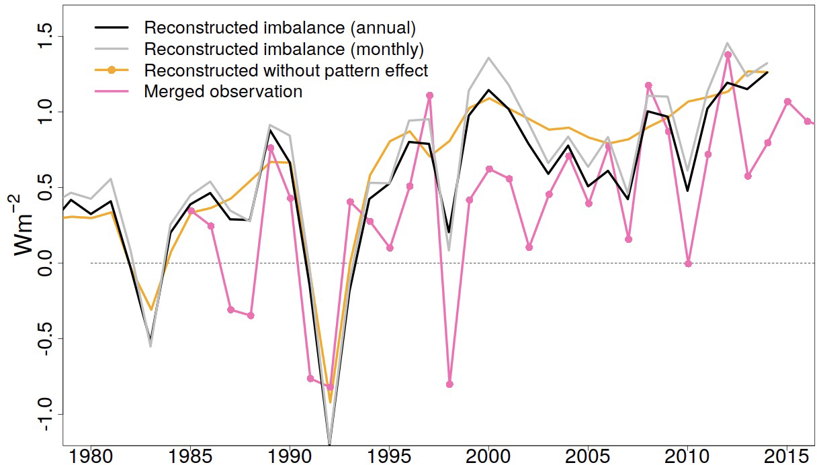
Quantification of obs. PE
Closure of obs. energy balance
Notes:
They tried to close TOA radiation budget with climate model simulations and compare that to `ceres observations, showing that once you account for the “pattern effect”, you get a reconstruction much closer to the observations. YAY.
The core of my MS thesis was inspired from this approach, and I will guide you through the steps in which Zhou et al closed the radiation and how we are trying to close the radiation imbalance.

Slide 20
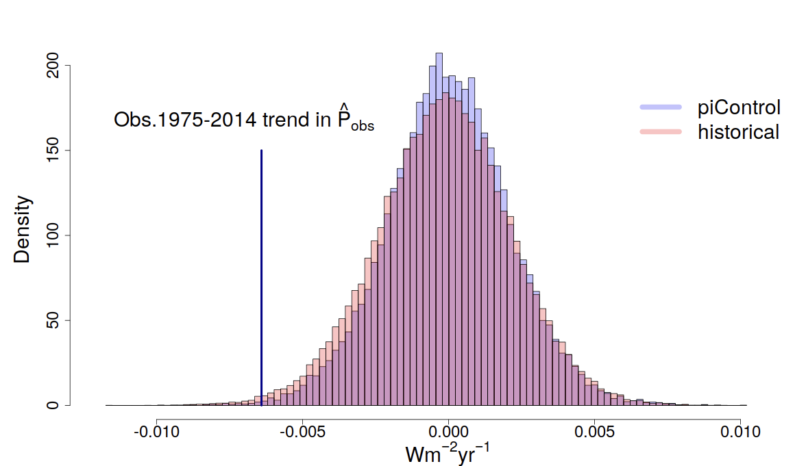
KEY RESULT: Detection of 1975-2014 trend in observed PE
Distribution of all 40-year trends in PE derived from SSTs from historical and piControl simulations
Notes:
They tried to close TOA radiation budget with climate model simulations and compare that to `ceres observations, showing that once you account for the “pattern effect”, you get a reconstruction much closer to the observations. YAY.
The core of my MS thesis was inspired from this approach, and I will guide you through the steps in which Zhou et al closed the radiation and how we are trying to close the radiation imbalance.

Slide 21
Next steps…

Slide 22
Finding characteristic patterns corresponding to characteristic timescales
Can we find patterns corresponding to characteristic timescales?
IDEA: For each time-step we can decompose the true pattern into characteristic timescale patterns
Full pattern = a * Slow response pattern + b* Fast Response pattern + ε
?
Empirical Mode Decomposition, but using the pattern
Discriminant analysis
PCA adapted in a way to suit our problem..
Other non-linear methods?
FULL
SLOW
FAST

Slide 23
References
Direct references
Coats, S., Karnauskas, K. (2017). Are simulated and observed twentieth century tropical Pacific sea surface temperature trends signi cant relative to internal variability?" In: Geophysical Research Letters 44.19, pp. 9928-9937.
Gregory, J., Ingram, W.J., Palmer, M.A., Jones, G.S., Stott, P.A., Thorpe, R.B., Lowe, J.A., Johns, T.C. and Williams, K.D., 2004. A new method for diagnosing radiative forcing and climate sensitivity. Geophysical research letters, 31(3).
Meehl, G. A., Senior, C. A., Eyring, V., Flato, G., Lamarque, J.-F., Stou er, R. J., Taylor, K. E., Schlund, M. (2020). Context for interpreting equilibrium climate sensitivity and transient climate response from the CMIP6 Earth system models". In: Science Advances 6.26, eaba1981.
Maraun, Douglas. "The Challenge of Providing Information About Regional Climate Change." Shaping Tomorrow Today–SDGs from multiple perspectives. Wiesbaden: Springer Fachmedien Wiesbaden, 2023. 15-46.
Nijsse, F.J., Cox, P.M. and Williamson, M.S., 2020. Emergent constraints on transient climate response (TCR) and equilibrium climate sensitivity (ECS) from historical warming in CMIP5 and CMIP6 models. Earth System Dynamics, 11(3), pp.737-750.
Sherwood, S., Webb, M. J., Annan, J. D., Armour, K. C., Forster, P. M., Hargreaves, J. C., Hegerl, G., Klein, S. A., Marvel, K. D., Rohling, E. J., et al. (2020). An assessment of Earth's climate sensitivity using multiple lines of evidence". In: Reviews of Geophysics 58.4, e2019RG000678.
Zhou, Chen, et al. "Greater committed warming after accounting for the pattern effect." Nature Climate Change 11.2 (2021): 132-136.
Title Image Courtesy
NOAA/NESDIS, url: https://www.nesdis.noaa.gov/news/el-nino, accessed on 01.03.2022.

