Slide 1

ECON 206 TUTORIAL
MID TERM TEST
Tuesday 19th August
5-6pm in A5
Notes:
Introduce
Ourselves
The Club
Thank for coming
Explain
Thank for submitting
Why we are going these

Slide 2


@the_investmentsociety

Slide 3
Test Format
Section A: Multichoice
Section B: Short Answers
Section C: Long Answers

Slide 4
Section A: Multichoice
Best practice is quizzes and past papers
Find quizlets
15 questions worth 2 marks each

Slide 5
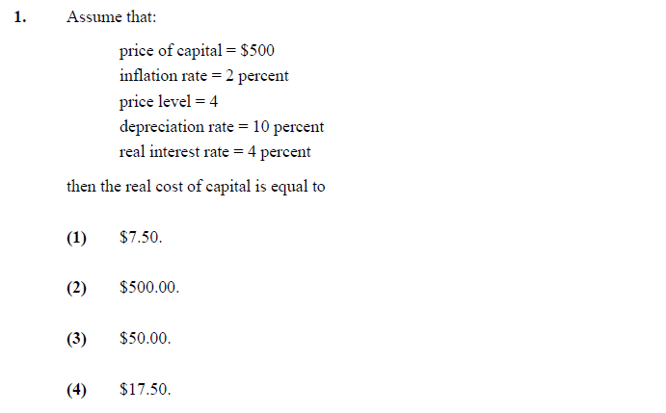
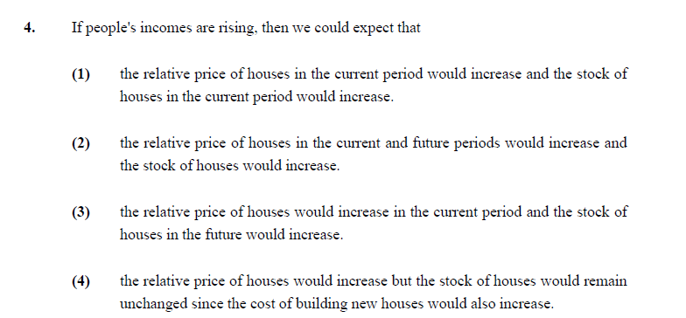
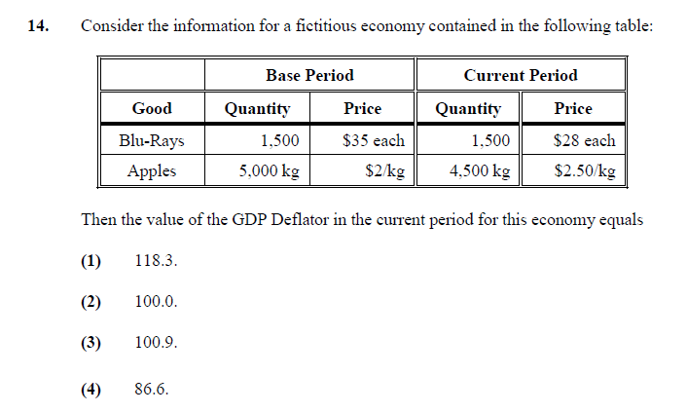
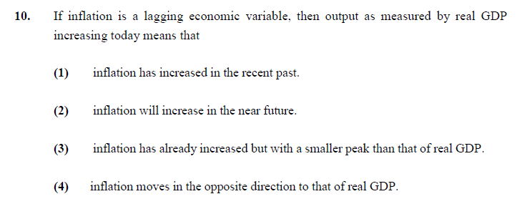
2018 Past multichoice
Notes:
Cost of capital = pk/p *(r+d) = 500/4 * (0.04+0.1)
4) Increase in demand for housing pushes up the price now, which encouraged more construction of houses increasing stock
10) Lagging means moves same direction as GDP just after it
GDP deflator = nominal GDP / real gdp
Nominal GDP is current quantity * prices = (1500*28) + (4500 * 2.50) = 53,250
Real is current quantities * base year prices = (1500 *35) + (4500*2) = 61,500
= 53250/61500 = 86.6

Slide 6
2018 Past multichoice
Notes:
Cost of capital = pk/p *(r+d) = 500/4 * (0.04+0.1)
4) Increase in demand for housing pushes up the price now, which encouraged more construction of houses increasing stock
10) Lagging means moves same direction as GDP just after it
GDP deflator = nominal GDP / real gdp
Nominal GDP is current quantity * prices = (1500*28) + (4500 * 2.50) = 53,250
Real is current quantities * base year prices = (1500 *35) + (4500*2) = 61,500
= 53250/61500 = 86.6

Slide 7
Section B: Short Answers
One question will be from your problem sets
Most of this section is pulled from your notes!
5 questions worth 8 marks each

Slide 8

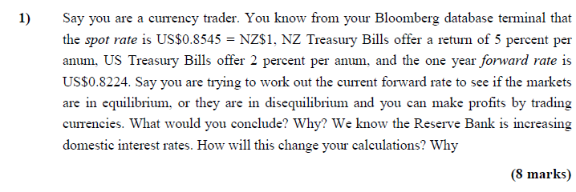
2018 past question
Interest parity condition
Notes:
Plugging values into interest parity condition shows that (0.8545*1.02/0.8224) = 1.0598 , this is greater than the current return in NZ can get of 1.05
-US gives higher return than NZ bonds to get rid of this:
NZ interest rates rise to attract investment,
US interest rates fall as realise their interest rates too high, can lower them and still have demand, lower debt servciving costs
Demand for USD increase, causes spot NZ exchange to fall
But demand for NZD in forward increases which causes forward rate to increase
IF RBNZ increases rates lowers the gap and might change it so that NZ bonds return more then opposite scenario

Slide 9
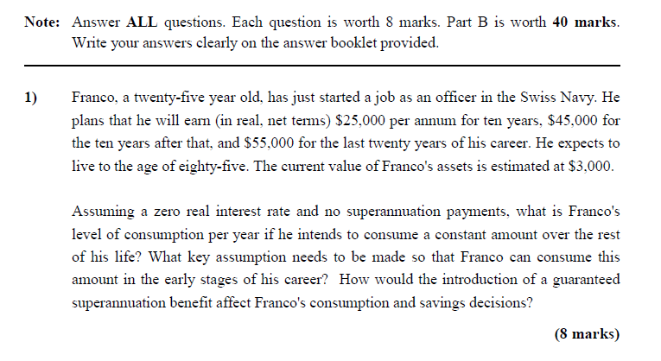
2020 past question
Notes:
Need to work out how much lifetime resources are: (15k*10) + (45k*10) + (55k*20) + 3k = 1803k /60 years = 30,050 p/y
Potential issue is that he only earns 25k at the start, so needs to borrow
Superannuation plan lessen desire to save so consume more per year

Slide 10
Section C: Long Answers
GDP calculation question guaranteed
2 questions worth 15 marks each
Notes:
Do not force the answers

Slide 11
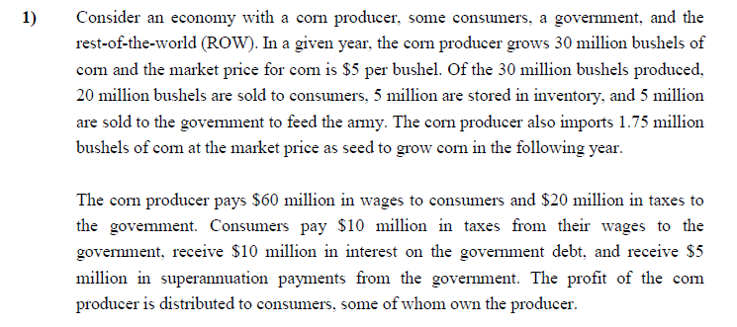
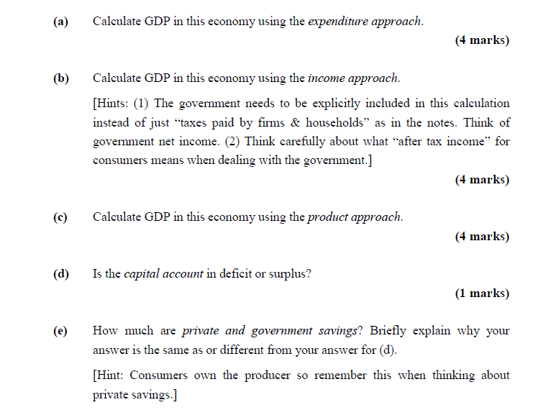
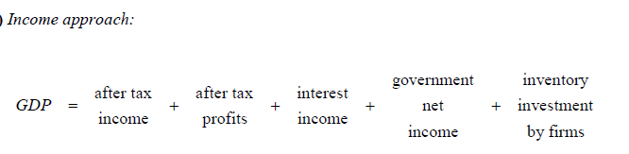


2018 GDP question
Notes:
Expenditure
Consumption is the 100m, 20 million bushels @50 each
Investment : inventory = 25m and the imported seed 8.75m
Government – purchases 5m bushels = 25m
Exports – nothing
Import = 8.75m – the corn seed imports
Total = 150m
Income
Consumers income: wage income of 60m less 10m of taxes and +5m of super – 55m
Profits: revenue = 125m, costs = 60m wages and taxes 20m = 45m
Interest income = 10m
Taxes = consumers 30m, super 5m and producers 20m = 30m
Investory invesestment = 25m same as investment from expenditure
Total 150m
Product approach:
Added value of the producers = 150m no intermediate inputs
Govt doesn’taddd anything, 25m costs but all intermediate inputs as just the corn
D
Capital account
Current account we know to be a deficit as only 8.75m of imports so a capital account in a surplus
e)
Private savings
= wage income (60 +45 + 150 + 5 – 10 – 100) = 10m
Govt savings
= 30 – 10 -5 = 15m
Natinal savigns 25m, not same as CA balance because have to factor in invesmtne tof 33.75m
National savigns – invesmtnet = CA
25-33.75 = -8.75

Slide 12
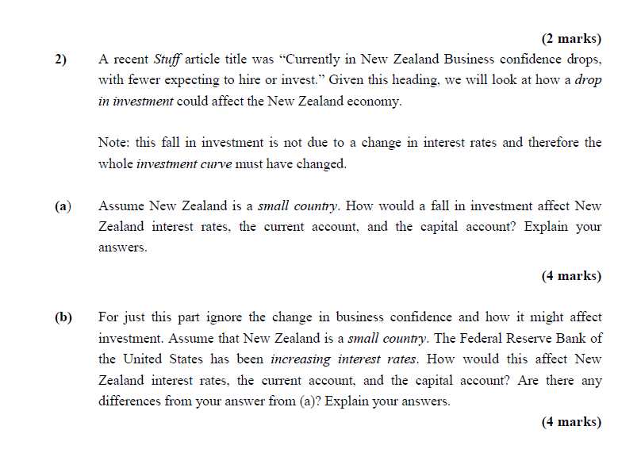
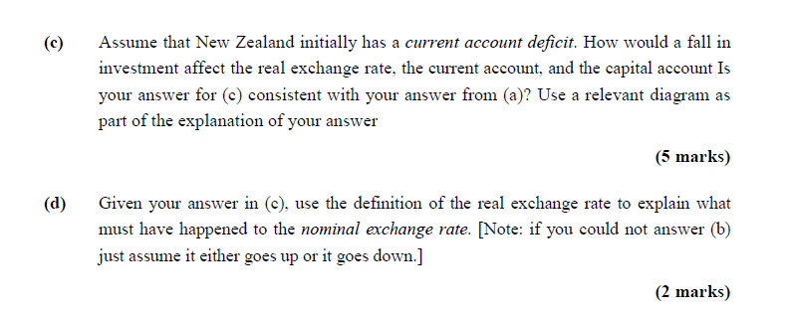
2018 Part C question 2
Notes:
2a) NZ is in a current account deficit so Investment exceeds savings, we can show that Investment curves shift left but still exceed savings.
NZ being a small country means price taker so interest rate is world interest rate, if the interest rate fell with investment falling then investors would just shift funds overseas to get the higher returns
We can see interest rate doesn’t change just CAB deficit falls
2B) Price taker so world interest rates increase
Domestic savigns doesn’t change based on doemsic income
Investment changes as cost capital increases (higher borrowing cost so investment falls
Capital account surplus and current account deficit falls
2c)
Currenlty given that current account deficit, means that there is net demand for forex (imports > exports) for current account and net supply for the capital account
Invesment falling means we demand less funds for overseas, so there is less demand for the NZD which funds investment, depreciate exchange rate, or think about it like more of NZ savings spare to go to overseas projects
Depreciation exchange rate increase export and decrease imports which improves CAB moving it to positive
2D)
-Nominal exchange rate * domestic price level / foreign price level
- If real exchange rate gone down, something else has changed likely nominal as we don’t know that any changes in price levels

Slide 13
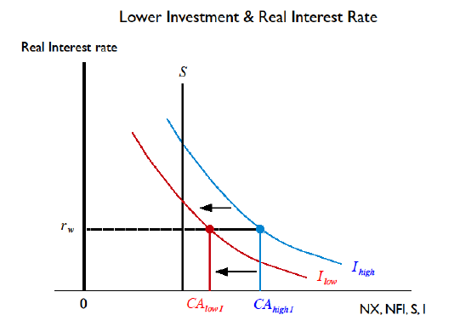
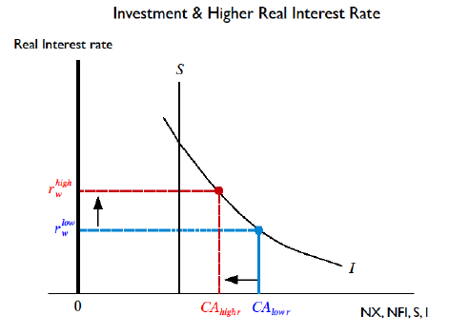
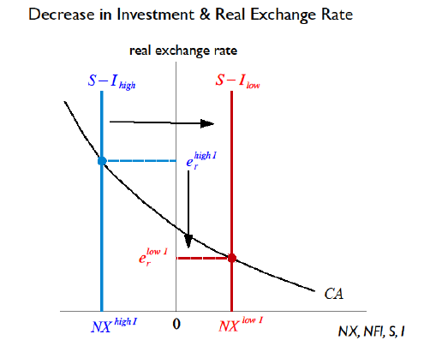

2018 Part C question 2
Notes:
2a) NZ is in a current account deficit so Investment exceeds savings, we can show that Investment curves shift left but still exceed savings.
NZ being a small country means price taker so interest rate is world interest rate, if the interest rate fell with investment falling then investors would just shift funds overseas to get the higher returns
We can see interest rate doesn’t change just CAB deficit falls
2B) Price taker so world interest rates increase
Domestic savigns doesn’t change based on doemsic income
Investment changes as cost capital increases (higher borrowing cost so investment falls
Capital account surplus and current account deficit falls
2c)
Currenlty given that current account deficit, means that there is net demand for forex (imports > exports) for current account and net supply for the capital account
Invesment falling means we demand less funds for overseas, so there is less demand for the NZD which funds investment, depreciate exchange rate, or think about it like more of NZ savings spare to go to overseas projects
Depreciation exchange rate increase export and decrease imports which improves CAB moving it to positive
2D)
-Nominal exchange rate * domestic price level / foreign price level
- If real exchange rate gone down, something else has changed likely nominal as we don’t know that any changes in price levels

Slide 14
General Tips
Write neatly and concisely
Bullet points are fine – don’t need paragraphs
Know the different graphs
Do the past papers!
Learn your notes
Include examples on your cheat sheet
Practice problem sets!

