Slide 1

fff
ECON 105 TUTORIAL FINAL EXAM
Thursday October 23rd
2pm - 3pm in Rehua 002

Slide 2

STRUCTURE
100 marks—30 multiple choice, 70 written answers
Allocate around 1 min 45 sec per mark

Slide 3
ECONOMIC HISTORY – 5 Marks
Notes:
Most likely multichoice

Slide 4
NATIONAL ACCOUNTING, PRICES, MEASUREMENT, BOP – 5 Marks

Slide 5
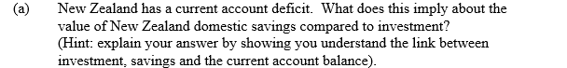
BOP QUESTION
From S2-2015

Slide 6
BOP
From S2-2015
CA = - ROW Savings
I = S_{P} + S_{G} + ROW Savings
I = S_{NZ} + ROW Savings
If the CAB is negative (deficit) then ROW Savings must be positive and NZ is borrowing money to fund investment
Domestic S < I

Slide 7
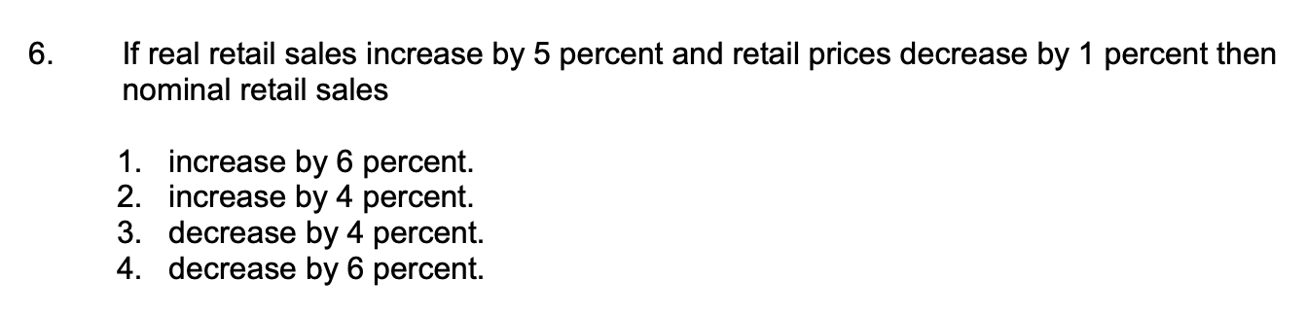
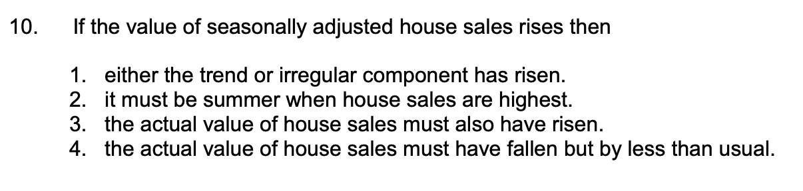
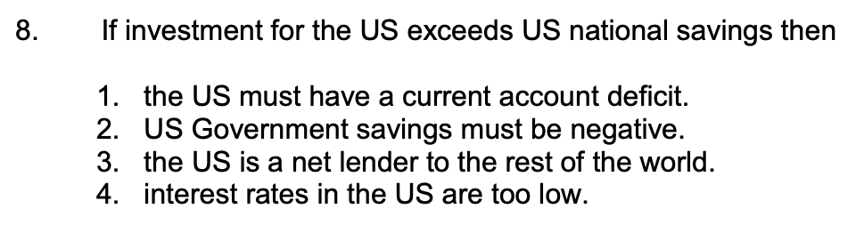
MULTICHOICE QUESTIONS

Slide 8
MULTICHOICE QUESTIONS

Slide 9
FOREIGN EXCHANGE – 5 Marks

Slide 10
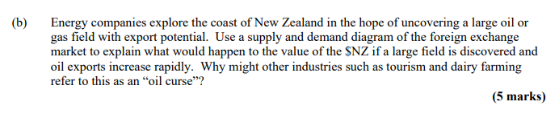
EXCHANGE RATE
From S2-2018
Notes:
Xr: foreign currency units per $NZ

Slide 11
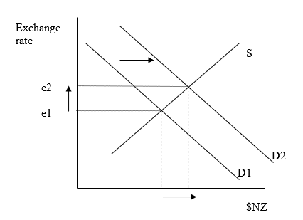
EXCHANGE RATE QUESTION
To buy NZ goods (exports):
Foreigners must first change their foreign currency into $NZ.
An increase in the demand for NZ oil will increase the demand for $NZ
On NZ money market market diagram, demand will shift out from D1 to D2
The quantity of $NZ will increase and the exchange rate will increase (appreciate)
The increase in the exchange rate (value of $NZ rise) makes other exports such as tourism and milk more expensive to overseas customers. These industries are therefore less competitive compared to overseas goods so might suffer.
Notes:
Xr: foreign currency units per $NZ

Slide 12
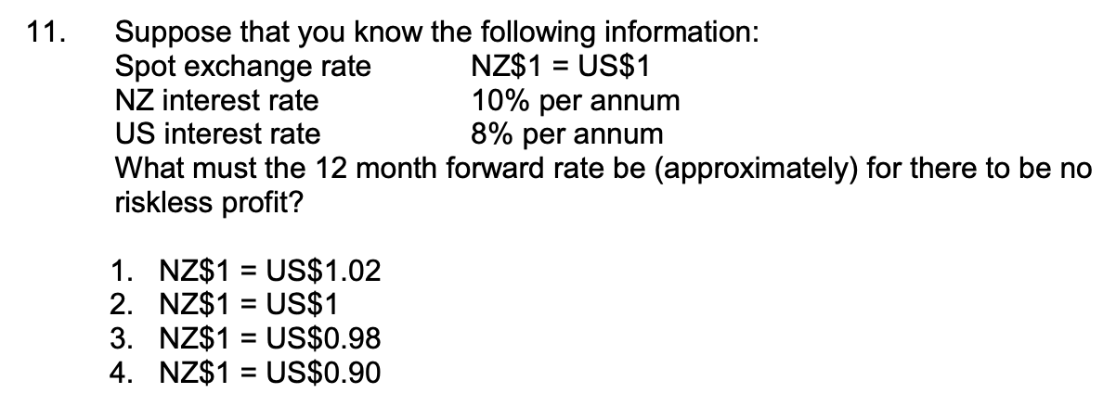
FORWARD RATE QUESTION
Notes:
Xr: foreign currency units per $NZ

Slide 13
FORWARD RATE QUESTION
F = S * [(1 + rd)/(1+rf)]
F = (1+0.08)/(1+0.1)
= 0.98
Notes:
NZD needs to depreciate in the forward market due to the higher interest rate so no riskless profit can be made

Slide 14
LABOUR MARKET – 10 Marks

Slide 15
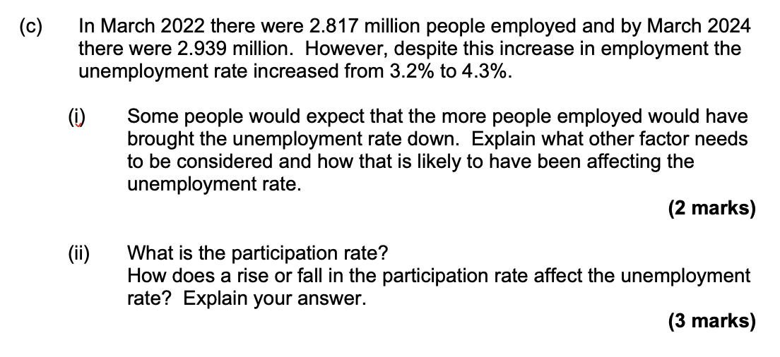
UNEMPLOYMENT

Slide 16
UNEMPLOYMENT
Labour force growth rate
If labour force is growing faster than the job growth rate, then the unemployment rate will actually rise
Percentage of working age population that is in the labour force
If participation rate is rising, then the labour force will grow faster than otherwise would
Rising participation rate would cause higher unemployment for any job creation rate

Slide 17
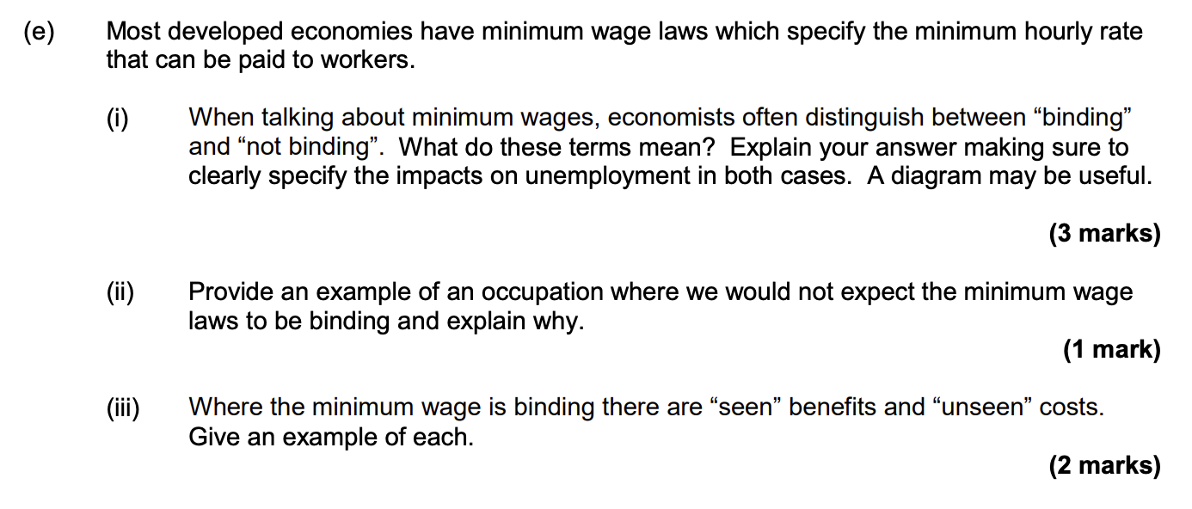
LABOUR MARKET

Slide 18
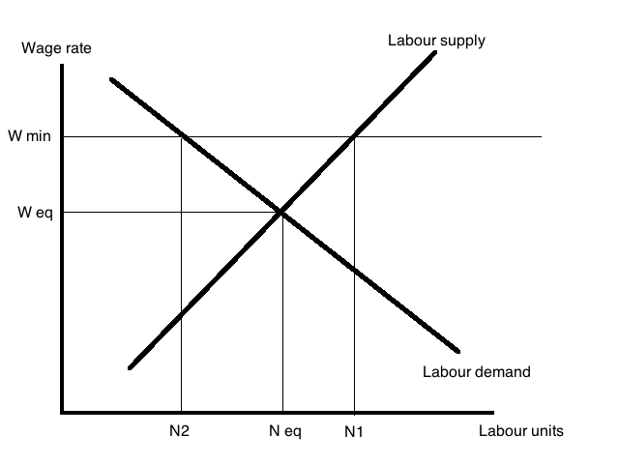
LABOUR MARKET
i)
Minimum wage above equilibrium is binding
Below is not binding
Below equilibrium has no impact on unemployment, demand is greater than supply of labour so the wage can rise to equilibrium
Above equilibrium, supply is greater than demand and there is unemployment as the wage can’t fall

Slide 19
LABOUR MARKET
ii)
Lawyer, judge, dentist, doctor, etc.
Wage rates are above minimum wage in those industries
iii)
Seen - those who keep there jobs after minimum wage are better off
Unseen - those who are no longer able to get jobs

Slide 20
MONEY AND INFLATION – 15 Marks

Slide 21
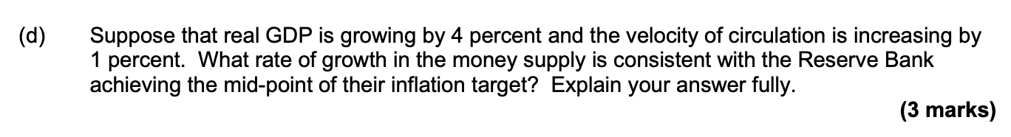
MONEY QUESTION
From S2-2023

Slide 22
MONEY QUESTION
Mid point = 2%
%ΔM = %ΔP + %ΔY - %ΔV
%ΔM = 2 + 4 - 1
%ΔM = 5

Slide 23
MONEY QUESTION
From S2-2023

Slide 24
INFLATION
Changes in money supply have no impact on real variables
If government prints money and causes inflation, nominal wages rise so real wages are more constant
When inflation rises, we expect nominal rates to rise but real rate remains approximately constant

Slide 25
AD/AS, MONETARY POLICY, INFLATION & UNEMPLOYMENT TRADE-OFF – 25 Marks

Slide 26
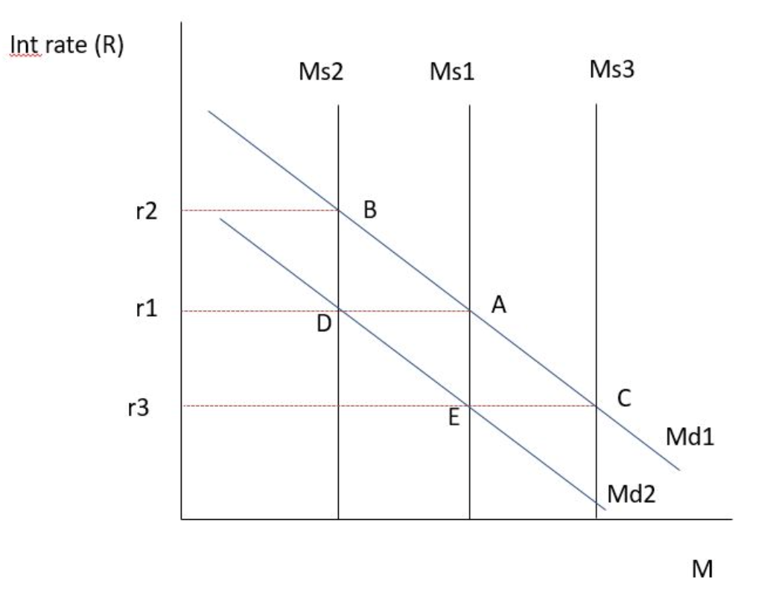
MONETARY POLICY
RBNZ uses the OCR as a tool for monetary policy:
Tightening - increase OCR
Loosening - decrease OCR
If RBNZ tightens monetary policy:
OCR rises
Banks reduce the amount they borrow via settlement account or increase what they hold in settlement account
Reduce the money supply
Interest rates in wider economy rise

Slide 27
OCR MEDIA RELEASE APR 2025
The Monetary Policy Committee today agreed to reduce the Official Cash Rate by 25 basis points to 3.5 percent.
Annual consumer price inflation remains near the mid-point of the Monetary Policy Committee’s 1 to 3 percent target band. Firms’ inflation expectations and core inflation are consistent with inflation remaining at target over the medium term.
Economic activity in New Zealand has evolved largely as expected since the February Monetary Policy Statement. Higher-than-expected export prices and a lower exchange rate have supported primary sector incomes and overall economic growth. While monetary restraint has been removed at pace, household spending and residential investment have remained weak.
The recently announced increases in global trade barriers weaken the outlook for global economic activity. On balance, these developments create downside risks to the outlook for economic activity and inflation in New Zealand.
Having consumer price inflation close to the middle of its target band puts the Committee in the best position to respond to developments. As the extent and effect of tariff policies become clearer, the Committee has scope to lower the OCR further as appropriate. Future policy decisions will be determined by the outlook for inflationary pressure over the medium term.

Slide 28
OCR MEDIA RELEASE APR 2025
The Monetary Policy Committee today agreed to reduce the Official Cash Rate by 25 basis points to 3.5 percent.
Annual consumer price inflation remains near the mid-point of the Monetary Policy Committee’s 1 to 3 percent target band. Firms’ inflation expectations and core inflation are consistent with inflation remaining at target over the medium term.
Economic activity in New Zealand has evolved largely as expected since the February Monetary Policy Statement. Higher-than-expected export prices and a lower exchange rate have supported primary sector incomes and overall economic growth. While monetary restraint has been removed at pace, household spending and residential investment have remained weak.
The recently announced increases in global trade barriers weaken the outlook for global economic activity. On balance, these developments create downside risks to the outlook for economic activity and inflation in New Zealand.
Having consumer price inflation close to the middle of its target band puts the Committee in the best position to respond to developments. As the extent and effect of tariff policies become clearer, the Committee has scope to lower the OCR further as appropriate. Future policy decisions will be determined by the outlook for inflationary pressure over the medium term.

Slide 29
OCR MEDIA RELEASE APR 2025
Inflation near midpoint of 2%
Negative output gap
OCR reduced by 25 basis points to 3.5%
Loosening monetary policy - increase in money supply

Slide 30
AD
X-M
Higher than expected export prices - increased overseas demand for NZ exports
Lower exchange rate, exports relatively cheaper in foreign currency
Partially offset by rising global trade barriers
C
Decrease in OCR will make borrowing cheaper
Residential investment weak, global uncertainty will reduce consumer confidence
I
Decrease in OCR will lower borrowing costs for firms
Supported primary sector incomes and overall economic growth
esidential investment weak so firms may be cautious

Slide 31
SAS
Stable inflation expectations
Weaker NZ so imports become more expensive; firms reliant on imports may face higher production costs
Global trade barriers can raise the cost of imports or restrict export markets, can make production less efficient or more expensive

Slide 32
ECONOMIC GROWTH, INCOME & POVERTY – 25 Marks

Slide 33
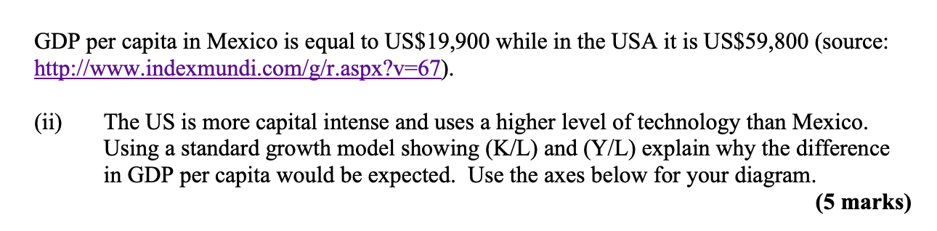
K/L AND Y/L

Slide 34
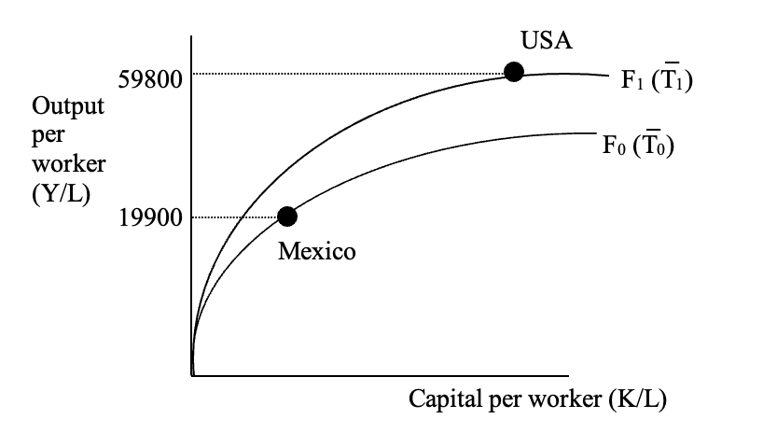
K/L AND Y/L
Mexico are on the steeper part of production function
The slope of production function is the growth rate

Slide 35
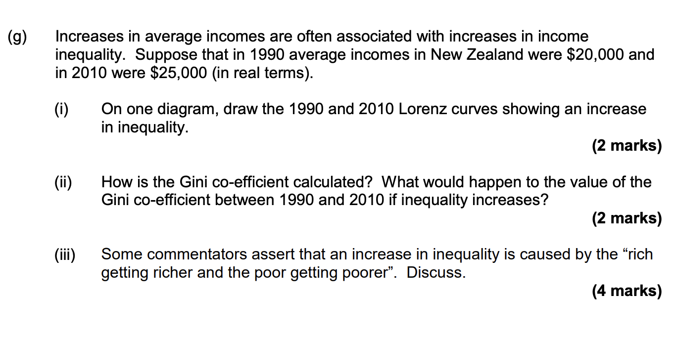
INEQUALITY
FFrom S2-2020

Slide 36
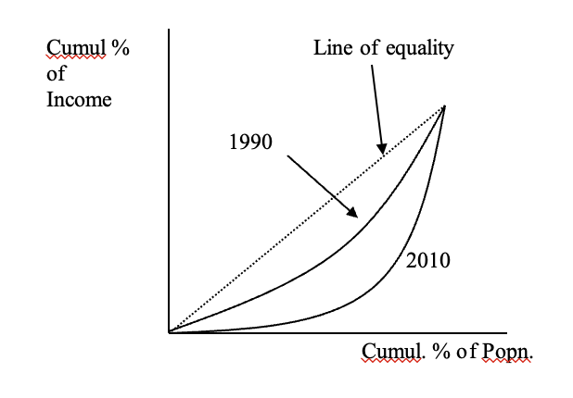
INEQUALITY
i)
Fii)
Ratio of area between the Lorenz curve and line of equality to total area under line of equality
Gini coefficient has risen
iii)
Could be correct
Inequality can be rising if all incomes rising (poor also getting richer)
Incomes of rich are rising at faster rate
Notes:
Gini coefficient = A / A+B
0 = perfect equality
1 = perfect inequality
If Lorenz curve is further from line of equality → more inequal

Slide 37

ECONOMIC GROWTH

Slide 38
ECONOMIC GROWTH
The actual purpose of growing our economy is to improve the wellbeing and living standards of New Zealanders.
GDP is not a measure of everything we value but it is highly correlated with things that we do such as falling poverty rates, child mortality declining, child labour declining and life expectancy improving.
It doesn’t take into account the distribution of income, products that are sold on the black market, quality of life, negative externalities or sustainability.

Slide 39
GOVERNMENT AND TAX – 25 Marks

Slide 40
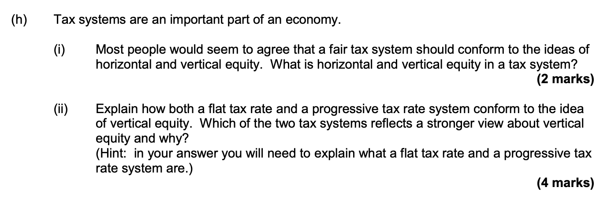
TAX
From S1-2023

Slide 41
TAX
i)
Horizontal equity – people with the same ability to pay should be treated the same in the tax system
Vertical equity – those with a greater ability to pay should pay more
ii)
Flat tax system has one rate
Progressive tax system has tax rates that rise as income rises (or increasing marginal tax rates)
Higher incomes pay higher taxes
Progressive system reflects a stronger view about vertical equity, higher incomes pay proportionately more

