Slide 1

FINC 203 TUTORIALS
MID TERM TEST
Tuesday 23rd April
6-7pm in Rehua 002
Notes:
Introduce
Ourselves
The Club
Thank for coming
Explain
Thank for submitting
Why we are going these

Slide 2


@the_investmentsociety

Slide 3
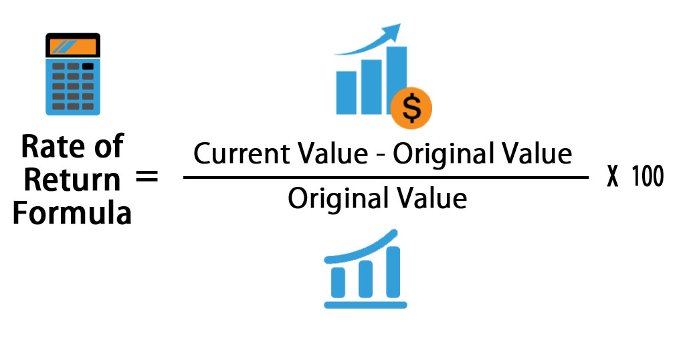
Basic Terms
Also known as (P1-P0)/P0
Bob bought a stock for $100. He then sold it one year later for $110.
Return = (110-100)/100 = 10%

Slide 4
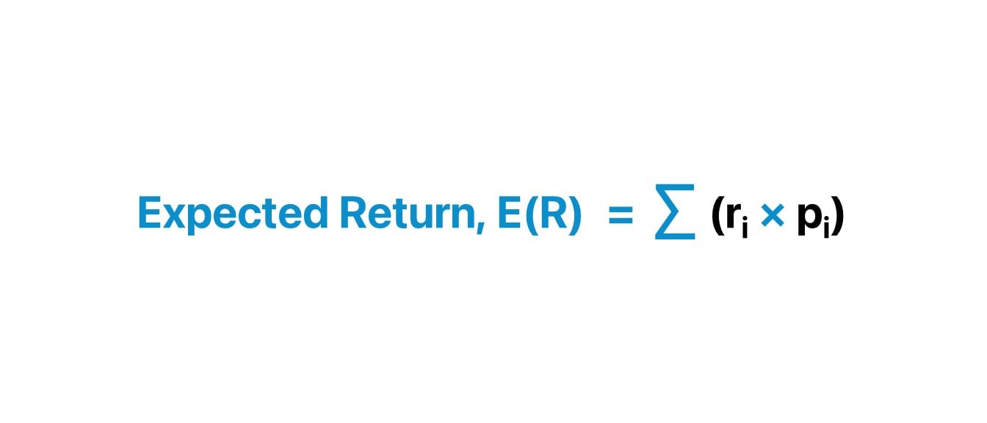
Basic Terms
(Probability of outcome A * return of outcome A) + (Probability of outcome A * return of outcome B)

Slide 5
Basic Terms
Financial markets
Financial institutions
Where financial institutions operate
Money market
Capital market
Who operate in financial markets
Commercial banks
Credit unions
Insurance companies

Slide 6
Funds flow
Lender – Savers = SSU
Borrower – Spenders = DSU
Groups who have excess money they don’t require
Households
Business’s
Governments
Examples: Term Depoist
Groups who have a short of money they require
Business’s
Governments
Example: Bank loan

Slide 7
Funds Flow
Direct Financing
Indirect Financing
Avoids using an intermediary
Examples: IPO’s
Examples: Bonds direct from companies
Uses an intermediary
Examples: Buying shares off shareies

Slide 8
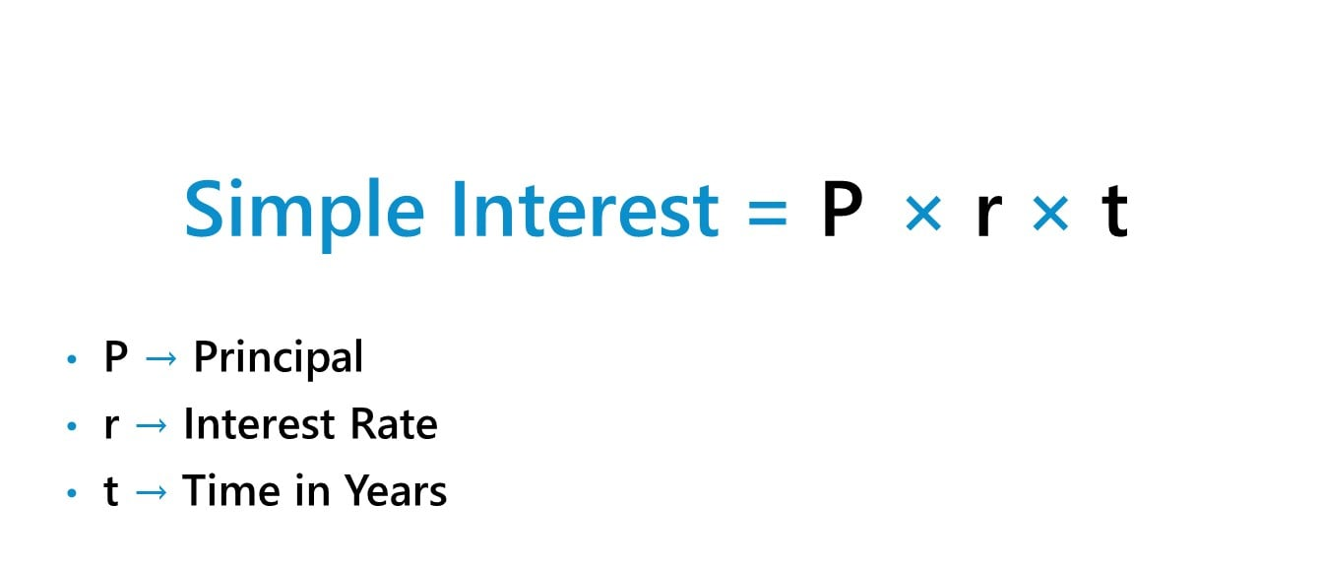
Simple Interest
Example: James deposits $1000 earning 5% simple interest annually for 2 years. How much interest has he earned
$1000 * 0.05 * 2 = $100

Slide 9
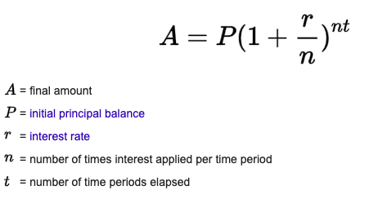
Compound Interest
Example: James deposits $1000 earning 5% simple interest annually for 2 years. How much interest has he earned
1000*(1+0.05)^2 = $1,102.50

Slide 10
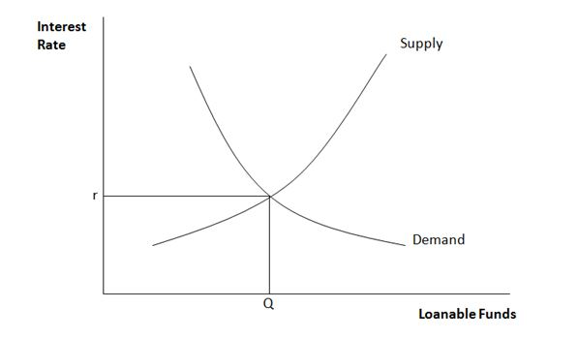
How interest rates are determined

Slide 11
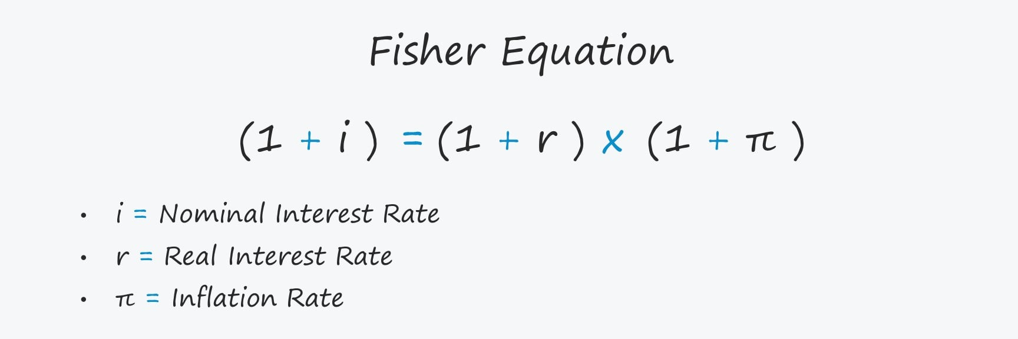
Fisher equation

Slide 12
Types of bonds
Treasury bonds
  Issued by the Government
  Considered very safe – lower return
Treasury Indexed bonds
  Principal changes to reflect inflation – Interest Rates doesn’t!
Municpial bonds
  Tax exempt
Corporate bonds
  Secured – underlying asset attached to the bond
  Unsecured – no asset attached to the bond

Slide 13
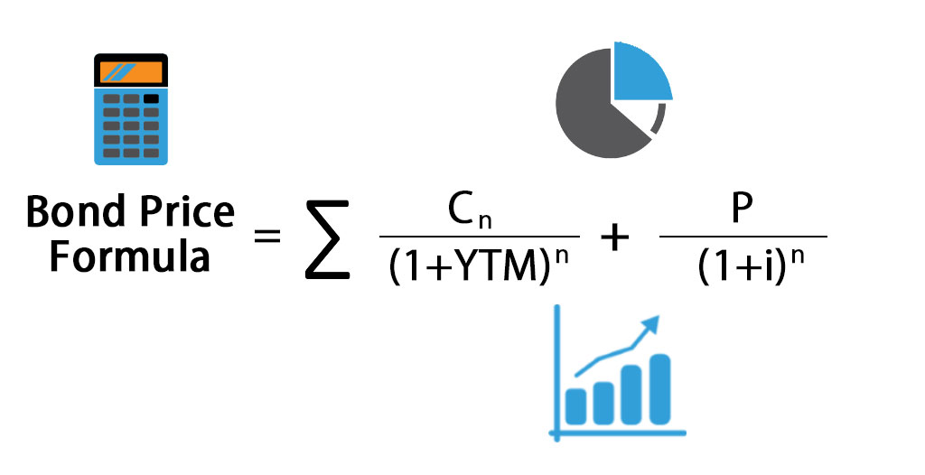
Bond pricing
YTM = CR -> Par Value
YTM < CR -> Premium Bond
YTM > CR -> Discount Bond

Slide 14
Bond Risks
Default risk: Issuer of the bond may fail to make bond payments
Callable option: Issuer can buy back the bond for a guaranteed price
Interest Rate risk: The interest rate may rise which decrease the value of the bond you possess
Time: The longer you hold the bond for the riskier it may be

Slide 15
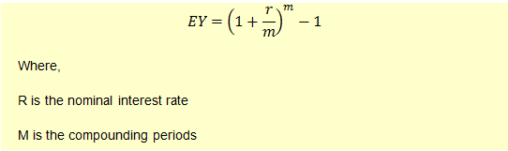
Effective Annual Yield

Slide 16
Money market
Highly liquid
Low transaction costs
Large deposits (typically more than $1 million)
Short time frame (less than one year)
Low default risk
Most important function: provide a way for economic units to undertake liquidity management
Examples: one name paper, t-notes, repos, negotiable CD’s, commercial papers
Main participants: commercial banks, central banks, governments, corporations

Slide 17
Market for securities
Primary market: Companies sell shares for the first time in order to raise money
Second market: outstanding shares are bought and sold among investors. Any trade of a security after its primary offering is said to be the secondary market
Broker markets: broker brings buyers and sellers together in order to earn commission
Dealer market: Buy and sell securities (profit is the difference between bid and ask price)

Slide 18
Types of Orders
Market orders (Ask price)
Limit order (Bid price)
Execute the trade at the current market price
Execute the trade at a given price limit

Slide 19
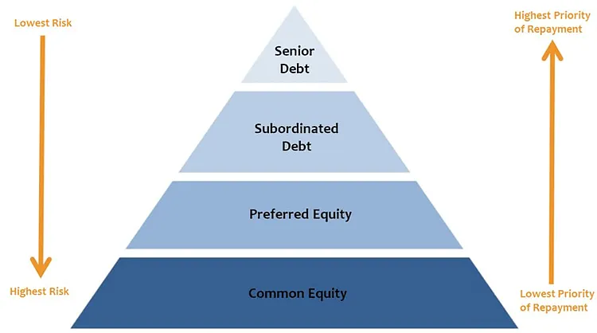
Ranking of debt
Preference shares
  No voting rights
  Fixed dividend
  Priority to payment
Common shares

Slide 20
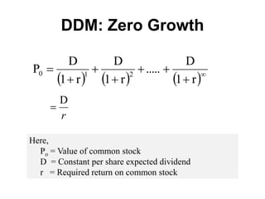

How to value stocks
Constant dividend
Constant-growth dividend

Slide 21
Forward Contract
Agreement that guarantees the delivery of a certain amount of goods, on a certain day (the settlement date) at a certain price (forward price)
Spot price is the current price
Buyer of the forward contract has a long position
Seller has a short position

Slide 22
Payoff in a forward contract
Long position: Spot Price – Future Price
  Buying because you expect the price to rise.
Short position: Future Price - Spot Price
  Selling because you expect the price to fall

Slide 23
Uses of futures
Reducing systematic risk
Guaranteeing cost of funds
Hedge – to reduce price risk
Speculate – expectation of earning a high return

Slide 24
Options
Gives the holder the right but not obligation to buy or sell an asset at a predetermined price (strike/exercise price)
Calls – gives the holder the right to buy the underlying asset at a predetermined price
Puts – gives the holder the right to sell the underlying asset

Slide 25
Payoff and profits of options
Call option
Put Option
If Spot price > Strike price (Exercise)
Payoff = St – K
Profit = St – K - C
If Spot Price < Strike price
(Don’t Exercise)
Payoff = 0
Profit = -C
If Spot Price > Strike Price (Don’t Exercise)
Payoff = 0
Profit = - C
If Spot Price < Strike Price (Exercise)
Payoff = K – St
Profit = K – St - C

Slide 26
Options Simply
Call Option = Only exercise if the strike price is LESS than the spot price
Put Option = Only exercise if the strike price is MORE than the spot price

