Slide 1

FINC 201 TUTORIAL WEDNESDAY 16th AUGUST
5-6pm IN REHUA 620
SIGN UP TO THE INVESTMENT SOC: HTTPS://WWW.THEINVESTMENTSOCIETY.ORG/
Notes:
Introduce
Ourselves
The Club
Thank for coming
Explain
Thank for submitting
Why we are going these

Slide 2
SIGN UP FOR FREE
STAY UPDATED FOR EVENTS
Facebook Page: The Investment Society
Instagram: the_investmentsociety
QUESTIONS AND FEEDBACK
Email: tutorials@ucinvestmentsociety.com

Slide 3

OVERVIEW
Goal of the Firm
Financial Statements & Ratio Analysis
Time Value of Money (TVM)
Practicing Approach and Method to Answering Questions
Continuous Compounding
Annuity Due
Inflation Adjustments
Effective Annual Rate (EAR)
Bond Valuation
Practicing Approach and Method to Answering Questions
Stock Valuation
Key Formulas and Variables
Practicing Approach and Method to Answering Questions
NPV
Projects with unequal length
Finding IRR
Notes:
Also we have the help guide, which outlines some key tips and things to remember and focus on before the test.
These tutorials won’t be recorded on ECHO, but we are happy to release these tutorial slides if you think that will be helpful.
And, as we go through problems and sections displayed on this slide, we will be showing you how to perform the calculations on your FINC calculation, under the document camera here!
We received quite a few submissions asking about financial statements ratios/analysis, however we won’t be covering this, because when we talked to Deb about doing these tutorials, she said not to bother covering it, and that probably means it won’t be in the test (or if it is, it will be very small e.g. 5 marks out of 100)

Slide 4
About the Test
REMEMBER, you must write down the relevant formula and plug in correct numbers before using financial calculator
When using financial calculator, state what you are doing and write down variables inputted eg. N= ____ , I/Y = ____ etc…
If you do not have a financial calculator, you must rearrange and solve mathematically
Notes:
This is just a brief overview! There is often a test question on this so go over your notes on the area and make sure you know about the goal of the firm and agency theory but also how shareholders can control managers!

Slide 5
Goal of the Firm
Maximise shareholder value!
Usually through maximising returns to shareholders through dividends and capital growth (appreciation in the share price).
Also related to the goal of the firm is agency theory which says that there is a misalignment of interests between those managing the firm and those who own the firm (shareholders).
However, shareholders have an indirect power over the managers as they elect the Board of Directors who elects the CEO who determines secondary management.
Notes:
This is just a brief overview! There is often a test question on this so go over your notes on the area and make sure you know about the goal of the firm and agency theory but also how shareholders can control managers!

Slide 6
QUESTION 1

Slide 7
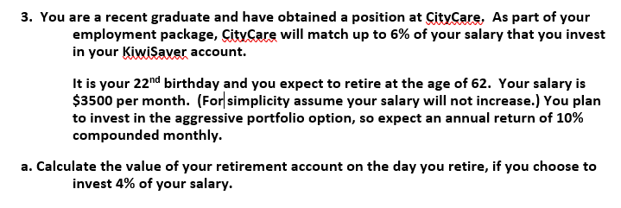
Question 1
What would you do first?

Slide 8
Question 1
NEED TO IDENTIFY WHICH OF THE 5 KEY VARIABLES BELOW WE NEED FOR OUR ANSWER
Age 22 62
Year 0 40
$ 0 FV
These are the key variables we need – can you find them all?
N | I/Y | PV | PMT | FV

Slide 9
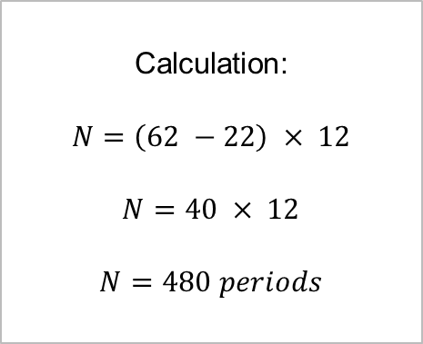
Finding N (Number of Periods)
These are the key variables we need – can you find them all?
N | I/Y | PV | PMT | FV
480
Notes:
N = (62 – 22) x 12
N = 40 x 12
N = 480

Slide 10
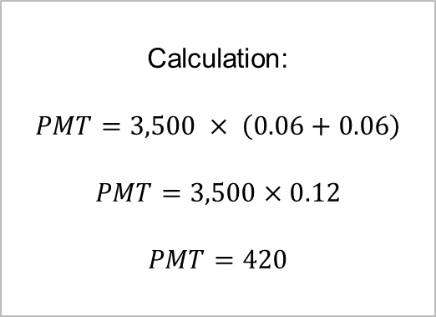
Finding PMT (or CF – per period)
These are the key variables we need – can you find them all?
N | I/Y | PV | PMT | FV
480 |  |  | 420
Notes:
PMT = 3,500 x (0.06 + 0.06)
PMT = 3,500 x 0.12
PMT = 420

Slide 11
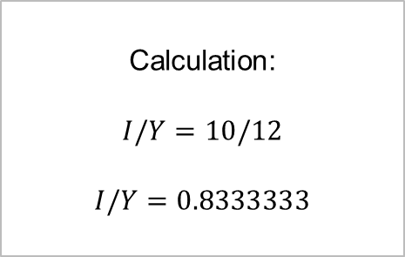
Finding Required Rate of Return (I/Y, OCC, r)
NOTE: Enter percentages as whole numbers in financial calculator!
e.g. enter 10% as 10, NOT 0.10
These are the key variables we need – can you find them all?
N | I/Y | PV | PMT | FV
480 | 0.83333333 |  | 420
Notes:
I/Y = 10 / 12
I/Y = 0.83333333 per period
The 6% contribution, while displayed as a %, is NOT a rate, it is part of the PMT calculation!!!

Slide 12
Calculating Future Value (FV)
INPUT FIGURES INTO FINANCIAL CALCULATOR
THEN COMPUTE FV
These are the key variables we need – can you find them all?
N | I/Y | PV | PMT | FV
480 | 0.8333333 | 0 | 420 | =???
Notes:
Note: The PV is assumed to be $0, as no initially funds in this retirement account are mentioned (this will generally be the case)

Slide 13
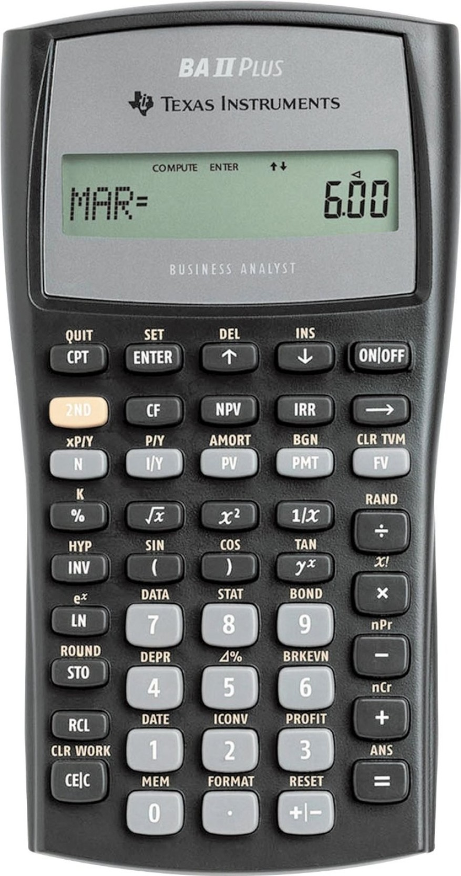
Find FV - Financial Calculator (Texas)
N | I/Y | PV | PMT | FV
480 | 0.8333333 | 0 | 420 | =$2,656,113.42
Calculator Key(s)
Gives FV = $2,656,113.42
Variable | Input
N | 480
I/Y | 0.83333
PMT | 420
PV | 0
CPT | FV
Notes:
Show me using my own financial calculator on document camera!

Slide 14
Final Answer
INPUT FIGURES INTO FINANCIAL CALCULATOR
THEN COMPUTE FV
These are the key variables we need – can you find them all?
N | I/Y | PV | PMT | FV
480 | 0.8333333 | 0 | 420 | = $2,656,113.42
Notes:
Note: The PV is assumed to be $0, as no initially funds in this retirement account are mentioned (this will generally be the case)

Slide 15
Question 2

Slide 16

Question 2
Where do we start?
NEED TO IDENTIFY WHICH OF THE 5 KEY VARIABLES BELOW WE NEED FOR OUR ANSWER
N | I/Y | PV | PMT | FV

Slide 17
Create A Timeline
Age 22 62 82
Year 0 40 60
$ 0 PV FV
These are the key variables we need – can you find them all?
N | I/Y | PV | PMT | FV
Notes:
The FV from the previous question is the PV in this question

Slide 18
Finding the Present Value (PV)
Age 22 62 82
Year 0 40 60
$ 0 PV FV
KEY:
OUR FV from (b) is now our PV in (c)
These are the key variables we need – can you find them all?
N | I/Y | PV | PMT | FV
 |  | 2,656,113.4

Slide 19
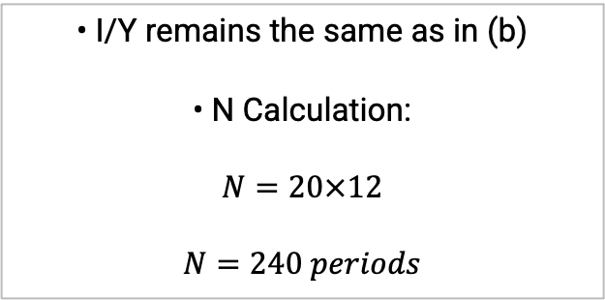
Finding the Remaining Variables
Age 22 62 82
Year 0 40 60
$ 0 PV FV
$2,656,113.42 $0
These are the key variables we need – can you find them all?
N | I/Y | PV | PMT | FV
240 | 0.83333333 | 2,656,113.4 | =??? | $0
Notes:
Note, since it is retirement, the FV is $0, as we don’t need any money at the end of retirement (death).
Rate is the same as previous question

Slide 20
Find PV - Financial Calculator (Texas)
N | I/Y | PV | PMT | FV
240 | 0.83333333 | 2,656,113.4 | =$25,632.07 | 0
Calculator Key(s)
Gives PMT = $25,632.07
So monthly income while retired will be $25,632.07
Variable | Input
N | 240
I/Y | 0.83333
PV | 2,656,113.4
FV | 0
CPT | PMT
Notes:
Show me using my own financial calculator on document camera!

Slide 21
Final Answer (PMT)
Age 22 62 82
Year 0 40 60
$ 0 PV FV
$2,656,113.42 $0
These are the key variables we need – can you find them all?
N | I/Y | PV | PMT | FV
240 | 0.83333333 | 2,656,113.4 | =$25,632.07 | $0
NOTE: THIS IS MONTHLY!
Notes:
Note, since it is retirement, the FV is $0, as we don’t need any money at the end of retirement (death).
Rate is the same as previous question

Slide 22
Continuous Compounding

Slide 23
Method
If you are receiving an annual return of 5% per annum, continuously compounding monthly, how long will it take to double your money?
Use Financial Calculator:
N = 166.7 months
N = 13.89 years
N | I/Y | PV | PMT | FV
=??? | 5/12 | $1 | $0 | $2
Notes:
Note, since it is retirement, the FV is $0, as we don’t need any money at the end of retirement (death).
Rate is the same as previous question

Slide 24
Annuity Due

Slide 25
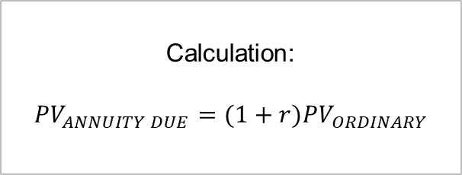
Annuity Due v Ordinary Annuity
Difference between Ordinary Annuity and Annuity Due
So which would we expect to have a higher NPV?
Year 0 1 2 3 4 5
$ CF1 CF2 CF3 CF4 CF5
$ CF1 CF2 CF3 CF4 CF5
SO WE CAN SOLVE LIKE AN ORDINARY ANNUITY, THEN AT THE VERY END WE JUST ADJUST BY ONE (1) PERIOD (USING THE RATE)
Ordinary Annuity
Annuity Due

Slide 26
QUESTION 3
Inflation Adjustments
Notes:
Inflationary Adjustments

Slide 27
Question 3
You will receive $100 from a savings bond in 3 years. The nominal interest rate is 8%.
(a) What is the present value of the proceeds from the bond?
(b) If the inflation rate over the next few years is expected to be 3%, what will the real value of the $100 payoff be in terms of today’s dollars?
(c) What is the real interest rate?
(d) Show that the real payoff from the bond [from part (b)] discounted at the real interest rate [from part (c)] gives the same present value for the bond as you found in part (a).

Slide 28
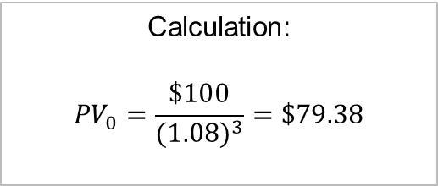
Answer to 3(a)
You will receive $100 from a savings bond in 3 years. The nominal interest rate is 8%.
(a) What is the present value of the proceeds from the bond?
Year 0 1 2 3
CF $100
Notes:
We are happy with this, this is nice and straight forward (just read carefully – this isn’t a bond persay, just a savings account called “savings bond”)

Slide 29
Question 3(b)
You will receive $100 from a savings bond in 3 years. The nominal interest rate is 8%.
(b) If the inflation rate over the next few years is expected to be 3%, what will the real value of the $100 payoff be in terms of today’s dollars?
Notes:
READ CAREFULLY – what will the REAL value be? NOT the PRESENT value!!! These are two (2) very different things (one is discounted by inflation, the other is discounted by r – opportunity cost of capital)

Slide 30
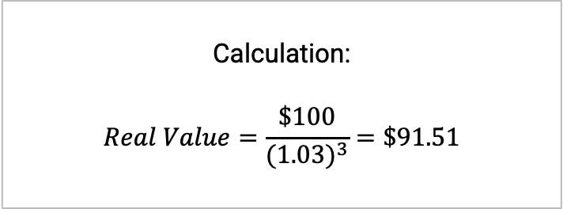
Answer to 3(b)
You will receive $100 from a savings bond in 3 years. The nominal interest rate is 8%.
(b) If the inflation rate over the next few years is expected to be 3%, what will the real value of the $100 payoff be in terms of today’s dollars?
Notes:
READ CAREFULLY – what will the REAL value be? NOT the PRESENT value!!! These are two (2) very different things (one is discounted by inflation, the other is discounted by r – opportunity cost of capital)

Slide 31
Question 3(c)
You will receive $100 from a savings bond in 3 years. The nominal interest rate is 8%. The inflation rate over the next few years is expected to be 3%.
(c) What is the real interest rate?

Slide 32
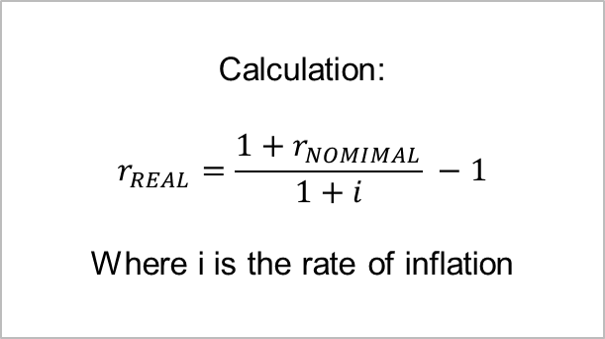
Formula
The key is to change the nominal rate to a real rate

Slide 33
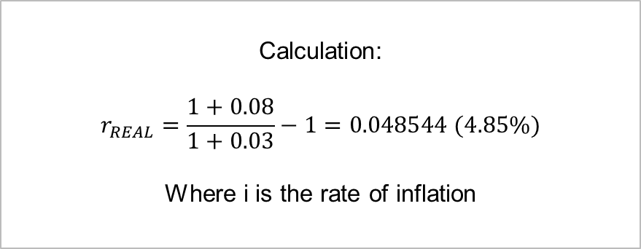
Answer to 3(c)
You will receive $100 from a savings bond in 3 years. The nominal interest rate is 8%. The inflation rate over the next few years is expected to be 3%.
(c) What is the real interest rate?

Slide 34
Question 3(d)
You will receive $100 from a savings bond in 3 years. The nominal interest rate is 8%. The inflation rate over the next few years is expected to be 3%.
(d) Show that the real payoff from the bond [from part (b)] discounted at the real interest rate [from part (c)] gives the same present value for the bond as you found in part (a).

Slide 35
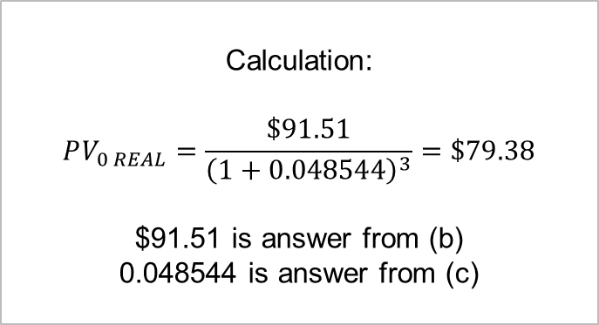
Answer to 3(d)
You will receive $100 from a savings bond in 3 years. The nominal interest rate is 8%. The inflation rate over the next few years is expected to be 3%.
(d) Show that the real payoff from the bond [from part (b)] discounted at the real interest rate [from part (c)] gives the same present value for the bond as you found in part (a).
THIS SHOWS THAT YOU SHOULD ARRIVE AT THE SAME ANSWER WHETHER YOU USE NOMINAL OR REAL
Notes:
WARNING:
If you go Nominal
Cash Flows MUST be nominal
Discount Rates MUST be nominal
Final PV will be in nominal terms
If you go Real
Cash Flows MUST be real (discount for inflation) – as we did in part (b)
Discount Rates must be real – as we did in part (c)
Final PV will be in real terms

Slide 36
QUESTION 4
Notes:
Effective Annual Rate (EAR)

Slide 37
Question 4
BNZ is loaning money at 6.2% compounded semi-annually
ANZ is loaning money at 6.0% compounded monthly
What is the best option?
Notes:
DON’T USE THIS FOR A TVM PROBLEM (e.g. Calculating NPV figure)
Only for comparing rates, e.g. compare getting a bank loan for buying a car, or getting finance from the car dealership

Slide 38
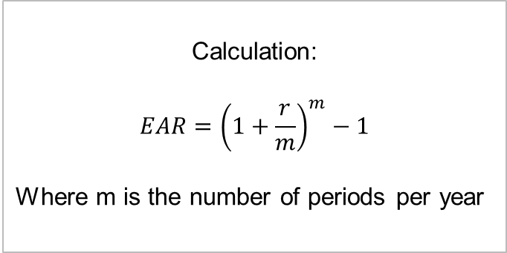
Formula
This formula is to help with comparing interest rates
This formula is made to help you “compare apples with apples”
EAR = Effective Annual Rate
Notes:
DON’T USE THIS FOR A TVM PROBLEM (e.g. Calculating NPV figure)
Only for comparing rates, e.g. compare getting a bank loan for buying a car, or getting finance from the car dealership
ALSO NOTE- MAY NEED TO WORK FROM EAR TO FIND APR- DO THIS BY JUST SUBBING IN WHAT YOU HAVE AND SOLVING FOR R.

Slide 39
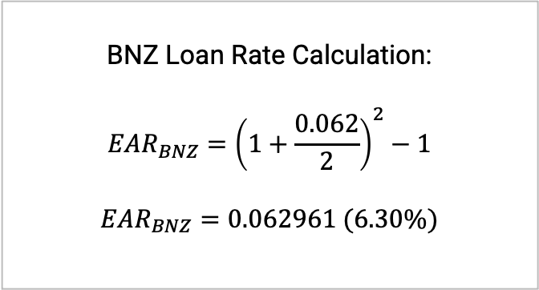
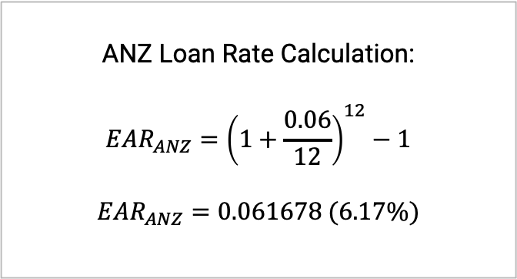
Answer
BNZ is loaning money at 6.2% compounded semi-annually
ANZ is loaning money at 6.0% compounded monthly
What is the best option?
So what does this mean?
Notes:
Since it is a loan, we will be PAYING interest (payments), therefore the lower the interest rate, the better the option becomes. Therefore, we will prefer the loan which has the lowest EAR (when we are borrowing).

Slide 40
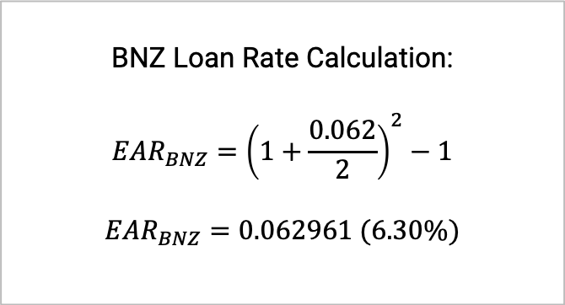
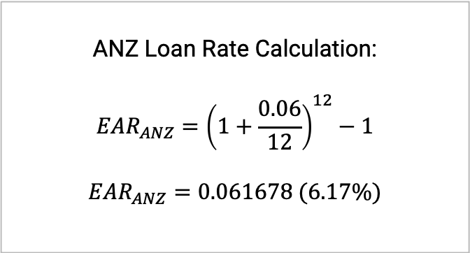
Answer
BNZ is loaning money at 6.2% compounded semi-annually
ANZ is loaning money at 6.0% compounded monthly
What is the best option?
The EAR of ANZ’s rate indicates that it is cheaper than BNZ.
So since we are borrowing, we should choose ANZ.
Notes:
Since it is a loan, we will be PAYING interest (payments), therefore the lower the interest rate, the better the option becomes. Therefore, we will prefer the loan which has the lowest EAR (when we are borrowing).

Slide 41
QUESTION 5
Bond Valuation

Slide 42

Question 5

Slide 43
Question 5
NEED TO IDENTIFY WHICH OF THE 5 KEY VARIABLES BELOW WE NEED FOR OUR ANSWER
WE NEED PRICE
SO WE ARE CALCULATING PV!
Year 0 1 20
$ ?? PV FV
These are the key variables we need – can you find them all?
N | I/Y | PV | PMT | FV
 |  | =???

Slide 44
Question 5
Year 0 1 20
$ ?? PV FV
INITIAL INFO THAT DOESN’T CHANGE!
These are the key variables we need – can you find them all?
N | I/Y | PV | PMT | FV
 |  | =??? | 1000(0.07)=70 | 1000

Slide 45
Question 5
Year 0 1 20
$ ?? PV FV
FILL IN NEW INFORMATION THAT HAS CHANGED
These are the key variables we need – can you find them all?
N | I/Y | PV | PMT | FV
20-1=19 | 6 | =??? | 1000(0.07)=70 | 1000

Slide 46
Find PV - Financial Calculator (Texas)
N | I/Y | PV | PMT | FV
19 | 6 | =$1,111.58 | 70 | 1,000
Calculator Key(s)
Gives PV = $1,111.58
So the current price of the bonds is $1,111.58
Variable | Input
N | 19
I/Y | 6
PMT | 70
FV | 1,000
CPT | PV
Notes:
Show me using my own financial calculator on document camera!

Slide 47
Question 5
N | I/Y | PV | PMT | FV
20-1=19 | 6 | =$1,111.58 | 1000(0.07)=70 | 1000
Look over notes so you can explain why price rises with a drop in interest rates...

Slide 48
QUESTION 6

Slide 49
Question 6
Air NZ has issued 8% annual coupon bonds that are now selling at a yield to maturity of 7% and current yield of 7.475%. What is the remaining maturity of these bonds?
Notes:
Are we missing information?
This seems different to our other bond questions???
What is a “current yield”???

Slide 50
Question 6
Air NZ has issued 8% annual coupon bonds that are now selling at a yield to maturity of 7% and current yield of 7.475%. What is the remaining maturity of these bonds?
How would you approach this?
Is this all the information we have?
What is a “current yield”?
These are the key variables we need – can you find them all?
N | I/Y | PV | PMT | FV
Notes:
Are we missing information?
This seems different to our other bond questions???
What is a “current yield”???

Slide 51
Question 6
Air NZ has issued 8% annual coupon bonds that are now selling at a yield to maturity of 7% and current yield of 7.475%. What is the remaining maturity of these bonds?
ASSUME: Face Value is $1,000
N | I/Y | PV | PMT | FV
 |  |  |  | 1,000
Notes:
We know our answer is going to be (n) years remaining, so that is our unknown!
If we are not told, then we always assume the face value of a bond is $1,000
This then gives us FV, helps us calculate PMT (using FV and Coupon Rate, given)
We already have YTM, so that can do straight in
Now, how do we get the price????

Slide 52
Question 6
Air NZ has issued 8% annual coupon bonds that are now selling at a yield to maturity of 7% and current yield of 7.475%. What is the remaining maturity of these bonds?
N | I/Y | PV | PMT | FV
=??? | 7 |  | =(0.08)(1,000)=80 | 1,000
But how do we figure out the current price?
Notes:
We know our answer is going to be (n) years remaining, so that is our unknown!
If we are not told, then we always assume the face value of a bond is $1,000
This then gives us FV, helps us calculate PMT (using FV and Coupon Rate, given)
We already have YTM, so that can do straight in
Now, how do we get the price????

Slide 53
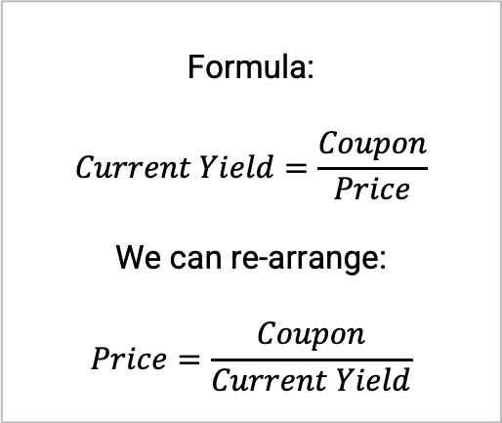
Finding Current Price, using Current Yield
Air NZ has issued 8% annual coupon bonds that are now selling at a yield to maturity of 7% and current yield of 7.475%. What is the remaining maturity of these bonds?
What is the “current yield”?
Notes:
What is a “current yield”???
The coupon payment comes from before, were we used 8% of $1,000 and got $80

Slide 54
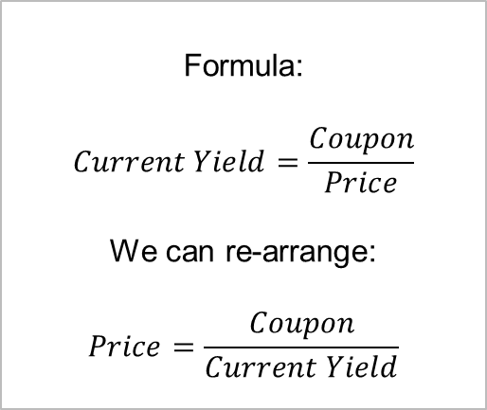
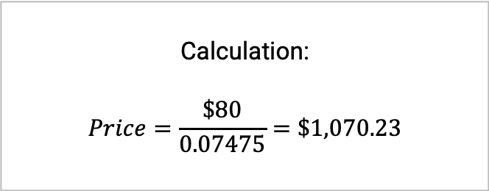
Finding Current Price, using Current Yield
Air NZ has issued 8% annual coupon bonds that are now selling at a yield to maturity of 7% and current yield of 7.475%. What is the remaining maturity of these bonds?
What is the “current yield”?
For Financial Calculator:
PMT is Coupon
PV is Price
Notes:
What is a “current yield”???
The coupon payment comes from before, were we used 8% of $1,000 and got $80

Slide 55
Question 6
Air NZ has issued 8% annual coupon bonds that are now selling at a yield to maturity of 7% and current yield of 7.475%. What is the remaining maturity of these bonds?
NOTE: Enter PV as a negative
N | I/Y | PV | PMT | FV
=??? | 7 | -1,070.23 | =(0.08)(1,000)=80 | 1,000
Now we plug numbers in and CPT for N
Notes:
Now we plug in PV, but we enter it as a negative, since it is an outflow! (as we have to pay the price, to get the bond)
Now, we plug numbers in and compute (CPT) for years (N)

Slide 56
Question 6
Air NZ has issued 8% annual coupon bonds that are now selling at a yield to maturity of 7% and current yield of 7.475%. What is the remaining maturity of these bonds?
N | I/Y | PV | PMT | FV
=9.99 | 7 | -1,070.23 | =(0.08)(1,000)=80 | 1,000
Therefore, 10 years remaining!
Notes:
Calculator outputs 9.9988
We need to be sensible, and round this up to 10.
The units are years (as it was stated in the question that this is “annual”).
Therefore, there are 10 years remaining until maturity of these bonds.

Slide 57
STOCK VALUATION

Slide 58
Key Formulas and Variables

Slide 59
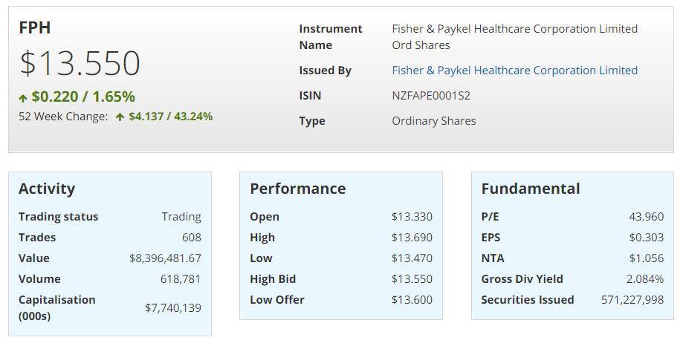
Calculate the Current Share Price (P0)
Notes:
Using Market Cap formula

Slide 60
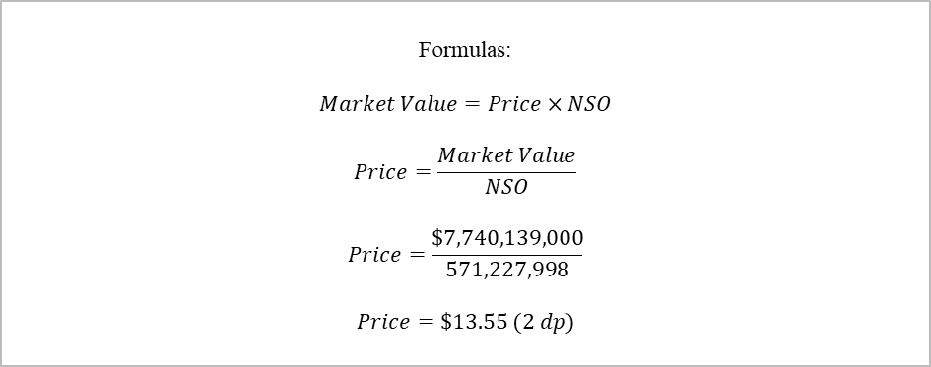
Answer
Notes:
Using Market Cap formula

Slide 61
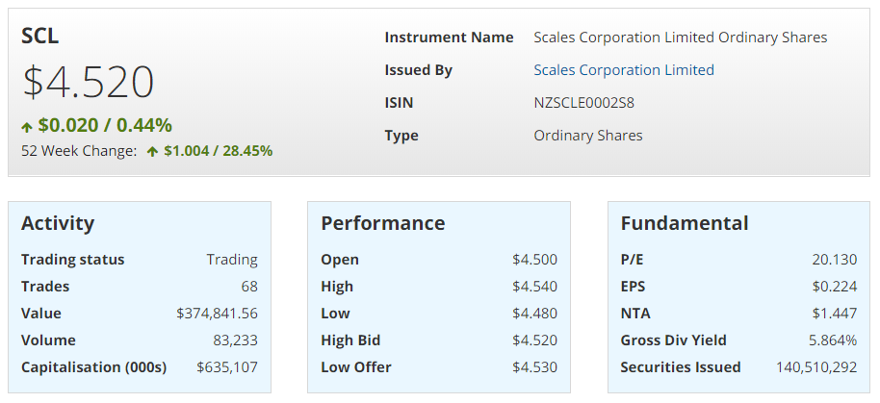
Calculate the Current Share Price (P0)
Notes:
Using P/E formula

Slide 62
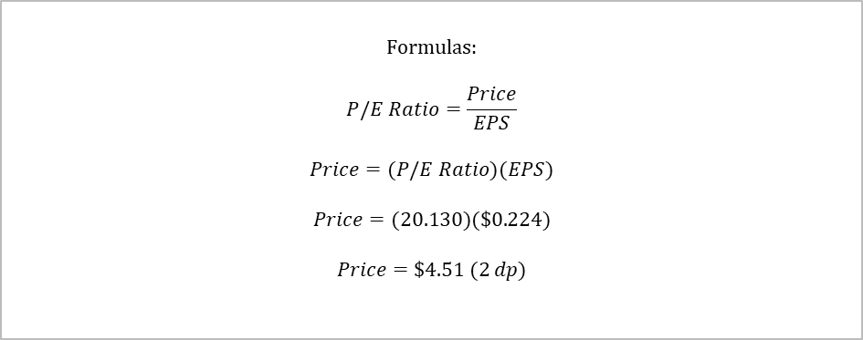
Answer
Notes:
Using P/E formula
Note: this is 1 cent off (at the 2 dp level, whether Deb will accept this due to how the P/E and EPS were rounded, or these will have more decimal points when give to you

Slide 63
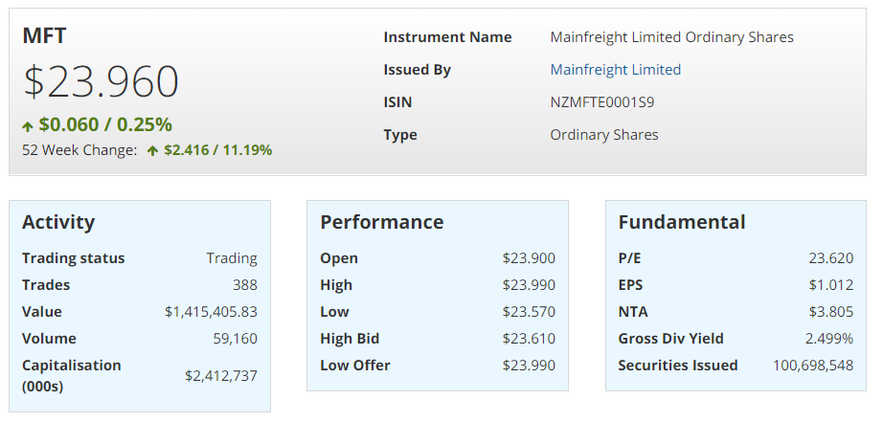
Calculate Market Capitalisation

Slide 64
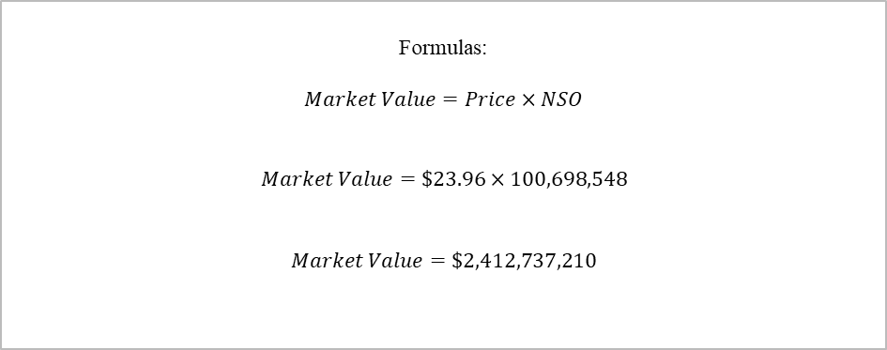
Answer

Slide 65
QUESTION 7

Slide 66
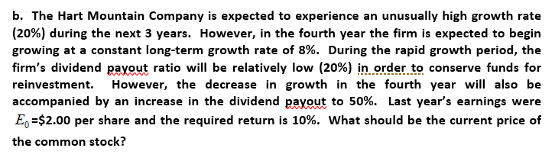
Question 7
Notes:
Note – we have been given a short term growth rate (for years 1-3) and then a long-term for a perpetuity
The other way she might give it to you is particular dividends ($) for first 1-3/4 years, and then a growth rate
Also Note – we have been given straight growth rates, but alternatively she might just give ROE
In that case, you need to find plowback (which is 1- div payout) – which she has given
And then plowback x ROE = g, then apply g to EPS, and the d to EPS to get DPS (or D)

Slide 67
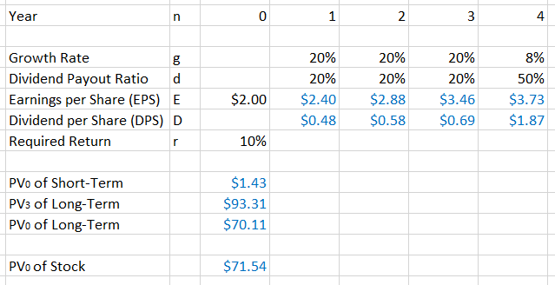
Question 7
SET IT UP WITH A TIMELINE, AND A TABLE OF FIGURES BELOW

Slide 68
Question 7
ESTABLISH ALL THE GIVEN FIGURES, THEN CALCULATE THE GAPS

Slide 69
Question 7
START WITH EPS, THEN DPS COMES FROM THIS

Slide 70
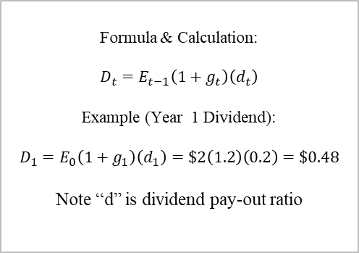
Question 7
NOTE: IN THE TEST, DON’T ROUND UP UNTIL THE VERY END!!!
Notes:
It might seem quite annoying writing out all the decimal places, and then keying them back into your calculator, but it really does matter with your final answer!
You are given enough time on this question (in terms of marks per minute) to be able to do these extra decimals (not rounding) and it is definitely worth it to get the accurate final answer!

Slide 71
Question 7
NOW SET UP LABELS AND SPACE FOR YOUR FINAL CALCULATIONS

Slide 72
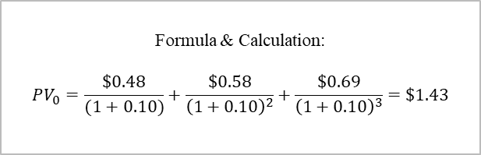
Question 7
NOW YOU NEED TO DISCOUNT THE FIRST “SET” OF DIVIDENDS BACK TO PV at Year 0

Slide 73
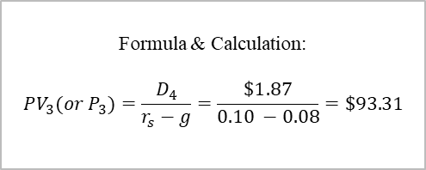
Question 7
THIS IS WHERE YOU USE THE GROWING PERPETUITY FORMULA

Slide 74
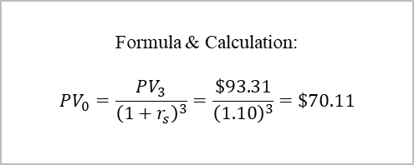
Question 7
BE CAREFUL! THIS FIGURE IS THE PV at Year 3! SO WE NEED TO BRING IT BACK to Year 0!

Slide 75
Question 7
THEN SIMPLE ADDITION OF THE TWO PV0’s
Notes:
Therefore, since we have calculated the current present value at year 0 of the stock to be $71.54, this should be the current market price!

Slide 76
Question 7
IF THE CURRENT PRICE IS $65 WHAT DO YOU CONCLUDE?
IF THE CURRENT PRICE IS $80 WHAT DO YOU CONCLUDE?
Notes:
At a current market price of $65 the stock is undervalued (by $6.54 per share) and therefore my recommendation is to BUY stock!!!
At a current market price of $80 the stock is overvalued (by $8.46 per share) and therefore my recommendation is to SELL any existing stock and/or to SHORT SELL (by borrowing other investor’s stock)!

Slide 77
How to do this on Financial Calculator
Variable | Input
CFo | 0
C01 | 0.48
F01 | 1
C02 | 0.576
F02 | 1
C03 | = 0.6912 + 93.312 = 94.0032
F03 | 1
Calculator Key(s)
ENTER
ENTER
ENTER
ENTER
ENTER
ENTER
ENTER
Notes:
Show me using my own financial calculator on document camera!

Slide 78
How to do this on Financial Calculator
Variable | Input
I | 10
NPV | [empty]
Calculator Key(s)
ENTER
CPT
AND THIS GETS US THE PRESENT VALUE OF THE STOCK OF $71.54
Notes:
Show me using my own financial calculator on document camera!

Slide 79
Financial Ratios & Analysis

Slide 80
Types of Financial Ratios
Efficiency Ratios: how well we are using our assets to generate earnings
Asset Turnover, Inventory Turnover, Accounts Receivable Collection Period
Profitability Ratios: how well we use assets to retain profits
Net Profit Margin, Gross Profit Margin, Return on Equity, Return on Assets
Leverage Ratios: how well we maintain the right mix of debt and equity
Debt Ratio, Debt-Equity Ratio, Interest Coverage Ratio
Liquidity Ratios: how well can we meet our short term debt obligations
Current Ratio, Liquid Ratio

Slide 81
Question 8

Slide 82
Question 8 (a)
What are the annual sales for a firm with $400,000 in debt, a total debt ratio of 0.4, and an asset turnover of 3.0?

Slide 83



Question 8 (a)
What are the annual sales for a firm with $400,000 in debt, a total debt ratio of 0.4, and an asset turnover of 3.0?
What we are given:

Slide 84
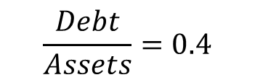
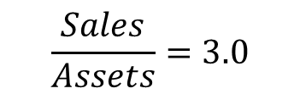


Question 8 (a)
What are the annual sales for a firm with $400,000 in debt, a total debt ratio of 0.4, and an asset turnover of 3.0?

Slide 85
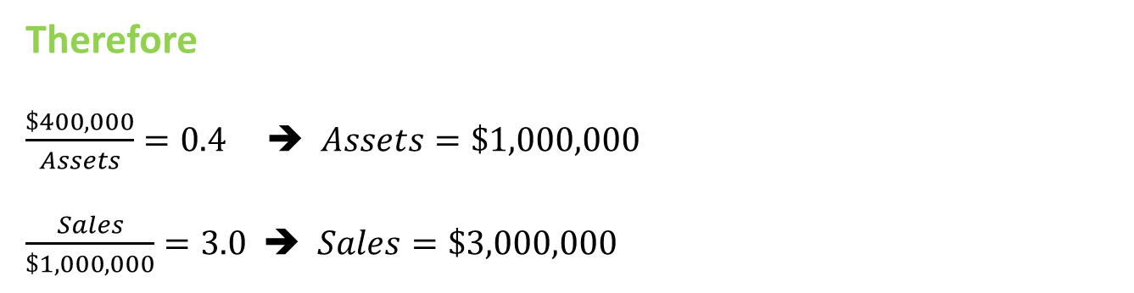
Question 8 (a)
What are the annual sales for a firm with $400,000 in debt, a total debt ratio of 0.4, and an asset turnover of 3.0?

Slide 86
Question 8 (b)
Your firm is currently doing very well with a return on equity (ROE) of 25%, so you would like to payout 40% of earnings in dividends next year. What earnings growth rate do you need to have to do that without increasing your profit margins or efficiency ratios?

Slide 87
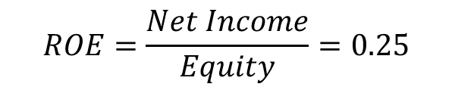

Question 8 (b)
Your firm is currently doing very well with a return on equity (ROE) of 25%, so you would like to payout 40% of earnings in dividends next year. What earnings growth rate do you need to have to do that without increasing your profit margins or efficiency ratios?
What we are given:

Slide 88
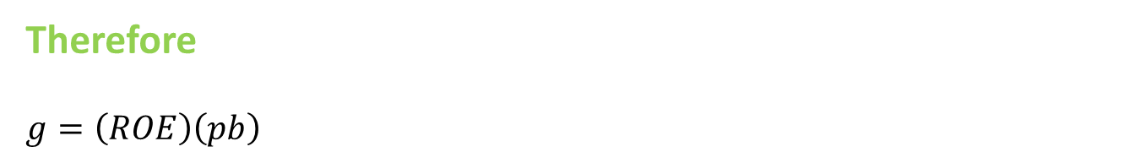
Question 8 (b)
Your firm is currently doing very well with a return on equity (ROE) of 25%, so you would like to payout 40% of earnings in dividends next year. What earnings growth rate do you need to have to do that without increasing your profit margins or efficiency ratios?

Slide 89
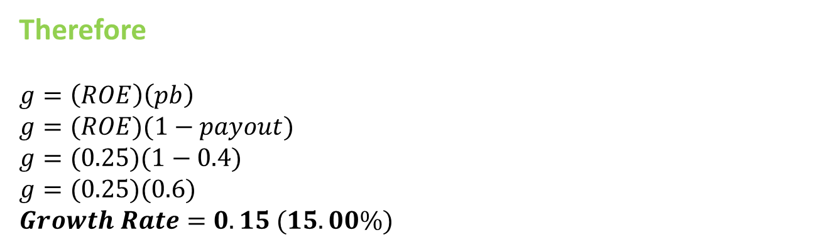
Question 8 (b)
Your firm is currently doing very well with a return on equity (ROE) of 25%, so you would like to payout 40% of earnings in dividends next year. What earnings growth rate do you need to have to do that without increasing your profit margins or efficiency ratios?

Slide 90
Key Tips for Financial Ratios
Know the different categories of ratios and be able to give a few examples of each
Know what variables belong in each ratio (they might not ALL be on the formula sheet – check ahead of time and get familiarised)
Know how to manipulate, combine and re-arrange ratios and formulas to help solve problems
Need to know how the different ratios relate to each other (e.g. a common variable)

Slide 91
Question 9

Slide 92
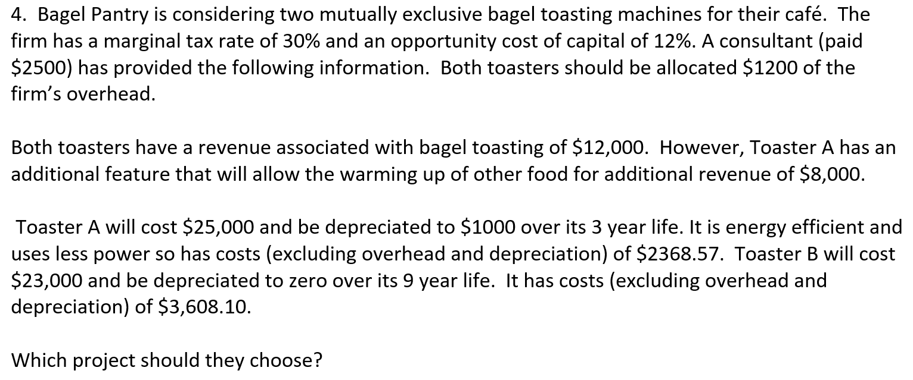
Question 9
So what do we do first?
How do we approach this type of question?

Slide 93
Question 9
Need to compare both projects, so find NPV!
Do them separately, find NPV of Toaster A, then NPV of Toaster B.

Slide 94
But! There is a problem!
TOASTER A: 3 years
TOASTER B: 9 years
Therefore, NPV isn’t a proper comparison, unless they have the same life (in years). So need to find the Equivalent Annual Annuity
Unequal Lives!
Notes:
Unequal Life Projects
Replacement Chain/Matching Cycle

Slide 95
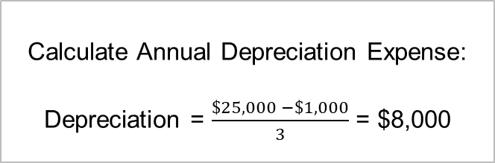
Focus on Toaster A
Toaster A:
Main Revenue $12,000
Additional Revenue $8,000
Total Revenue $20,000
Less Cash Costs ($2,368.57)
Less Depreciation ($8,000)
EBIT $9,631.43
OVERHEADS ARE NOT INCREMENTAL! SO IGNORE THEM!
CONSULTANT FEE ($2,500) IS A “SUNK COST”, SO IGNORE!

Slide 96
Focus on Toaster A (continued)
We know that we need the OCF:
OCF = EBIT(1 - tc) + Dep
Toaster A:
EBIT $9,631.43
tc 30%
EBIT(1 – tc) $6,742.00
Dep $8,000
OCF $14,742

Slide 97
Focus on Toaster A (continued)
Calculation of Year 3 CF’s:
CF3 or 6 + Salvage = 14,742 + 1,000 = 15,742

Slide 98
Toaster A’s NPV - Financial Calculator (Texas)
Variable | Input
CFo | -25,000
C01 | 14,742
F01 | 1
C02 | 14,742
F02 | 1
C03 | = 14,742 + 1,000 = 15,742
With r= 12%, NPV = 11,119.57
Equivalent Annual Annuity = NPV/ PV of $1 annuity at n periods.
= 11,119.57 / 2.401831
Equivalent Annual Annuity of Toaster A = $4629.62
Notes:
Show me using my own financial calculator on document camera!

Slide 99
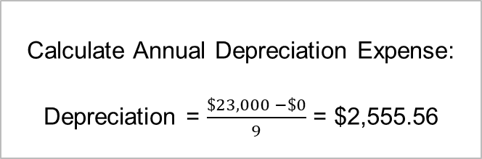
Focus on Toaster B
Toaster B:
Main Revenue $12,000
Total Revenue $12,000
Less Cash Costs ($3,608.10)
Less Depreciation ($2,555.56)
EBIT $5,836.34
OVERHEADS ARE NOT INCREMENTAL! SO IGNORE THEM!
CONSULTANT FEE ($2,500) IS A “SUNK COST”, SO IGNORE!

Slide 100
Focus on Toaster B (continued)
We know that we need the OCF:
OCF = EBIT(1 - tc) + Dep
Toaster B:
EBIT $5,836.34
tc 30%
EBIT(1 – tc) $4,085.44
Dep $2,555.56
OCF $6,641.00

Slide 101
Focus on Toaster B (continued)
Because the cashflows are equal and there is no salvage value, can simply use the below five variables.
These are the key variables we need – can you find them all?
N | I/Y | PV | PMT | FV
9 | 12 | =? | 6,641 | 0
Notes:
Note if there was a given salvage value this is what you would put in the FV value

Slide 102
Focus on Toaster B (continued)
These are the key variables we need – can you find them all?
N | I/Y | PV | PMT | FV
9 | 12 | =$35,384.91 | 6,641 | 0

Slide 103
Focus on Toaster B (continued)
We know that we need the NPV:
j
NPV = PV – IO
IO = 23,000
NPV = 35,384.91 – 23,000
NPV = $12,384.91
These are the key variables we need – can you find them all?
N | I/Y | PV | PMT | FV
9 | 12 | =$35,384.91 | 6,641 | 0

Slide 104
Focus on Toaster B (continued)
With r= 12%, NPV = $12,384.91
Equivalent Annual Annuity = NPV/ PV of $1 annuity at n periods.
= 12,384.91 / 5.328250
Equivalent Annual Annuity of Toaster B = $2324.38

Slide 105
Finally – Answering the Question
Equivalent Annual Annuity of Toaster A = $4629.62
Equivalent Annual Annuity of Toaster B = $2324.382324.38
Therefore Toaster A has the highest value ($4629.62 > $2324.38) , and therefore should be chosen as the project to accept (or in this case, the toaster to purchase)

Slide 106
Final Summary of Key Points for Term Test
Get a financial calculator and practice using it – so you can be fast, yet accurate in the test
Look over key ratios, definitions and formulas so you can understand what a question is asking and wanting you to do
Make sure you can remember some of the key concepts e.g. goal of the firm, as there is likely to be some written answers, also these help you with how you approach some of the long/complex questions
PRACTICE!
Even though the test won’t be the exact same, it gets you ready for following the different processes and looking for specific details when question spotting, that you need for the test!

Slide 107
THANK YOU AND GOOD LUCK!

Slide 108
STAY UPDATED FOR EVENTS
SIGN UP FOR FREE
Website: www.ucinvestmentsociety.com
Facebook Page: The Investment Society
Instagram: the_investmentsociety
QUESTIONS AND FEEDBACK
Email: tutorials@ucinvestmentsociety.com
Notes:
These tutorials won’t be recorded on ECHO, but we are happy to release these tutorial slides if you think that will be helpful.
And, as we go through problems and sections displayed on this slide, we will be showing you how to perform the calculations on your FINC calculation, under the document camera here!
Also, remember that Deb may ask a question in the exam, that was actually part of the previous term tests material e.g. TVM problem, we won’t specifically cover any of that material in this tutorial, as we covered it in our previous tutorial last term, you can still access our slides and handouts from that session, and we recommend having a look if you aren’t fully comfortable with any of last term tests content (Weeks 1 – 4). However, for this tutorial session we are just focussing on the content from weeks 5 – 8, which will make up the majority of what is assessed in this test (if not all of it …).

